Slide 1
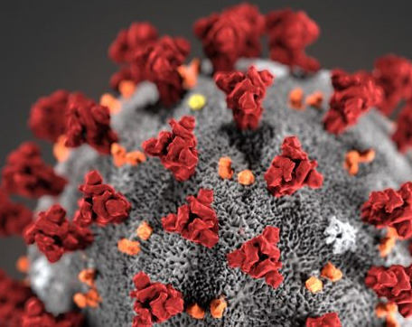
COVID-19

Slide 2


Information source: John's Hopkins University
COVID-19
Can stay on plastics for up to 72 hours
Can stay on stainless steel for up to 48 hours
Can stay on cardboard for up to 24 hours
Can stay on copper for up to 4 hours
Can stay in the air for up to 3 hours
But, the amount of the virus that stays on the surface is 0.1% of the starting virus material.

Slide 3
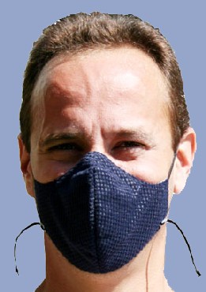
Cloth face covers are meant to protect other people from getting COVID-19 if you have it, not to protect you from getting the virus. A cloth face cover doesn't substitute for social distancing, so continue to stay 6 feet from people if you go outside of your house.
CDC.gov

Slide 4
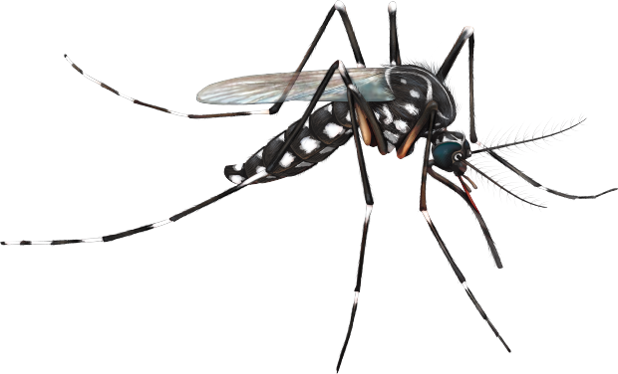

Information source: WHO.int
COVID-19 cannot be spread through mosquito bites.
Animals
There is a possibility that some of the animals who have been in close contact with humans that have COVID-19 could get infected.
More information is needed to know if animals or pets cold spread the disease.

Slide 5




How to prevent Covid-19
Wash your hands
Drink liquids
Social distancing
Work from home if possible
Clean and sanitize things that are touched often
Wear a face mask if you can get one
Stay 6 feet from everyone when you are outside
Do not go to anyone's house
Contact a doctor if you have symptoms

