Slide 1
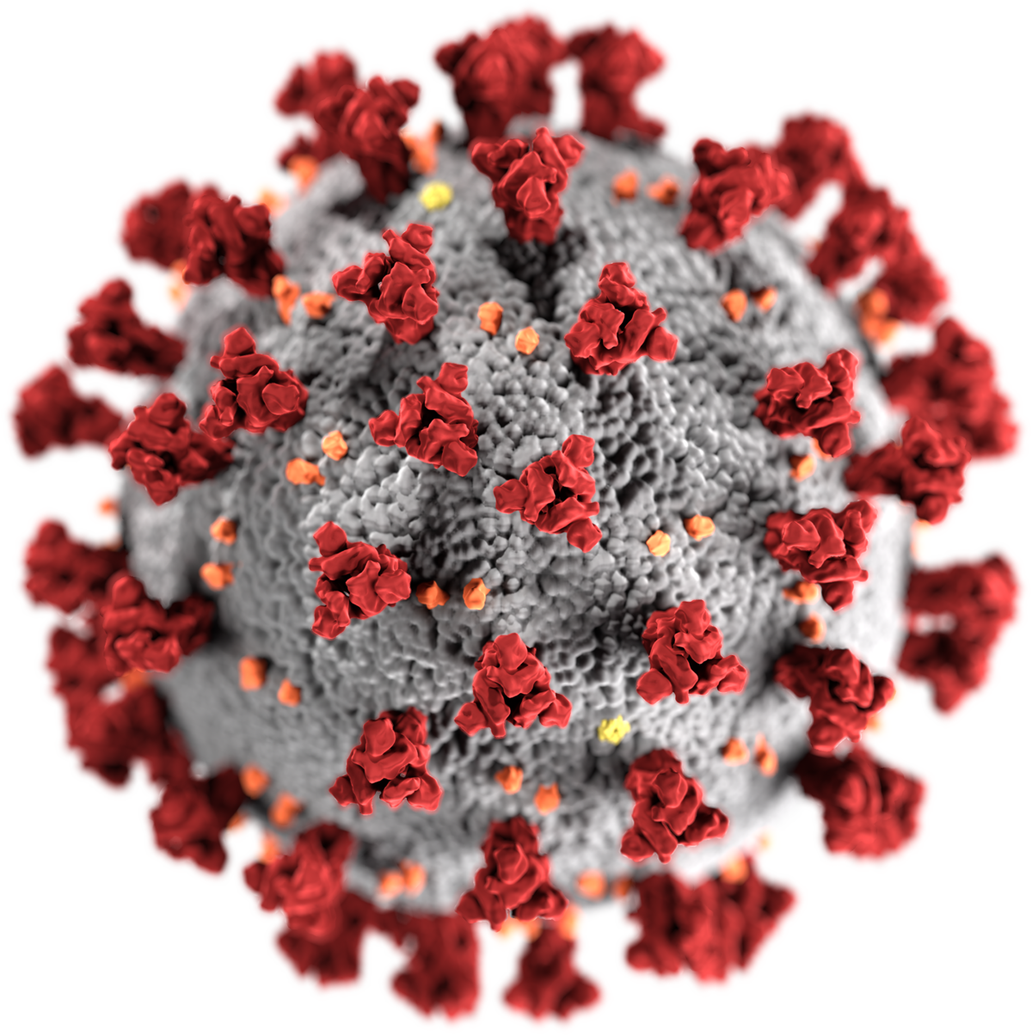
How To Avoid Getting Covid-19
By Rakesh

Slide 2
Wash your Hands
Wash your hands regularly to keep your hands clean.
Wash your hands especially when you cough or sneeze
Wash your hands for at least 20 seconds. That's 2 happy birthdays.
Make sure to wash under your fingernails and in between your fingers.
Washing your hands will kill any bacteria or germs on your hands.
Resources- who.int (World Health Organization), cdc.gov, kidshealth.org

Slide 3
Don’t Touch Your Face
Avoid touching your nose, mouth, and eyes
If the virus is on your hands touching your nose, mouth, and eyes could pass the virus from your hands to your nose, mouth, and eyes
If you pass the virus to your nose, mouth, and eyes the virus can then enter your body from there
Resources- who.int (World Health Organization), cdc.gov

Slide 4
Social Distancing
Social distancing means not getting together with people who don't live with you
Stay at least 2 meters (6 feet) from people because if someone coughs or sneezes, they spray small liquid droplets from their nose or mouth which might have a virus and if you are too close, you can breathe in the droplets.
Resources- cdc.gov, kidshealth.org

Slide 5
Resources
who.int (World Health Organization)
cdc.gov
kidshealth.org

