Slide 1
Helping your Kids during the Corona Virus
Power point and video

Slide 2
Introduction
How can you help your Kids
Ways our family is staying healthy
Video to help wash hands
Example of me washing my hands

Slide 3
^G7ell%UB&37#Ln
Ways to Help your kids during the Corona Virus
https://www.theladders.com/career-advice/10-ways-to-keep-your-family-happy-and-healthy-during-coronavirus-isolation
https://www.cdc.gov/coronavirus/2019-ncov/daily-life-coping/children.html
1. Decide What You Want Your Kids To Know and Talk With Them
2. Don’t Let Young Kids Watch The News and Monitor News Intake for Older Kids
3. Let Your Kids Help Make a Centralized Sanitation Station and “To-Go Bag”
4. Schedule Calls and Video Chats with Friends and Family
5. Go Outside When You Can

Slide 4
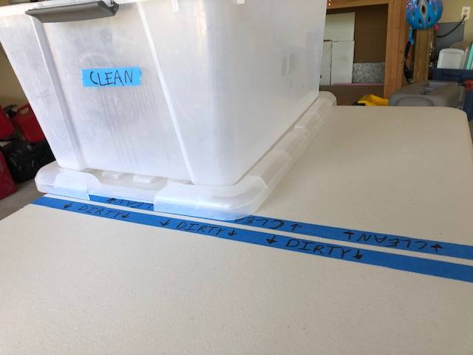
What our Family is doing
Washing our hands a lot
bringing wipes every time we leave the house
having a cleaning station

Slide 5
WATCH THE VIDEO!
Here is a video your kids can watch to make sure they wash their hands for 20 seconds
Thanks to you-Tube for letting me use thar video https://www.youtube.com/watch?v=L89nN03pBzI
(Video copied and pasted from you-tube)
TICKET
TICKET
TICKET
TICKET
TICKET

Slide 6
BY!
bye

Slide 7
Thanks for watching
Stay safe

