Slide 1
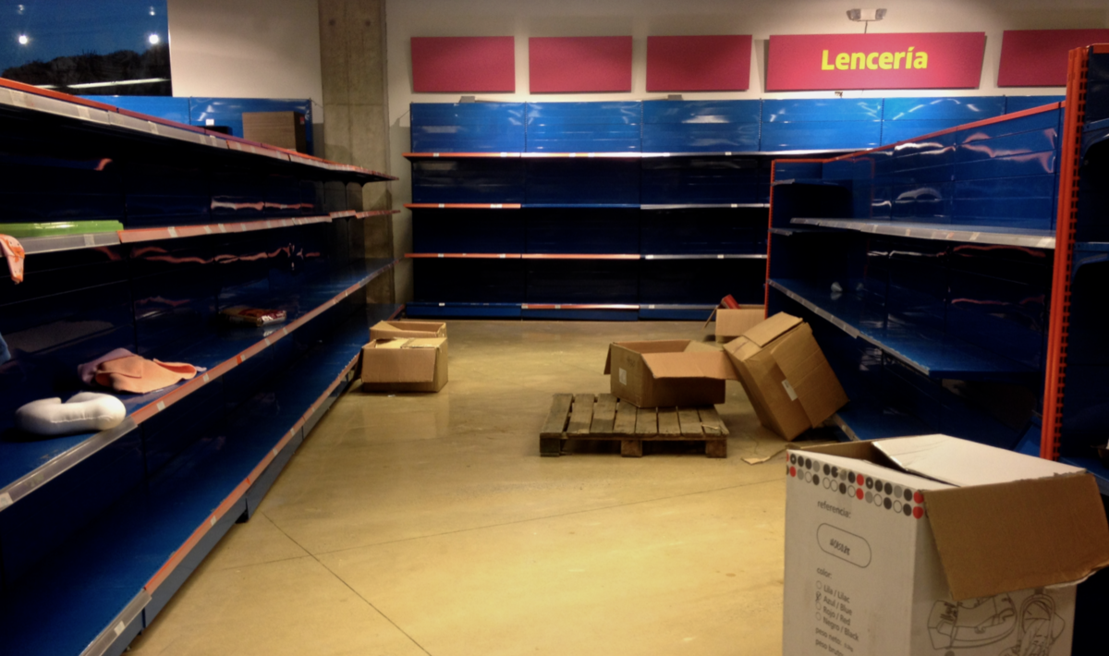
Food shortages
This Photo by Unknown author is licensed under CC BY-SA.

Slide 2
problem
Since the pandemic started it has been hard to get the supplies and ingredients, we usually need like vegetables ,fruits, and everyday items such as water paper towels and toilet paper

Slide 3
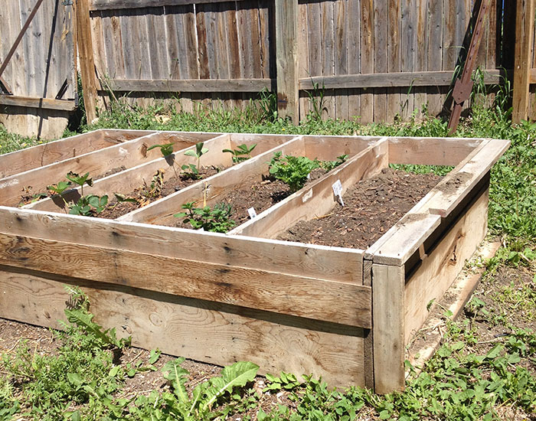
solution
Me and my mom always wanted a garden so now was the perfect time to build one! Wechoose to grow plants that grew food instead of a flower or insect garden
Kidsconnect.com/science/garden/
This Photo by Unknown author is licensed under CC BY-SA-NC.

Slide 4
Fun facts
The first gardens were strictly practical and only grew food and medicine
There is a garden in England called the poison garden .the garden is home to 100 murderous plants
Japanize gardens are gardens that create miniature landscapes that are often idealized and highly abstract
The secret to a great garden is mostly in the soil. Adding nutrients such as homade compost orcrushed leaves will help to feed and norish the garden
Some fruit trees need a pollinator such as apples pears and most sweet cheries
Without bees more than 100,100 would not exist
Some flowers can be in direct sunlight because they cant handle the heat causing the to burn
www.phillytrib.com www.factritriver.com

