Slide 1
Staying Busy, Staying Clean
By Elora

Slide 2
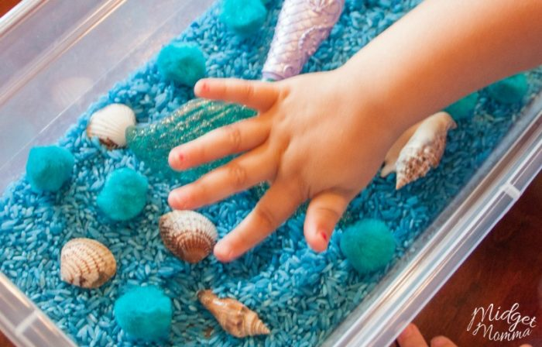

Activities to Keep Kids Busy During Social Distancing
Make a fort out of cardboard
Make a treasure hunt(hide toys everywhere then kids can find them)
Bake something
Sensory bin
Make playdough
Puzzle
Make your own soap
Learn a new language Sensory bin
Ice paint
Make a pizza
Facetime friends and family
Write letters to people Make playdough
Organizing or cleaning
Recipe for homemade playdough: https://www.google.com/search?q=recipe+for+playdough+at+home&rlz=1C1CHBF_enUS831US831&oq=recipie+for+playdough&aqs=chrome.3.69i57j0l7.11812j0j7&sourceid=chrome&ie=UTF-8#kpvalbx=_TWicXtqKC4Ga_QaS74agAg44
Source: Parade.com
This Photo by Unknown Autho is licen under CC BY-SA-NC
This Photo by Unknown Author is licensed under CC BY-SA-NC

Slide 3
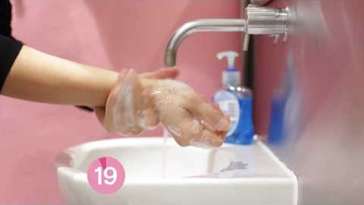
Hand washing
Wash Hands for 20 seconds(be sure to get under your finger nails, the back of your hands, and between your fingers) Good times to wash your hands would be after touching animals or pets, after you blow your nose, after sneezing, after coughing, after you use the restroom, before having contact with food.
***95% people wash their hands incorrectly.

Slide 4

Hand Sanitizer
Rub hands until they are dry.
Sources: CDC.gov
Cleaninginstitute.org

Slide 5
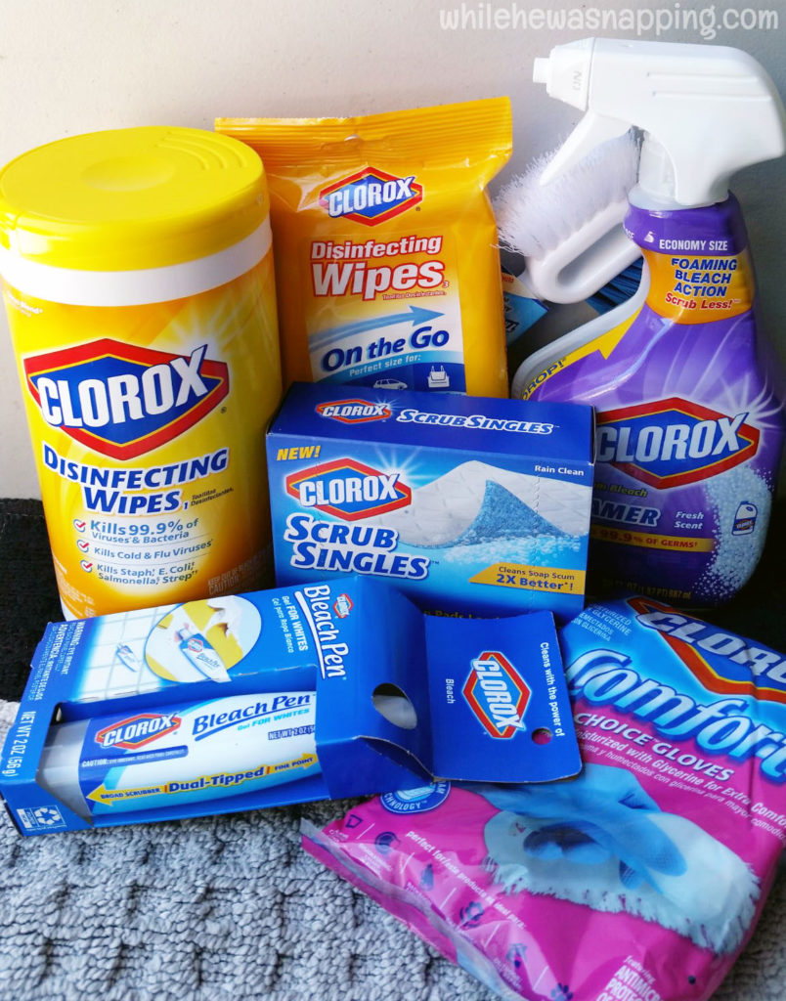
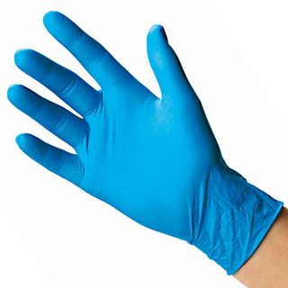
Disinfecting
When disinfecting, wear disposable gloves
Disinfect high touch surfaces(tables, Doorknobs, light switches, countertops, handles, phones, faucets, sinks, etc.)
When disinfecting surfaces that are soft use soap and water
When you are disinfecting electronics, you can get a cover for your device that you can wipe off or follow manufactures directions
Places that you should keep disinfected would be
  Homes
  Work
  Grocery carts
  Reusable grocery bag
Sources: https://www.cleaninginstitute.org/coronavirus
https://www.cdc.gov/coronavirus/2019-ncov/community/disinfecting-building-facility.html#

Slide 6
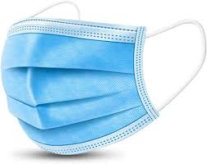
Ways to stop the spread of Covid-19
Avoid getting close to sick people
Cover your mouth when you sneeze or cough
Don’t touch your eyes, mouth, and nose
When in public places, wear a face mask to cover your nose and mouth
Clean objects that are used a lot
When you are sick, stay home or go to the hospital if needed
Wash hands with soap and water for 20 seconds
Source: https://www.cdc.gov/coronavirus/2019-ncov/downloads/stop-the-spread-of-germs.pdf
Mask making directions: https://www.tmh.org/-/media/files/coronavirus/instructions-for-homemade-cotton-face-mask.pdf?la=en

Slide 7
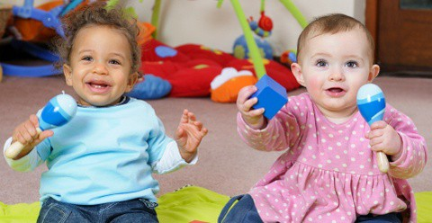
My Personal Experiences
Some ways I help are helping my mom sew masks. I also help watch and play with my baby brother and sister .I also write on the bathroom mirrors with expo marker to remind my family to wash hands for 20 seconds.

