Slide 1
Handwashing a vital role in staying healthy
by Lexi

Slide 2
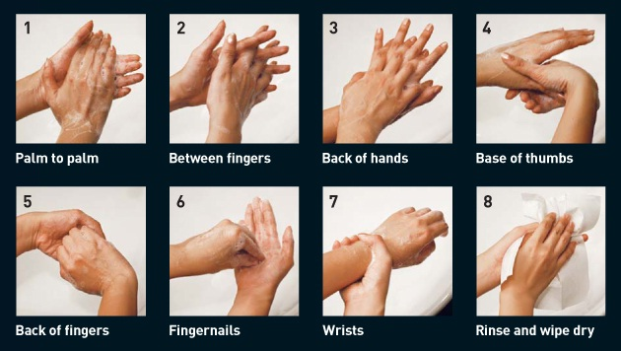
How To Wash
You wash your hands every day, right? or at least you should, but do you do it the correct way? The way to correctly wash your hands is to do the motions on the left all in 20 seconds.
Source- Health Hub

Slide 3
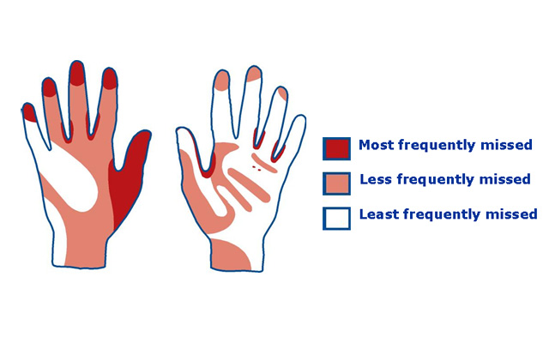
royal college of anaethesia e-safe 2nd edition 2019

Slide 4
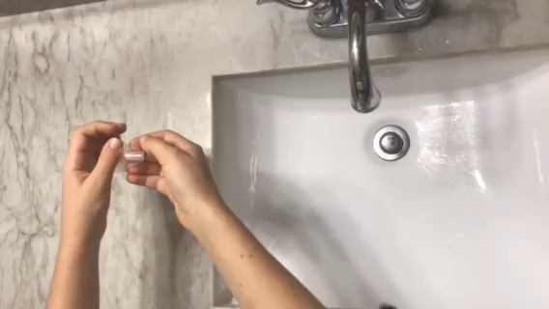

Slide 5
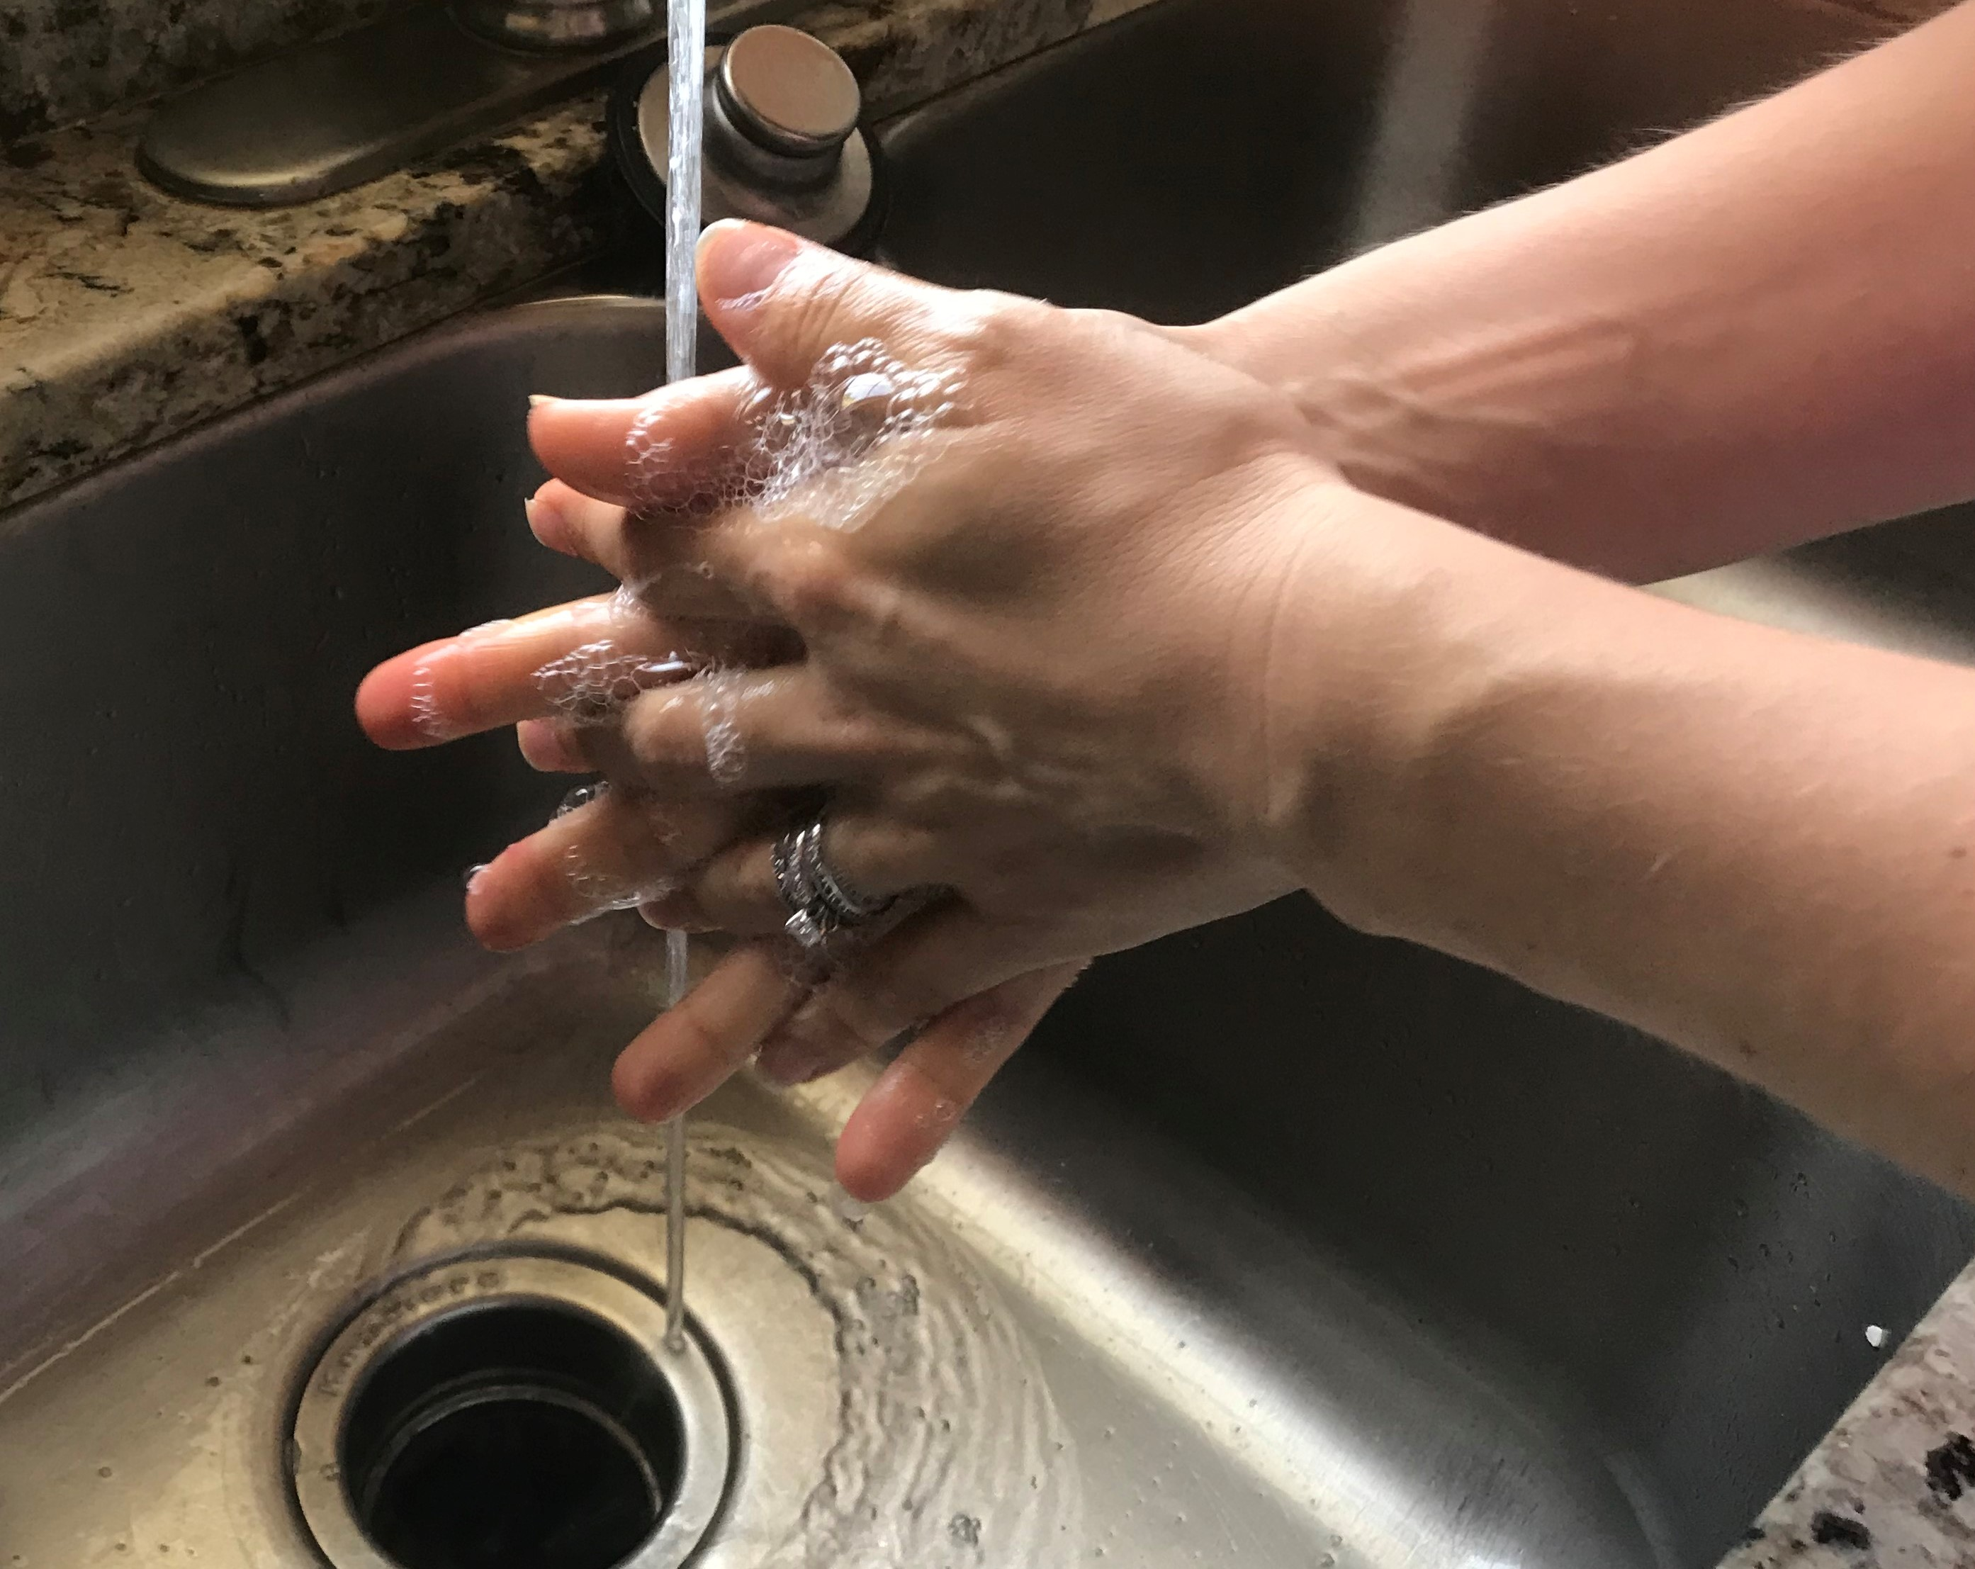
When to Wash
We are being told to wash our hands all the time because of coronavirus. We should wash our hands often but also after doing things like
Before preparing food
Before eating food
Before and after treating a wound
After using the bathroom
After changing diapers
After touching garbage
Source-cdc.gov

Slide 6
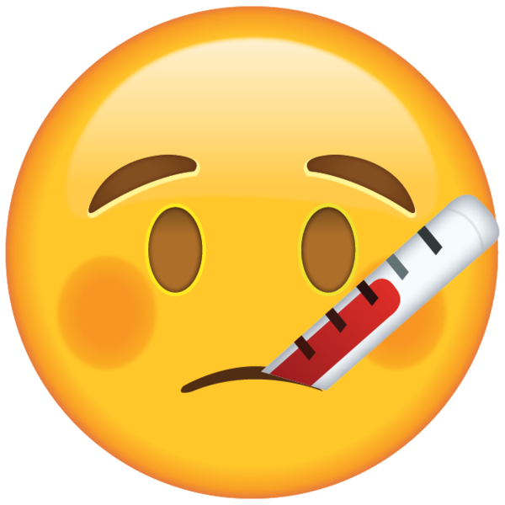

Why you Wash
Why do we wash our hands, especially right know? Well, washing your hands is one way of keeping you healthy and preventing the spread of germs (covid-19).
Source- cdc.gov

Slide 7
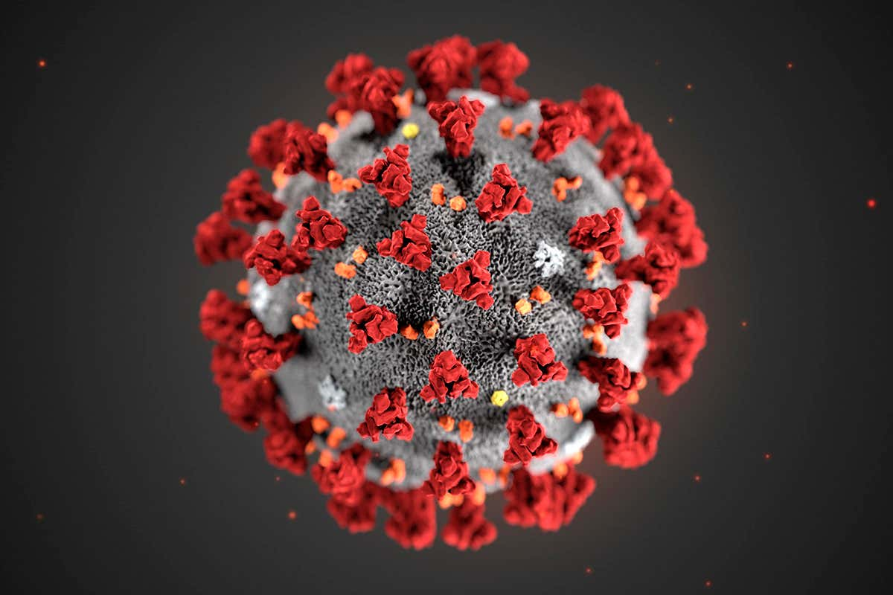
What else you can do
In addition to washing your hands often, you should also stay home as often as you can, stock up on supplies, avoid travel, disinfect frequently touched surfaces, don’t touch your face, and stay 6 ft. away from other people.
Source-Newscientist.com
Source-cdc.gov

