Slide 1

Covid-19 Project
BY: JACOB

Slide 2
WHAT IS COVID-19?
According to the World Health Organization's website COVID-Coronavirus disease (COVID-19) is an infectious disease caused by a newly discovered coronavirus. The COVID-19 virus spreads primarily through droplets of saliva or discharge from the nose when an infected person coughs or sneezes.
There are so many countries that have a lot of cases and it is spreading to so fast across the world that it is now a pandemic.
Worldometers.info says that as of 4/26/2020, over 2,994,761 people in the world have gotten COVID-19. There have been 206,662 deaths and 878,820 people have recovered.

Slide 3
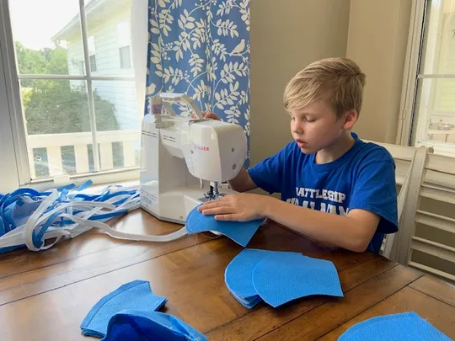
Problem & solution
According to the Centers for Disease Control, "PPE shortages are currently posing a tremendous challenge to the US healthcare system because of the COVID-19 pandemic. Healthcare facilities are having difficulty accessing the needed PPE and are having to identify alternate ways to provide patient care." https://www.cdc.gov/coronavirus/2019-ncov/hcp/ppe-strategy/index.html
PPE is Personal Protective Equipment like masks and gowns that keep healthcare workers safe from bad germs.
Health care workers and people at high risk need to wear PPE like masks.
Problem: not enough safe masks for medical professionals
Solution: we made reusable masks that are safer than N95 masks and more comfortable

Slide 4
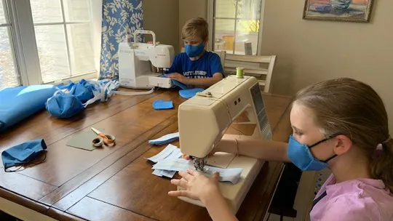
Who helped me
Me, my mom, and my sister helped make the masks while my dad and others gave us feedback . When my project got too big, my mom's work started helping sew.

Slide 5
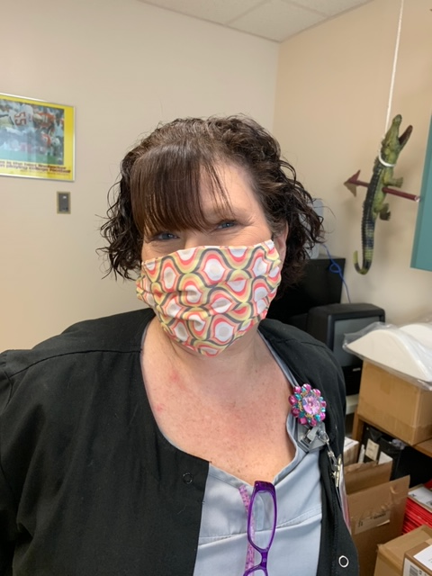
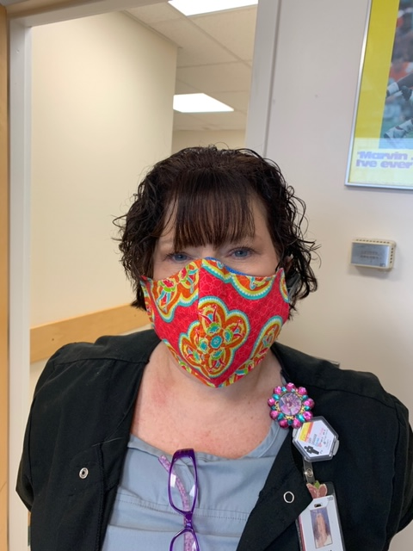
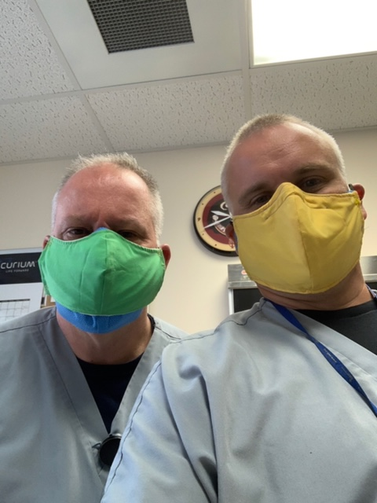
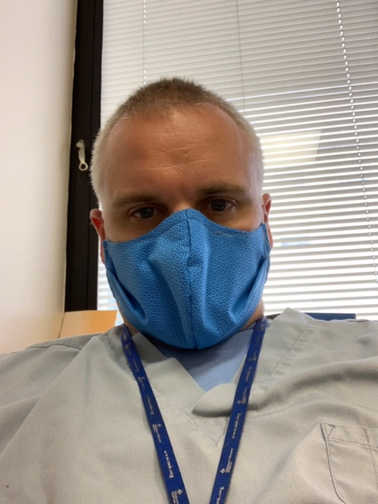
My Models
Measure/Evaluation: Each Model will be measured/evaluated by feedback given after a shift of working in my mask.

Slide 6
Model 1
Tallahassee Memorial Hospital mask design
Pros: quick to make and material is easy to get, can be washed in the washing machine and reused many times
Cons: does not stay up and is uncomfortable, the design is hard to breathe through, cotton material is not effective against COVID-19

Slide 7
Model 2
Cricut mask design
Pros: quick to make and material is easy to get. Can be washed in the washing machine and reused many times, the design is easier to breathe through
Cons: does not stay up, has too much room in the chin, cheeks and chin areas to keep people safe, material is not effective against COVID-19

Slide 8
Model 3
Cricut mask design modified with feedback to add length to cheeks, and a pleat for a tight fit to the chin and cheeks, we also added a wire nose piece.
Pros: material is easy to get. Can be washed in the washing machine and reused many times. Design is easier to breathe through, it fits the face well
Cons: material is not effective against COVID-19

Slide 9
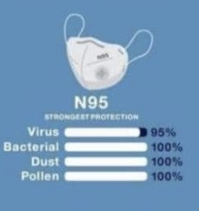
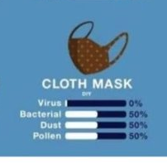
We found the perfect design but...
Cloth does not help against covid-19
According to Dr. Bruce Spiess with University of Florida Anesthesiology, Halyard H600 can be used to create masks. H600 is 4% more effective than N95 making the masks 99% effective. This material can be resterilized up to 20 times! Listen to NPR report here (report start at 5:43)
https://www.wuft.org/news/2020/04/02/dr-bruce-spiess-has-an-alternative-to-n95-masks/
Photo from Newsweek "Surgical and Cotton Masks Ineffective at Blocking SARS-COV-2 Particles when COVID-19 Patients Cough, Study Finds," 07 April 2020. Kashmira Gander.

Slide 10
The final model
Modified Cricut mask design, modified with feedback to add length to the cheeks, a pleat for tight fit to chin and cheeks and an added wire nose piece. Used Halyard H600 sterilization wrap recommended by University of Florida.
Pros: Highly effective against COVID-19, easy to breathe through, fits well, is comfortable. Can be resterilized up to 20 times. It can last healthcare workers up to 20 shifts.
Cons: Material can only be gotten by hospitals or surgery centers. It takes about 15 minutes to make each mask. You cannot make a mistake sewing this mask. One extra hole makes it not work

Slide 11
summary
After people started seeing my masks, I started donating them. My mom's friends from work started help sewing them because I got too many requests. Together we have made over 1700 masks as of April 20,2020.
Some of the places who have requested masks:
TMH Radiology, TMH Cancer Center, TMH Pediatric ICU, TMH Neuro ICU, Southern Medical Group Cardiology and Internal Medicine, Tallahassee Primary Care, Publix, Chick-Fil-A, Advanced Urology Associates, Southeastern Plastic Surgery, Tallahassee Orthopedic Clinic, North Florida Women, Lapcorp , Tallahassee Police Department, Florida Surgeon General's Office, Capital Regional Medical Center Covid ICU, the prison and many, many people who have called and asked for them.
Read the story from the Tallahassee Democrat here: https://www.tallahassee.com/story/life/wellness/2020/04/13/school-project-grows-into-innovative-mask-making-effort/2980186001/

Slide 12
Resources
Tallahassee Memorial Healthcare Instructions for Homemade Cotton Masks https://www.tmh.org/-/media/files/coronavirus/instructions-for-homemade-cotton-face-mask.pdf
NPR Interview with Dr. Bruce Spiess https://www.wuft.org/news/2020/04/02/dr-bruce-spiess-has-an-alternative-to-n95-masks/
University of Florida https://ufhealth.org/news/2020/uf-health-anesthesiology-team-devises-respirator-mask-made-existing-hospital-materials
Newsweek "Surgical and Cotton Masks Ineffective at Blocking SARS-COV-2 Particles when COVID-19 Patients Cough, Study Finds," 07 April 2020. Kashmira Gander.
Cricut Design Store
Tallahassee Memorial Nuclear Medicine
https://www.cdc.gov/coronavirus/2019-ncov/hcp/ppe-strategy/index.html
https://www.who.int/health-topics/coronavirus#tab=tab_1
Worldometers.info

