Slide 1
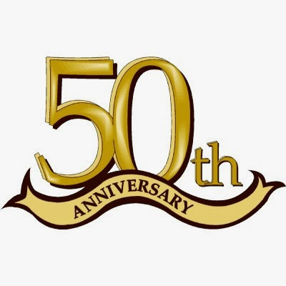
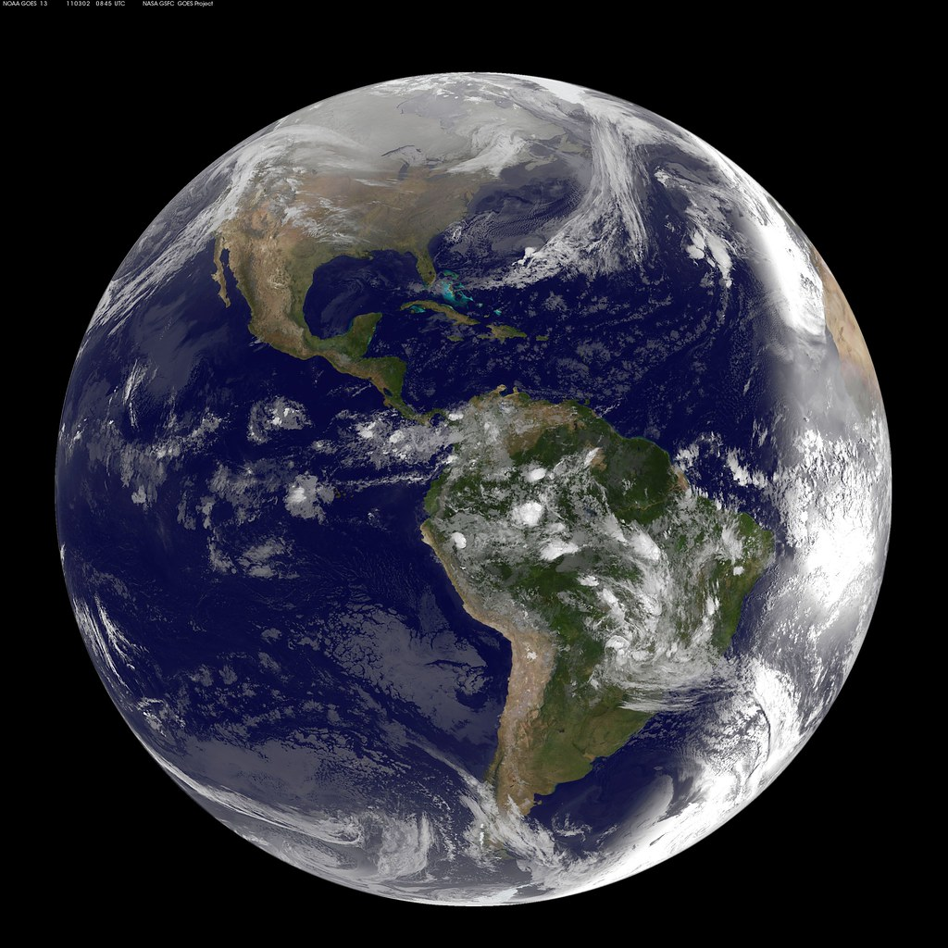
Earth Day
50th anniversary
April 22, 2020
By Will

Slide 2
Earth day history
This year is the 50th Earth Day. Earth Day is on April 22nd every year. First celebrated in 1970, Earth Day was how citizens showed they cared for the environment and were against air pollution and global warming. Earth Day was founded by Gaylord Nelson who was a U.S. senator who saw the oil spill in Santa Barbara California. On April 22,^{nd} 1970 20 million Americans, 10% at the time went to parks and stood on streets to protest on air pollution and global warming. Now in 2020 are more than 190 countries that celebrate Earth Day.
https://www.earthday.org/history/

Slide 3
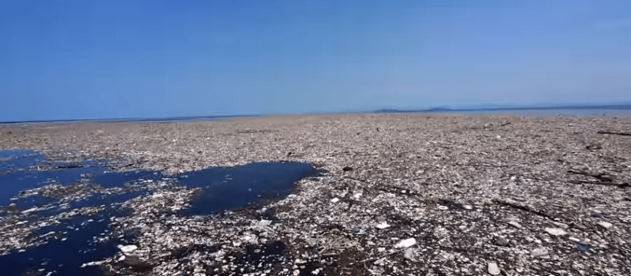
The Great pacific garbage patch
The Great Pacific Garbage Patch is a part of the North Pacific Ocean that is filled with trash. The garbage patch is actually two patches of garbage that connect in the middle to create the Great Pacific Garbage Patch. Those patches are the Western Garbage Patch and the Eastern Garbage Patch. The Great Pacific Garbage Patch stretches from North America to Japan. The Great Pacific Garbage Patch is also known as the Pacific Trash Vortex. It is two times as big as Texas and will keep growing unless people stop throwing trash in the ocean.
https://www.nationalgeographic.org/encyclopedia/great-pacific-garbage-patch/

Slide 4
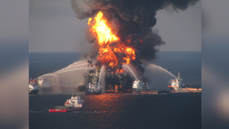
Gulf oil spill
The Gulf Oil Spill was the worst oil spill ever. 0n April 20th, 2010 a Deep Water Horizon oil drill exploded and sunk into the bottom of the ocean killing 11 people and the drill leaked over 130 million gallon of oil into the ocean. Once the oil left the well it spread through the ocean. As the wind pushed the oil, it spread even more. The oil mixed with the water and the oil kept spreading. Some oil mixed together and sunk to the ocean floor harming the coral reefs and other ecosystems.
https://ocean.si.edu/conservation/pollution/gulf-oil-spill

Slide 5
How can you help

Slide 6
Compost | Trash | Recycling
Fruit peals/cores Eggs or egg shells Used paper towels napkins or plates Plat materials such as corn cobs, coffee grounds and flowers Grass clippings Nuts or grains Shredded paper Tea bags or leaves Small pieces of cardboard Bread Chips Pasta | Meat or fish Dairy Lots of liquid Metal Some Plastic Rubber Plastic wrap | Glass bottles Aluminum cans Large cardboard boxes plastic containers & bottles Some bags [only at stores with bins. NOT at home]
https://www.crowntowncompost.com/what-can-i-compost

Slide 7
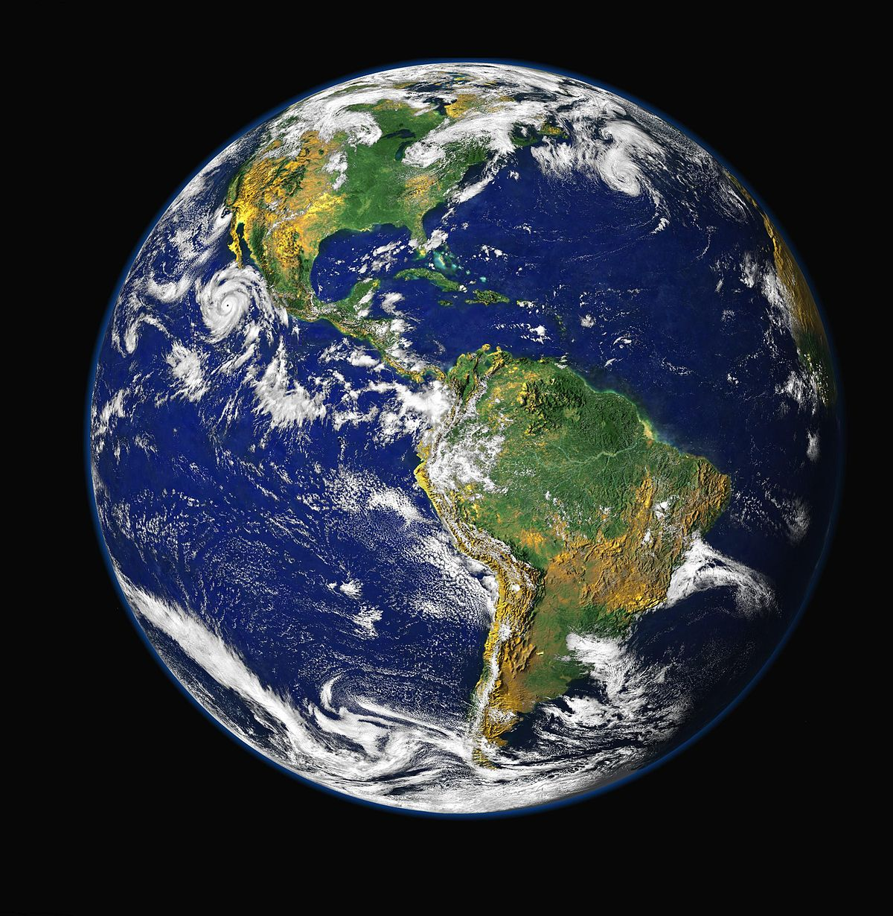
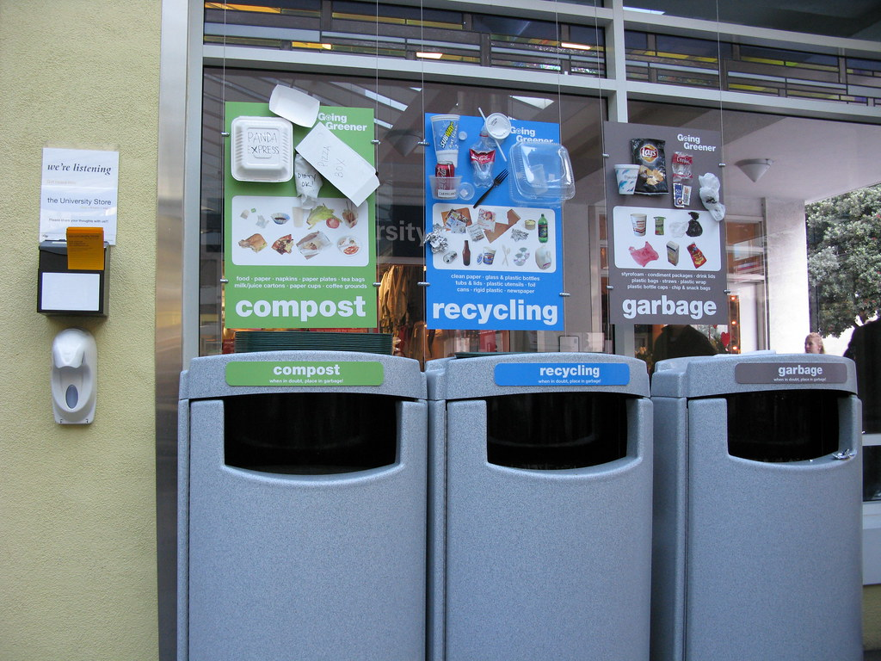
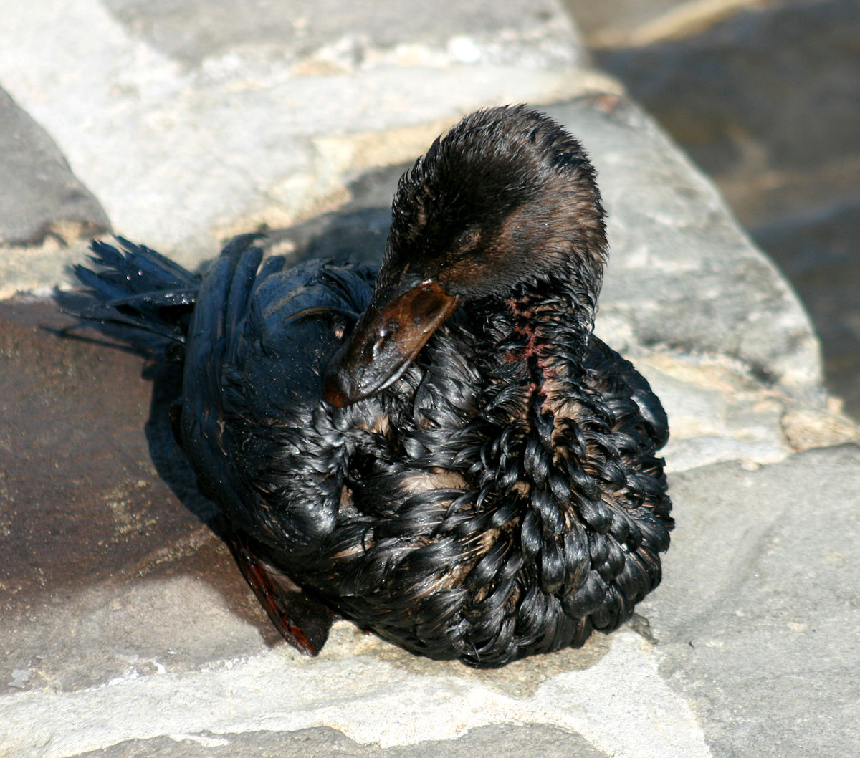
How do these affect the earth?

Slide 8
Quiz time

Slide 9
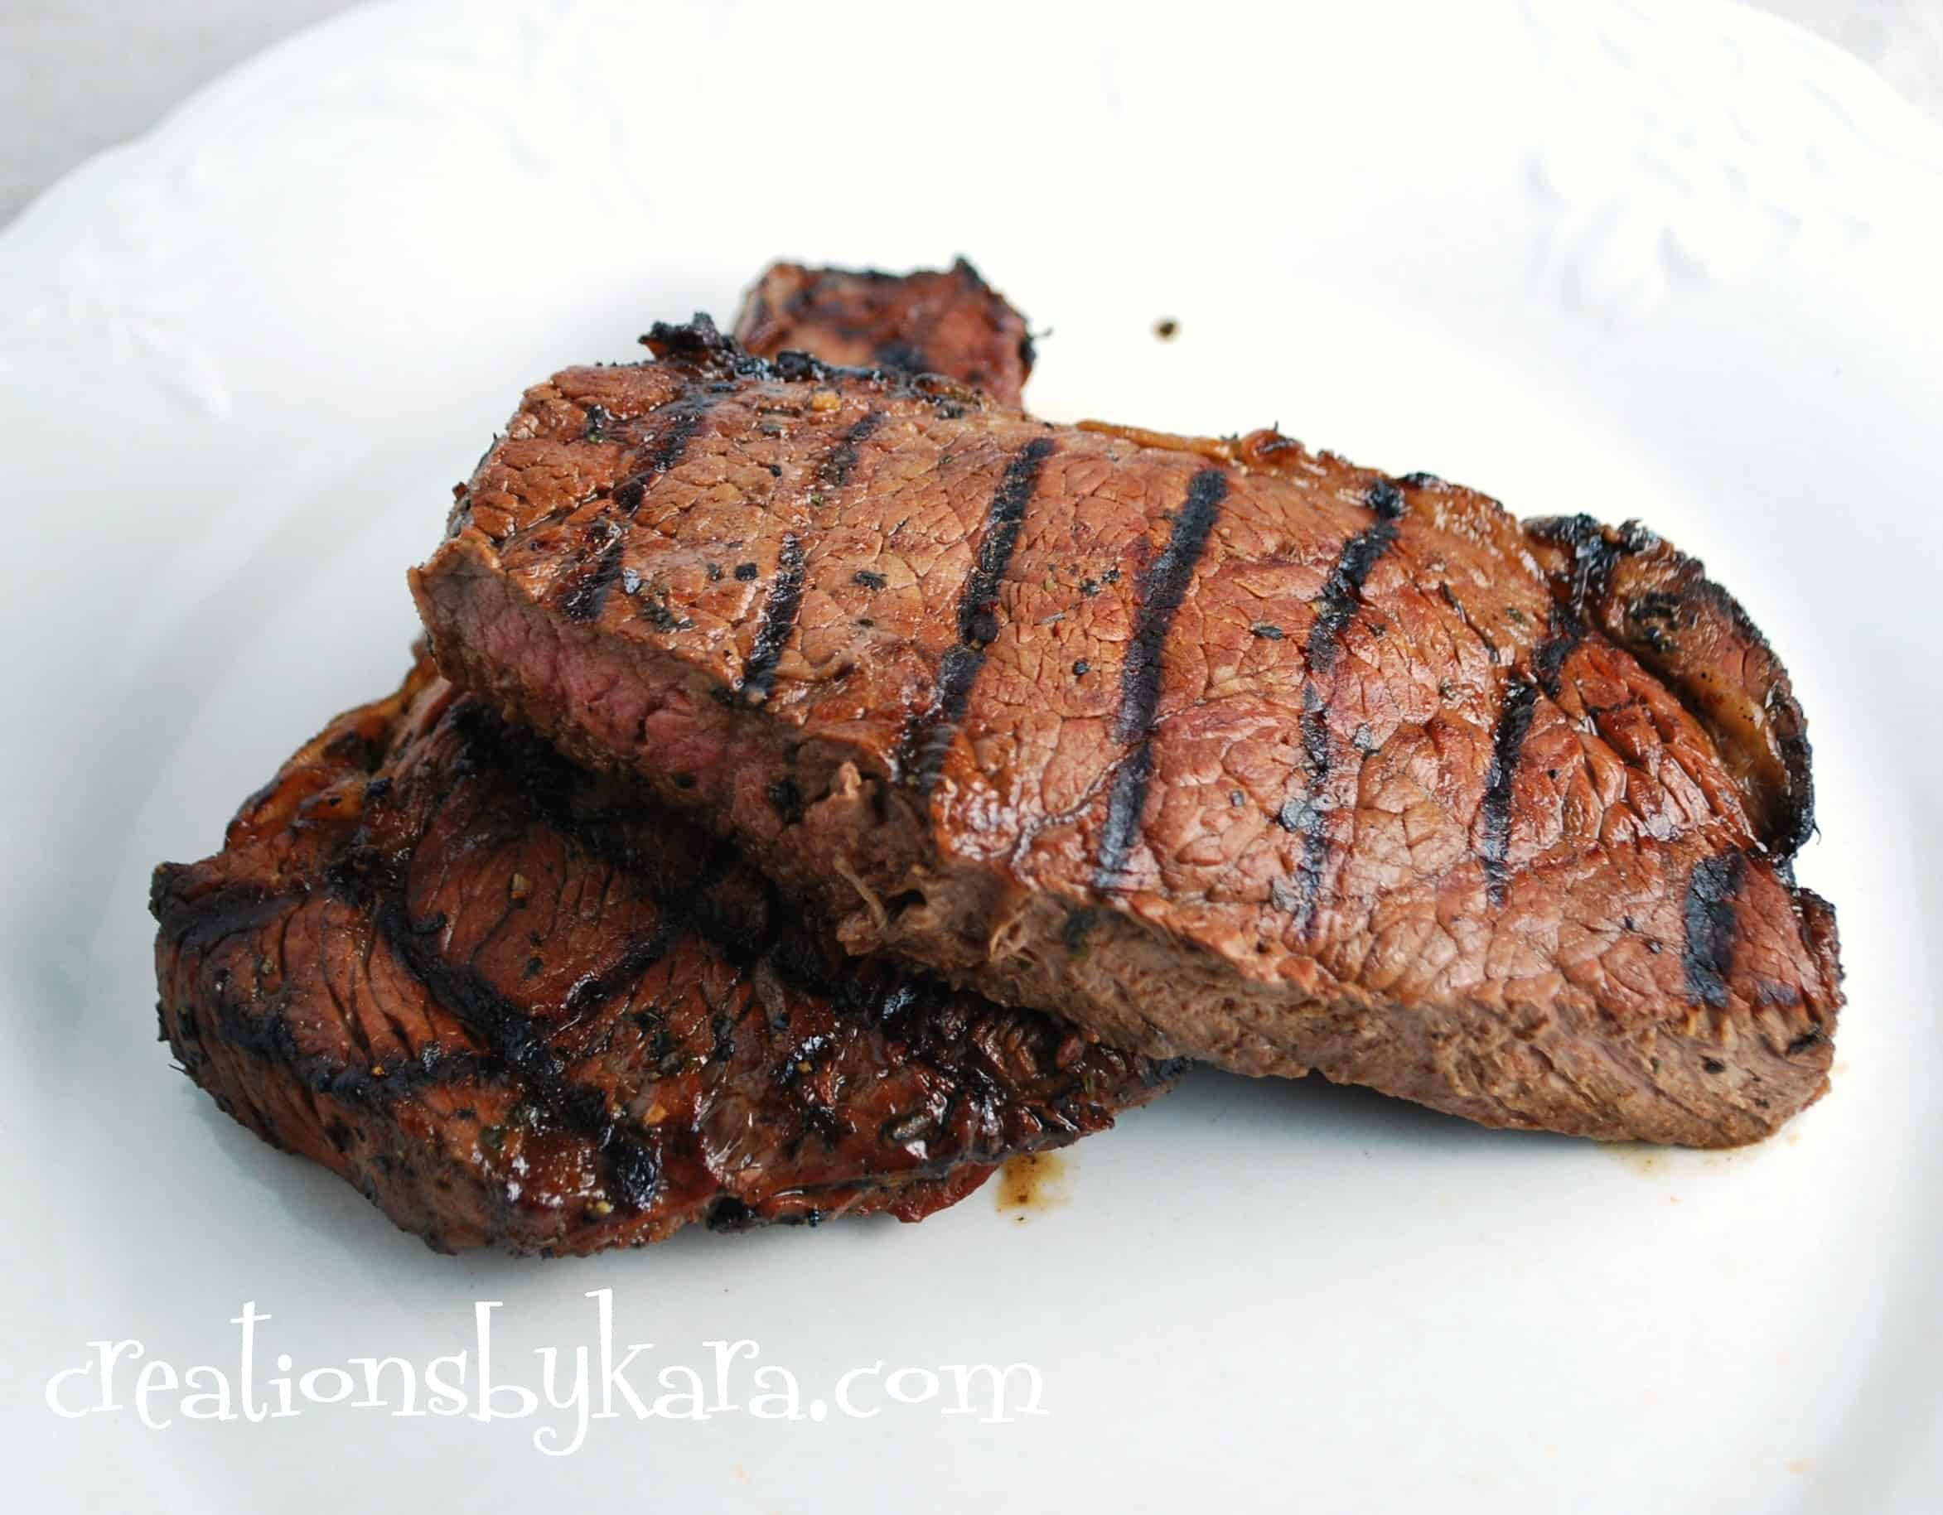
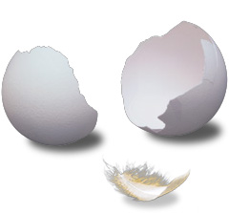
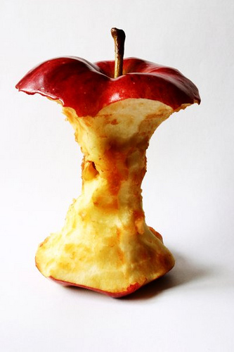
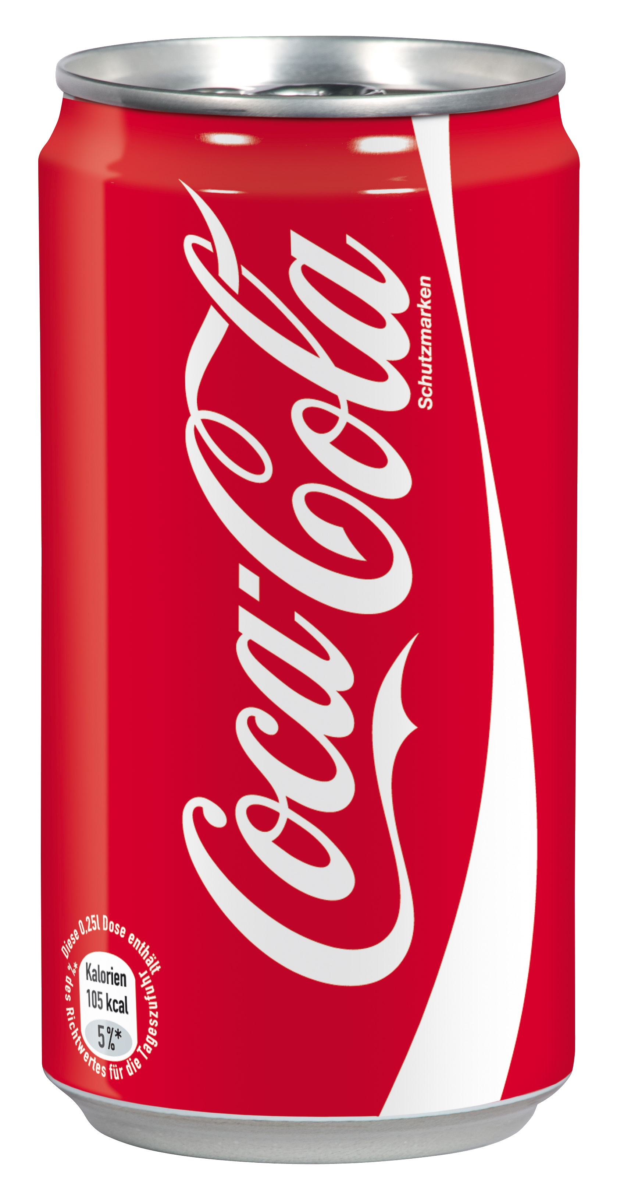
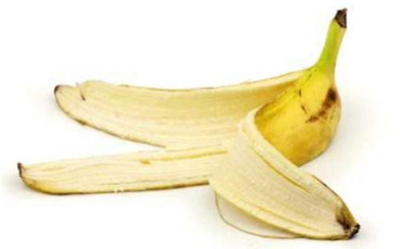
Which can be composted and which Cannot?

Slide 10
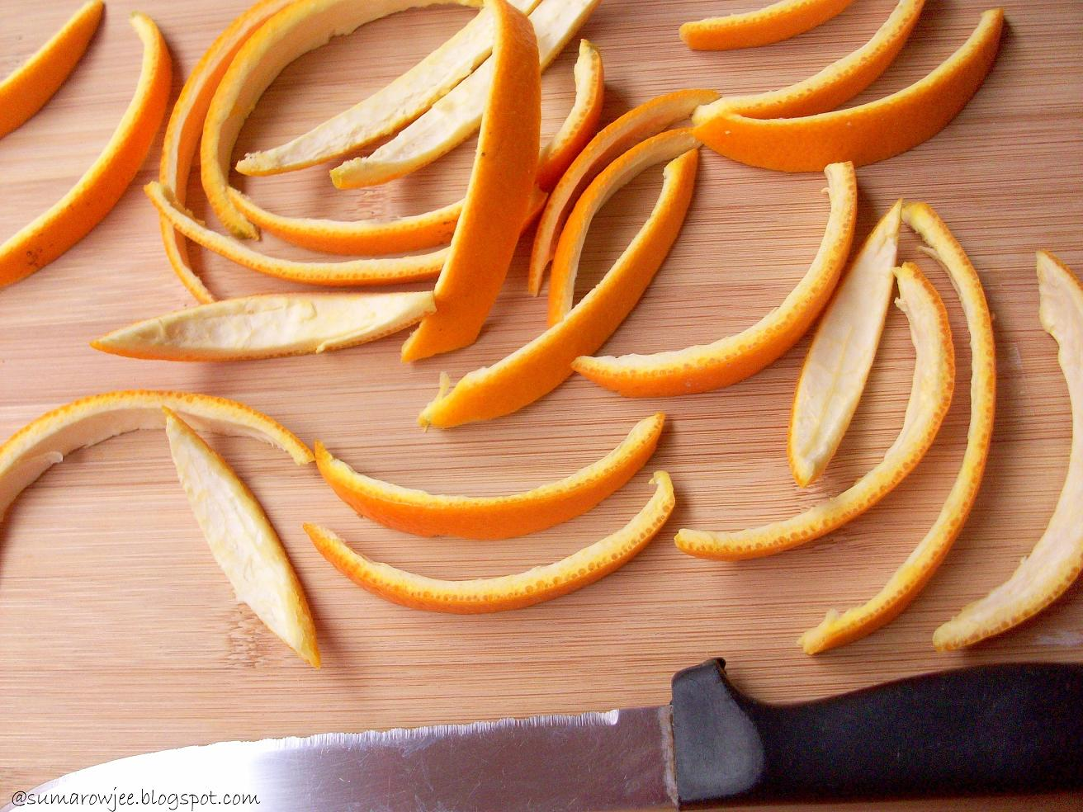
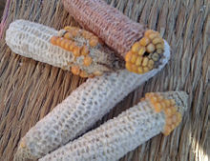
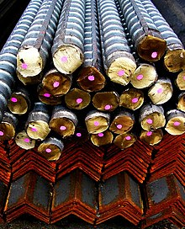
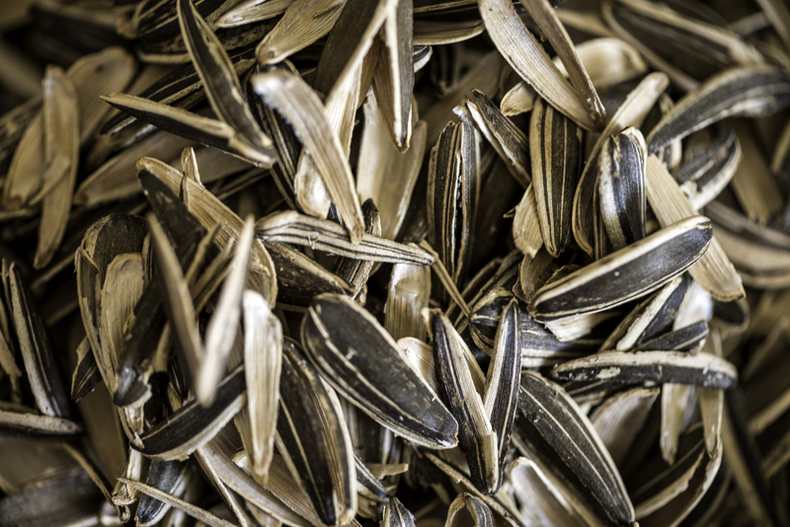
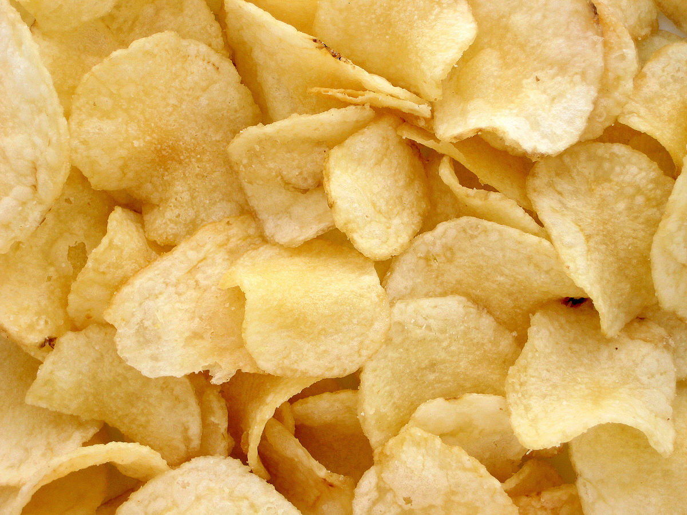
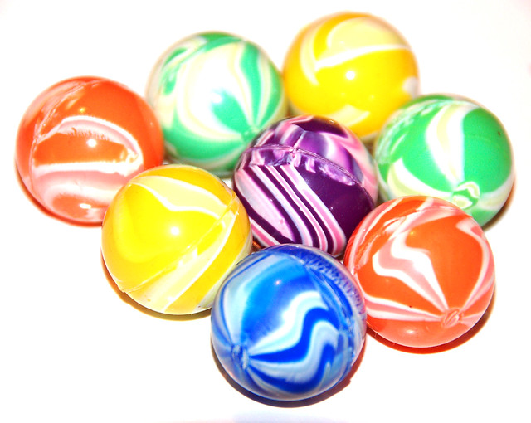
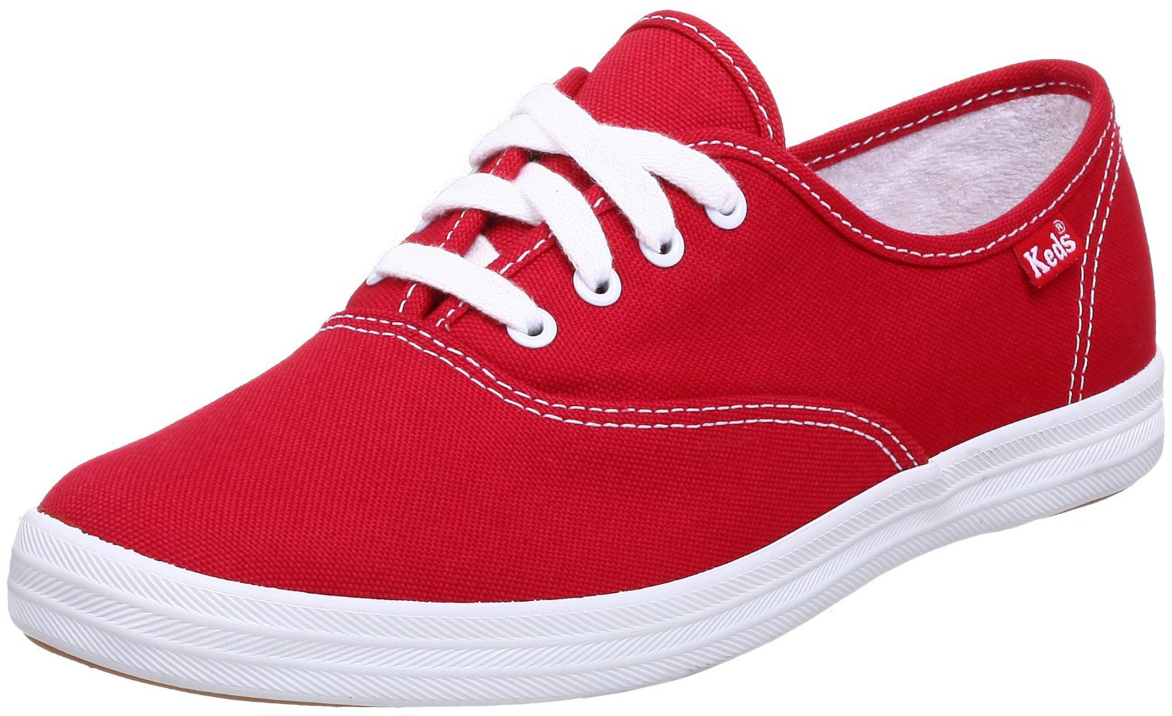
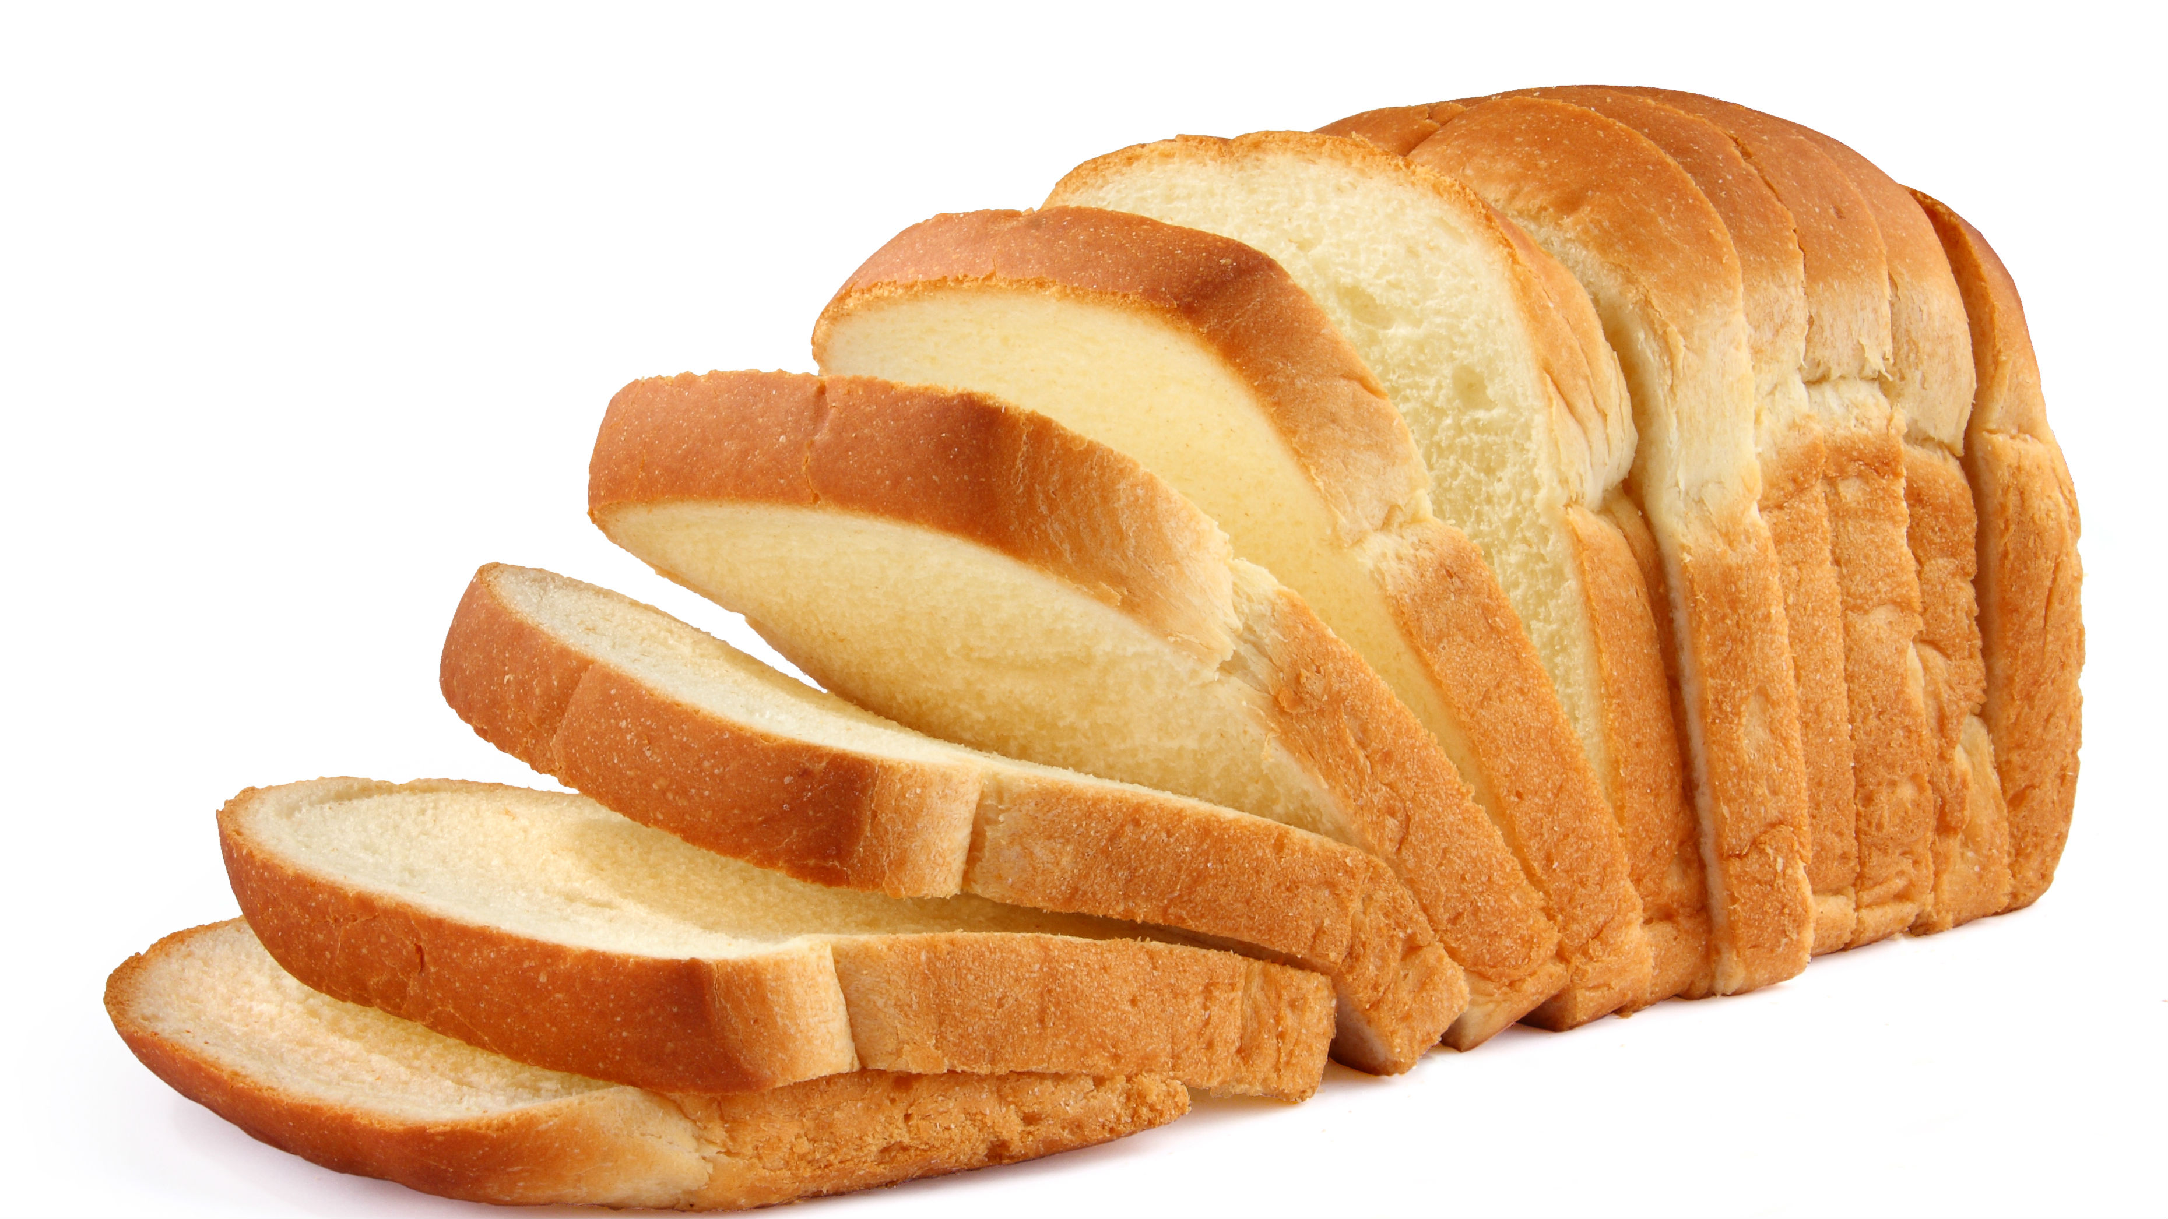
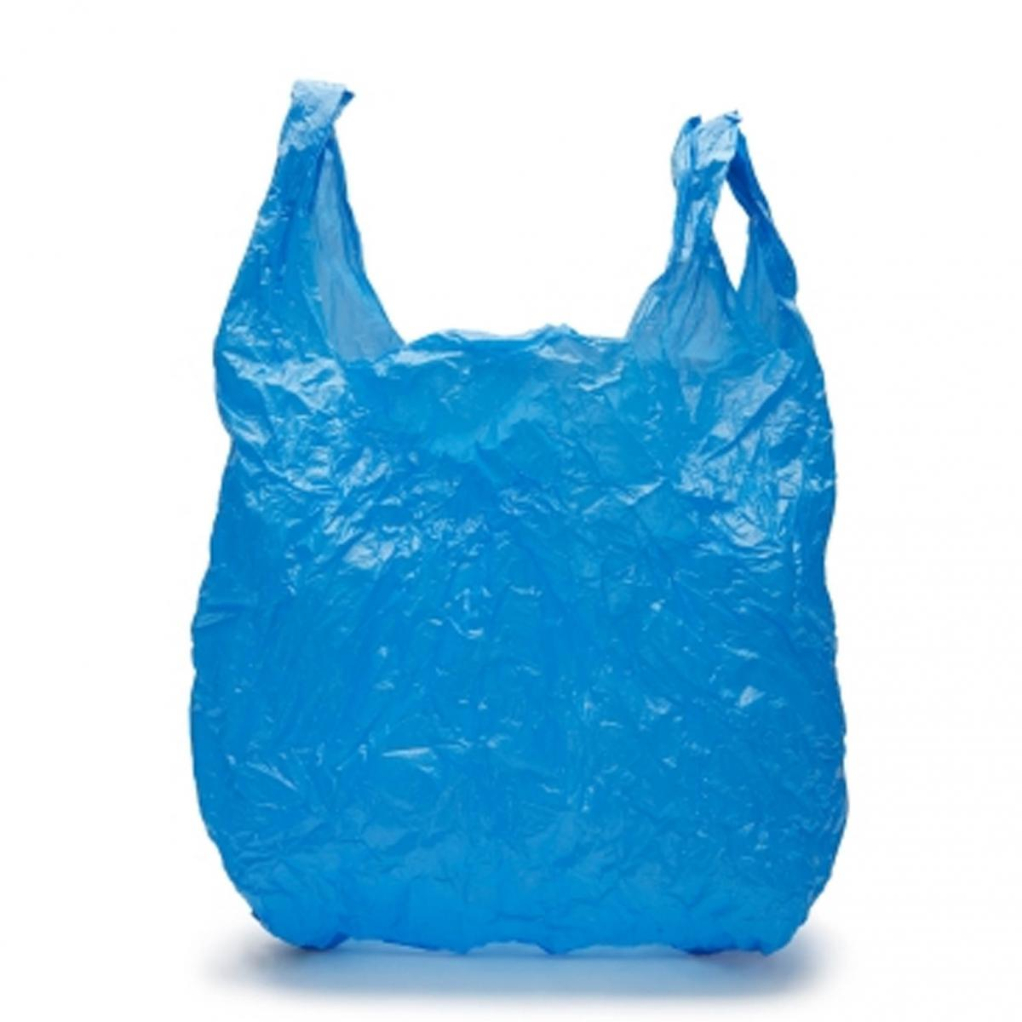

Slide 11
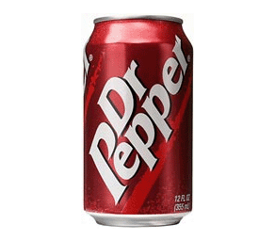
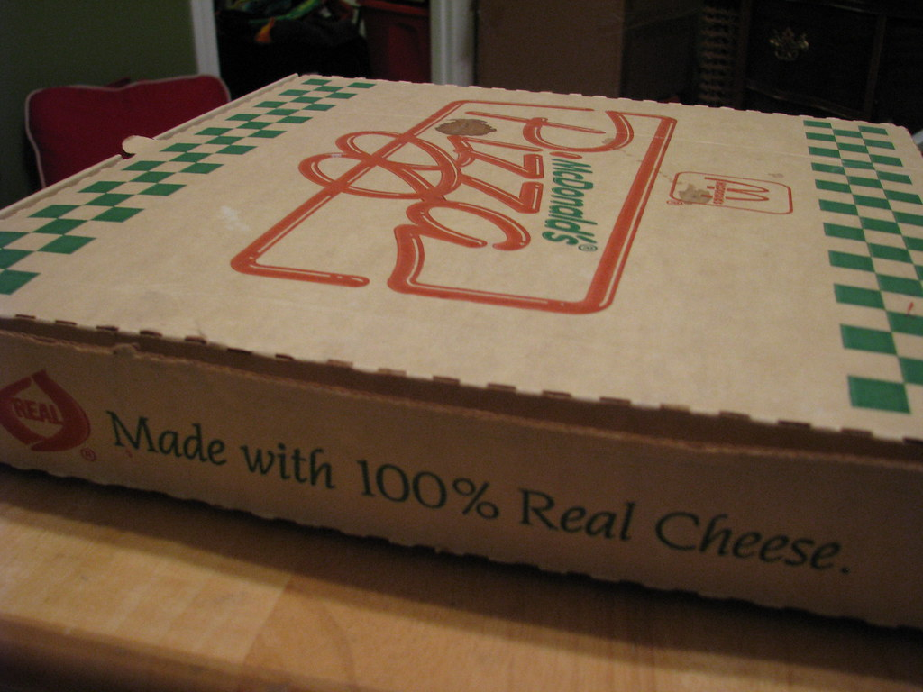
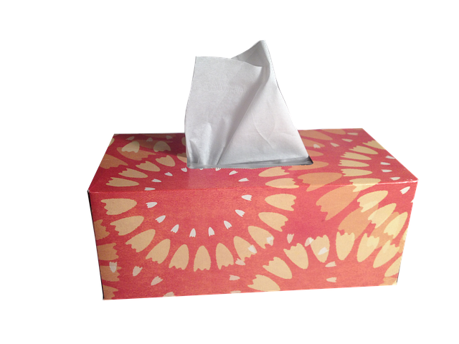
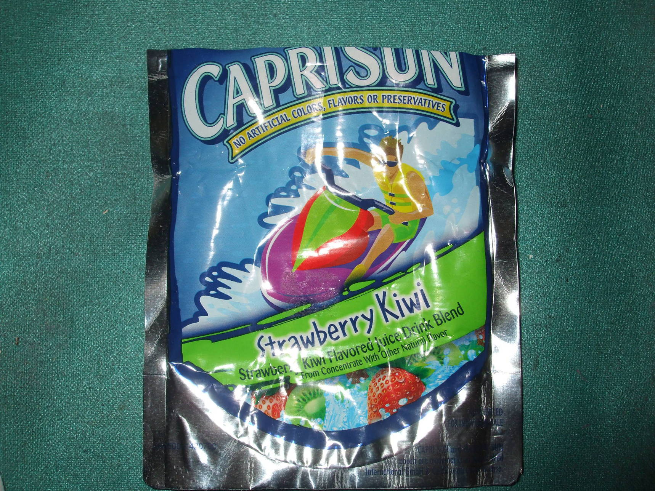
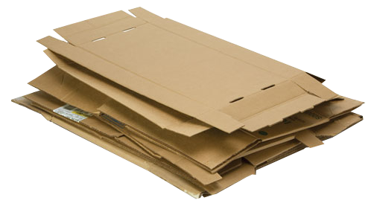
Which can you recycle?

Slide 12
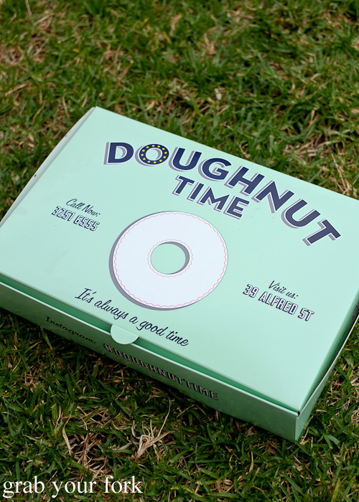
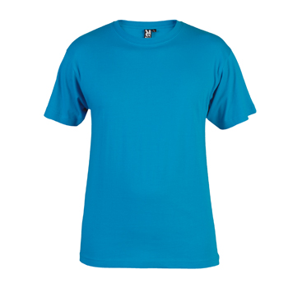
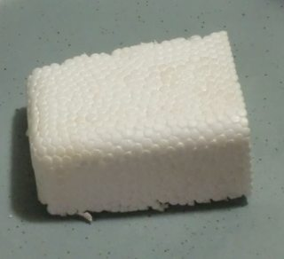
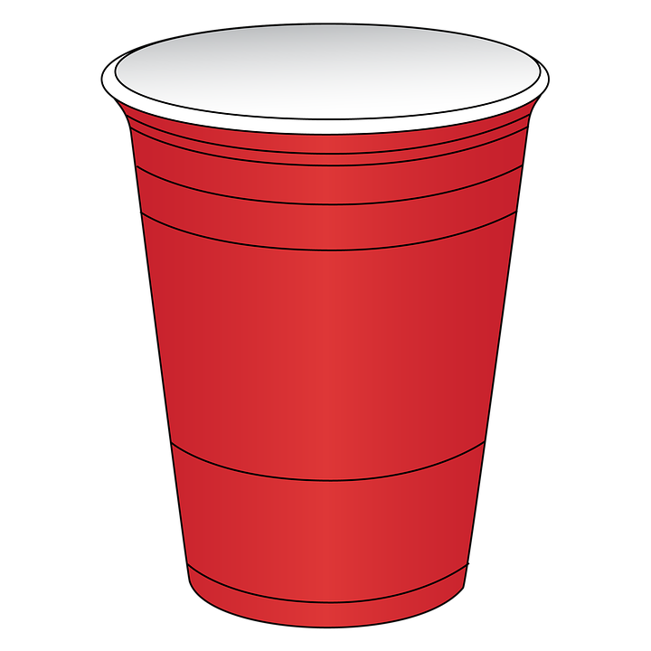
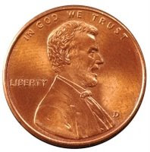
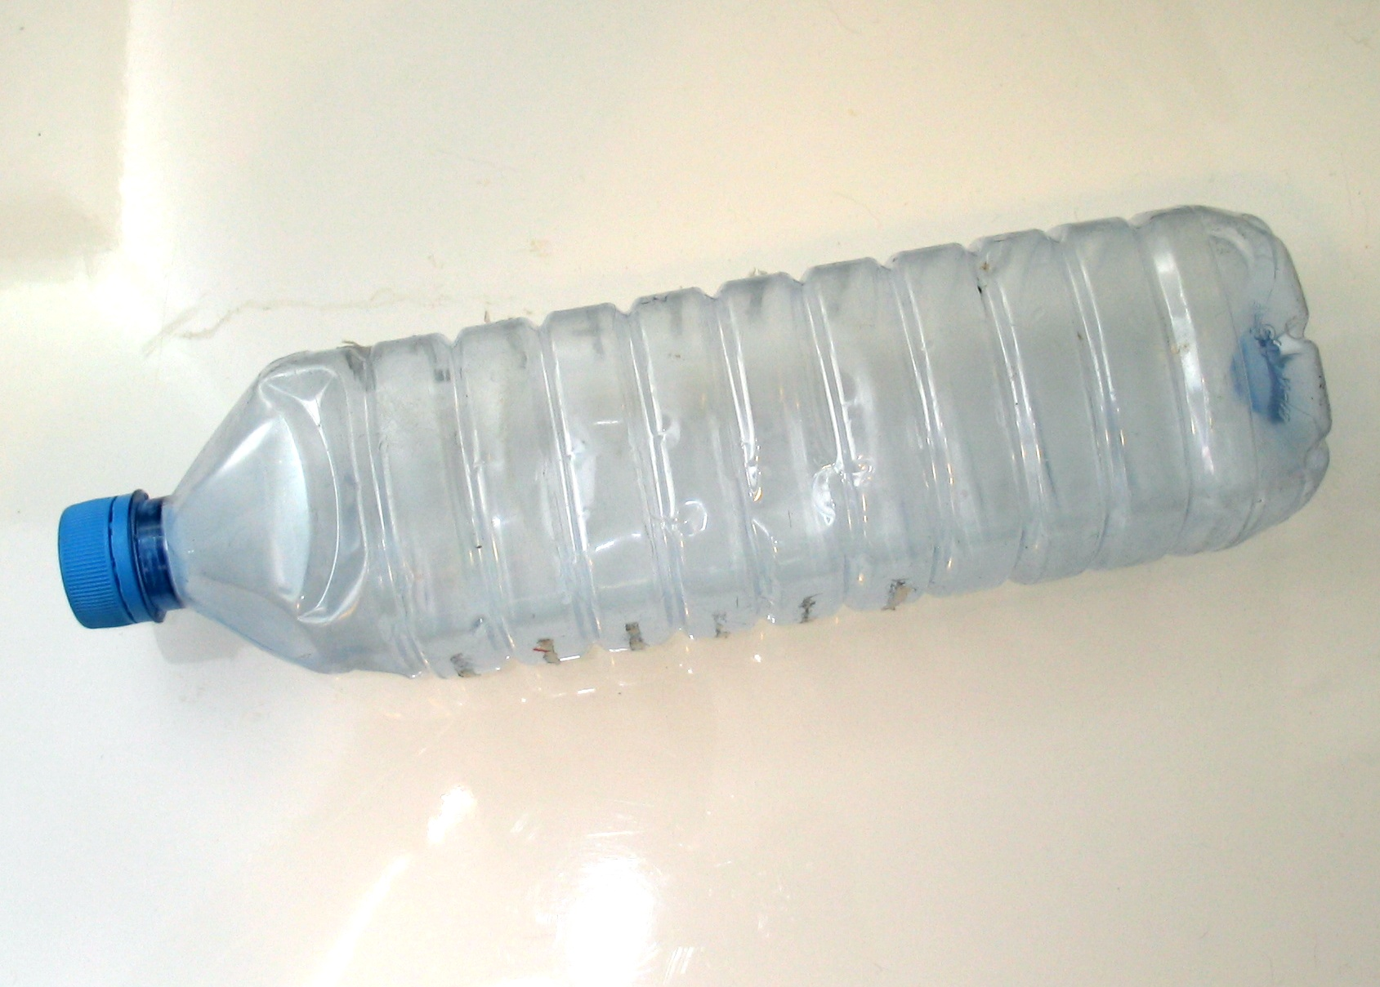
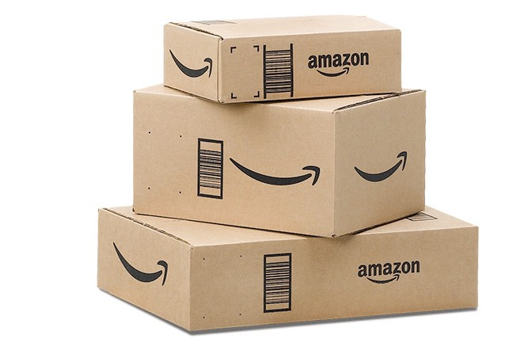

Slide 13
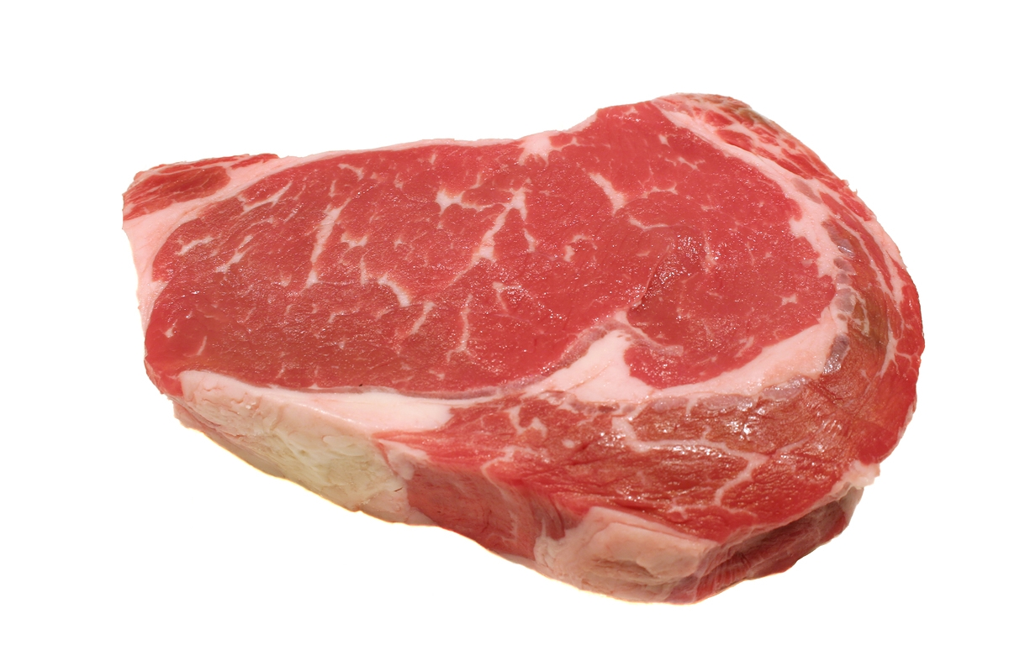
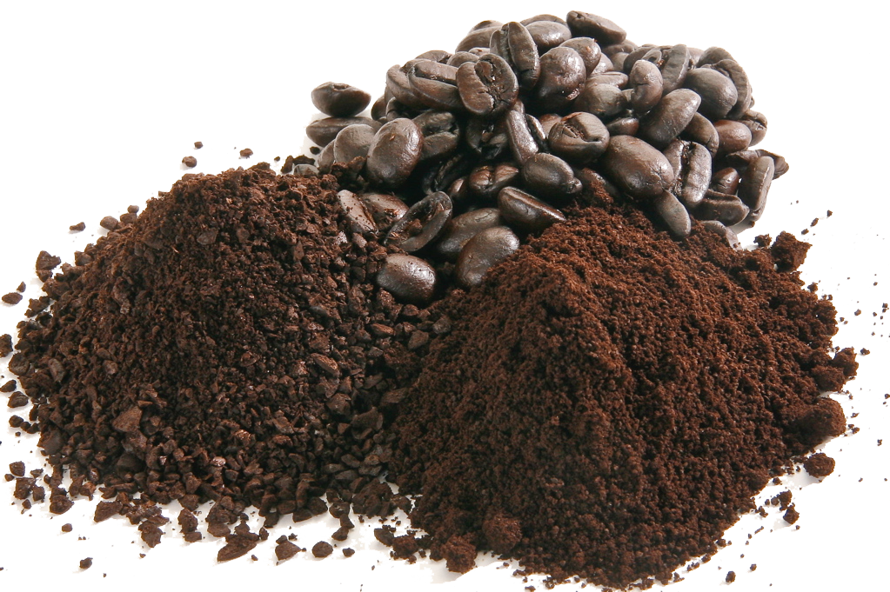
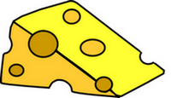
Which are trash and which are not?

Slide 14
