Slide 1

the danyang bridge
By Kaylee

Slide 2

comparson
The Danyang bridge is 101 miles longer than the Golden Gate Bridge

Slide 3
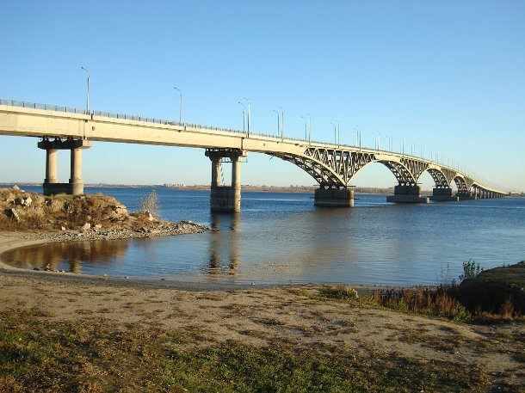
Interesting facts
It is the longest bridge in the world
It is longer then every bridge
Part of the Beijing high speed railway

Slide 4
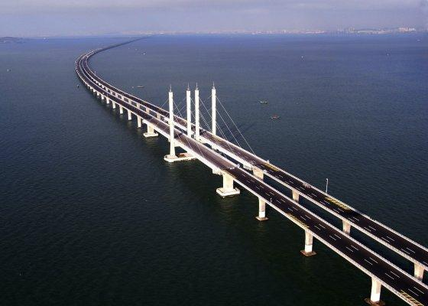
measurements
it is 102 miles
114 km
It was made in china
Ft 540682.41
Built in 2011
spans are 102 ft

Slide 5


Slide 6
Researched and produced by Kaylee
2nd grade
2019

