Slide 1
50
^{LARGE}
Lifelong
Achievement
Responsibility
Growth
Education
Changing lives by inspiring hope, molding character, teaching responsibility, and providing opportunity.
Notes:
Good morning everyone, I am Larry Thompson, District Administrator for Leon County Schools and Coordinator of 50 LARGE. First and foremost – We want to thank you for this opportunity… Our group consist of 50 L staff members,, 50 L Steering Committee and Intervention Team members, Foundation for Leon County Schools director and board members, and LCS district administrators, parents and one 50 L clients LCS is administering FCAT testing this week, thus the only student able to attend is a program graduate who is attending TCC.
I will open the presentation with an overview of the program, and we will follow the agenda as closely as possible.
50 LARGE is in the business of inspiring hope, molding character, teaching responsibility, and providing “real” opportunity for young men who have gotten off track and trying to turn their lives around.

Slide 2
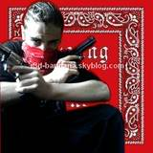
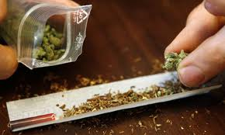
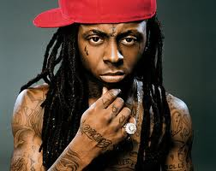
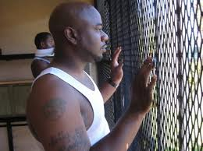
The Problems
Gangs & gang violence
Drugs & the War on Drugs
Mass incarceration
Pop culture & rap music
Notes:
The problems and issues related to gangs and drugs IMPACT everyone’s quality of life, sometimes in a very dramatic fashion… The 50 LARGE collaborative is determined to be an effective and important part of the solution.

Slide 3
Gangs and Gang Violence
What Gangs are Active (documented)
Westside | Approximately 75+ members
Northside | Approximately 90+ members
Southside | Approximately 40+ members
Hit Squad | Approximately 30+ members
National | Approximately 20+ members includes Crips, Bloods, Gangster Disciples, Surenos, Latin Kings, etc.
Total | 255 Documented Gang Members
Notes:
For every documented gang member there are probably 2 or 3 more who are undocumented; quite possible a 1,000 or more gang guys is our midst.
We’ve worked with guys who are national affiliates, the local neighborhood gang guys, Hit Squad guys and we’ve been successful with a fair percentage. At the re-entry board meeting last Friday – I requested referral for three more Hit Squad guys who will be released within the next month or six weeks.

Slide 4
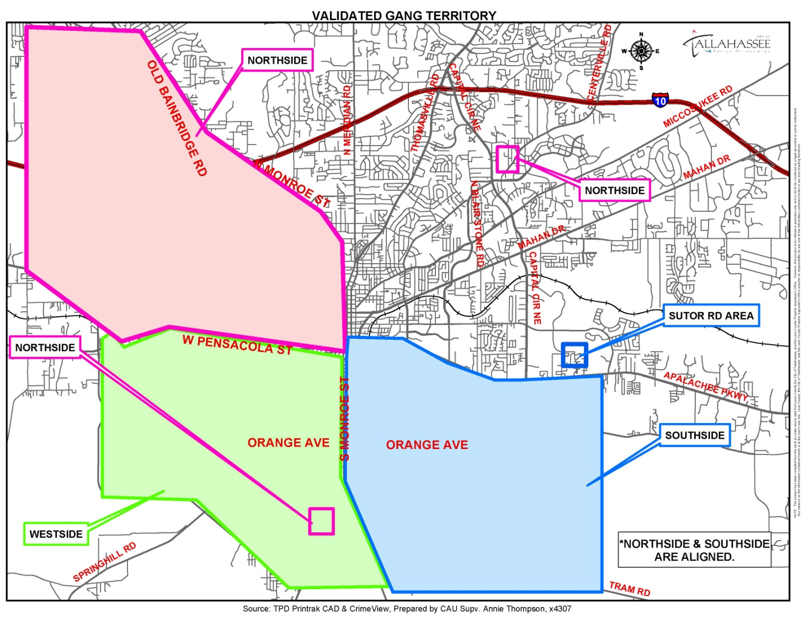
Where are they?
Griffin Heights
YouTube: Bama Documentary
Treehouseboiz 4186 views
Hit Squad
National affiliates dispersed throughout community…
Notes:
The Northside and Southside gangs are aligned and the frequently have beefs with the Westside cliques; the “Hit Squad” is kind of a rogue independent group – and they are quite dangerous. The gangs are operating pretty much inside the I-10 corridor.
To get some insight into the psyche of the gang guys, and witness how blatant they are at times and how thoroughly they indoctrinate youngsters growing up in the mean streets of Griffin Heights – Alabama and Basin Streets: Check out this YouTube video, Bama Documentary.

Slide 5
Gang Crimes…
Drug related crimes and violence
  Murder
  Assault and battery
Robberies
Burglary and criminal mischief
Property crimes
Notes:
These guys carry guns – and they don’t mind using them.

Slide 6
Tallahassee makes Forbes top 10 most dangerous cities…
Metro Statistical Area (includes surrounding counties) | Population | Violent Crimes per 100K
#1 Detroit, MI | 1,895,974 | 1,111
#2 Memphis, TN | 1,313,722 | 1,006
#3 Springfield, IL | 206,661 | 856
#4 Flint, MI | 419,008 | 827
#5 Anchorage, AK | 313,181 | 813
#10 Tallahassee, FL | 363,918 | 775
Notes:
The Forbes Magazine most dangerous city ranking really got everyone’s attention.

Slide 7
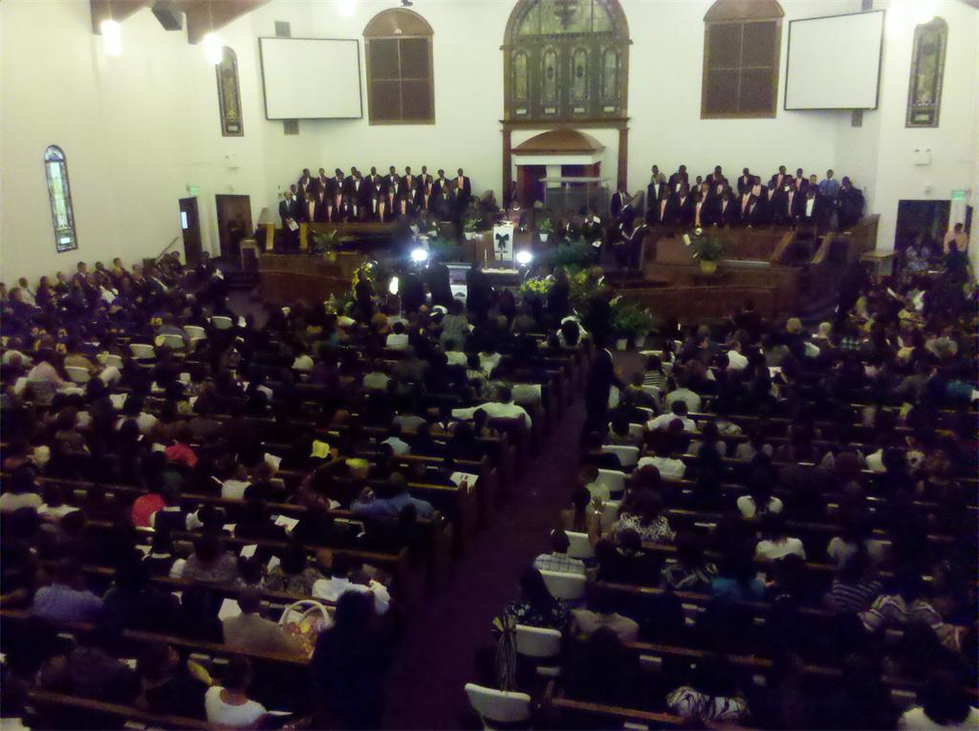
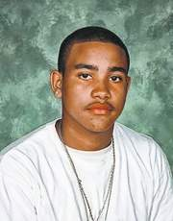
Bethel AME Church
Memorial Service: Reshard Morrell
April 30, 2011
Notes:
This one was especially painful for me…
Reshard Morrell was murdered senselessly
15 year old Rickards High School 10th grader , dilligent student, football player, and member of the Tallahassee Boys Choir.
A member of the “Hit Squad” had a “beef” with someone at a party sponsored by a local fraternity. He came back with a gun and shot into the crowd as they were leaving the party. Reshard wasn’t a member of any gang – he was just in the wrong place at the wrong time…

Slide 8
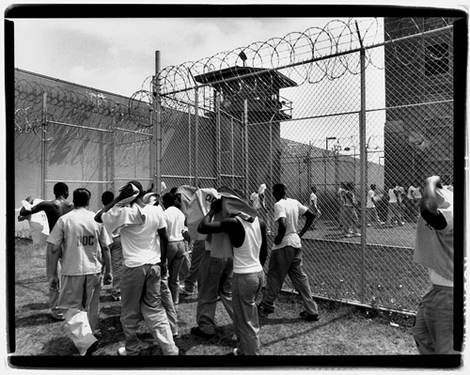
The New Jim Crow:
Mass Incarceration in the Age of Colorblindness by Michelle Alexander
Notes:
I abhor gang violence and senseless loss of life…
But, the mass incarceration of young men from poor communities is a worse travesty… And it’s drug related…
Many of our communities have been just decimated, there are not enough positive male role models in these poor communities…
To gain some real insight – check out The New Jim Crow by Michelle Alexander

Slide 9
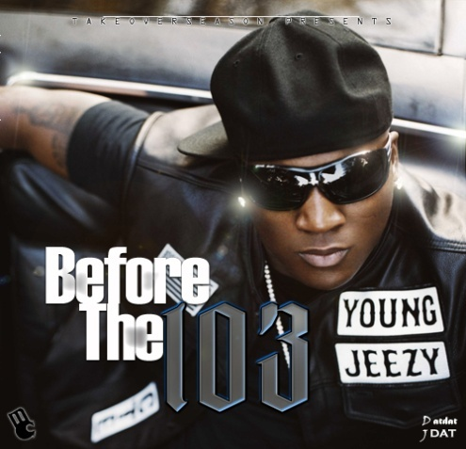
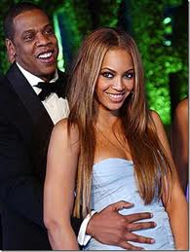
Pop Culture Icons:
Young Jeezy & Jay-Z
Crazy World: Young Jeezy
See this dope still selling and these n…. still tellin’
Will you make it through the day?
There’s no tellin’ in this crazy world
When I was 14 I turned nothin’ to a quarter mil
If I should Die: Jay-Z
If I should die don't cry my n.....s
just ride my n.....s bust bullets in the sky my n.....s
And when I'm gone don't mourn my n.....s
get on my n.....s when it's real
say word to Shawn my n.....s
If I should die [echoes]
Notes:
These rich and famous rappers are a real problem… they are former drug dealers gone legal and they promote the gangster life, drugs, and violence in their music… And, there just aren’t enough positive male role models in the hood to counteract this message.
Extra Info:
Young Jeezee is a very successful rap artist. He’s a former dope dealer and affiliate of the Black Mafia Family which was run by Demetrius “Big Meech” Flenoy and his brother Terry “Southwest T.” In the early 1990’s ,they rose up from the slums of Detroit and were able to build one of the largest cocaine empires in American history. Big Meech and Southwest T are in jail, probably for life. Young Jeezy never went to jail…
Jay-Z (born Shawn Corey Carter) grew up in Brooklyn’s drug-infested Marcy Projects. He raps about his drug dealing and gun toting background. He got out fairly early – 20 years old – and starting his rapping career, started his own record label at age 27, and eventually would become the biggest name in hip-hop. He is a shrewd business man, he definitely made a wise move in marrying Beyonce’.
They are NOT dummies… But, they are the fortunate few. When there aren’t other role models – they can and do seem very attractive.

Slide 10
50 LARGE Solution
Case Managers
Deportment Standards
Targeted Reading Tutoring
Computer Technology Training
Vocation\Motivation\Leadership Training
Stipend Incentive & Jobs…
Projected Expansion
  Entrepreneurial Business Training
Notes:
The basic components of the 50 LARGE Solution, and our expansion plans…

Slide 11
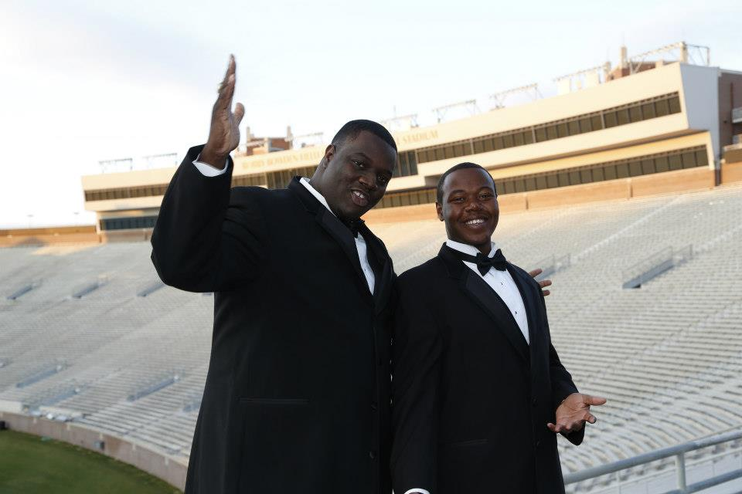
Case Managers:
It’s a family affair…
Notes:
We are different from other programs – because #1 - we are NOT a program – WE ARE FAMILY… We take them to raise… Literally
We spend quality time with our guys; I’m granddaddy and my case managers are their uncles.
They have our cell numbers and they use them
And, we are just like “Enterprise” – We pick them up and take them home for our twice weekly meetings. We have access to Leon County Schools’ vans and a bus. The transportation is a real game changer – they can’t use the excuse that they can’t get to our meetings.

Slide 12
50 LARGE Bible
 | Deportment Standards
1. | Dress and groom for success; neat hair style and NO “Saggin” trousers
2. | Arrive early for school, appointments, work, and meetings (15-30 minutes)
3. | Sit up straight, make eye contact during individual discussion or group presentations
4. | “Yes sir, no ma’am, please, thank you, and excuse me”
5. | Work hard: always do more than expected
6. | Read 60 minutes everyday; carry your book with you
7. | Complete ALL work, class, and homework assignments
Notes:
The 50 LARGE bible… We start and end here… It’s a real basic success formula…
Dress for success, arrive early, make eye contact, be respectful, work hard, read everyday – I literally get down on my knees and plead with them to READ. If they can develop proficient reading skills – they have half a chance.

Slide 13
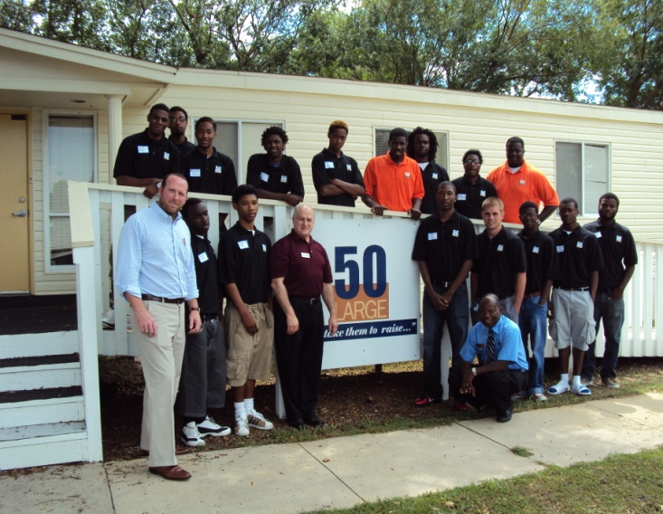
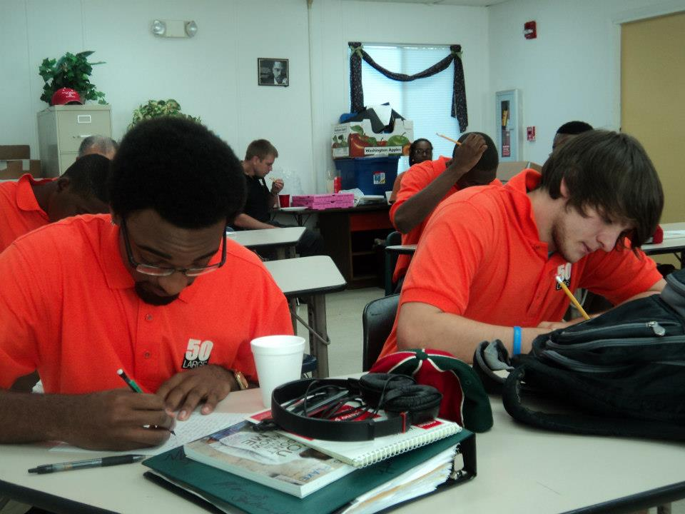
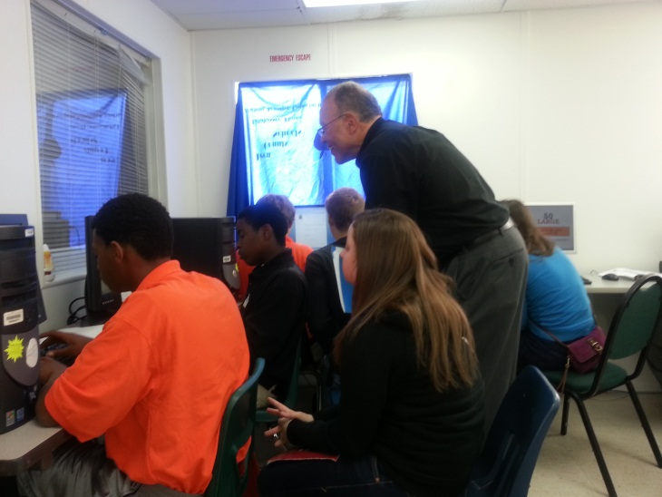
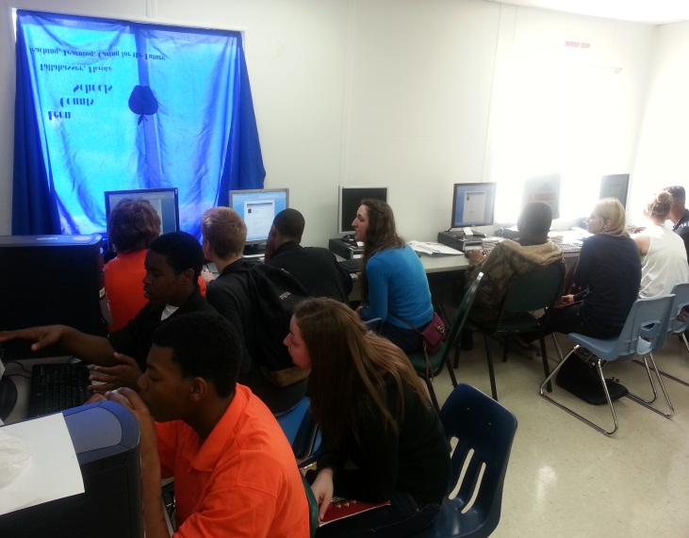
50 LARGE Headquarters
Notes:
We now have a headquarters for operations. It’s located on the Nims Middle School grounds. There is office space for our case managers and volunteers; and a small group meeting room. We’re excited about that!!

Slide 14
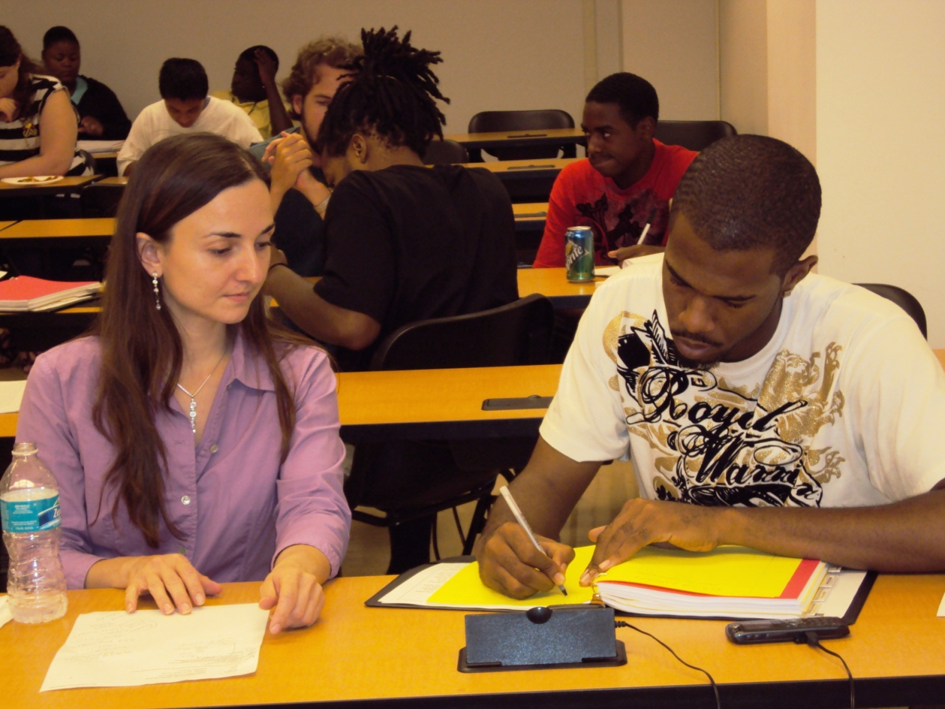
Targeted Reading Tutoring at FSU
Notes:
We partner with Florida State University to provide one to one Targeted reading tutoring for our guys. This young man, got into a lot of trouble in high school, but now he’s enrolled at TCC and earned a 2.75 GPA for the first semester…
He and his mom are here with us today.

Slide 15
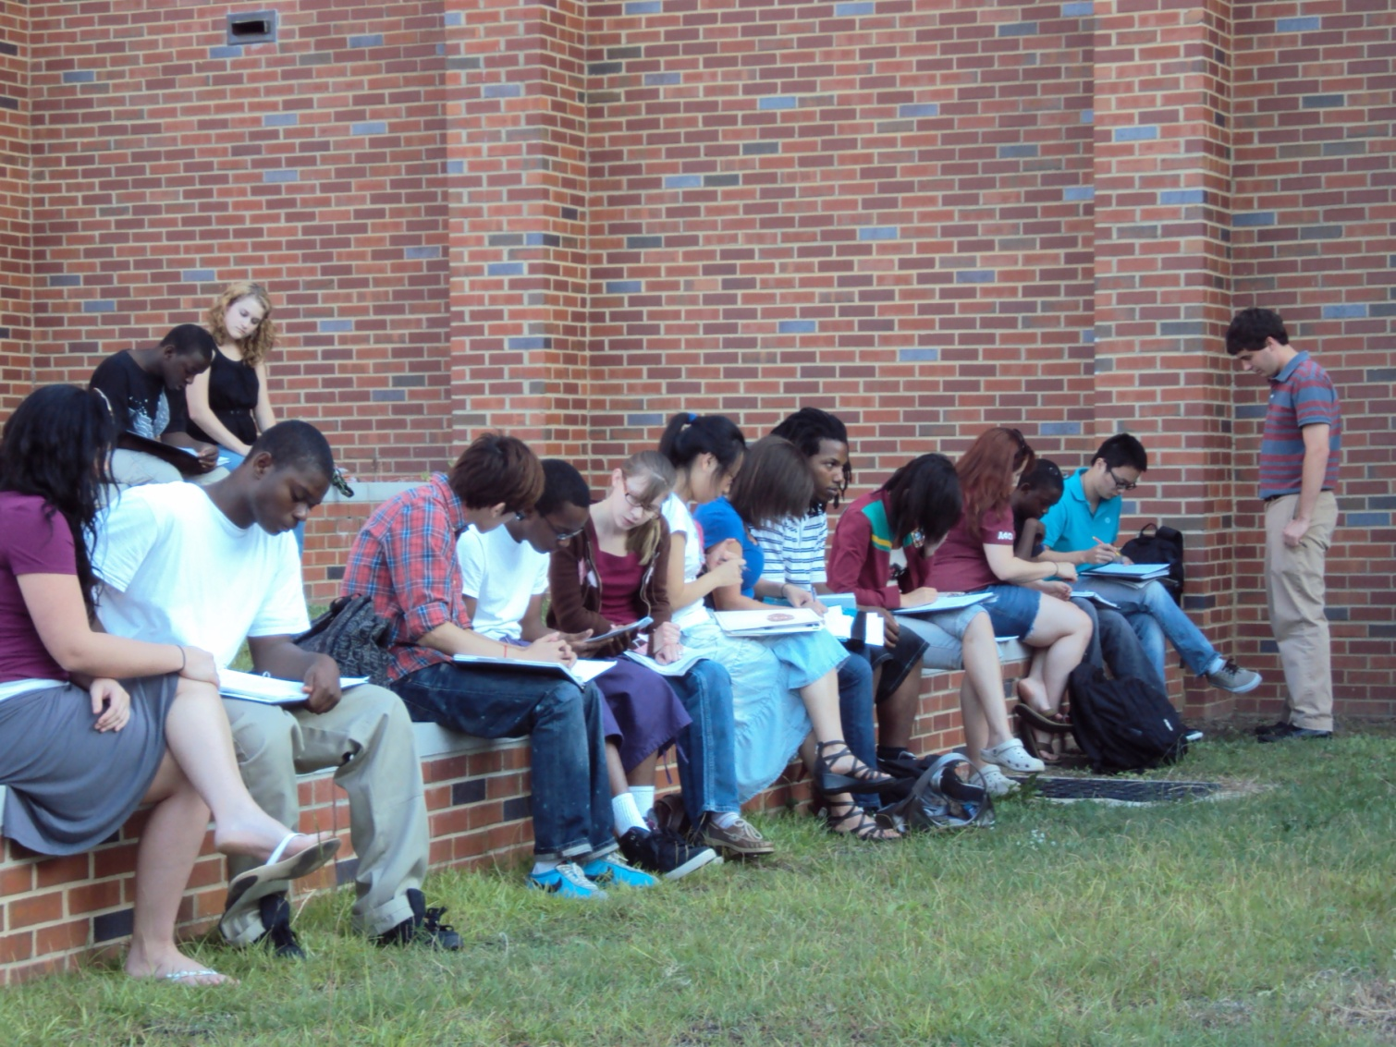
Reading outside at FSU
We lost this one, unbelievable hard knock life story…
Notes:
Note the level of engagement….
Dr. Pamela “Sissi” Carrol, Assoc. Dean of the College of Education, is a member of the 50 L Steering Committee. We met two years ago and she embraced 50 immediately. She’s here today and will make brief remarks.

Slide 16
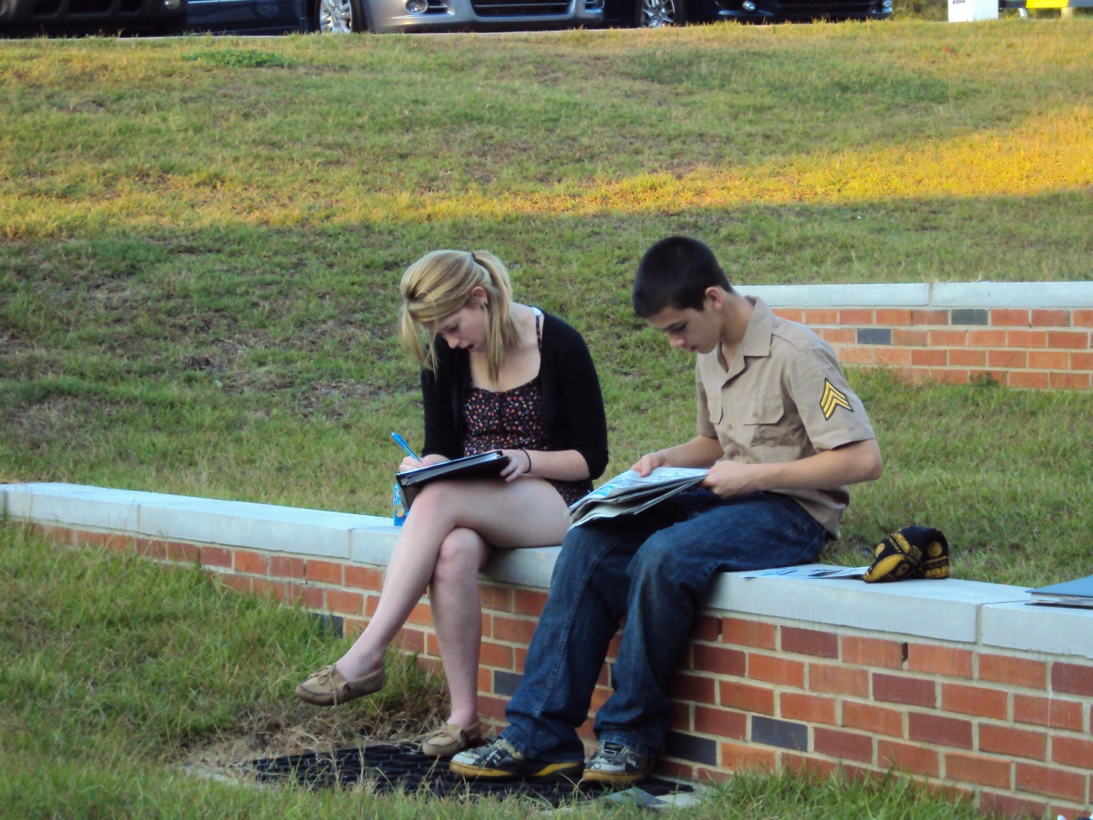
One to One Strategy Works
He’s reading the newspaper…
Notes:
This young man has been sent away to secure detention facilities several times… His is a real hard knock life story… He keeps coming back and one his first calls is to one of the 50 LARGE uncles.

Slide 17
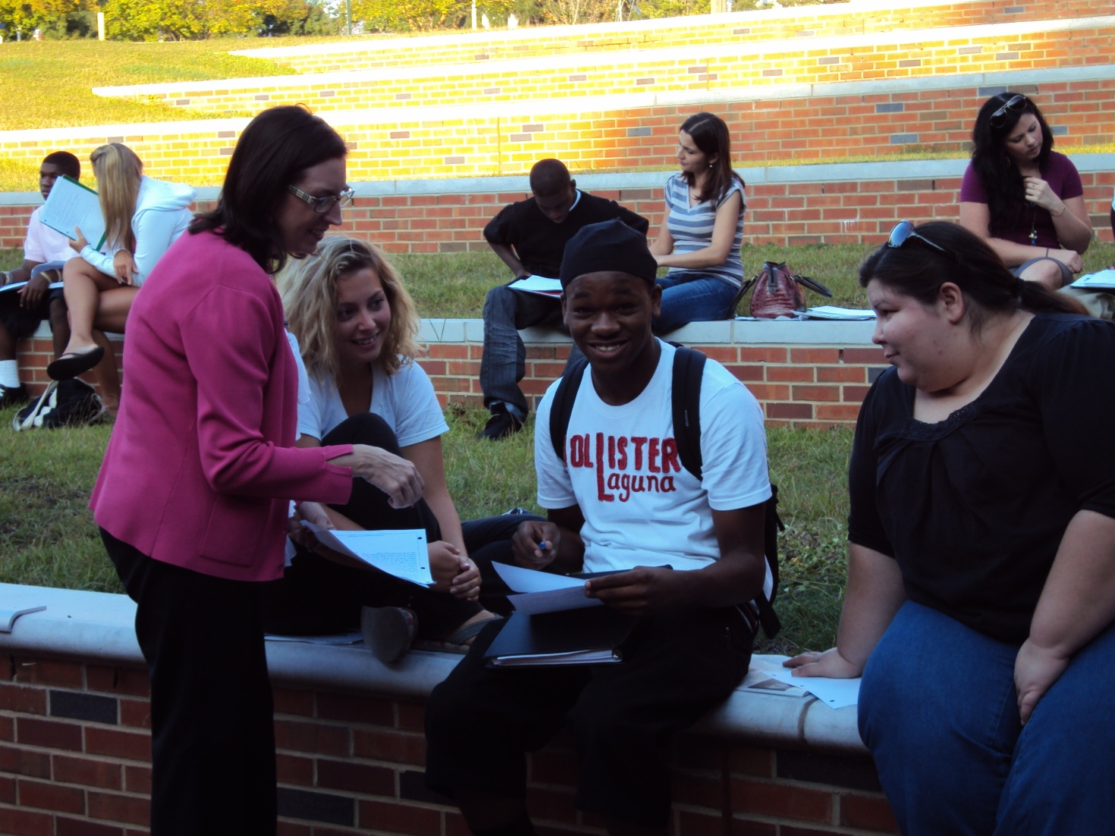
Kelly Seay:
Reading Component Coordinator
Earned his GED, First Responders Certification, and employed via 50 L
Notes:
Kelly Seay is our reading component coordinator. Kelly is the Florida Department of Education Teacher Liaison. She is a master reading teacher, she constructs the reading curriculum, trains and monitors the FSU students while they work with our guys.

Slide 18
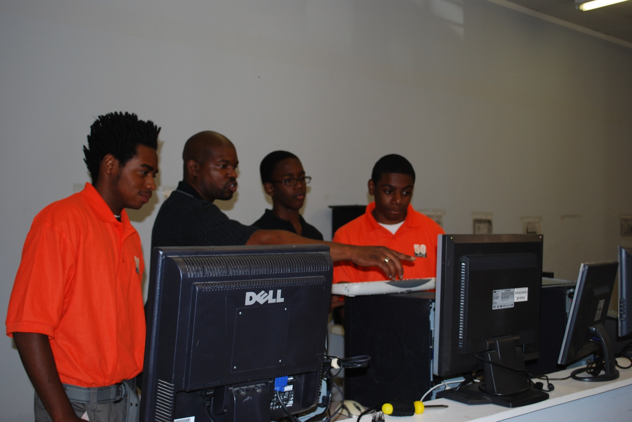
Technology at Goodwill
Notes:
Our partner list continues to expand, and when Goodwill Industries of the Big Bend came on board, it was advantageous for us to move the computer technology training component to their computer store on Tennessee Street.
In addition, they are one of our major sources for job opportunities for the guys who earn the privilege.
I have a brief Forever Family video by Anna Johnson – Riedel highlighting our partnership…

Slide 19

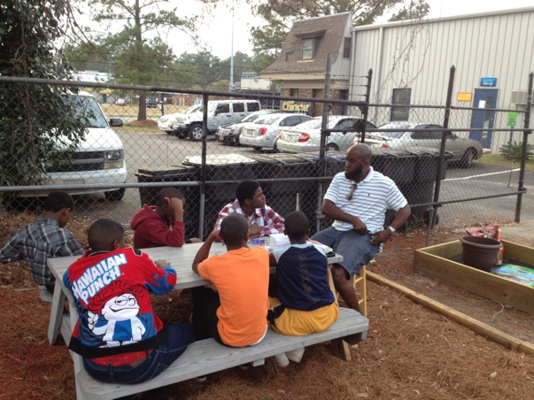
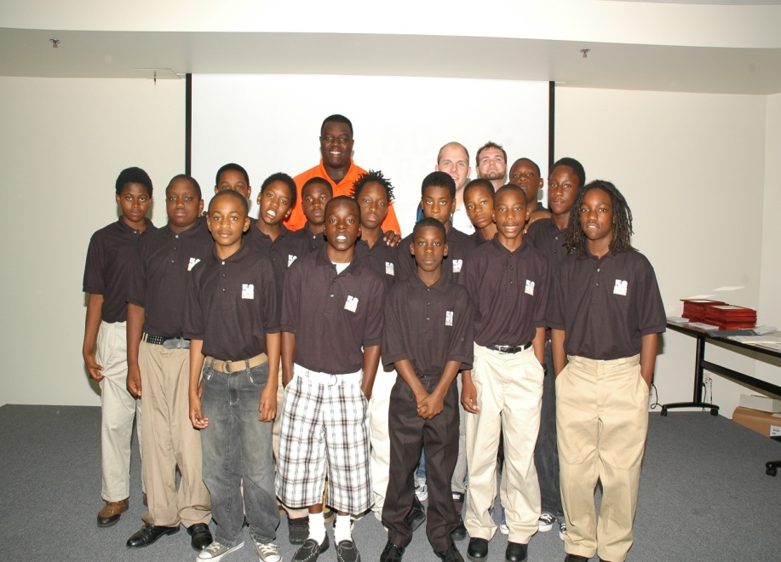
Prevention: Bond Cohort
Matriculation Celebration
Notes:
For the past 18 months, we’ve gotten into prevention and worked with over aged 5th grade students at Bond Elementary. We get academic support and character building with Zack Richardson, the CEO \owner \ operator of the Character Center. Mr. Richardson is a master teacher and an outstanding role model. The photo on the right was taken of the Bond Cohort that graduated last May.
The group did receive technology training a refurbished computer at the “Matriculation Celebration.”

Slide 20
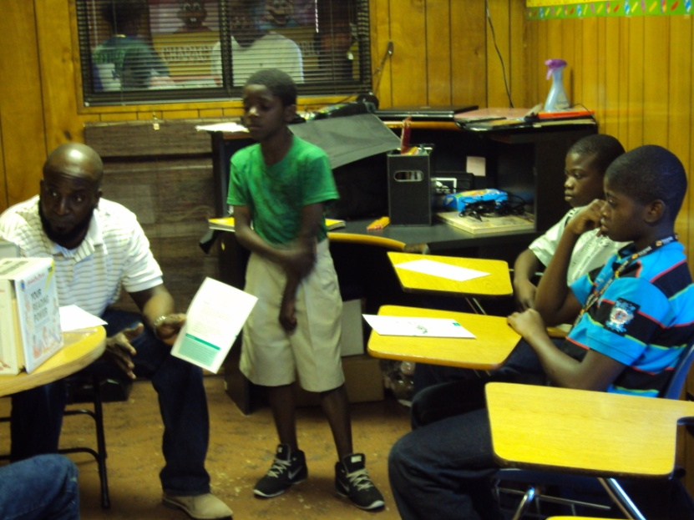
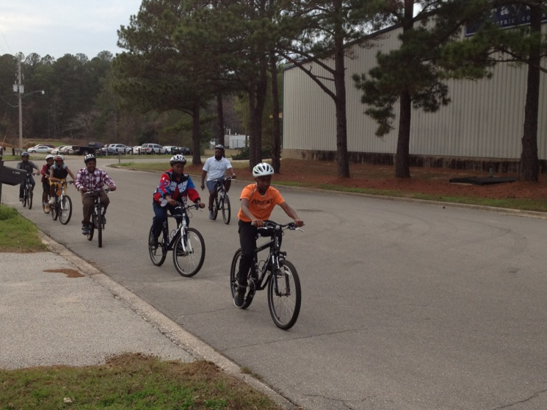
Zach Richardson
The Holistic Approach
Character First
  “Learning Well & Living Right”
  Healthy snacks
Hard work = safe bicycle excursions
Notes:
During this financial transition phase we had to downsize; thus the current Bond Cohort is 6 – 8 and meets once per week at the Character Center, and occasional workshops and for community service events.

Slide 21
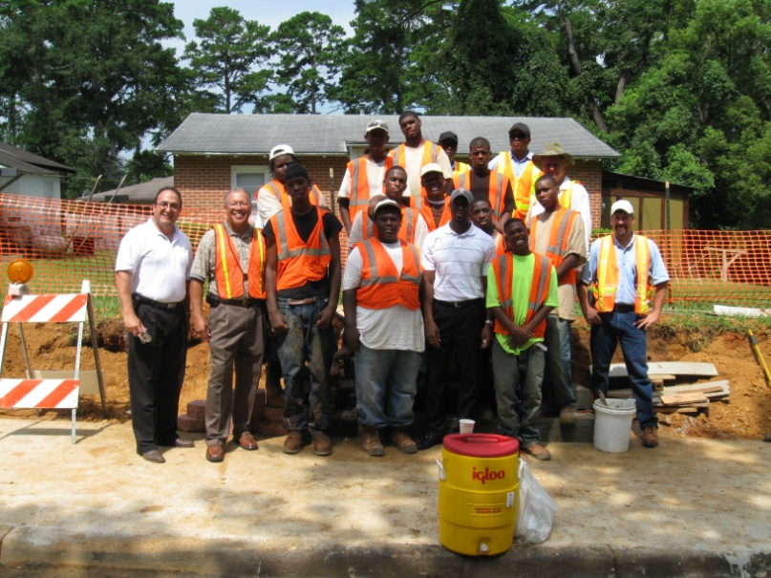
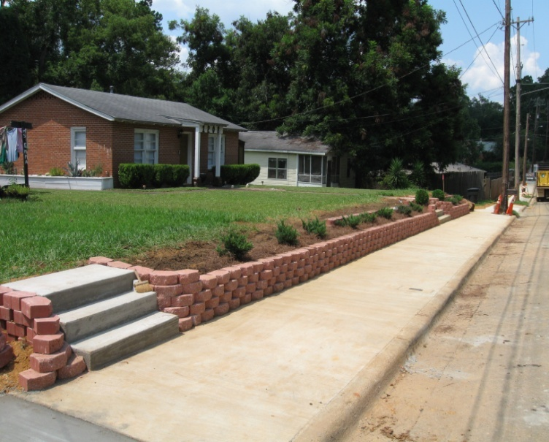
Stipends & Jobs
Clients earn $5.00 for each meeting attended
  Bond clients earn $3.00 per meeting
  Compliance with Deportment Standards
  Checks issued monthly
Partners provide employment opportunity
  Minimum wage jobs go a long way…
Notes:
A little money goes a long way with our guys…
And a minimum wage job… A real job…
Of course we make absolutely sure they will deport perfectly before arranging employment.

Slide 22
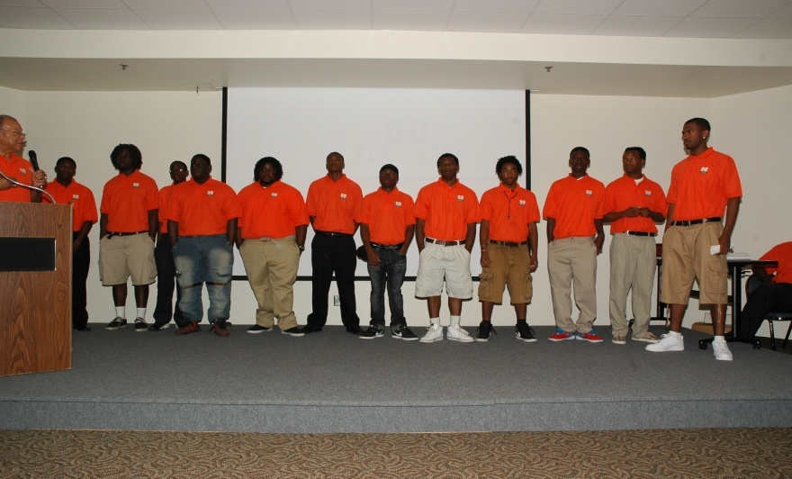
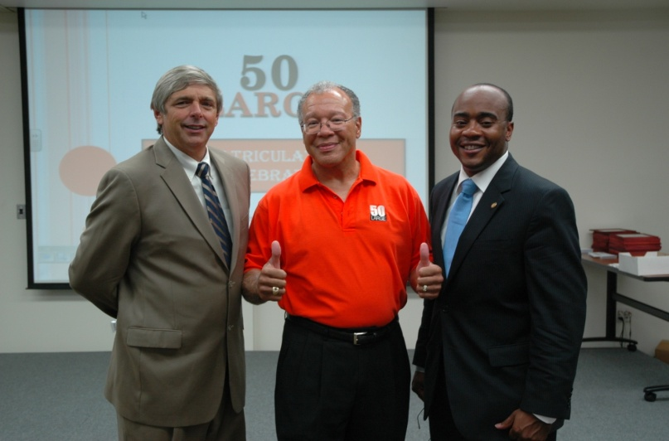
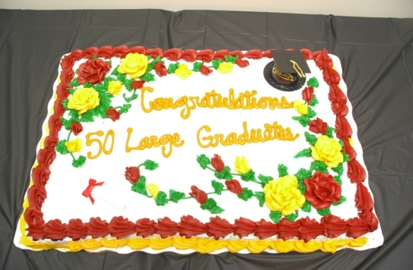
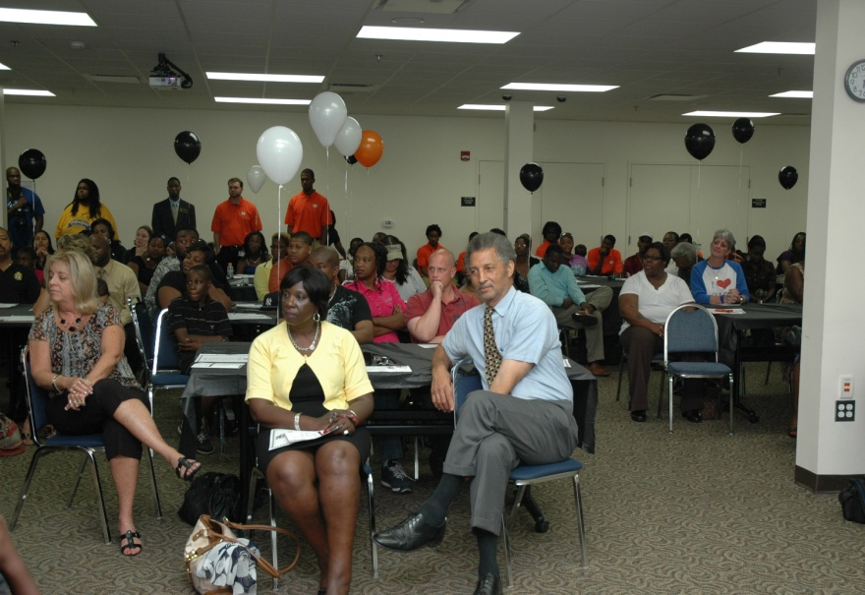
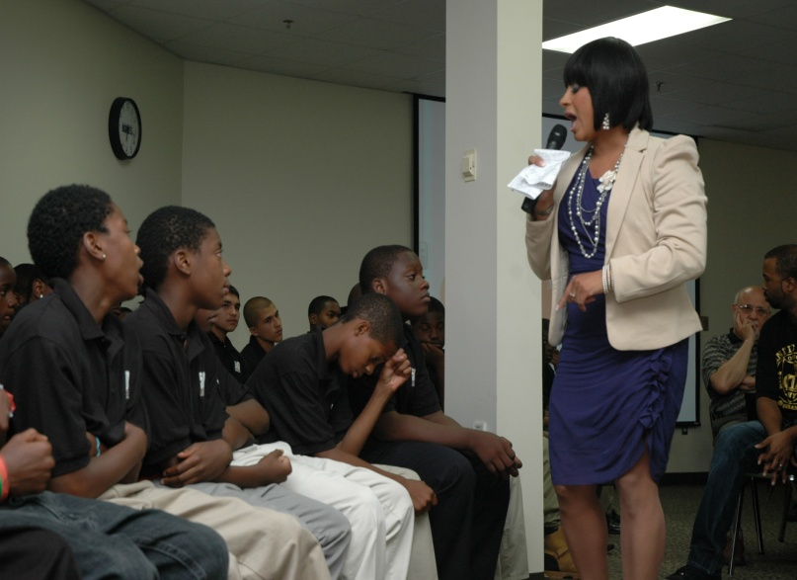
1st Annual
Matriculation Celebration
Notes:
Our guys haven’t had many occasions to be honored, to be the center of attention in a positive light. Our first major event was an unqualified success – and we plan to end each school year in this fashion!

Slide 23
Jail vs. College
Florida Department of Corrections
  $2.3 B = operating expense
  $34 K = annual cost\youthful offender
Department of Juvenile Justice - Residential
  $98 M = operating expense
  $24 K = annual cost\ secured detainee
Florida State University
  $14 K = annual cost \ tuition & fees
    SEND THEM TO COLLEGE, duh…
Notes:
The cost of locking young me up compared to sending them to college…
We need to be sending more guys to college…
You do the math…..

Slide 24
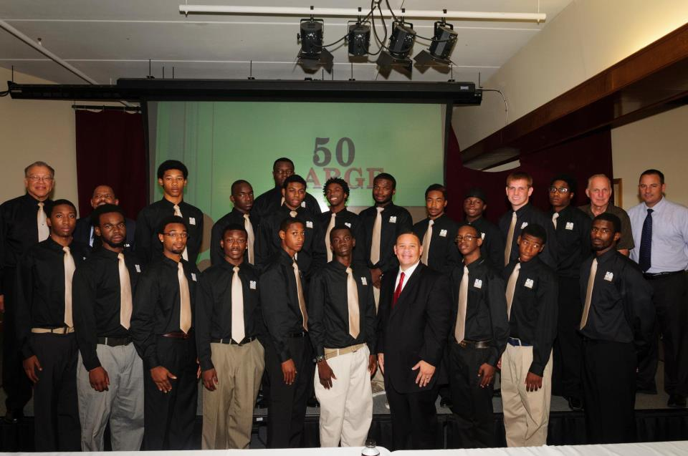
50 L Annual Cost Savings
80 member cohort with 75% success rate
  60 young men redirected from jail
    20 Youthful Offenders = $680,000
    40 Juvenile Offenders = $960,000
      Total Savings = $1,640,000
FSU tuition for 60 young men = $878,880
Notes:
If we adopt 80 guys and continue to have a 75% success rate. We could send 60 guys to college and save tax payers $800 K in the process. That’s just the savings in raw dollars – not to mention the ripple effect in the community.
When a young man is retained once = his probability for graduating from high school drops to 50%
When he falls two years behind = the probability is to 10%
That’s why we chose to reach down to elementary school; the young men we serve are already 1 or 2 years behind…

Slide 25
Current Staff
Name | Title / Affiliation
Larry Thompson | Coordinator
Rhone Francis | Operations & Case Manager
William (BJ) Fletcher | Case Manager
Zac Osborne | Technology Component Coordinator Goodwill Industries, Asst. Store Mgr.
Kelly Seay | Reading Component Coord. FDOE, Teacher Liaison
Notes:
Current staff is bare bones… We downsized from 4 full time CMs to two ½ till we are able to develop the alternative funding streams….

Slide 26
Executive Team
Name | Title | Organization \ Title
Dr. Michael Moore | Chairperson | Leon County Schools Transportation Services Dir.
Brooke Lochore | Co-Chairperson | Goodwill Industries V.P. for Public Relations
John Wilson | Secretary | DISC Village CEO
Claudette Cromartie | Ex-Officio | Tallahassee Housing Authority CEO (retired)
Notes:
The Dynamic Steering Committee Executive Team – and we have them for two years…

Slide 27
Steering Committee
(Board of Directors)
First Name | Last Name | Title | Agency
Kimberly | Black | Registrar | Ghazvini Learning Center
Claudette | Cromartie | Executive Dir., Retired | Tall. Housing Authority
Vicki | Cunniff | Chief Probation Officer Circuit 2 | Department of Juvenile Justice
Cindy | Dick | Chief | Tallahassee Fire Department
Charles | Dodson | Circuit Judge - Juvenile | Leon County
Steve | Ghazvini | President | SANDCO, Inc.
Desiree | Gorman | Exec. Assistant | WORKFORCplus
Carol | Gordon | Director | Communities in Schools of Florida
Lois | Gracey | State Director | Communities In Schools of Florida
Bobby | Green | Sergeant | Leon County Sheriff's Office
Notes:
The Steering Committee is diverse, engaged, and committed. We meet regularly,
Monthly or bi-monthly depending on the gravity of issues and business.
Extra Info:
The Intervention Team is smaller group of key partners who meet more frequently to vet potential clients, and devise prescriptive plans for those inducted.

Slide 28
Steering Committee
(Board of Directors)
First Name | Last Name | Title | Agency
John | Hunkiar | Director | LCS Safety & Security
Leroy | James | Chief | TFD - Fire Academy
Robin | Johnston | V. P. for Development | TCC
Hiram | London | Service Manager | Kraft Nissan
Michael | Monroe | Lobbyist | Florida Education Association
Gary | Montgomery | Pastor | Living Stones International
Jeanna | Olson | Comm. Dev. Administrator | FL. Dept. of Children and Families
Steve | Outlaw | Lieutenant | Tallahassee Police Department

Slide 29
Steering Committee
(Board of Directors)
First Name | Last Name | Title | Agency
Kevin | Priest | CEO | Capital City Youth Services
Brenda | Rabilais | CEO | Lee's Place
Michael | Sheridan | CEO | FBMC Benefits Management Co.
Melvin | Stone | Director | Tallahassee Fire Academy
Joe | Thomas | Center Supv. | Walker - Ford Community Center
Eric | Trombley | Juvenile Div. Supervisor | State Attorney's Office
Gary | Walby | Evaluator | Ounce of Prevention Fund of FL
Kim | Williams | CEO | Marpan Supply Co., Inc.
Kevin | Winship | Administrator | Capital City Youth Services

Slide 30
Additional Information
50
^{LARGE}
“We take them to raise…”
Larry Thompson
3955 W. Pensacola Street
Tallahassee, FL 32304
Office: (850) 487-7173
Mobile: (850) 264-4155
Email: thompsonl3@leonschools.net
http://www.leonschools.net/50large.html
Notes:
Thank you again
And if you know a young man in dire straights – that you believe is salvageable – please refer him to 50 LARGE… “We take them to raise…”
Naturally, we would be glad to answer questions…

