Slide 1
Monday, January 30th
Happy Monday ☺
Please get out your notes and something to write with…We will also be taking notes today on “Supply”
Please get out your Chapter 5 Assessment – due today!

Slide 2
1) What is Supply?
Supply- is the amount of goods available
Supply refers to producers- people who make goods or offer services (Demand refers to consumers)
Suppliers enter markets when high prices or high profits are available from providing that good or service – why do they do this?

Slide 3
Law of Supply
Law of Supply- states that the quantity supplied, or the amount offered for sale, varies directly with its price
Essentially - the higher the price, the greater the quantity supplied; the lower the price, the lower the quantity supplied
P , QS (vice versa)

Slide 4
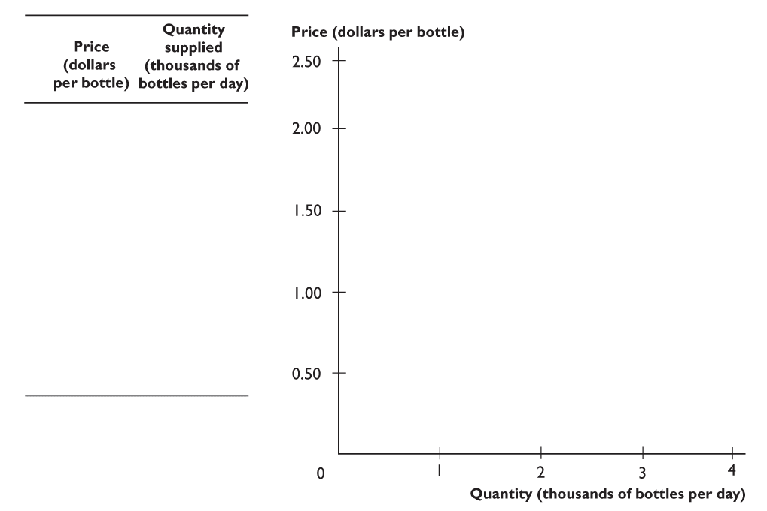
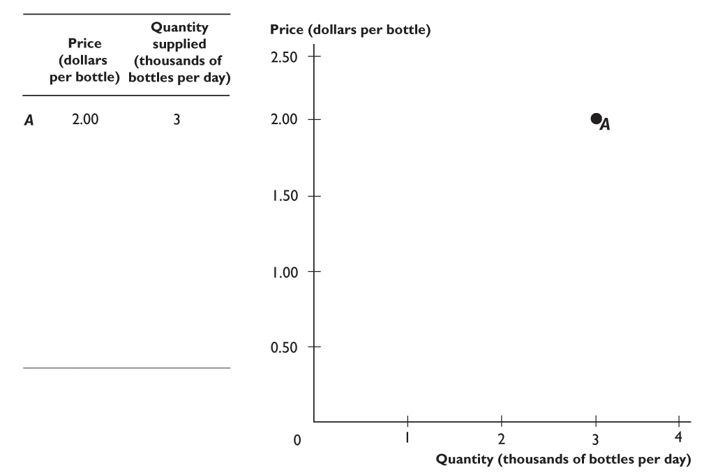
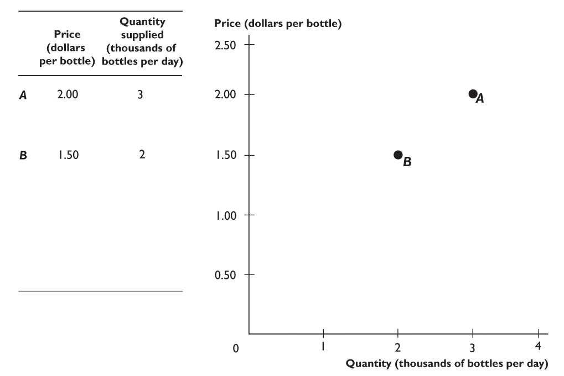
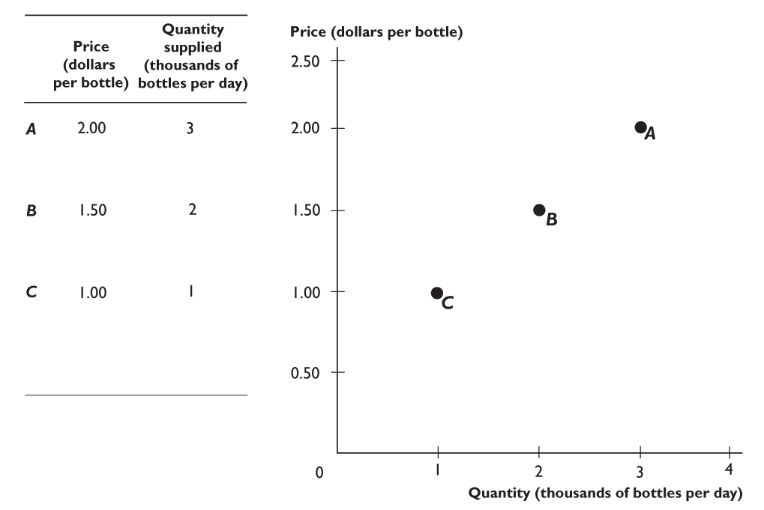
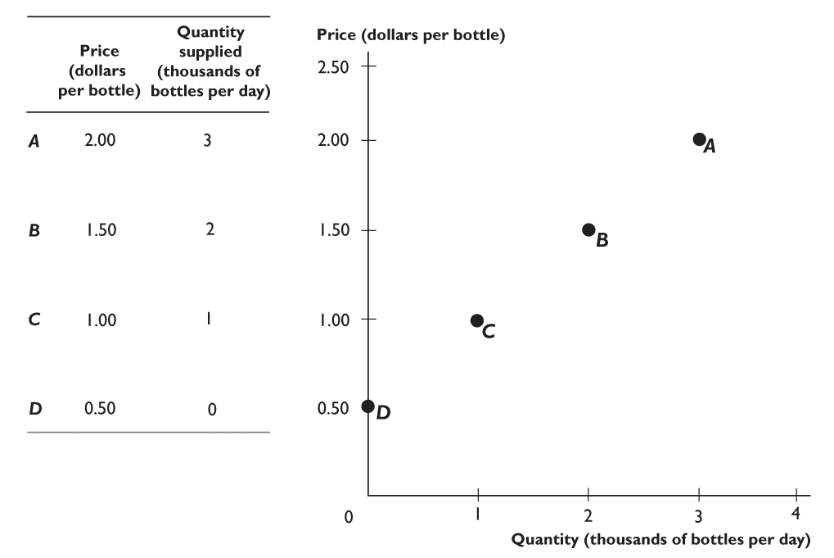
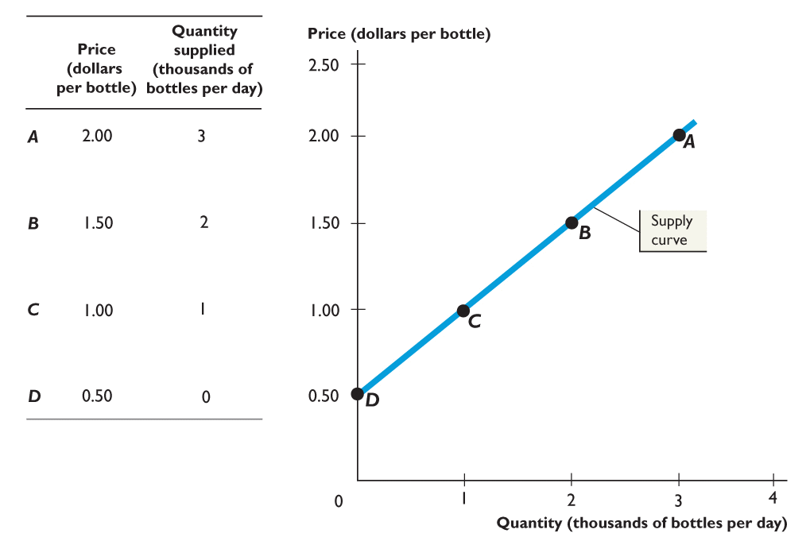
4.2 SUPPLY

Slide 5
Determinants of Supply
Change in supply- occurs when our supply curve shifts right or left. There are 9 determinants:
Productivity
Expectations
Taxes
Technology
Price of other goods
Inputs (cost of)
Gov’t Regulations
Subsidies
Sellers (number of)
Determinants of Supply
P | E | T | T
R | X | A | E
O | P | X | C
D | E | E | H
U | C | S | N
C | T |  | O
T | A |  | L
I | T |  | O
V | I |  | G
I | O |  | Y
Y | N
 | S
P | I | G | S | S
R | N | O | U | E
I | P | V | B | L
C | U |  | S | L
E | T | R | I | E
OF | S | E | D | R
Other Goods | Cost of | G | I | S
that can be |  | S | E | Number of
Produced |  |  | S

Slide 6
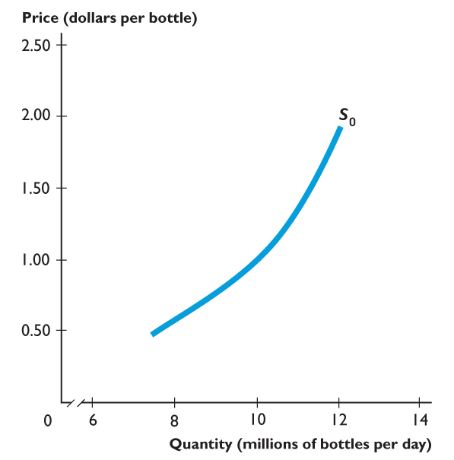
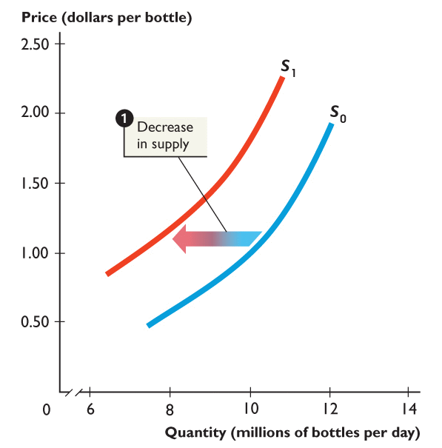
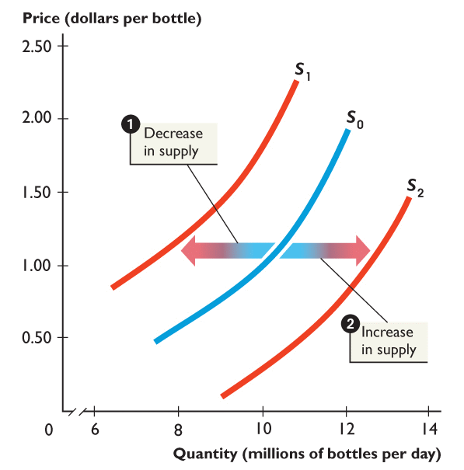
SUPPLY
A change in any of the determinants will cause a shift in the S curve..
1. When supply decreases, the supply curve shifts leftward from S₀ to S₁.
2. When supply increases, the supply curve shifts rightward from S₀ to S₂.
Notes:
When you draw a shift of the supply curve, again be careful to draw the arrows in the horizontal direction. Follow the text by always describing shifts of supply curves as “rightward” or “leftward.” Do not say that the curves shift “up” or “down.” This description of a shift is especially confusing for the supply curve. A rightward shift of the supply curve makes it look as if the curve is moving lower. Students who do not think in terms of “rightward” and “leftward” believe this shift reflects a decrease in supply, which is wrong. Get the student to always go left and right and draw the shift arrows too.

Slide 7
Determinants…PETT PIGSS
Productivity- is the efficiency of workers or the work process, when workers are happy or better trained they are more productive and supply increases, when they are unhappy or poorly trained productivity decreases so supply decreases

Slide 8
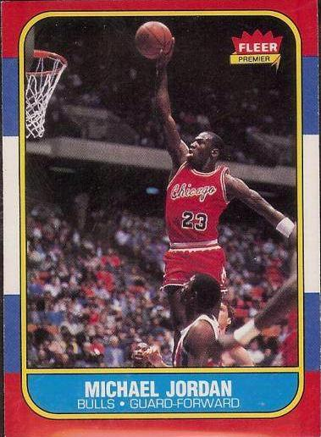
Determinants…PETT PIGSS
Expectations- if producers expect that the future price of their product will increase, they will limit supplies being sold now.
If they expect future prices to decrease they will increase supply for now.

Slide 9
Determinants…PETT PIGSS
Taxes - taxes have the same impact as an increase in the cost of inputs (decreasing supply)
Firms will produce less when they have to pay more taxes (supply decrease)

Slide 11
Determinants…PETT PIGSS
Technology- new technology almost always increases supply unless something goes very wrong with it

Slide 12
Determinants…PETT PIGSS
Prices of Related Goods
A change in the price of one good can bring a change in the supply of another good.
A substitute in production is a good that can be produced in place of another good.
For example, a truck and an SUV are substitutes in production in an auto factory.
The supply of a good increases if the price of one of its substitutes in production falls.
The supply a good decreases if the price of one of its substitutes in production rises.

Slide 13
Determinants…PETT PIGSS
A complement in production is a good that is produced along with another good.
For example, cream is a complement in production of skim milk in a dairy.
The supply of a good increases if the price of one of its complements in production rises.
The supply a good decreases if the price of one of its complements in production falls.

Slide 14
Determinants…PETT PIGSS
Cost of Inputs- if the price of the items used to make the goods increases, supply would decrease (shift left).
If the cost of an input or resource decreases, supply will increase

Slide 15
Determinants…PETT PIGSS
Government Regulations- tighter government regulations decrease supply, looser government regulations increase supply (ex: air bags in cars are now required, this is an increased cost causing a decrease in supply)

Slide 16
Determinants…PETT PIGSS
Subsidies- government payments used to protect an industry, they have the opposite effect of taxes (increasing supply).
Government offers subsidy to auto industry if they make more fuel efficient vehicles.

Slide 17
Determinants…PETT PIGSS
Number of Sellers- when more suppliers enter a market supply increases, when sellers leave the market, supply decreases.

Slide 18
Quantity Supplied v. Supply
Change in Quantity Supplied Versus Change in Supply
A change in quantity supplied is a change in the quantity of a good that suppliers plan to sell that results from a change in the price of the good.
A change in supply is a change in the amount that suppliers plan to produce/sell when any influence on selling plans changes (other than price.) – I.e., the determinants

Slide 19
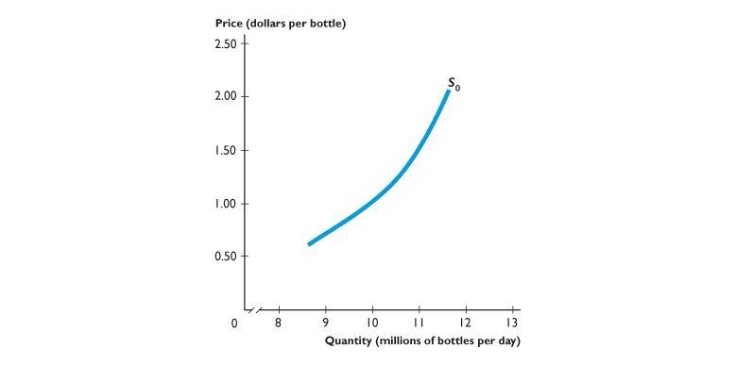
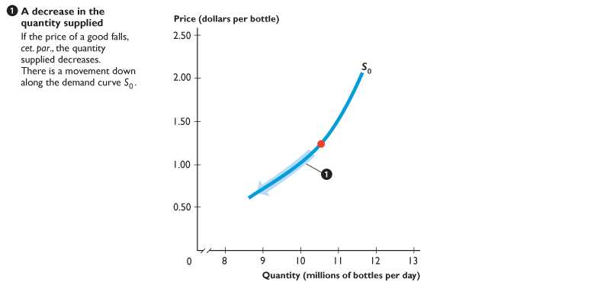
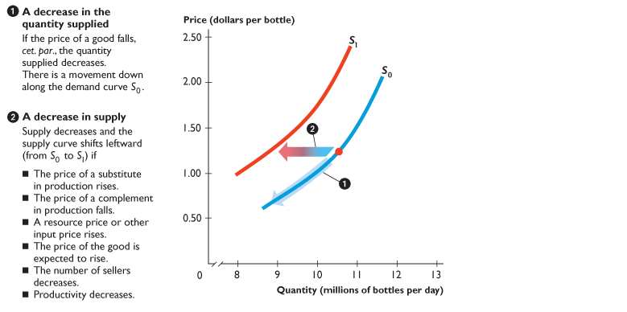
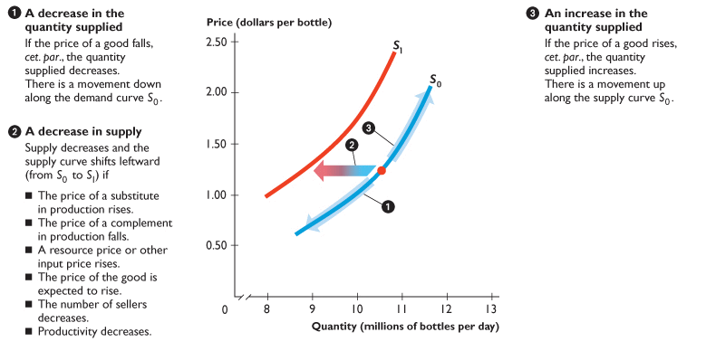
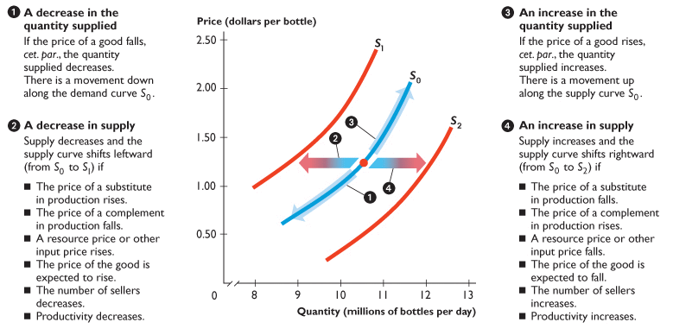
4.2 SUPPLY
Figure 4.8 illustrates and summarizes the distinction

