Slide 1

Welcome!
Ms. Mis'shaylanqua smith
Conley Elementary
K-5 Math interventions
Lcta site leader
4th grade math/science
Professional learning advocate

Slide 2
A Little about me
Teaching Experience
19 years in education
  2 at Havana Middle School
  8 at Havana Elementary School
  9 at Conley Elementary
  I have taught
  Grades K-6th except 1st
  Math, reading, science, writing, and social studies
  Interim EDEP manager
  21st Century Coordinator
  Summer school and after school tutoring
  Two time- Glenn Howell Distinguished Teacher of the Year
  Teacher of the Year multiple times
  Gadsden County Rookie Teacher of the Year
  Math Interventionist for 2 years

Slide 3
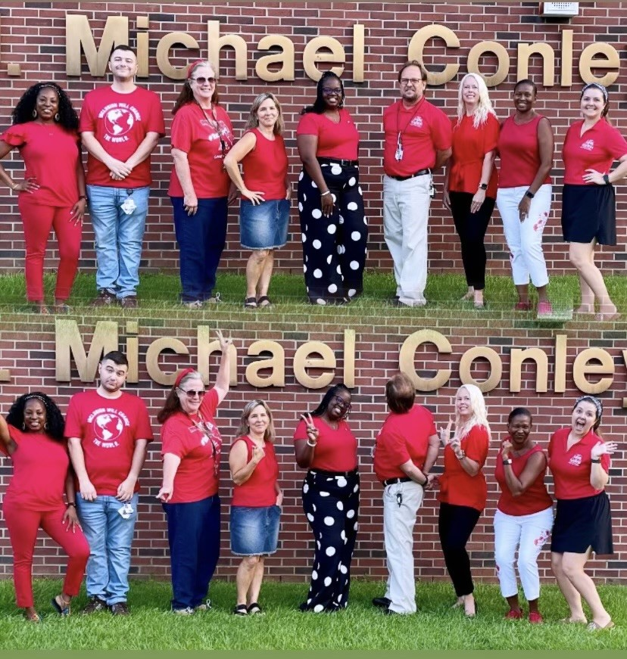
LCTA Site Leader

Slide 4
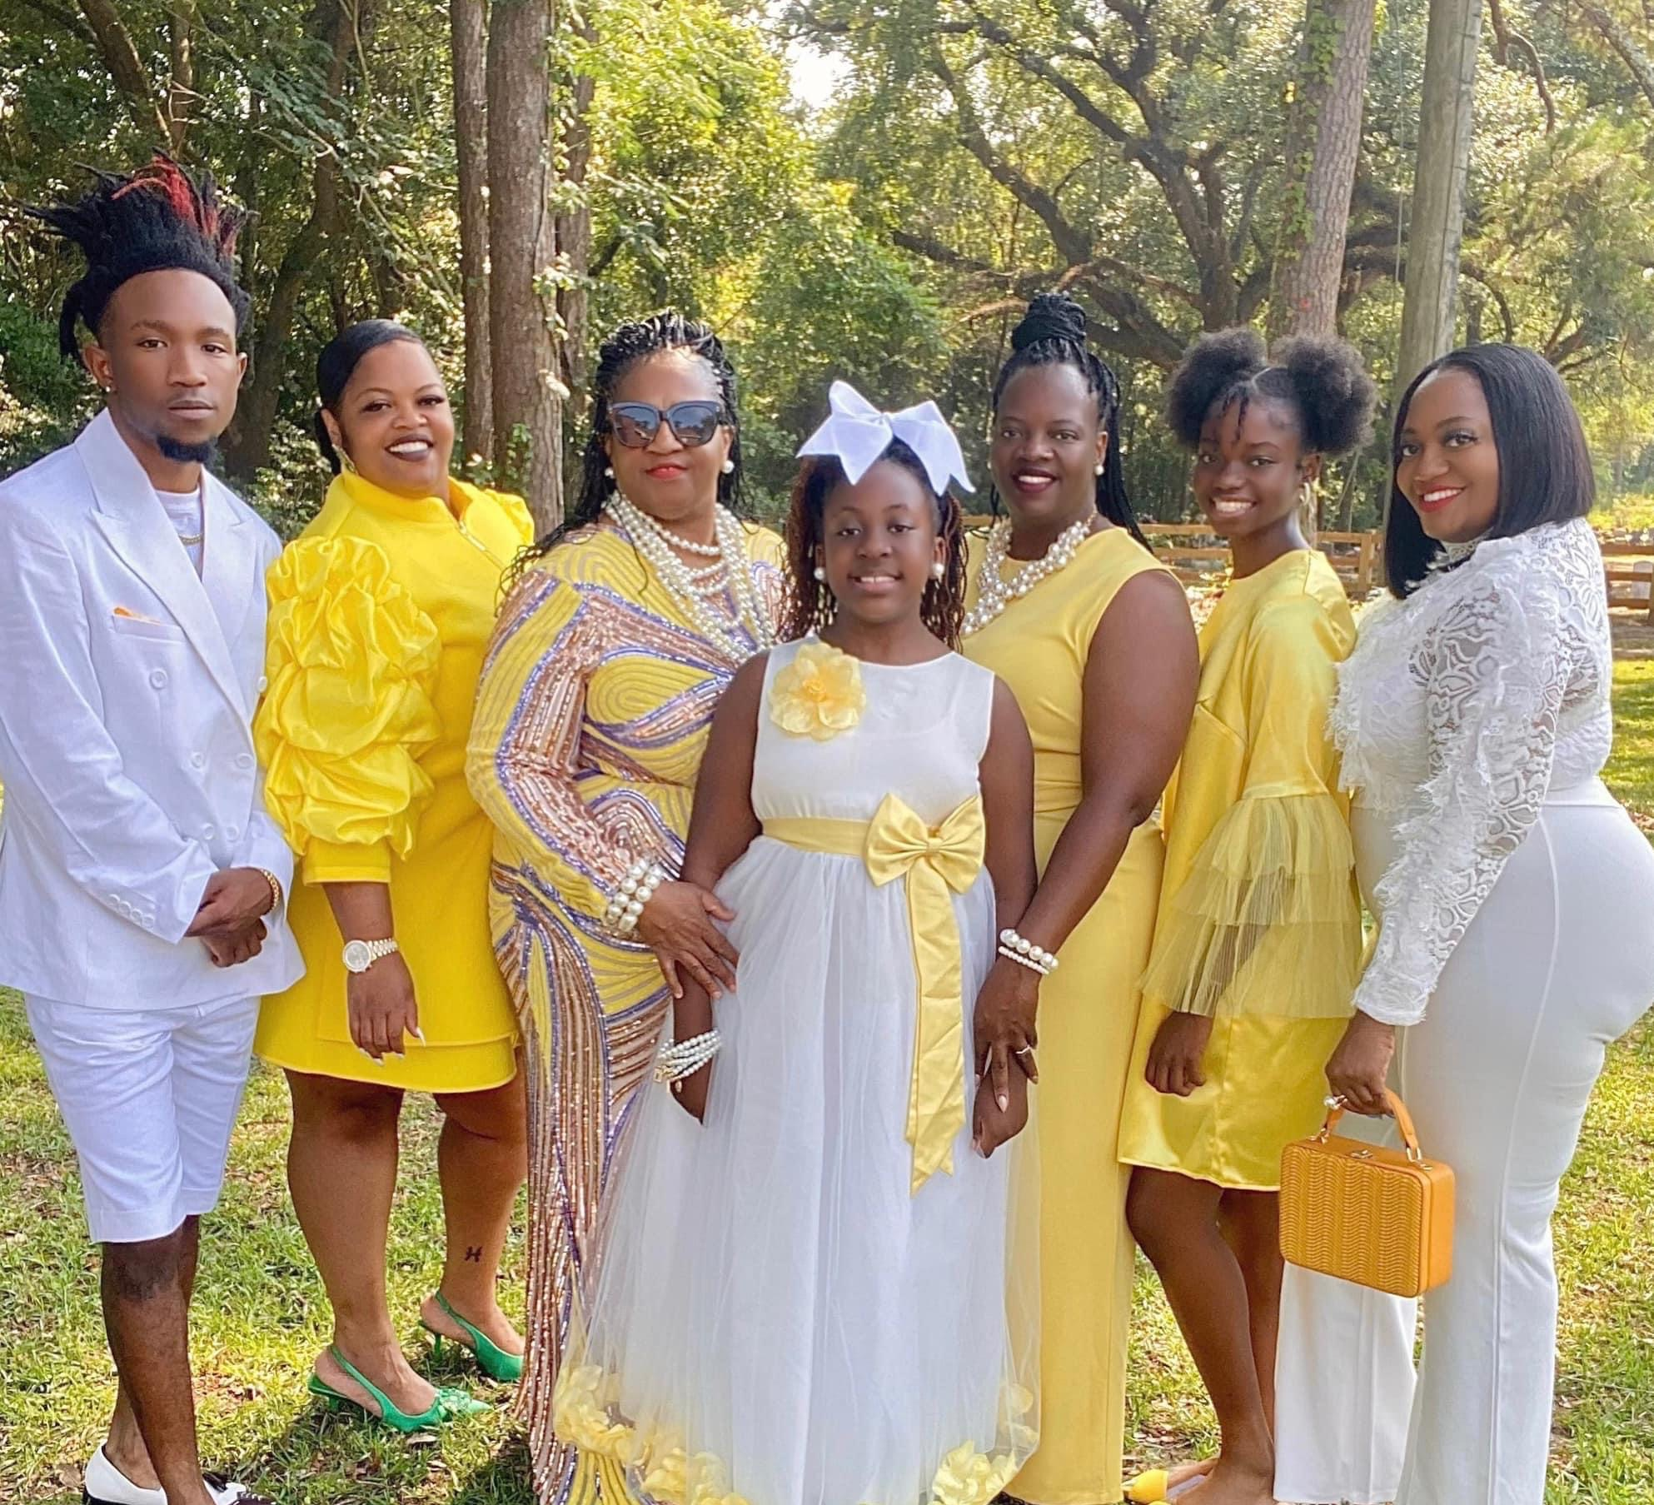
Family
I have a close-knot family including my mother and 3 siblings, 2 sisters and a brother. Mother of 2 daughters, Journi and Kassidi

Slide 5
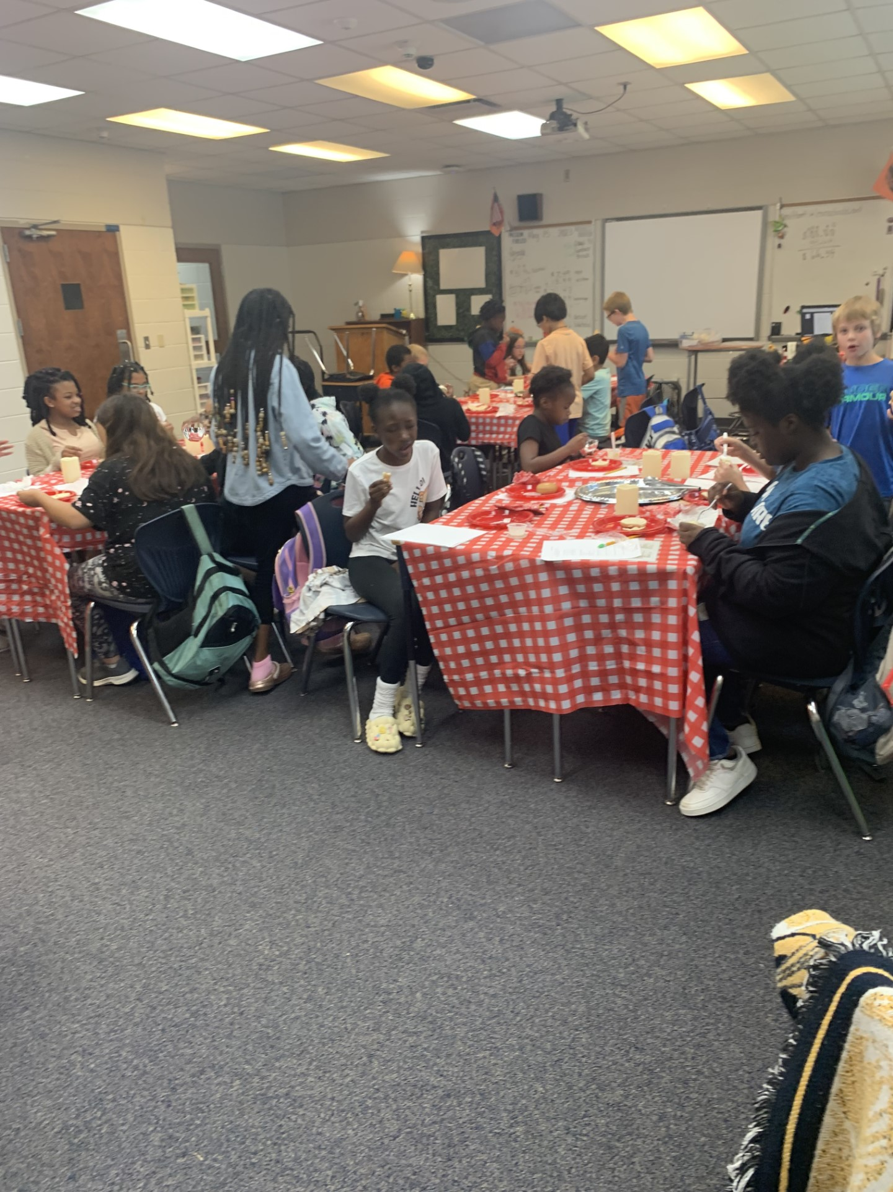
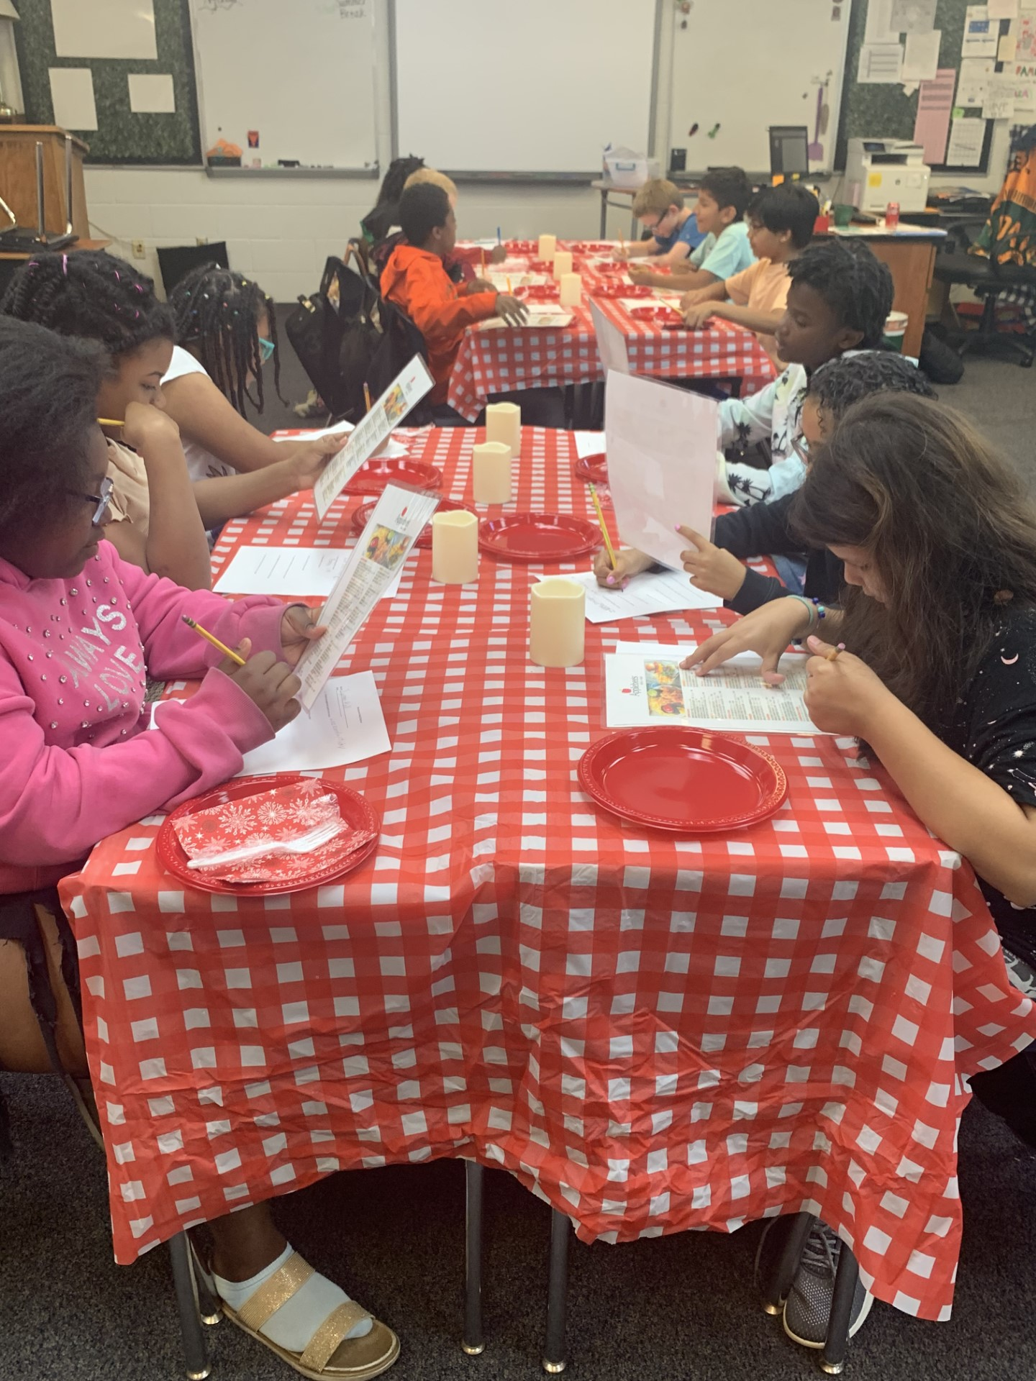
Real World Math

Slide 6
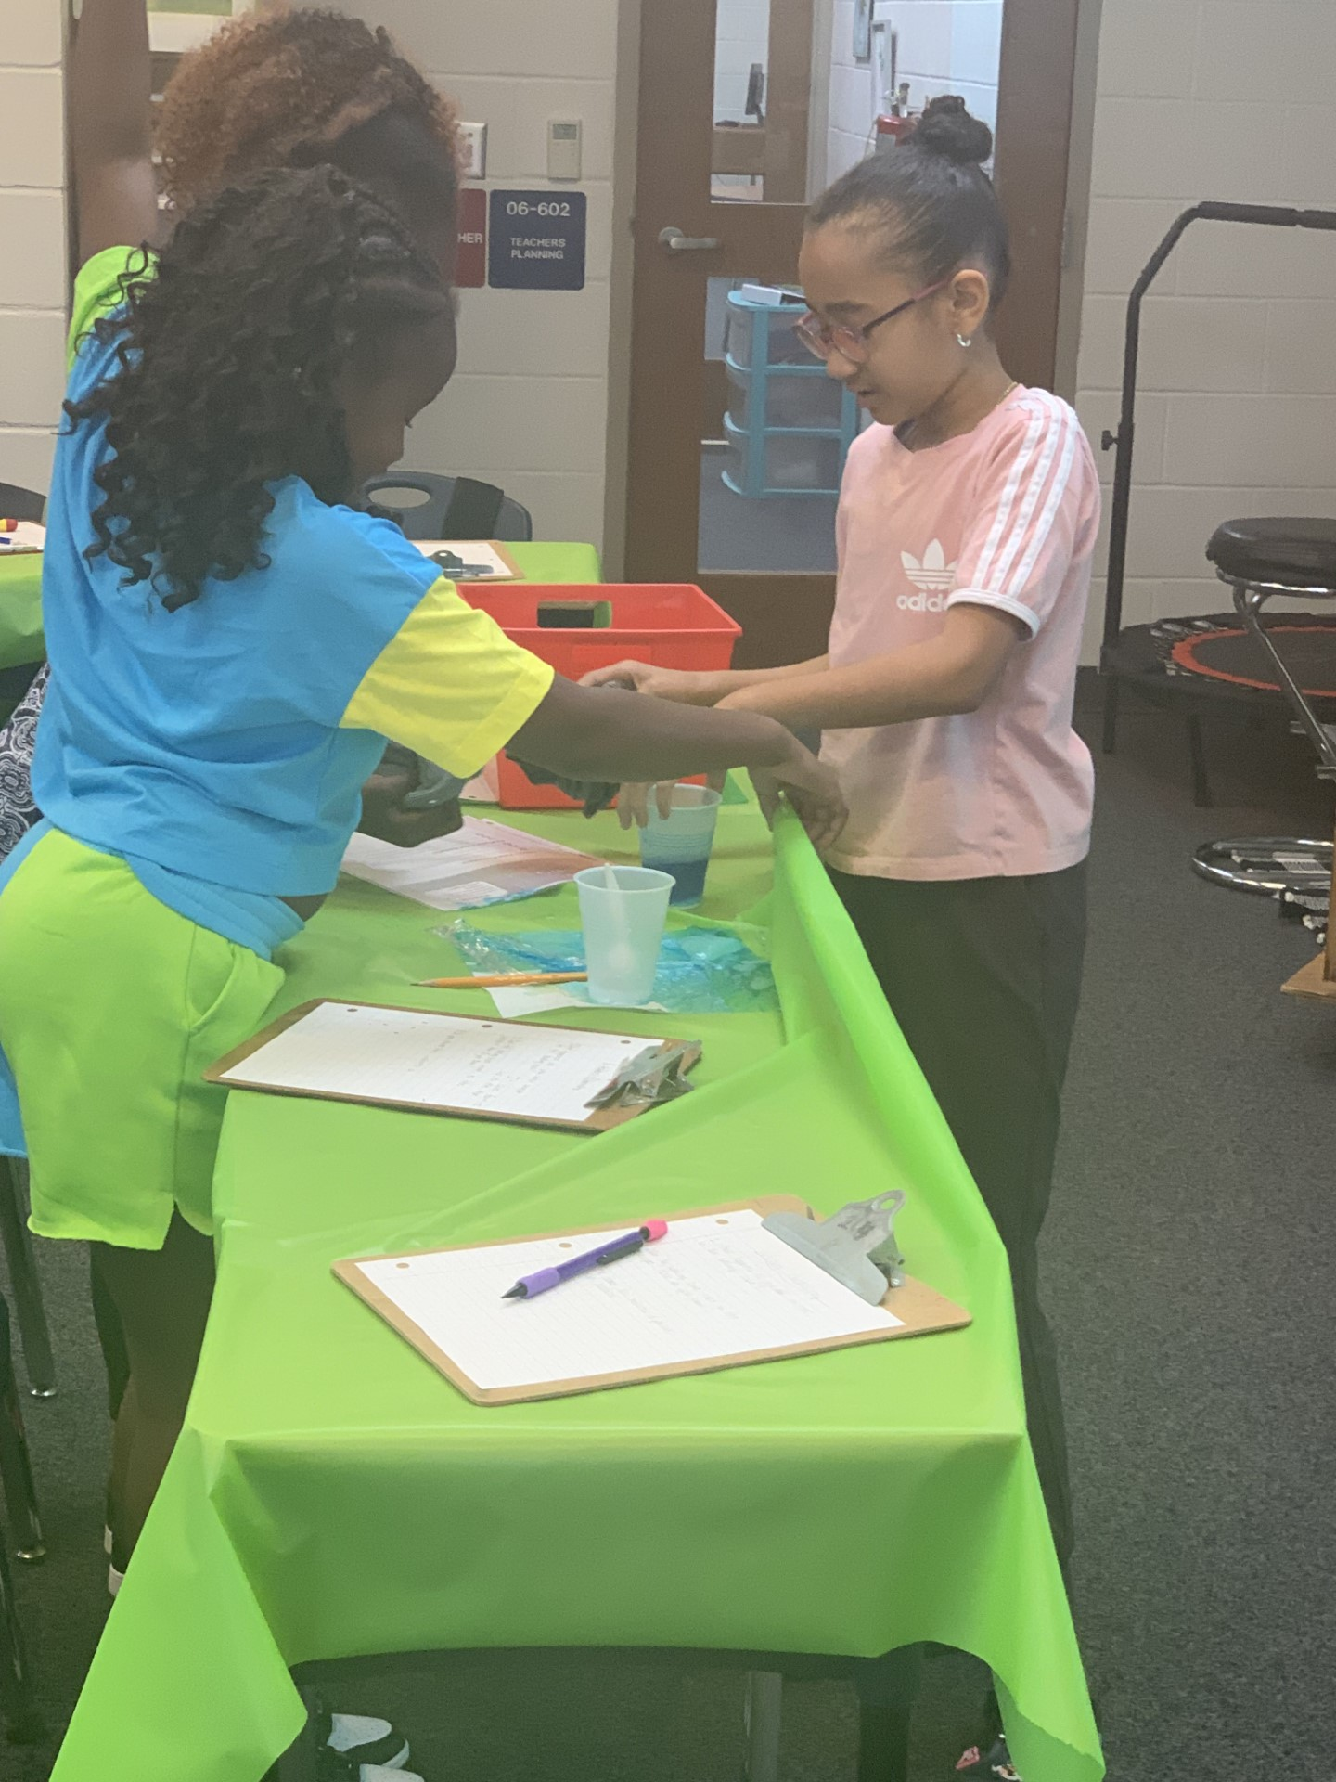
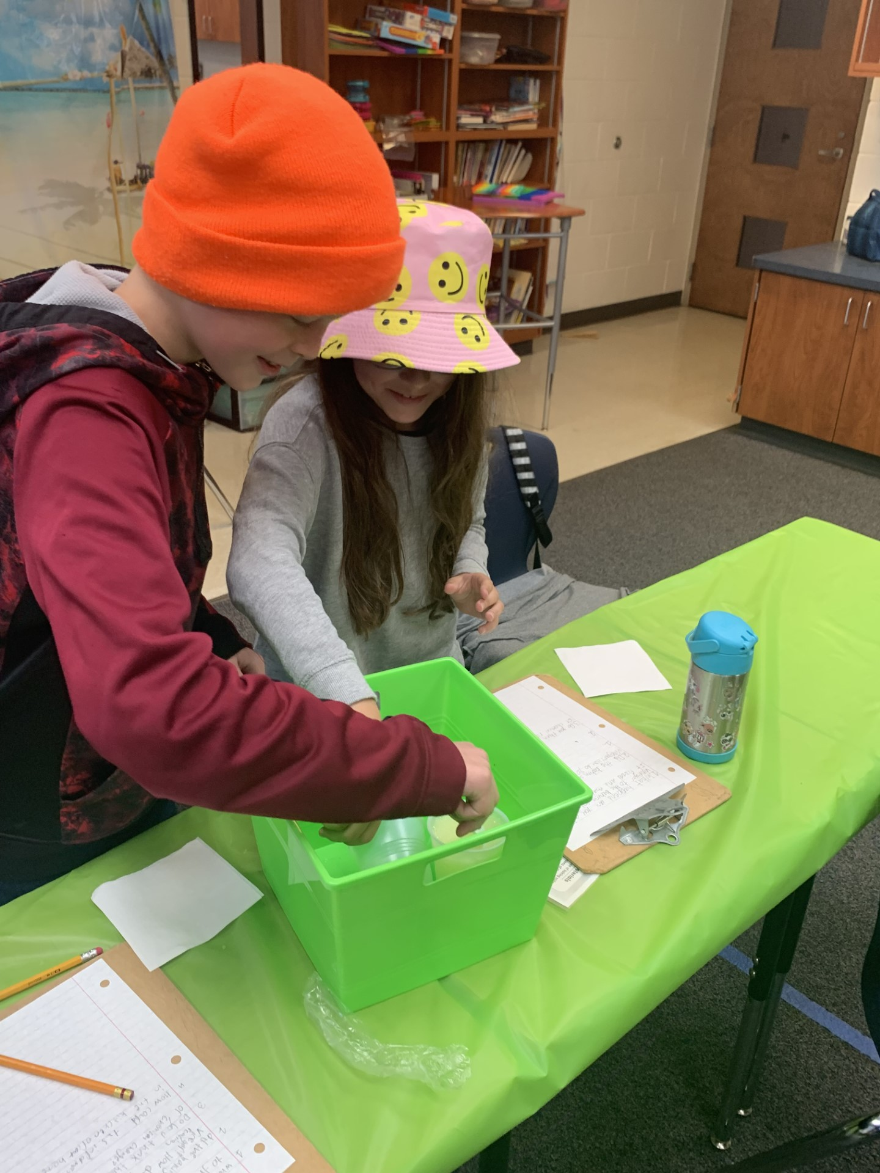
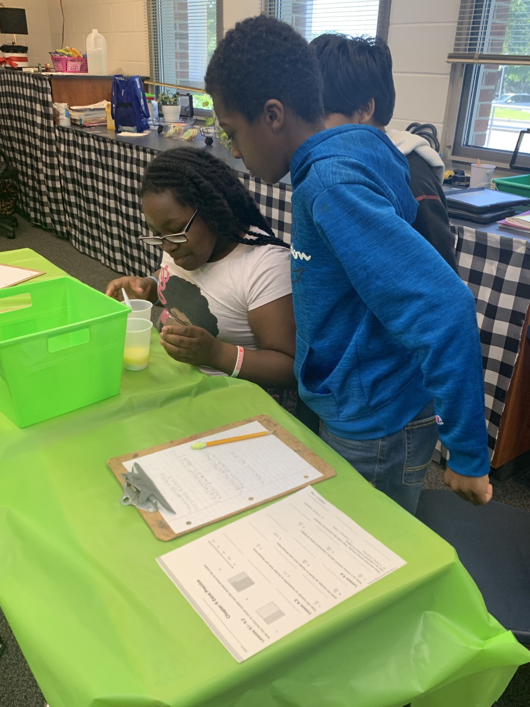
Real World Science

Slide 7
Grading-Math & Science
Assessments 50%
Classwork 30%
Quizzes 20%
Homework 0% ; shows in Gradebook for accountability

Slide 8

Graded Work
Goes home the day of or after it shows in the gradebook. Students are instructed to place the graded work in the back pocket of their planner.
Work with check marks or smiley faces is guided instruction or completion-only.

Slide 9
Homework
Students are instructed to write their homework in their planners along with upcoming dates for activities, tests, quizzes, and special area.
Homework is due the day after it is assigned unless notified in the planner.
In the gradebook you will see a checkmark if it was completed and turned in and a blank if not.
We review all homework if the students have questions or get a problem incorrect.

Slide 10
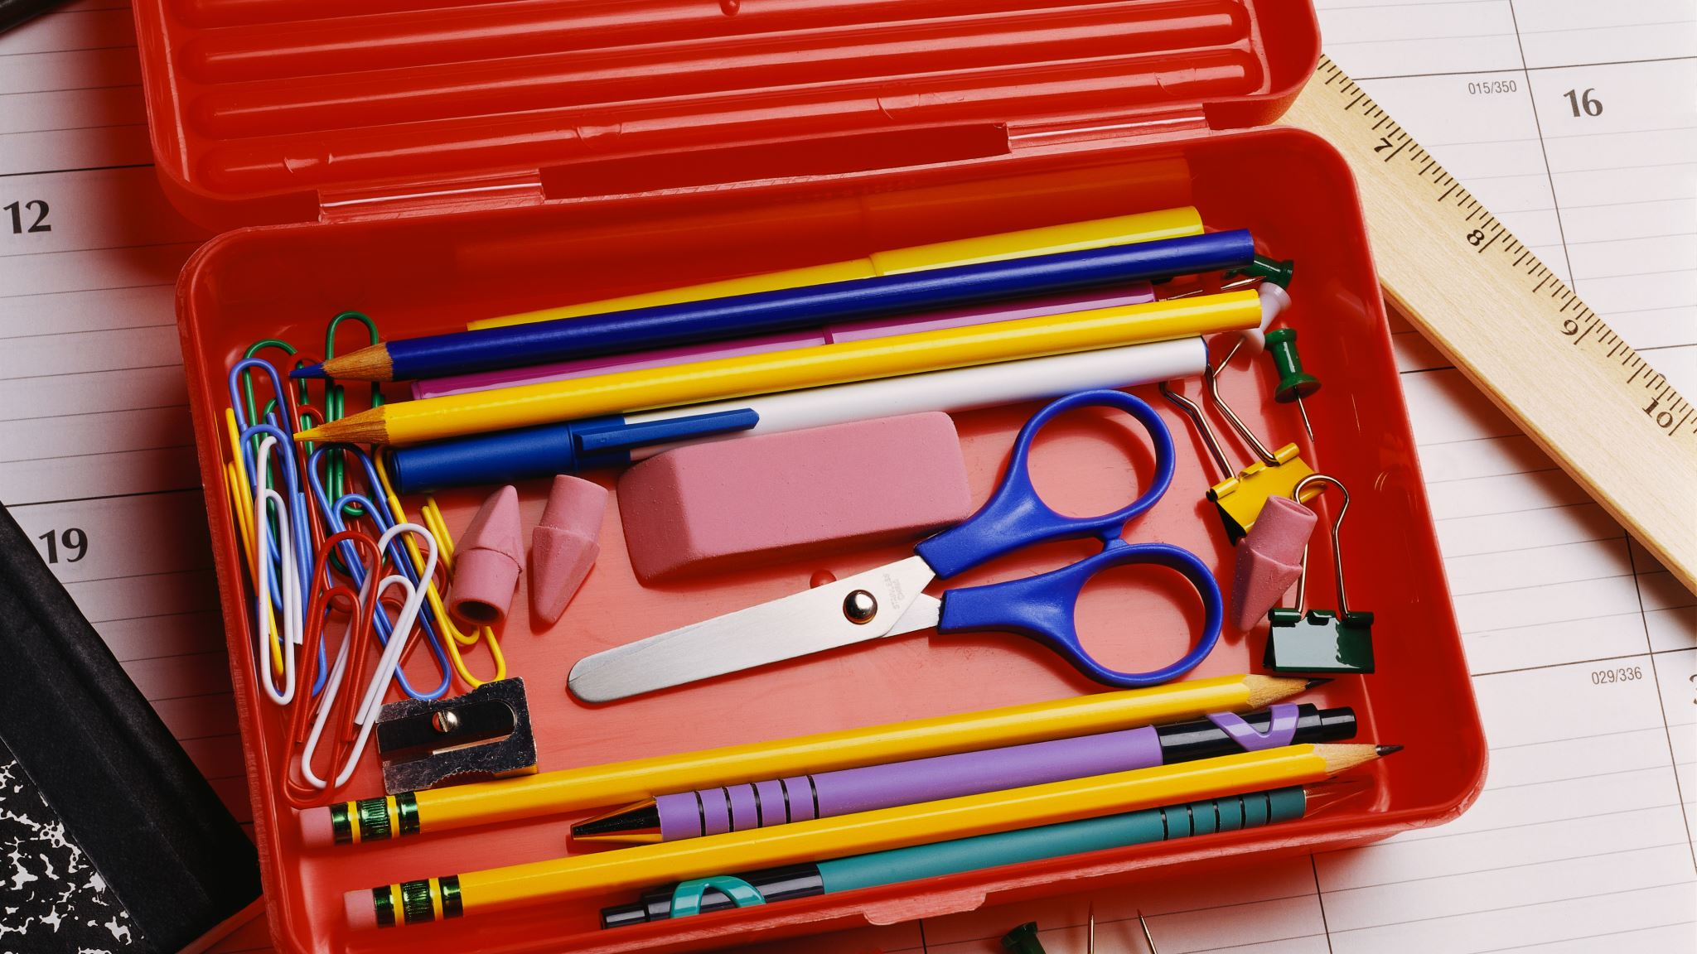
Make Up Work
Make up work will be placed in the student's classwork folder. They are expected to complete the assignment and turn it in. Each class has a drawer to place completed work. IF the assignment is digital the student MUST email me to say it was completed.
(Students will be taught how to email)

Slide 11
Classroom Expectations
Be respectful
Participate
Students are responsible for having supplies such as pencils, headphones, planners,1-composition notebook, binders, and math/science journal.

Slide 12
Teacher Contact
Teacher Website https://www.leonschools.net/Domain/6656
Email- smithm4@leonschools.net
Phone: (850)414-5610
Planning Time 1:55-2:30

Slide 13

Wish List
Headphones
Individual and boxes of facial tissue
Hand sanitizer
Disinfectant Wipes
Disinfectant Spray
Baby Wipes

