Slide 1
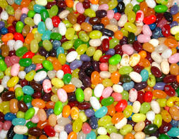
Bully B.E.A.N.S

Slide 2
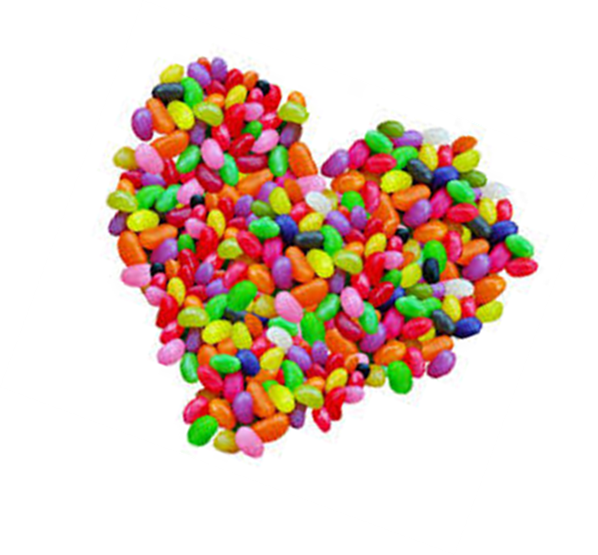
What do you think the story is about?
Let’s take a little preview!

Slide 3
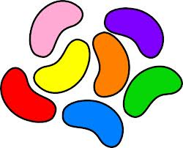
Definition of Bullying
Bullying is
intentional
aggressive
behavior.

Slide 4
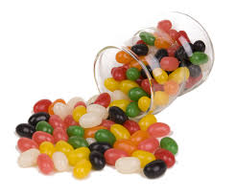
There are two components that make bullying unique:
An Imbalance of Power
Repetition

Slide 5
Types of Bullying
Verbal
Bullying
Using words to hurt
Making fun of
Calling names
Teasing
Making threats
Intimidation
Taunting
Cyber-bullying
Relationship
Bullying
Using friends to hurt
Emotional/Social bullying
Using power over friends
Making others feel inferior
Pressuring others
Exclusion= leaving out
Spreading rumors/gossip
Embarrassing others in public
Physical
Bullying
Using body to hurt
Physically fighting
Hitting, pushing, shoving, elbowing, kicking, biting, tripping, flicking, poking
Spitting
Making gestures
Taking or breaking others things
Can’t forget about
Cyber-bullying!

Slide 6
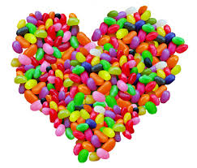
How can we prevent bullying?
Be nice to everyone
Treat others with respect
Be a good role model for others
Listen
Include others
Say polite things
Don’t spread rumors
Share with others
Think about others feelings
Understand everyone is different
Join together against a bully
Be strong and assertive
Tell an adult
Share your feelings with others
Be nice to bullies
Ignore the act of bullying
Stand up for others
Use humor
Be cyber safe
Be proactive

