Slide 1
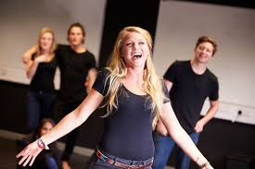
Welcome to Chiles Department of Theatre Arts
Ms. Shannon O’Bryan
Director of Theatre Arts
obryans@leonschools.net
ChilesTheatre.com

Slide 2
What theatre classes teach…
Oral communication
Written communication
Group problem solving
Confidence
Aesthetic Awareness
Goal-setting
How to connect content from other classes
How to have fun while working really hard!

Slide 3
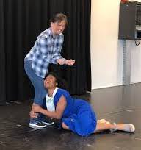
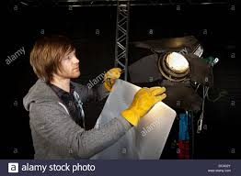
Beginning Classes in Theatre
Theatre 1
Introduction to Technical Theatre Design and Production
Costume and Makeup Design and Production
For all 9-12th grade students
All meet required fine arts credit

Slide 4
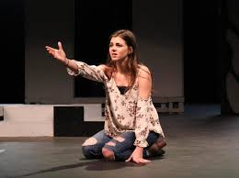
Theatre 1
Theatre 1 is a Beginning Acting Class.
The content generally includes:
1 – What is Theatre?
2 – Physical Acting/Pantomime
3 – Vocal Acting
4 – Improvisation
5 – Blocking/Stage Movement
6 – Reading a Play
7 – Realistic Acting – Monologue and Scenework
8 – Theatre History – Primitive to Elizabethan
9 – Shakespearean Acting

Slide 5
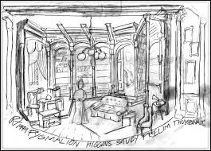
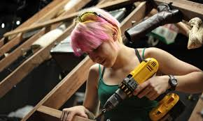
Technical Theatre Design & Production 1
Tech 1 is an introduction to the tools, design, and construction methods for scenery, lights, props and sound including:
1 - Theatre spaces and equipment technology
2 - Theatre safety
3 - Historical, cultural, and societal influences on design
4 - Analysis of dramatic literature to create theatrical reality
5 - Technical theatre skills for scenery, lighting, props and sound for the theatre
6 - Technical theatre design for scenery, lighting, props and sound for the theatre
8 - Theatre arts personnel and careers

Slide 6
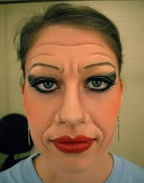
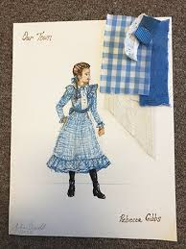
Costume & Makeup 1
Costume & Makeup 1 is an introduction to the tools, design and construction methods used to create costumes and makeup for the stage. The content generally includes:
1 – History of Fashion and Makeup
2 – Theatre arts personnel and careers
3 – Text analysis of dramatic literature to develop design
4 – Rendering techniques and figure drawing
5 – Costume construction techniques
6 – Makeup application techniques
7 – Costume and makeup design process
8 – Costume props research, design, and creation
9 – Presentation techniques

Slide 7
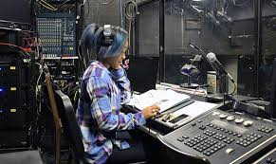
Advanced Theatre Classes
All Beginning Theatre Classes have four levels:
Theatre 2, Theatre 3 (Honors), Theatre 4 (Honors)
Tech Theatre 2, Tech Theatre 3, Tech Theatre 4 (Honors)
Costume 2, Costume 3, Costume 4 (Honors)
In addition, advanced students may choose to take the classes below in their junior or senior year instead of the level 3 or 4 class:
Stage Management and Direction 1
Stage Management and Direction 2 (Honors)

Slide 8
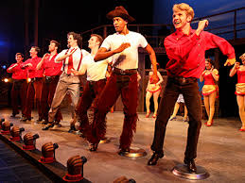
Musical Theatre 7th Period Class
Chiles offers Musical Theatre class as a part of the after-school academy. These classes are team taught by the theatre and chorus teachers. The content usually includes:
Audition techniques
How to read musical theatre music
Singing techniques
Dance techniques
Characterization techniques
History of Musical Theatre
Practical experience signing, dancing and acting
Performance experience in a musical revue

Slide 9
International Thespian Society
Chiles is a member of the International Thespian Society Troupe 6039. This is the Theatre Honor Society.
Students enrolled in a theatre class are eligible to prepare performances and designs to be adjudicated at District and State Festivals
Chiles will audition early in the school year for new troupe members to become a part of the team which will prepare for acting, musical theatre and design pieces. Chiles will also audition for a one-act every two years.
Go to FloridaThespians.com for more information about Thespians in Florida, or EDTA.org for information about ITS

Slide 10
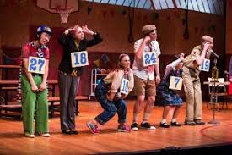
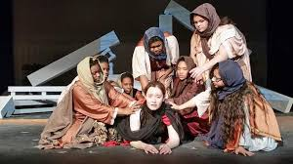
Extra-Curricular Theatre Experiences
All Chiles students may audition or apply to be a part of the technical crew for the Fall play and Spring Musical.
Technical Theatre and Costume students will spend some of their class time working on school productions
Students in Theatre 2, 3 and 4 classes will also perform in one-act plays as a part of their curriculum

Slide 11
Thank you for your interest in the Chiles Theatre program!
If you still have questions please contact me!
Ms. Shannon O’Bryan
Director of Theatre Arts
obryans@leonschools.net
ChilesTheatre.com

