Slide 1
Unit 4 Week 3: Around the World
April 13-April 17
Second Grade

Slide 2
Essential Question: How are kids around the world different?
Games
Food
Traditions
School

Slide 3
Vocabulary
Common:
Define: something that is common to a group of people is shared by all of them.
Example: Tag is a common game that children like.
Costume:
Define: A costume is clothing you wear to look like something or someone else.
Example: Each actor in the play wore a colorful costume.
Customs:
Define: If a group of people has a custom, they have something they do over and over again.
Example: A turkey dinner and a family gathering are Thanksgiving customs.
Favorite:
Define: Your favorite thing is something you like the best.
Example: Autumn is our favorite season, because we like cool weather best.

Slide 4
Vocabulary
Parades:
Define: Parades are large groups of people, including bands, moving through a public place for a special event.
Example: Our school band marches in town parades.
Surrounded:
Define: If something is surrounded by something else, the first thing is closed in on all sides by the second thing.
Example: We were surrounded by flowers.
Travels:
Define: If someone travels to a place, he or she makes a trip there.
Example: The car travels along the road.
Wonder:
Define: If you wonder about something, you think about it because you are curious about it.
Example: I wonder when it will stop raining.

Slide 5
Spelling Words
Port
North
More
Store
Oar
Roar
Board
Part
Start
Park
First
Hurt
Ago
Carry
People

Slide 6
Phonics Skill r-Controlled Vowels or, ore, oar and ar
R-Controlled Vowels
Or, ore, oar
AR
The letters or, ore, and oar can make the same sound.
You can hear the sound in the words
Short
Chore
Soar
The letters ar can stand for the sound you hear in the word arm or jar.

Slide 7
Irregular Verbs
Some verbs do not add –ed to form the past tense.
Ex. ) run→ ran
These verbs are called irregular verbs.
The verbs go and do have special forms in the past tense:
I, he, she, it, we, you, they go → went
I, he, she, it, we, you, they do → did
The irregular verbs see, say, and tell have special forms in the past tense.
We saw the movie last night.
Mom said, “That was a great movie.
They told us it was a funny movie.

Slide 8
Irregular Plural Nouns
Some nouns in their plural form change their spelling rather than adding –s or -es.
Examples:
Mouse → Mice
Child → Children
Tooth → Teeth
Man → Men
Goose → Geese
Foot → Feet

Slide 9
Compare & Contrast Key Details
Compare: when you compare something, you are telling how they are similar or alike.
Comparing words:
Like, both, similar, also, too, same, as
Contrast: When you contrast something you are telling how they are different.
Contrasting words:
But, although, differ, unlike, on the other hand, in contrast
Example:
Compare and contrast winter and summer.
Winter and summer both are seasons. They also have big holidays during their seasons. In contrast, winter is a cold season where people play in the snow for fun. Unlike summer, where the weather is hot, and people go to the beach for fun.

Slide 10
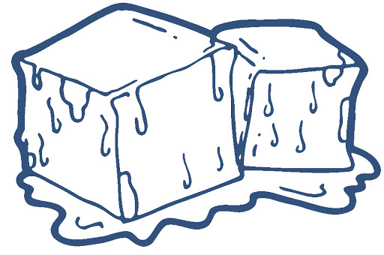
Similes
A simile compares two unlike things. It uses the word like or as to make the comparison.
Examples:
Her hands were as cold as ice.
You are comparing someone’s hands and ice.
That pillow is as soft as a rabbit.
You are comparing a pillow and a rabbit.
He is a good swimmer. He swims like a shark.
You are comparing a boy and a shark.
She runs like a cheetah.
You are comparing a girl and a cheetah.

