Slide 1
Monday
May 4th 2020
Ms.Reshard’s Class

Slide 2
Today’s Office Hours:
10:00 am - 11:00 am
4:00 pm - 5:00pm

Slide 3
Today’s live zoom sessions
11:30 - 12:00 pm
6:30 - 7:00 pm

Slide 4
THis week’s Learning Goals
Reading
Math
Science
Social studies
I can describe the connection between two events, individuals, ideas, or pieces of information in a story using sequencing and compare/contrast.
I can combine 3-dimensional shapes to create a new shape (composite shape) and build new shapes from composite shapes.
can build and draw shapes that have specific defining attributes.
I can sort and determine different bodies of water and describe water safety rules.
I can describe a community and how they are important.

Slide 5
Patience
Patience is being able to wait calmly without getting upset or angry.

Slide 6
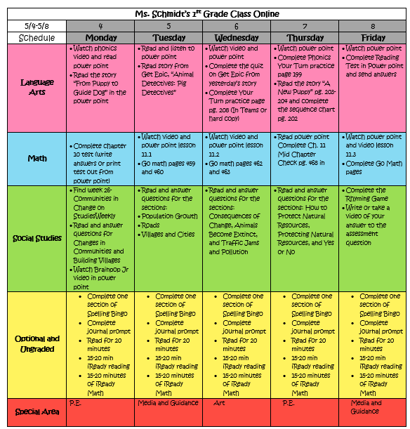
Weekly Calendar

Slide 7
Daily Affirmations
I can be anything I want to be.
I am an important person in this world.
I can dream dreams and make them come true.
Every new day is a chance to improve.
I can learn from my mistakes.
I can take risks and do hard things.
I can learn from others and they can learn from me.
I can make smart choices.
I control the good that happens to me.
I am kind. I am respectful. I am loved.

Slide 8
Reading

Slide 9
REading to do list
1.
3.
4.
Review Focus Slide
2..
Watch Weekly Opener
Complete Phonics Video Lesson
Watch and Listen to the story From Puppy to Guide Dog

Slide 10
THis week’s skills
comprehension
phonics
Structural analysis
grammar
Essential question
Sequence
Long e:
Y, ey
Compound words
Adverbs that tell when
How do people work with animals?

Slide 11
Unit 4 week 5 weekly opener

Slide 12
Unit 4 week 5 phonics lesson

Slide 13
Unit 4 week 5 spelling words
Key
Bumpy
Puppy
Funny
Penny
Sandy
My
Night
Wash
Would
Found
Hard
Near
Woman
Write

Slide 14
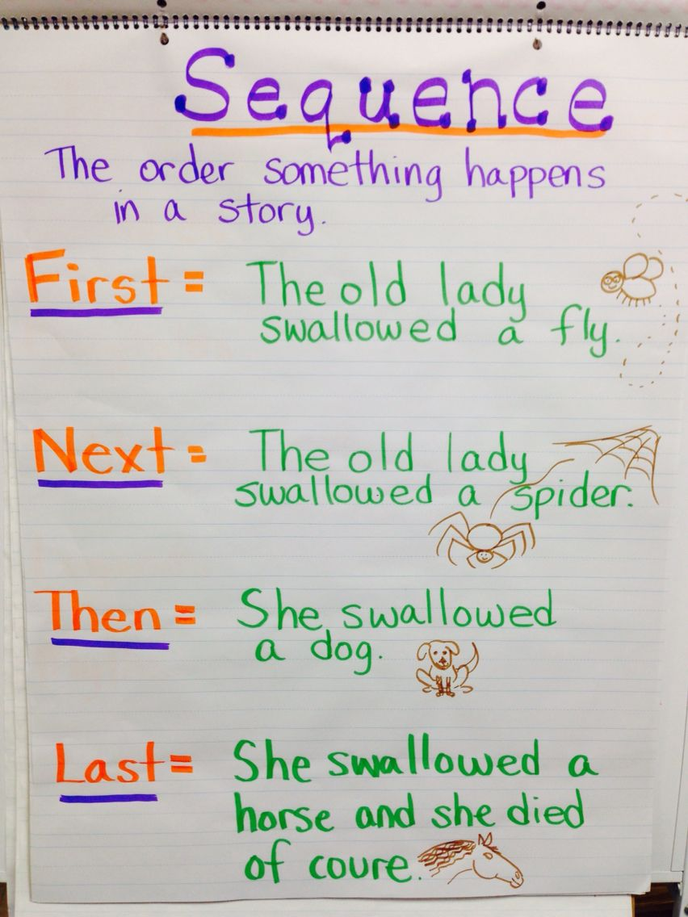
Sequencing

Slide 15
Listen and read Puppy to guide dog with me
The next slides are pictures of the story Puppty to guide dog. As a you get to each slide click play and follow along as I read the story a loud and ask questions.
After you read the whole story with me, go back and read the story on your own.
Then fill out the graphic organizer at the end.

Slide 16
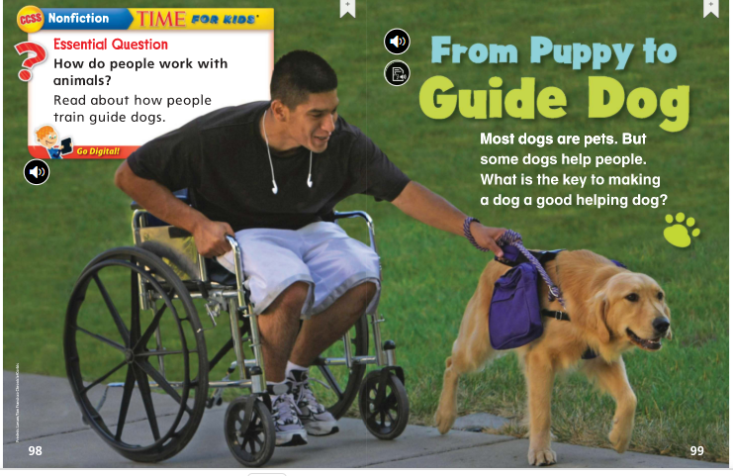
Puppy to guide dog

Slide 17
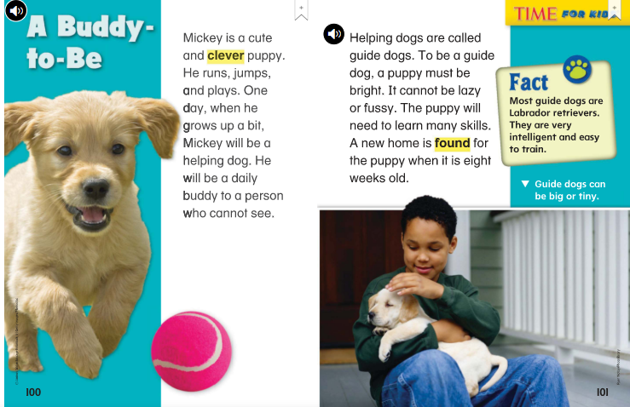

Slide 22
Brain break
Get up and move! Give your brain and your body a break!

Slide 23
mATH

Slide 24
math to do list
1.
Complete Chapter 10 Test
* You can write your answer on a sheet of paper or print it out.

Slide 25
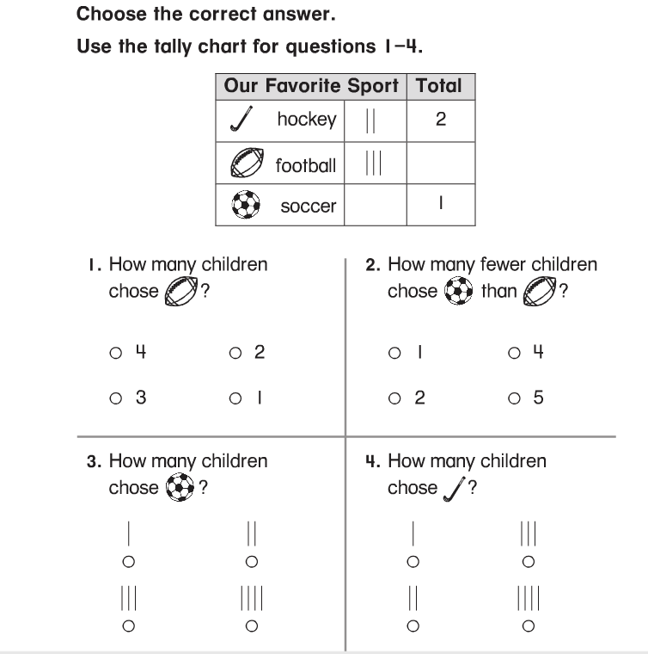
Chapter 10 Test

Slide 26
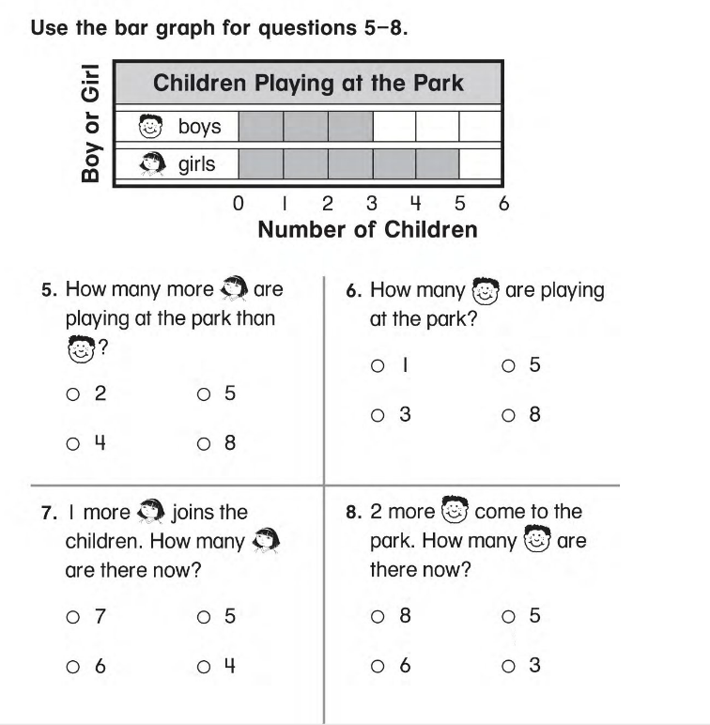

Slide 27
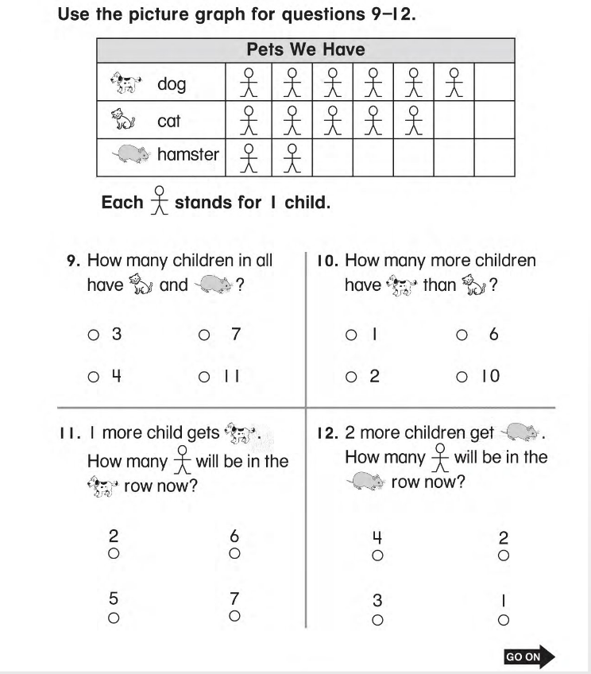

Slide 28
YOU’RE ALMOST DONE!
Make sure you go back and check your work

Slide 29
Social Studies

Slide 30
Social studies to do list
Complete Week 26 on Social Studies Weekly
Communities in change
Building Villages
1.

Slide 31
Login to social studies weekly: https://app.studiesweekly.com/online/
Click on Week 26
Read and answer the questions for the first two tabs
*can also access the pages in the following slides *

Slide 32
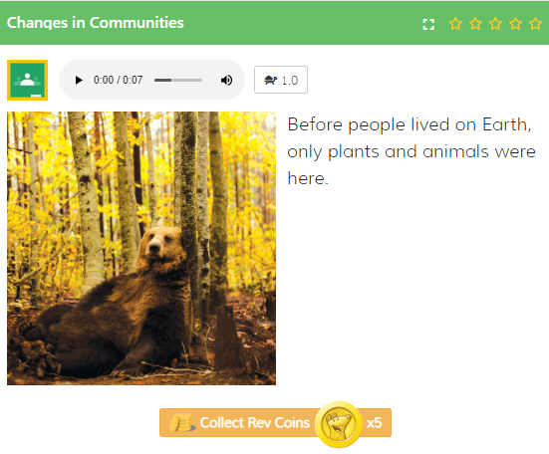

Slide 33
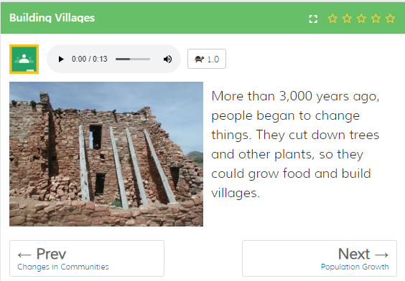

Slide 34
TURN THESE THINGS INTO MS. RESHARD
Math Test
You can turn this in my sending the picture through remind or uploading to Microsoft Teams.

Slide 35
More practice These things are optional

Slide 36
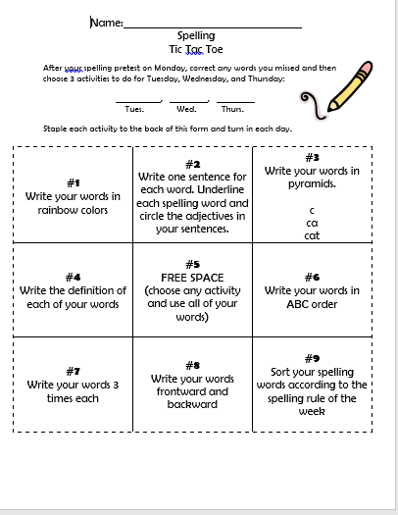
Spelling tic tac toe:
Pick one activity to complete! Pick a different one to complete every day of the week.

Slide 37
Getting ready for your daily journal:
Writing checklist
Copy the sentence and fill in the blanks, then add one sentence all on your own!
Check your punctuation and capitalization.
Check your spelling.
Make sure you use finger spaces.
Draw a picture about your writing.

Slide 38
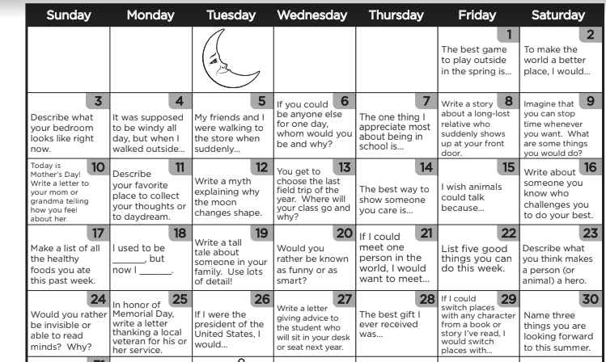
Writing prompt
What is your favorite animal and why?

Slide 39
YOU’RE ALMOST DONE!
COmplete 20 minutes of iready math and reading
Complete 20 minutes of independent reading

Slide 40
You're finished!

