Slide 1
How to use OneNote

Slide 2
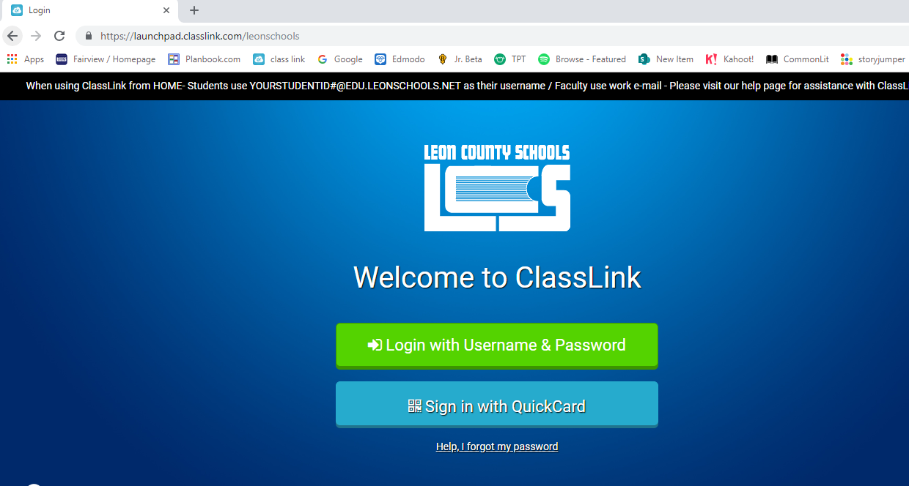
First thing is to log into your classlink

Slide 3
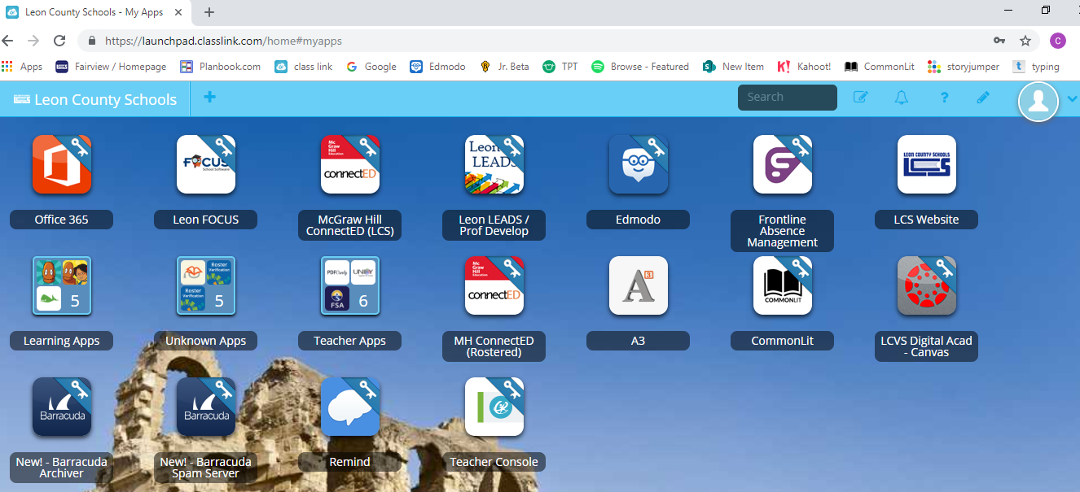
Next click on Office 365 (this is how you will be able to always access onenote AND your e-mail)

Slide 4
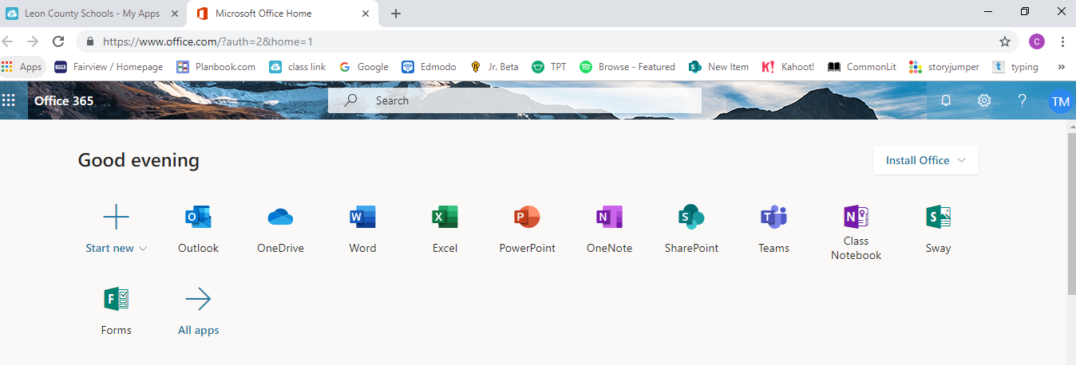
Once in office 365 click on OneNote

Slide 5
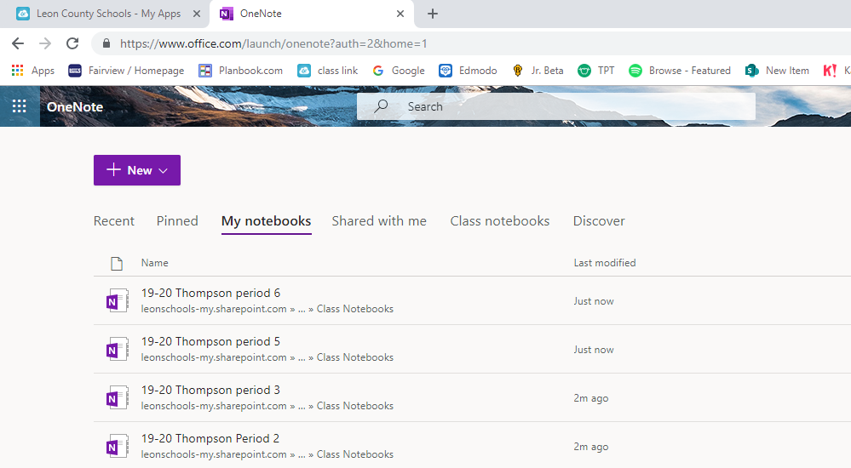
You will then click on shared with me (this should only need to be done the first time- next time it will be under recent)

Slide 6
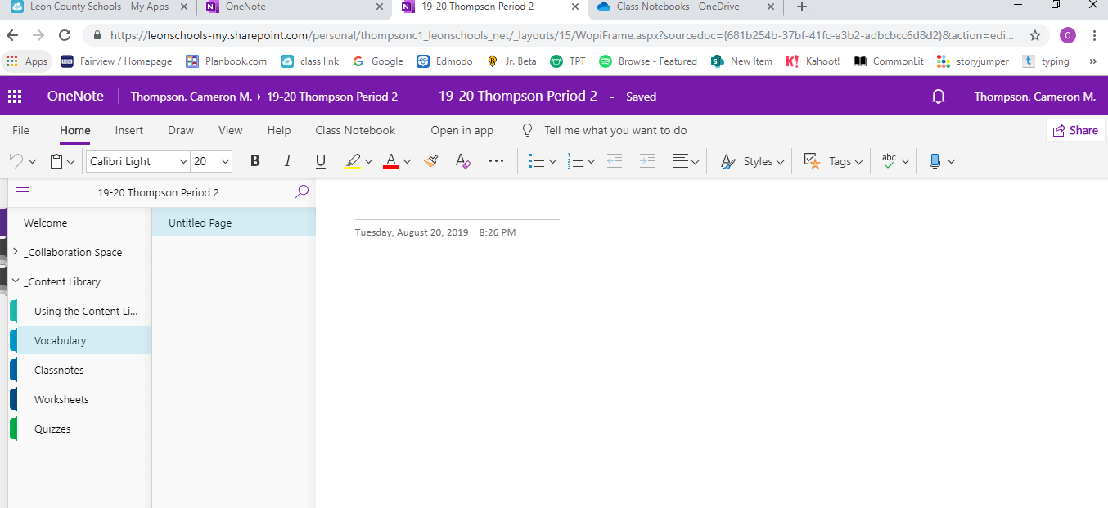
This is what your OneNote will look like. You will see your name on the left side with different “tabs”

Slide 7
How to complete assignments
First click on the appropriate tab and go to the assignment on the right.

Slide 8
Tips:
Everything you type is saved automatically
There is an “undo” button to use if you ever accidentally delete something.
IF YOU GET A STRANGE MESSAGE AT THE TOP THAT TELLS YOU TO CLICK ON SOMETHING OR STATES THAT YOUR WORK IS NOT SAVING…DO NOT CLICK ON IT! It will make your page un-editable.
If you are ever unsure if it is saving properly, you can always copy and paste your work into a Word document juuuuuuust in case… (but this rarely occurs)
If it’s not letting you edit the page, click on “edit in browser” in the top right hand corner.

