Slide 1
Quoting Poetry
How To
And
How NOT To

Slide 2
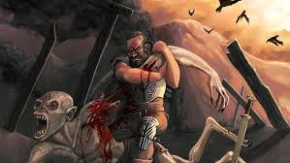
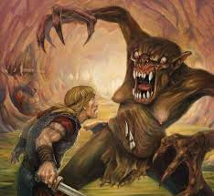
Beowulf

Slide 3
You want to integrate each of your quotes into one of your own sentences. Don’t let a quote stand by itself (ORPHANED), sandwiched between two of your own sentences, like this:
All of the men that came with him grew tired and faithless, except a certain group of men. “The Geats stayed, sat sadly, watching / Imagining they saw their lord” (1603-1604). This shows that the comitatus is strong and that the men will leave no one behind.

Slide 4
You’ve got to lead into that sentence! Here’s a possible revision:
All of the men that came with him grew tired and faithless, except the Geats, who “stayed, sat watching / Imagining they saw their lord” (1603-1604). This group’s dedication shows that the comitatus is strong and that the men will leave no one behind.

Slide 5
The trick is, your entire sentence—including the quote—still must follow basic grammatical rules and must read like a real sentence. Don’t create a run-on/comma splice by sticking a quote on the end of an already complete sentence:
No! When Beowulf finally defeats the monster he is lavished with gifts “Beowulf had been honored by both gifts / Hrothgar could have given him, horses and weapons” (1042-1045).
No! Hrothgar gave away treasure to share, “No ring-giver has given four such gifts” (1027).

Slide 6
Notice how the following writers incorporate their quotes into their own sentences, without disrupting the flow of the sentence:
YES! Grendel is one of the “murderous creatures banished / By God, punished forever for the crime / Of Abel’s death” (106-108).
YES! Unfortunately, Grendel had “bewitched the men’s weapons” so that they could not harm him during the battle (803).
YES! However, before Beowulf fights the dragon, he declares, “And this dragon’s treasure, his gold / And everything hidden in the tower, will be mine” (2535-2536).

Slide 7
YES! Although as a boy Beowulf grew to be a mighty warrior, “As a boy he was scorned; / The Geats considered him worthless” (2183-84).
YES! The narrator also describes Beowulf as he walks into the fight: “And the Geats’ ring-giver did not boast of glorious / Victories in other wars” (2583-2584).

Slide 8
YES! When Beowulf was fighting the dragon and needed help, “none of his comrades / Came to him, helped him, his brave and noble / Followers; they ran for their lives, fled / Deep in a wood” (2596-99).
YES! One of the first things he does is boast of his strength and vow that “Grendel is no braver, no stronger than I am! I could kill him with my sword; I shall not … I will meet him / With my hands empty” (674-84).

Slide 9
Remember, every specific reference you make to a text doesn’t have to be direct quotation. Paraphrasing is also a great approach—just remember that any paraphrase must be followed by a citation:
YES! Shild changed his own fate from being an abandoned child to being a rich and honored king (7-8).
YES! Also, when Beowulf is telling Wiglaf he will be the next king he says that their race has been swept away by fate (2814).

Slide 10
Final tip -- avoid weak lead-ins like these:
No! It is stated that, “---------.”
No! This can be seen in the quote “-----.”
No! The poem says, “---------.”
No! In lines 560-563 it says, “---------.”

