Slide 1
Juggling Jeopardy!
By Melanie Bynum
Period 5

Slide 2
Balls | Cigar Boxes | Diabolo | Kendama | Yo-Yo
100 | 100 | 100 | 100 | 100
200 | 200 | 200 | 200 | 200
300 | 300 | 300 | 300 | 300
400 | 400 | 400 | 400 | 400

Slide 3
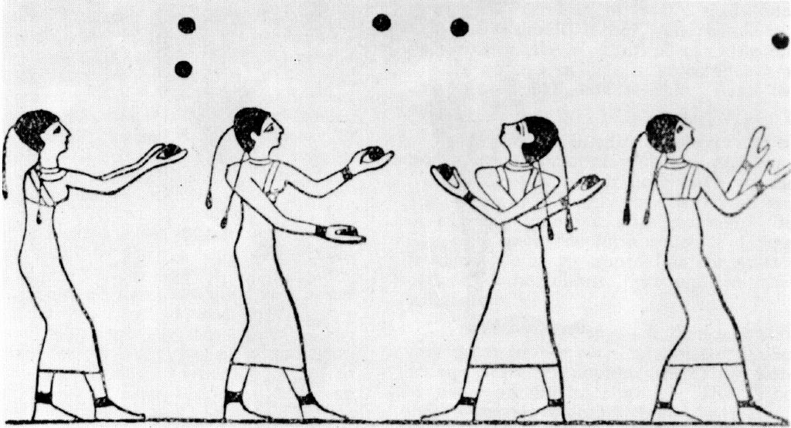
What country has the earliest depiction of ball juggling?
England
Egypt
Japan
China

Slide 4
What country did cigar box juggling originate from?
USA
Canada
England
China

Slide 5
What country is the diabolo said to originate from?
Japan
USA
England
China

Slide 6
What country did the kendama originate from?
China
Japan
Mongolia
India

Slide 7
According to many documentaries, what country is credited with the origin of the yo-yo?
Greece

Slide 8
In what year did someone first accomplish juggling eight balls for the IJA’s numbers endurance competition?
1981
1982
1983
1984

Slide 9
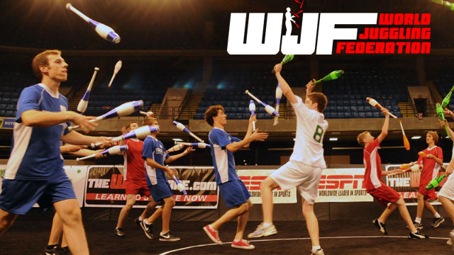
What was the first year that the WJF held the cigar box competition?
2003
2004
2005
2006

Slide 10
What was the first year (according to its website archives) that the Tokyo International Diabolo Competition was held?
2012
2013
2014
2015

Slide 11
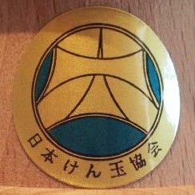
In what year was the first kendama contest held by the Japanese Kendama Association?
1965
1979
1984
1972

Slide 12
What year was the first World Yo-Yo Competition held?
1950
1932
1974
1996

Slide 13
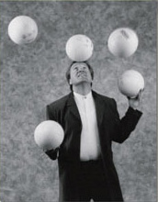
Who was the first person to juggle eight balls in the IJA’s numbers endurance competition?
Anthony Gatto
David Ferman
Dan Bennett
Fritz Grobe

Slide 14
How many competitors were there in the first World Juggling Federation’s cigar box competition?
Two

Slide 15
Who holds the TIDC record for Men’s 1 diabolo around the leg?
Torii Hiromiki
Zhao Zhi Han
Wu Qi Ming
Watanabe Hayato

Slide 16
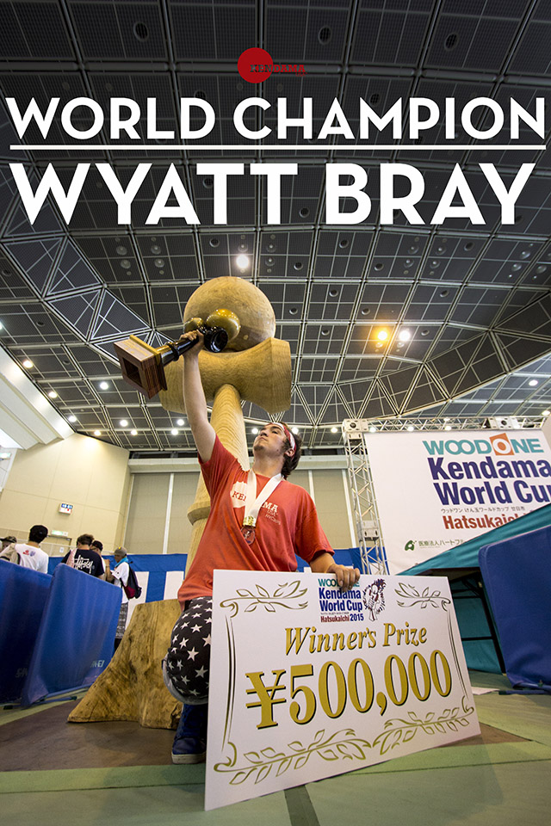
Who won the Kendama World Cup in 2015?
Satoru Kubota
Eric Martin
Ho Cheung Li
Wyatt Bray

Slide 17
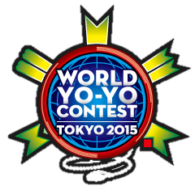
Who won the 2015 World Yo-Yo contest in the 1A Division?
Zach Gormely
Shiji Saito
Hajime Miura
Jake Elliott

Slide 18
What is the world record for three ball endurance juggling?
3 Hours
7 Hours
12 Hours
15 Hours

Slide 19
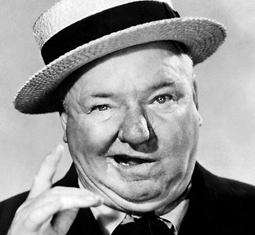
Who is credited with popularizing cigar box juggling?
W. C. Fields
Harriet Hughes
Michael Moschen
Enrico Rastelli

Slide 20
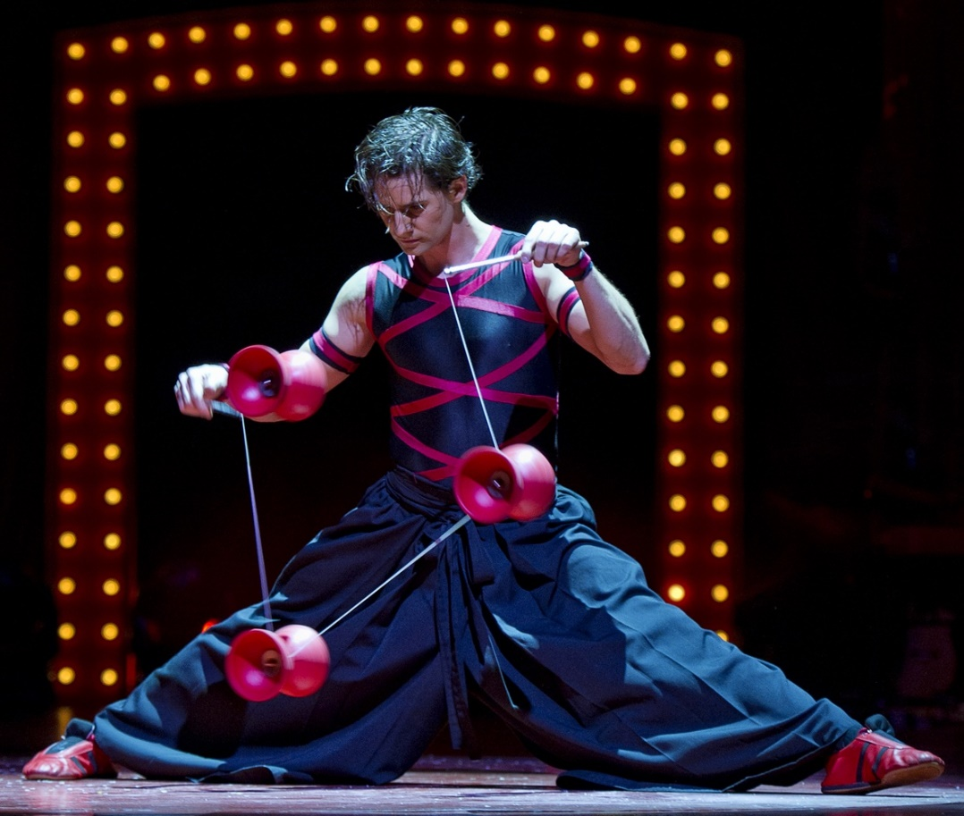
Who was the first person to juggle six diabolos?
Ryo Yabe
Pen Zen
Tony Frebourg
Trevor Nassler

Slide 21
In what century was kendama used as a sort of drinking game in Asia?
17th
18th
19th
20th

Slide 22
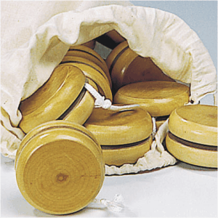
What are yo-yos traditionally made out of?
Wood

