Slide 1
Kendama Final Exam
BY: arlo harden

Slide 2
The Design
The kendama has eight parts that all work together to make a extremely fun prop.
the Ken is the spike and the sarado put together. It functions as the body of the Kendama. The Ken has three cups and the spike. You use the cup to land the tama on as a trick and you can also land the tama on the spike due to the hole in the tama.

Slide 3
The History
The Kendama was invented in France in the 1500’s, though, it is not certain.
its been believed that the Kendama has brought to japan through the silk road.
Primitive Kendamas only had one cup, but it eventually evolved into the three cup and spike Kendama we know today.

Slide 4
Tricks
The Kendama is a very versatile prop and has many kinds and levels of tricks.
The simplest kinds of tricks are done with the cups. The player can change from different cups and do an array of tricks.

Slide 5
Tricks pt 2
The second kind of trick are spike tricks, the tricks involve the tama landing on the spike and there is also a wide range of tricks you can do.

Slide 6
Tricks pt 3
After you learn spike and how to land the cups, the player can put them together and make long combinations of tricks.
These combos can be relatively hard or easy. Any player can do it.

Slide 7
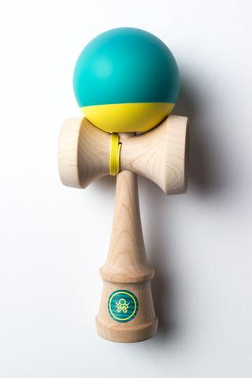
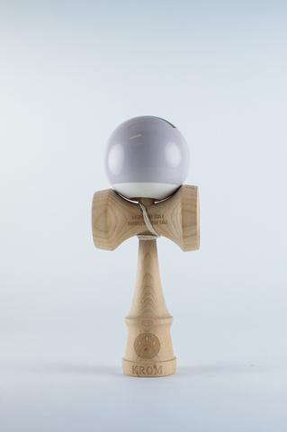
Brands
There are many Kendama manufactures, most of them are good. Two of the best in my opinion are sweets and Kendama USA

Slide 8
Professionals
There are lot of Kendama professionals, all having different styles of playing
Some of the noticeable players are: Jake Wiens, TJ Kolesnik, and Wyatt Bray.

Slide 9
The End
Thankyou!

