Slide 1
Cell Structure and Function

Slide 2
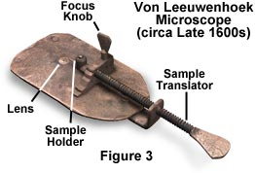
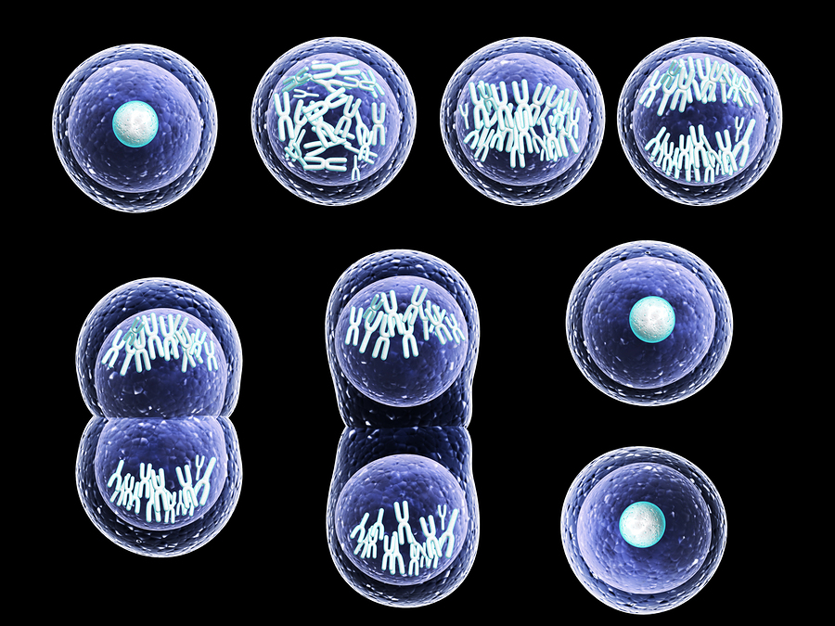
Cell Theory Review
1. All living things are made of cells
2. Cells are the basic units of structure and function in living things
3. New cells are produced from pre-existing cells

Slide 3
Types of Microscopes Compound Light vs. Scanning Electron vs. Transmission Electron

Slide 4
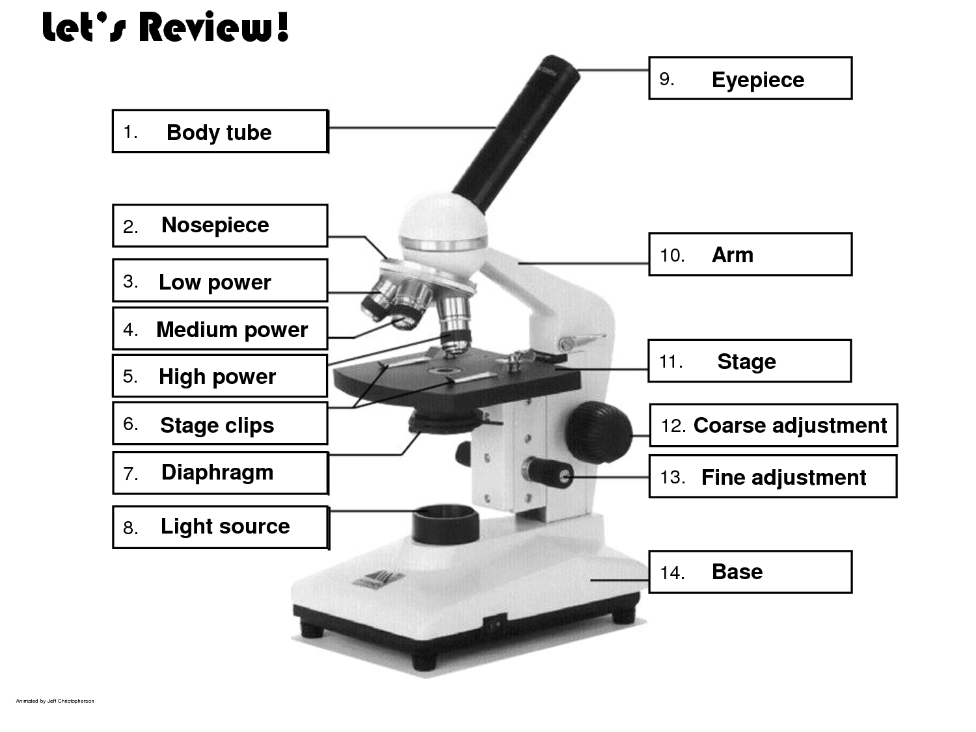
Types of Microscopes Compound Light

Slide 5
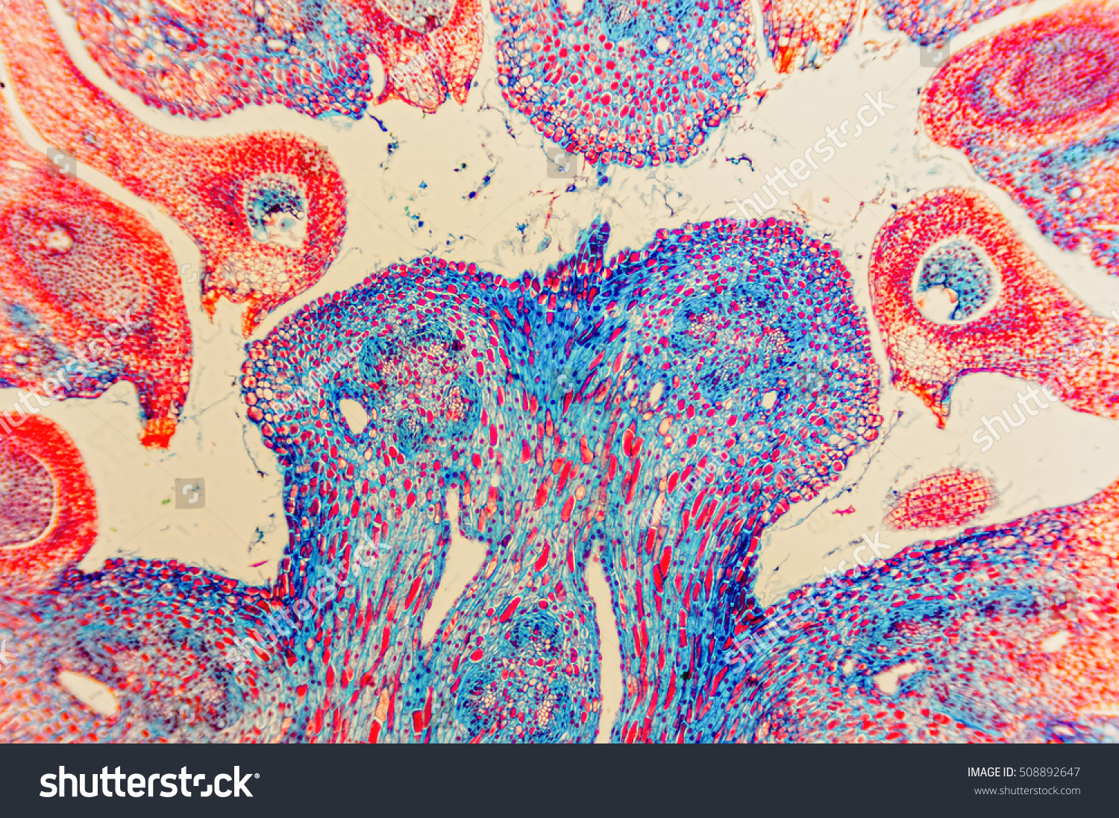
Types of Microscopes Compound Light

Slide 6
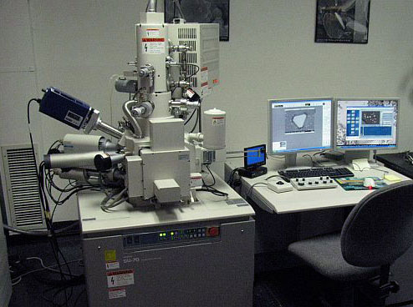
Types of Microscopes Scanning Electron

Slide 7
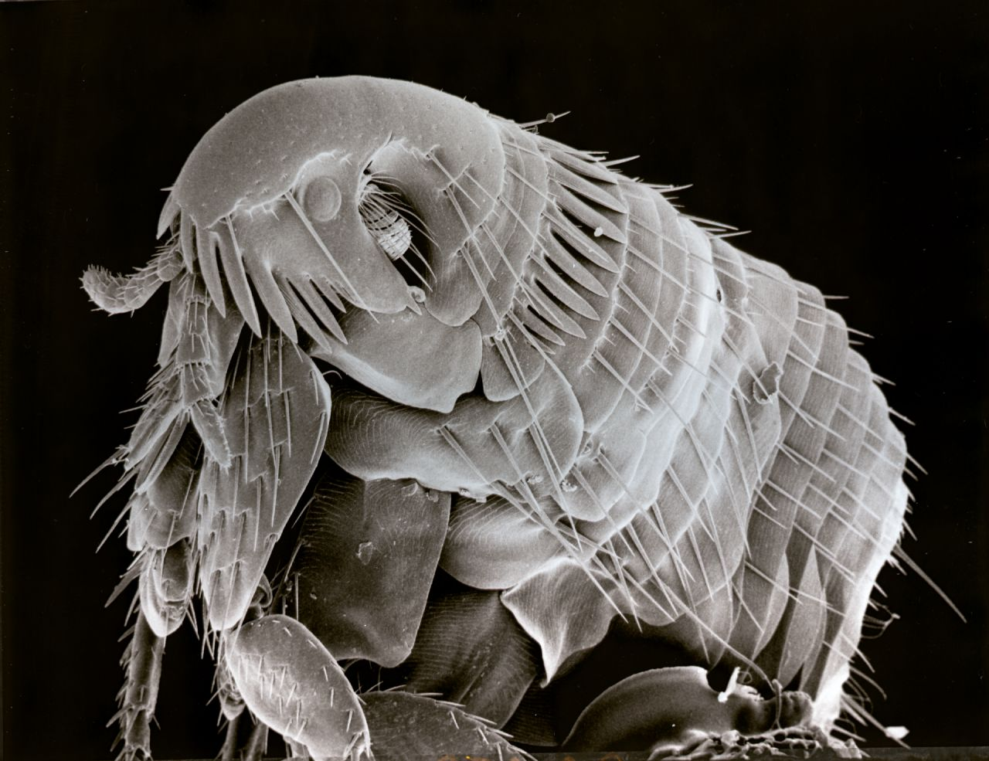
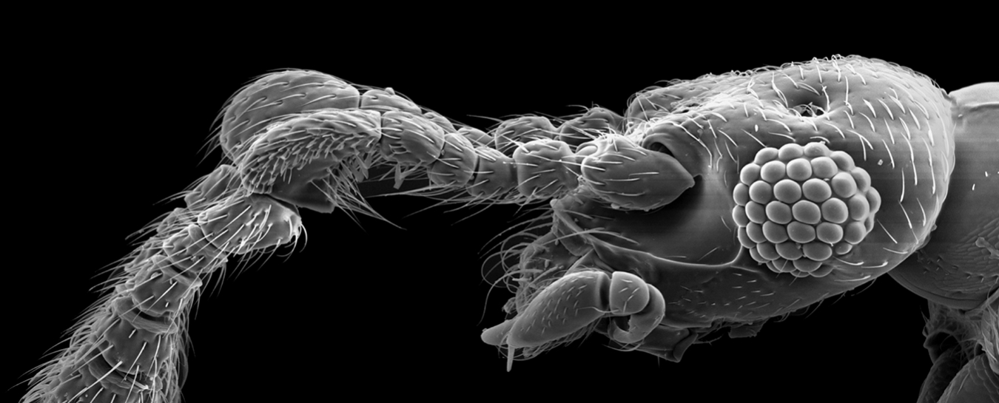
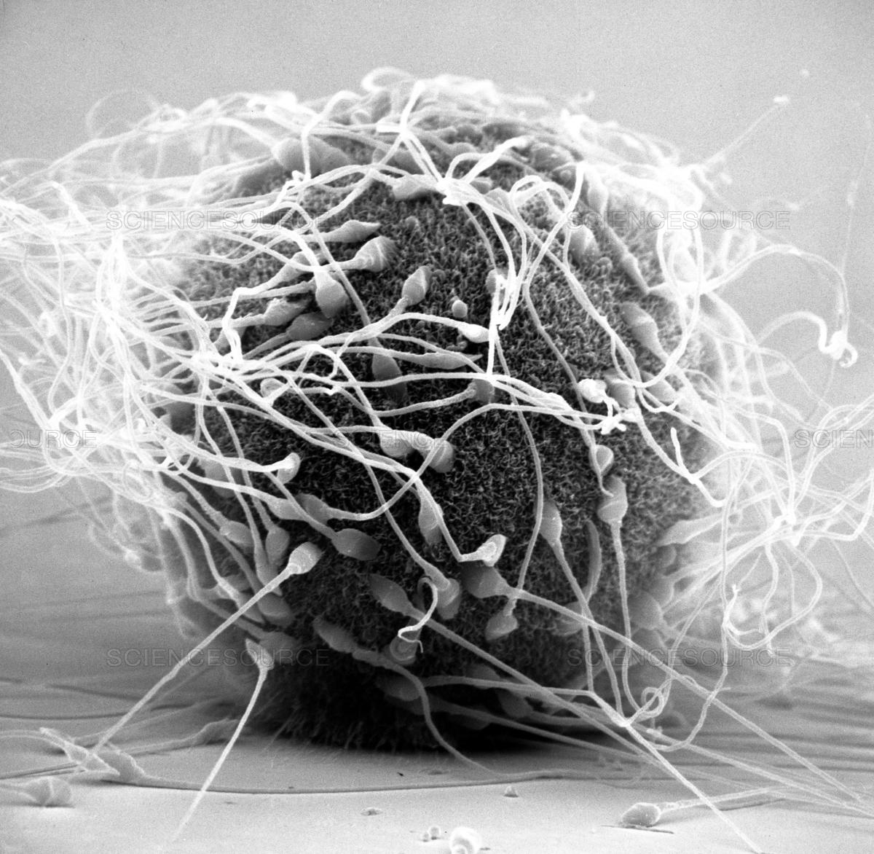
Types of Microscopes Scanning Electron

Slide 8
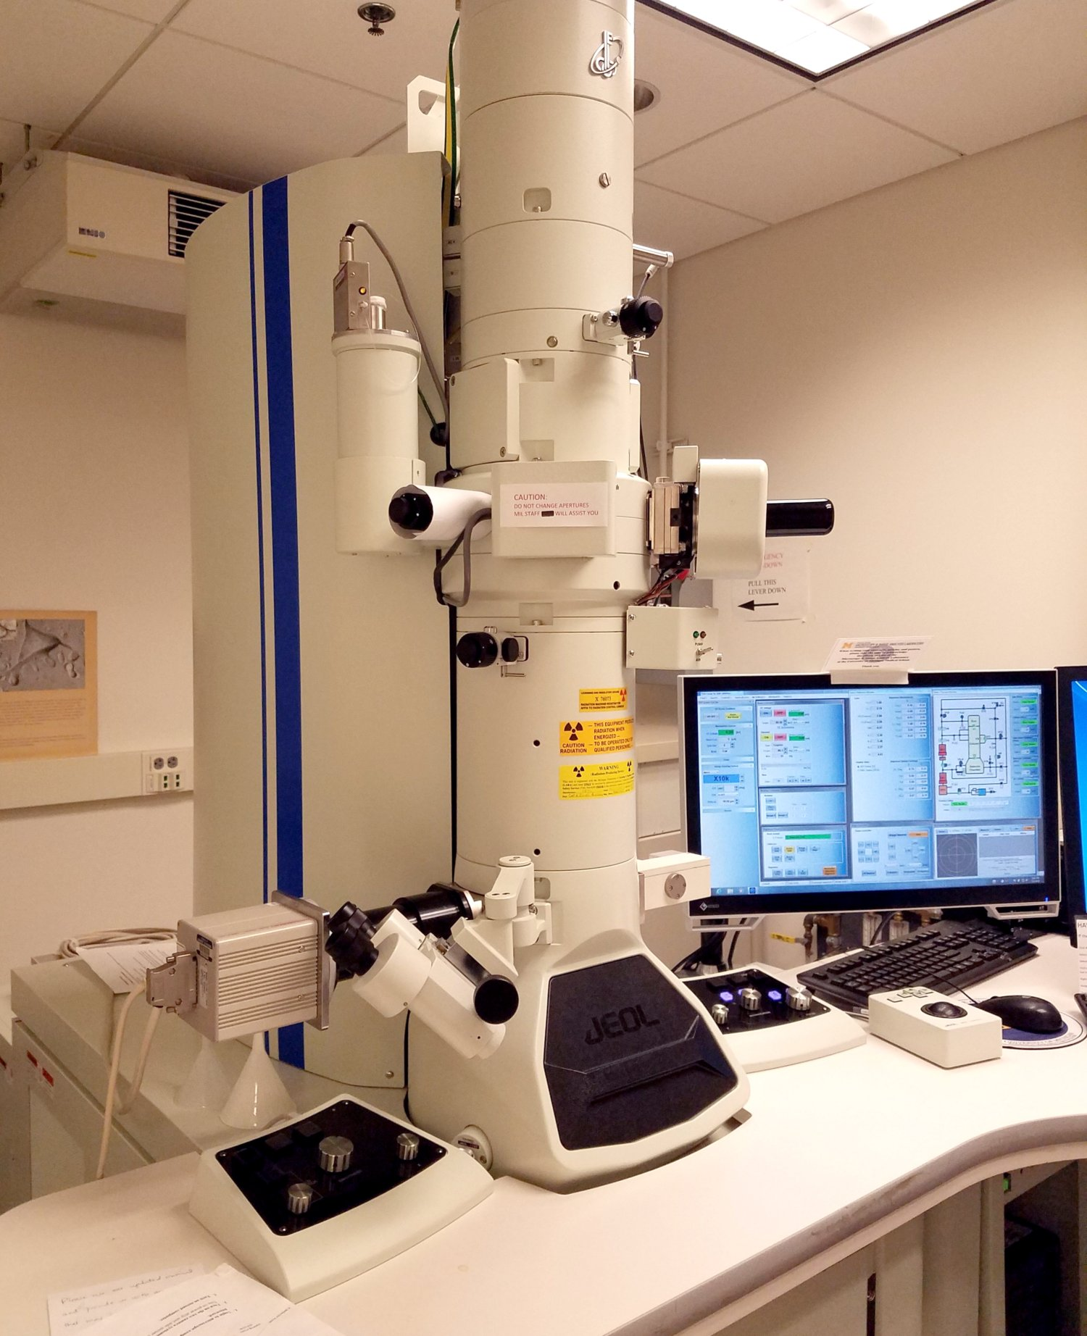
Types of Microscopes Transmission Electron

Slide 9
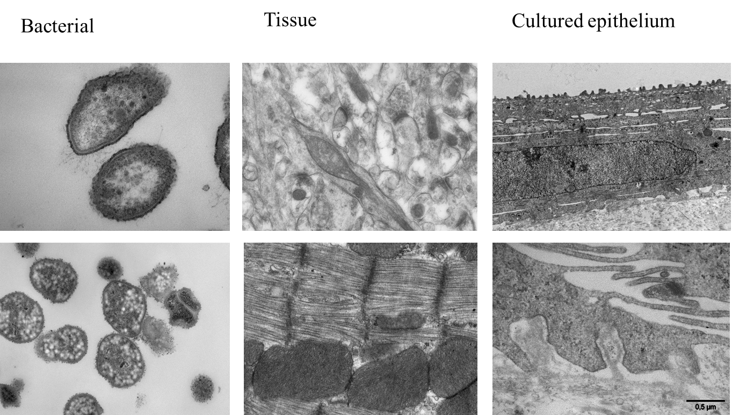
Types of Microscopes Transmission Electron

Slide 10
Types of Microscopes Compound Light vs. Scanning Electron vs. Transmission Electron

Slide 11
Types of Microscopes Compound Light vs. Scanning Electron vs. Transmission Electron

Slide 12
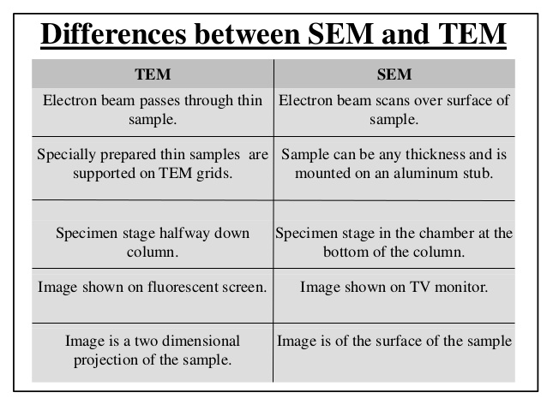
Types of Microscopes Compound Light vs. Scanning Electron vs. Transmission Electron

Slide 13
Prokaryotic vs. Eukaryotic Cells Review

Slide 14
The Cell and it’s Organelles Review

Slide 15
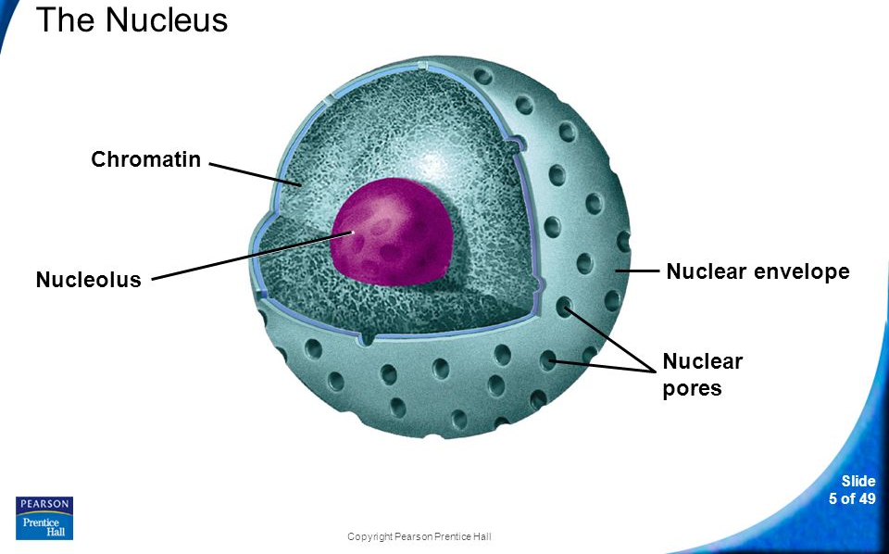
Nucleolus, Nuclear Envelope and Nucleus
The Nucleus contains nearly all the cell’s DNA and the coded instructions for making proteins and other important molecules.
Nuclear envelope- dotted with pores, allows material like ribosomes to move in and out of the nucleus
Nucleolus- small, dense region where ribosomes are initially made.

Slide 16
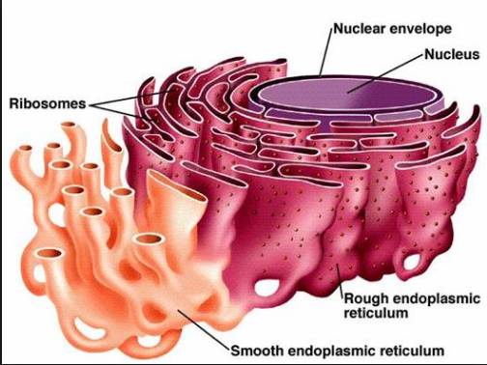
Endoplasmic Reticulum
Rough Endoplasmic Reticulum- site were proteins are further assembled within the cell.
Smooth Endoplasmic Reticulum- synthesizes lipids and carbohydrates as well as the detoxification of drugs.

Slide 17
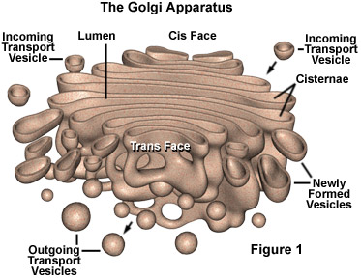
Golgi Apparatus
Modifies, sorts, and packages proteins and other materials from the ER for storage in the cell or release from the cell.

Slide 18
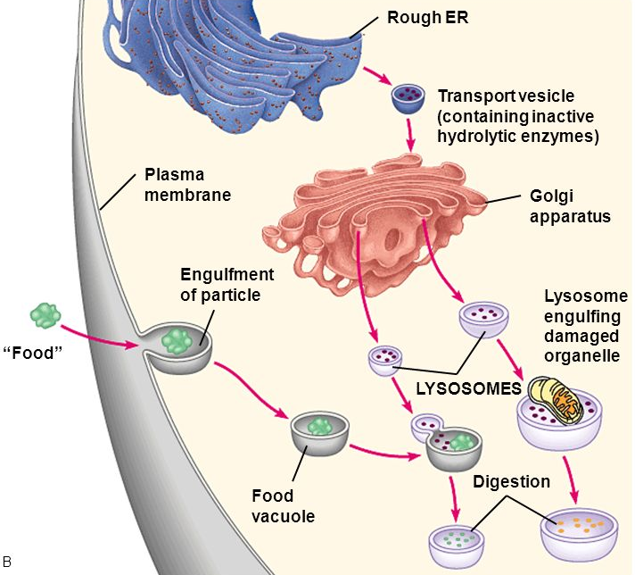
Vacuoles, vesicles and lysosomes
Vacuoles- store materials like water, salts, proteins, and carbohydrates
Vesicle- store and move materials between cell organelles
Lysosomes- break down lipids, carbohydrates, and proteins into small molecules that can be reused by the rest of the cell

Slide 19
Mitochondria and Chloroplasts
Mitochondria- convert the chemical energy stored in food molecules into compounds that are more convenient for the cell to use.
Chloroplasts- capture the energy from sunlight and convert it into chemical energy stored in food during photosynthesis.

Slide 20
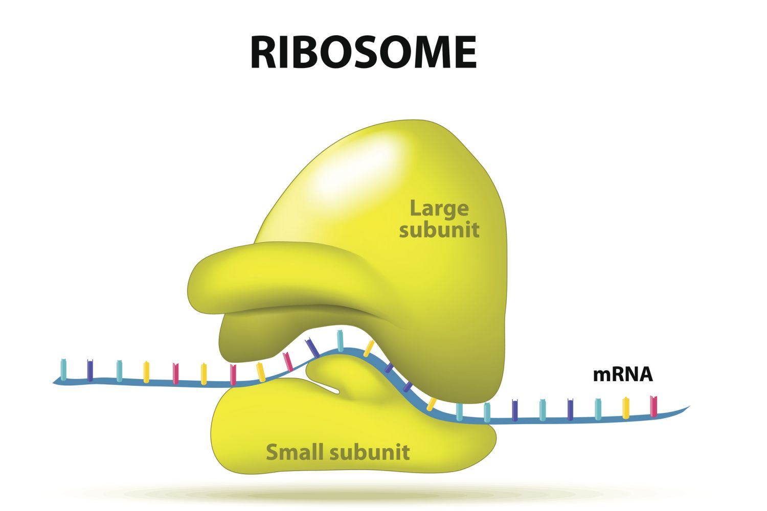
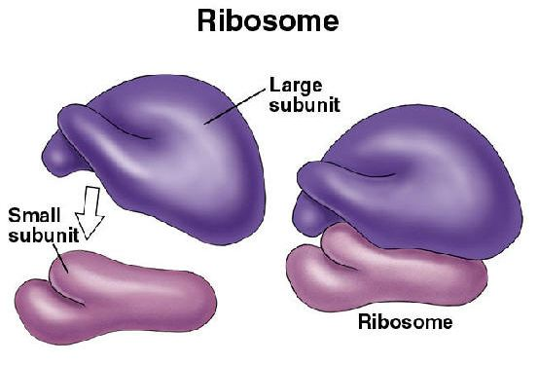
Ribosomes
Assembles proteins

Slide 21
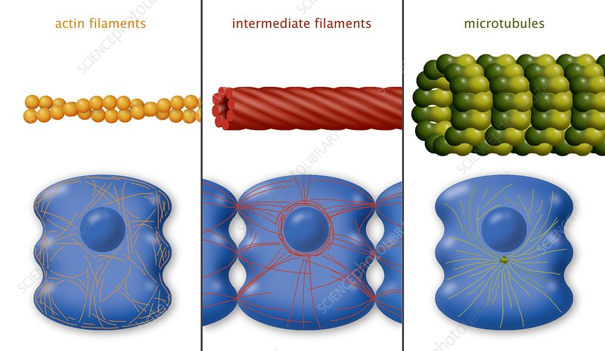
Cytoskeleton and Cytoplasm
Cytoskeleton maintains the cells shape, can allow cells to move as well
Cytoplasm is the portion of the cell outside of the nucleus and is made of a watery environment.

Slide 22
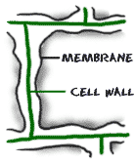
Cell Membrane and Cell Wall
The cell membrane regulates what enters and leaves the cell, as well as protects and supports the cell.
The cell wall surrounds the cell membrane of certain organisms like plants and bacteria and function to support, shape and protect the cell.

Slide 23
Cellular Transportation

Slide 24
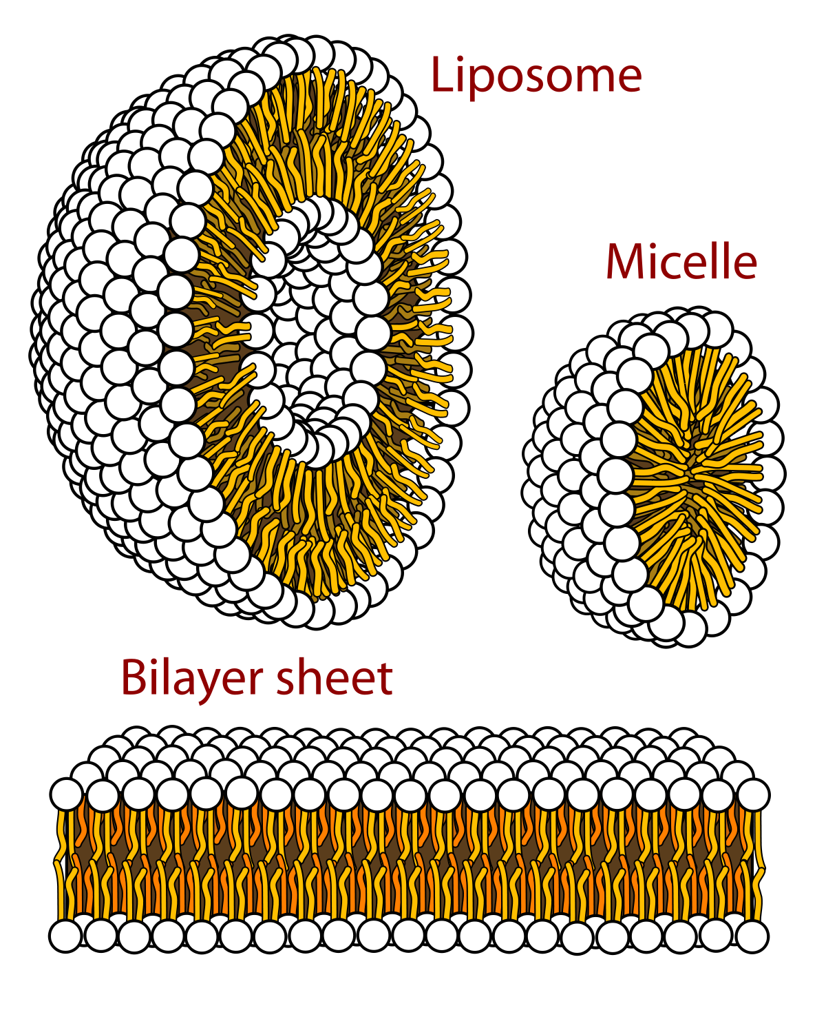
Cellular Transportation
Hydrophilic- “Water loving” Head
Hydrophobic- “Water fearing/hating” Tail

Slide 25
Cellular Transportation
The Fluid Mosaic Model- The many different embedded proteins can move, or “float” around in the layer.
Selectively Permeable- Some substances can pass across the membrane, and others cannot.

Slide 26
Cellular Transportation
Homeostasis- A state of relatively constant internal physical and chemical conditions.
Regulation of the movement of molecules and other substances from one side of the membrane to the other side.

Slide 27
Passive Transport vs. Active Transport
Passive Transport:
Movement of molecules across the cell membrane without using cellular energy
Active Transport:
Movement of materials against a concentration difference, and requires energy.

Slide 28
Passive Transport
Diffusion- Process by which particles move from an area of higher concentration to an area of lower concentration.
Diffusion is the driving force behind the movement of many substances across the cell membrane.

Slide 29
Passive Transport
Facilitated Diffusion- When molecules cannot directly diffuse across the membrane, they may pass through special protein channels.
Charged ions, like Clˉ­­, and large molecules, like the sugar glucose.
Osmosis

Slide 30
Passive Transport: Facilitated Diffusion
Osmosis- An example of facilitated diffusion, it is the diffusion of water through a selectively permeable membrane, using aquaporins.
Aquaporin- water channel proteins found in many cells.
Blood vessels, kidneys, eyes and ear cells

Slide 31
Osmosis: Tonicity
Tonicity- The concentration of solutes (such as salt or sugar) in a solution.
Isotonic- two solutions at the “same strength”
Hypertonic- When one solution is “above strength” to another solution.
Hypotonic- When one solution is “below strength” to another solution.

Slide 32
Active Transport
Active Transport- The movement of materials against a concentration difference that requires energy.

Slide 33
Active Transport
Protein Pumps can move calcium, potassium, and sodium ions across cell membranes.
Much of a cells energy consumption involves molecular transport.
Active Transport- The movement of materials against a concentration difference that requires energy.

Slide 34
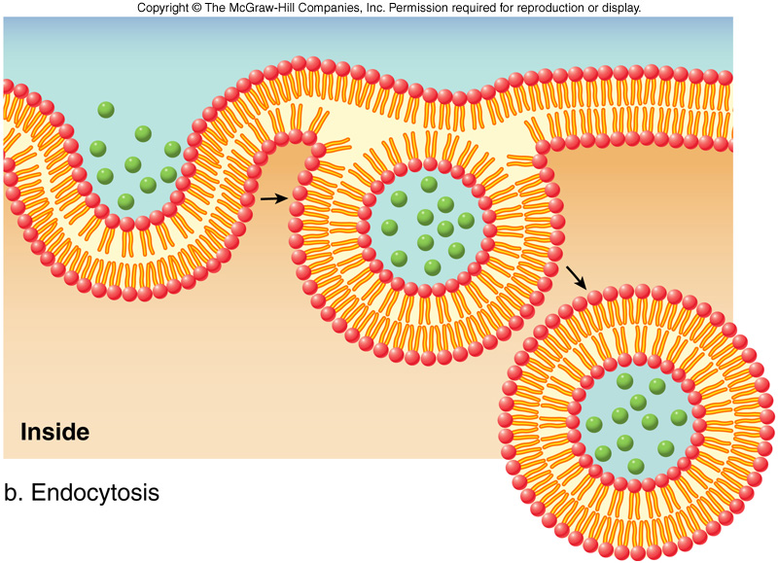
Active Transport
Exocytosis- process of cellular release of large amounts of material.
Endocytosis- process of taking material into the cell by means of infoldings, or pockets, of the cell membrane.
Phagocytosis (EAT)
Pinocytosis (DRINK)

Slide 35
Active Transport
https://youtu.be/iZYLeIJwe4w

Slide 36
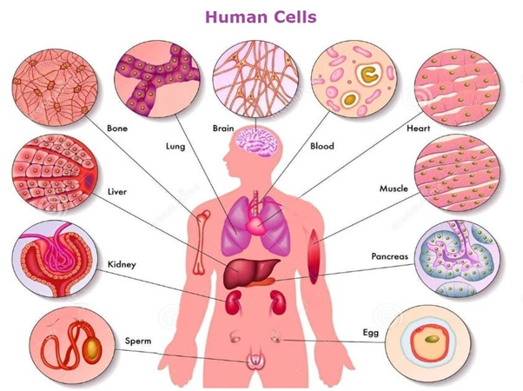
Homeostasis and Cells
To maintain homeostasis, unicellular organisms grow, responds to the environment, transform energy, and reproduce.
The cells of multicellular organisms become specialized for particular tasks and communicate with one another to maintain homeostasis.
Homeostasis- A state of relatively constant internal physical and chemical conditions.

Slide 37
Levels of Organization
Tissue- a group of similar cells that performs a particular function.
Organ- a group of tissues that work together to perform closely related functions.
Organ System- A group of organs that work together to perform a specific function.

Slide 38
Cellular Communication
Cells in a large organism communicate by means of chemical signals that are passed from one cell to another.
Cell Junctions- connections between neighboring cells that allow chemical messages or signals to pass directly from one cell to another.
Receptor- On or in a cell, a specific protein to whose shape fits a specific molecular messenger.

Slide 39
Videos
https://youtu.be/B_zD3NxSsD8
https://youtu.be/URUJD5NEXC8
https://youtu.be/WFCvkkDSfIU

