Slide 1
Money Matters

Slide 2
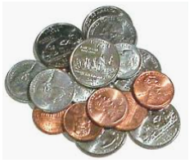
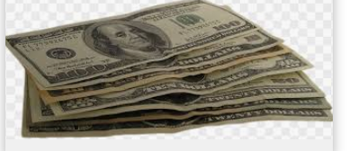
What is money?
Money is what people use to buy things.
Money usually comes in 2 forms,
coins or paper bills

Slide 4
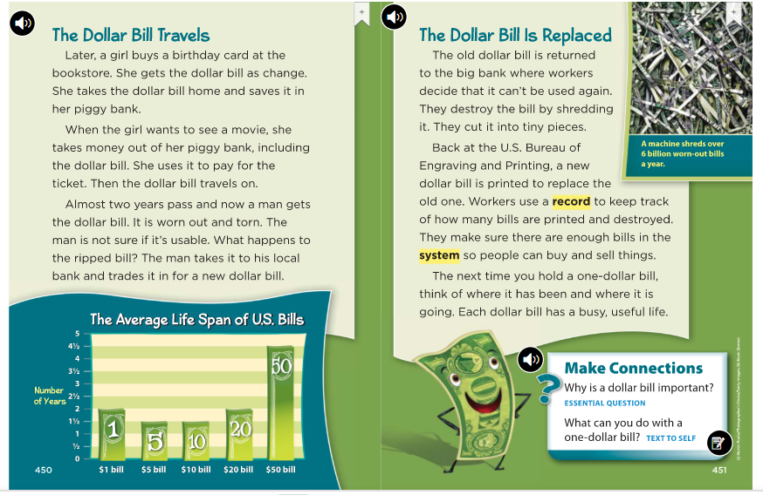

Slide 5
Watch this video!
How Money is Made
https://www.youtube.com/watch?v=iJIjZOEjouQ

