Slide 1
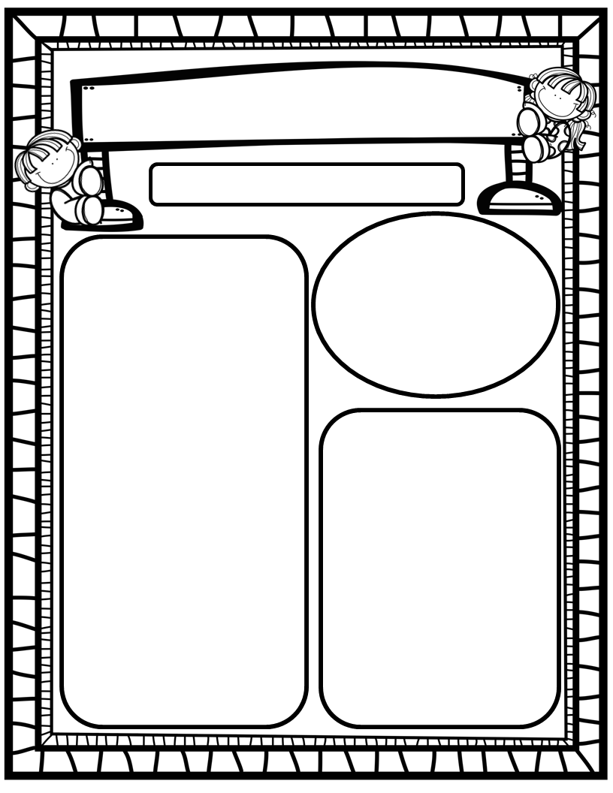
The Deason Digest Weekly Blast
February 24th, 2025
Homework:
Read to and with your child each night and record books on Reading Rally Log!
Practice HFW’s: the, I, and, a, is, as, said, to, do, of, see, he, be, me, from, was, you, have, what
Go Math Home Practice for Ch. 10 & 11
UFLI Home Practice Pages
Go over Weekly Work and discuss
We Are Learning About…
Reading: We will review the vowels Ee and Uu (SHORT sound production, mouth placement, words that begin with the sound & words with sound in middle), and HFW’s we have previously learned . We will identify main topic and several key details in texts we read. We will look at pictures, get our mouths ready, and use chunky monkey to help us stretchy-snake tricky words faster. EQ: What was life like in the past?
Writing: We will focus on printing and tracing upper and lowercase Ee and Uu, as well as using stretchy-spelling and sight words to write complete sentences!
Math: We will begin Go Math Ch. 11: Addition Up to 5!
Science: We will continue Unit 4: Day and Night!
Social Studies: We will continue to practice I-Care Rules. We will practice what it means to show Courage! We will continue learning about impactful African Americans as we approach the end of Black History Month!
Important Dates:
February 27: Black History Themed Late -Night Library
March 4: Field Day, 8:30 meet us at the track(get pre-cleared by taking your id to the front office a couple of days prior to the event)

