Slide 1
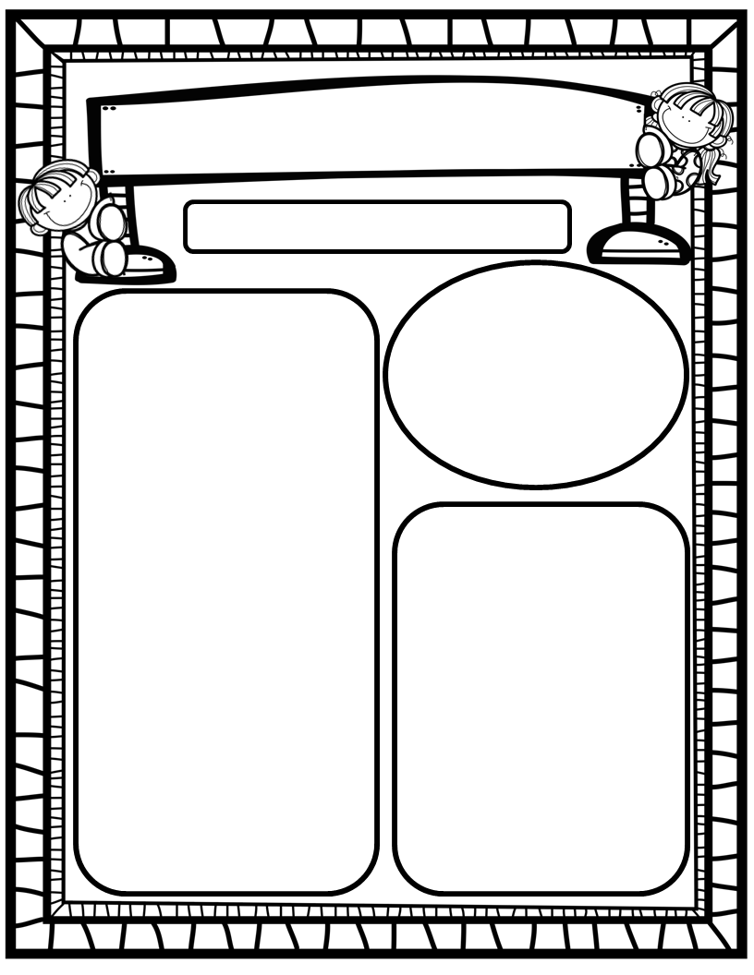
The Deason Digest Weekly Blast
March 31st, 2025
We Are Learning About…
Reading: We will focus on the digraph CH, Digraphs Review (CK, SH, TH), as well as HFW’s talk, walk. We will identify author’s purpose and fiction and nonfiction texts we read. We will look at pictures, get our mouths ready, and use digraph chunks to help us stretchy-snake tricky words faster. EQ: How have people learned to live in bad weather?
Writing: We will focus on printing and tracing upper and lowercase letters, as well as using stretchy-spelling and sight words to write complete sentences!
Math: We will continue Ch. 14: Subtraction within 10!
Science: We will continue learning about living things and non-living things!
Social Studies: We will continue to practice I-Care Rules. We will practice what it means to Share! We will also begin learning about our community and the helpers within our community!
Homework:
Read to and with your child each night and complete Reading Rally Log!
Practice HFW’s: the, I, and, a, is, as, said, to, do, of, see, he, be, me, from, was, you, have, what, your, want, go, no, so, goes, says, she, we, they, their, were, talk, walk
Toucan Sight Word Folders
Go Math Home Practice for Ch. 13 and 14
UFLI Home Practice Pages
Go over Weekly Work and discuss
Important Dates:
April 2: Light it up Blue for Autism Awareness (wear blue)
April 4: First Friday/Friendship Lunch (wear Grow Together t-shirts); Sight Word Testing Day
April 15: Field Trip to Publix, 9:00-1:00 (approximate time span)
April 18: Spring Holiday; No School
April 23-30: PTO Online Silent Auction (more info to come)
April 26: HRES “Flight Fest” Carnival

