Slide 1
Cell Growth and Division
Created by: Dean Struempf

Slide 2
Review of the Cell

Slide 3
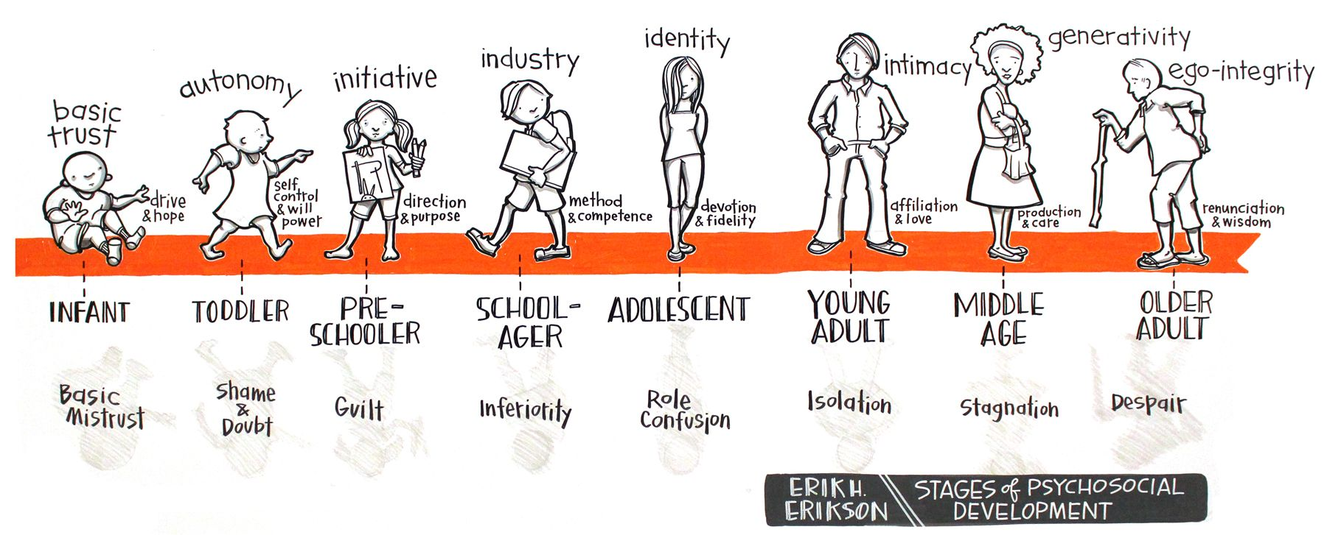
Growth

Slide 4
Limits to Cell Size
The larger a cell becomes, the less efficient it is in moving nutrients and waste materials across its cell membrane. In addition, as a cell grows, it places increasing demands on its own DNA.

Slide 5
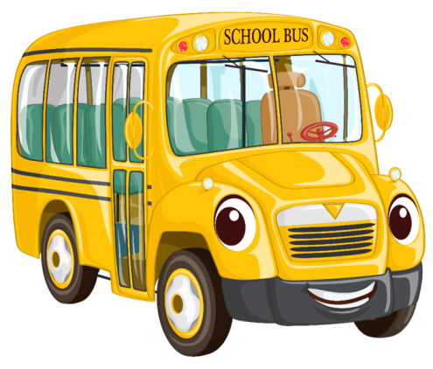
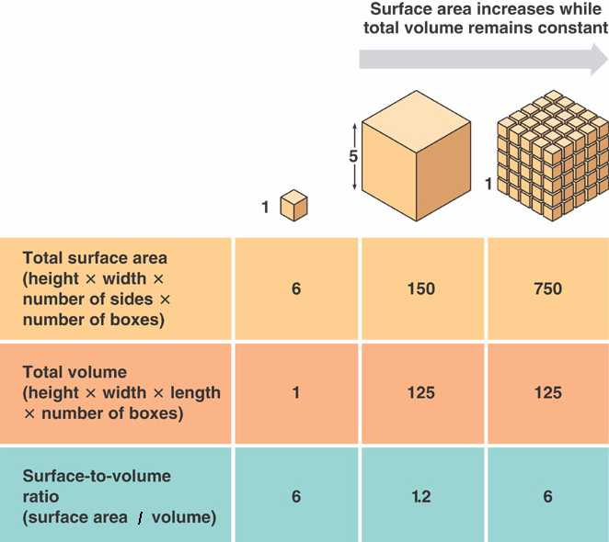
Limits to Cell Size: Surface Area to Volume Ratio
As a cell grows, it’s volume will increase faster than it’s surface area (cell membrane).
Results in traffic problems; gas/nutrient/waste exchange becomes difficult.
Information overload; too many organelles trying to get information from the DNA in the nucleus.
Notes:
Using school bus image, give example of a school trip: If you had 100 students on one bus, compared to 4 busses with 25 students each, what is the difference in the ability to get snacks to students, or information to chaperones?

Slide 6
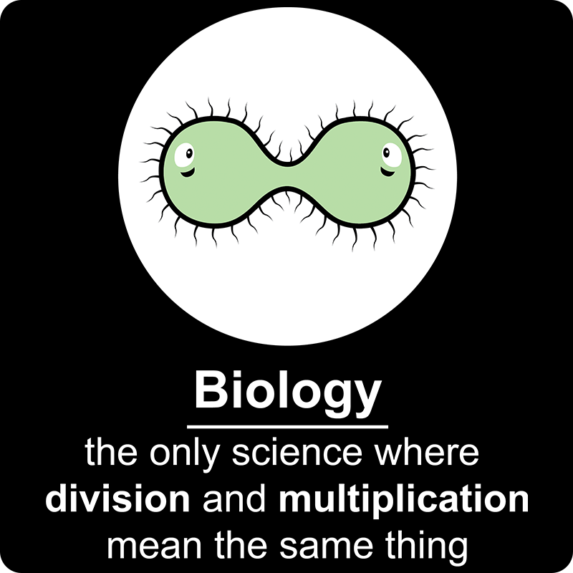
The Solution? Cell Division!
Cell division- The process by which a cell divides into two new daughter cells.
Solves the problem of increasing size by reducing cell volume, which increases the ratio of surface area (cell membrane) to volume for each daughter cell.
Results in a more efficient exchange of materials between the cell and its environment.

Slide 7
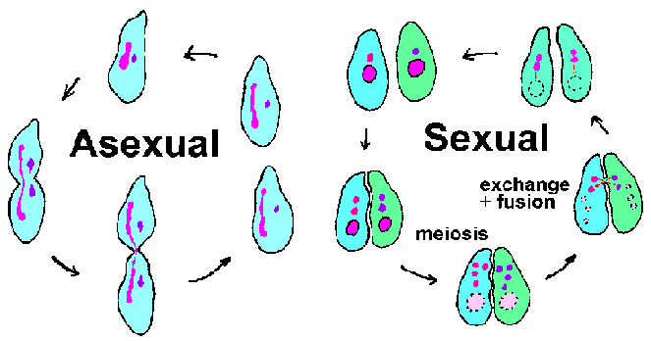
Cell Division
Asexual Reproduction- The production of genetically identical offspring from a single parent.
Advantage: With excellent environmental conditions, can reproduce rapidly
Disadvantage: Lack of genetic diversity can lead to being wiped out when conditions change.
Sexual Reproduction- The fusion of two reproductive cells formed by each of the two parents; offspring inherit some of their genetic information from each parent.
Advantage: Genetic diversity, which allows a greater ability to adapt to changing environments.
Disadvantage: Can be time consuming.

Slide 8
Cell Growth and Division: Review DNA
DNA- genetic material that organisms inherit from their parents; in eukaryotic cells, it is found in the cell’s nucleus.

Slide 9
Cell Growth and Division: Review DNA
Chromatin- substance found in eukaryotic chromosomes that consists of DNA tightly coiled around proteins called histones.

Slide 10
Cell Growth and Division: Review DNA
Chromosome- threadlike structure of DNA and protein that contains genetic information; in eukaryotes, chromosomes are found in the nucleus; in prokaryotes, they are found in the cytoplasm.

Slide 11
Cell Growth and Division: Review DNA
Chromatid- One of two identical “sister” parts of a duplicated chromosome.
Centromere- Point at which two sister chromatids are attached.

Slide 12
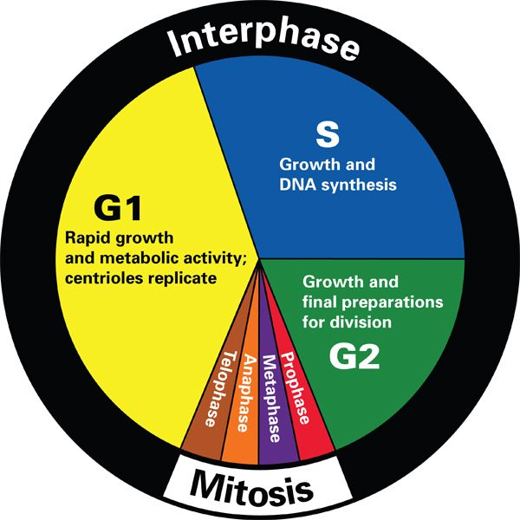
The Cell Cycle
During the Cell Cycle, a cell grows, prepares for division, and then divides to form two daughter cells.

Slide 13
The Eukaryotic Cell Cycle
Interphase- Period of growth between cell division, which includes G₁, S and G₂.
G₁ (Gap Phase 1)
Where cells spend most of their growth.
S (Synthesis)
New DNA is synthesized as chromosomes are replicated.
G₂ (Gap Phase 2)
Shortest growth period, preparing for Mitosis.

Slide 14
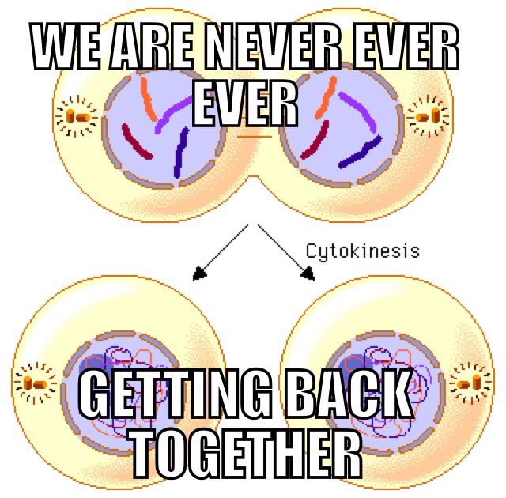
Cell Division: Mitosis & Cytokinesis
In eukaryotes, cell division occurs in two main stages. Mitosis is the division of the cell’s nucleus. Cytokinesis is the division of the cell’s cytoplasm.

Slide 15
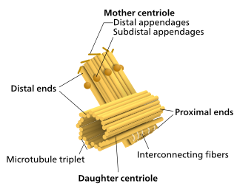
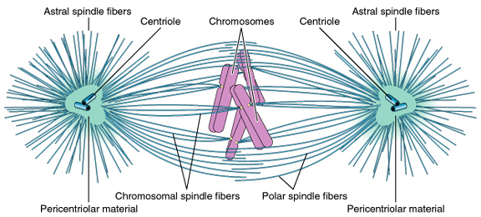
Centrioles
Centrioles- Small paired structures that contain the centrosome, where spindle fibers extend from.
Attachment cables that pull chromosome apart.

Slide 16
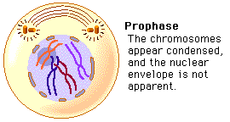
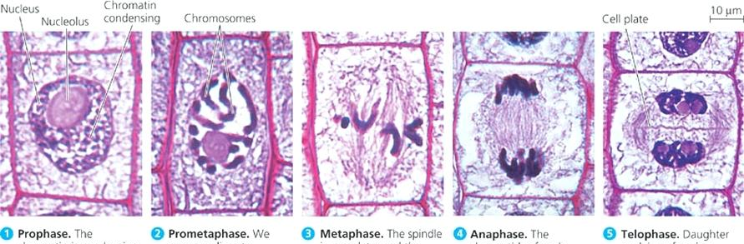
Mitosis: Prophase
During prophase, the genetic material inside the nucleus condenses and the duplicated chromosomes become visible. Centrioles move to opposite sides of the cell.

Slide 17
Mitosis: Pro-metaphase
During pro-metaphase, the nuclear envelope breaks down, and the spindle fibers attach to the chromosomes.

Slide 18
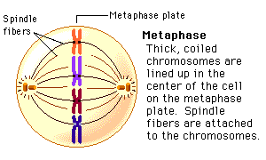
Mitosis: Metaphase
During metaphase, the centromeres of the duplicated chromosomes line up across the center of the cell.

Slide 19
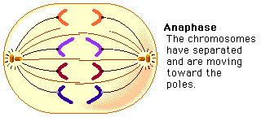
Mitosis: Anaphase
During anaphase, the chromosomes separate and move along spindle fibers to opposite ends of the cell.

Slide 20
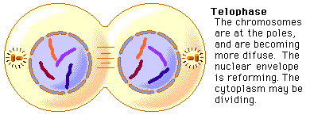
Mitosis: Telophase
During telophase, the chromosomes, which were distinct and condensed, begin to spread out into a tangle of chromatin. A nuclear envelope will reform around the DNA.

Slide 21
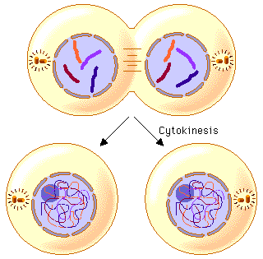
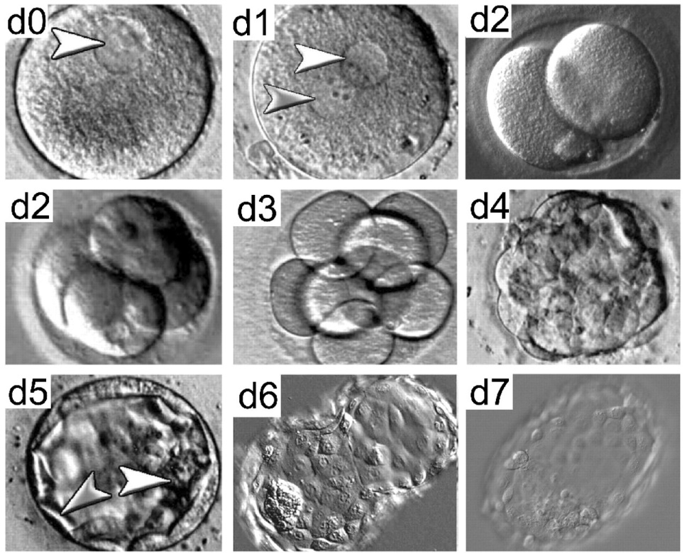
Cytokinesis
Cytokinesis completes the process of cell division by dividing one cell into two.
Notes:
https://www.youtube.com/watch?v=t1JdFVsyWkI

Slide 22
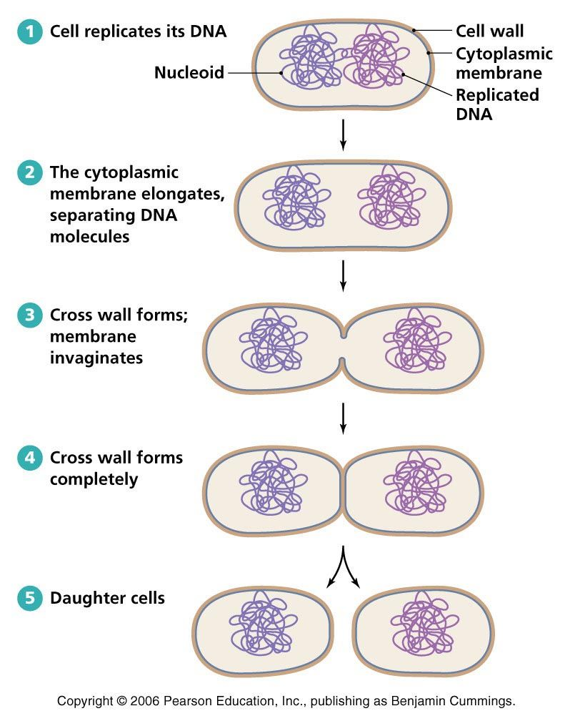
Binary Fission of Prokaryotic Cells
The Cell Cycle of Prokaryotic cells still results in two genetically identical cells.
Asexual

Slide 23
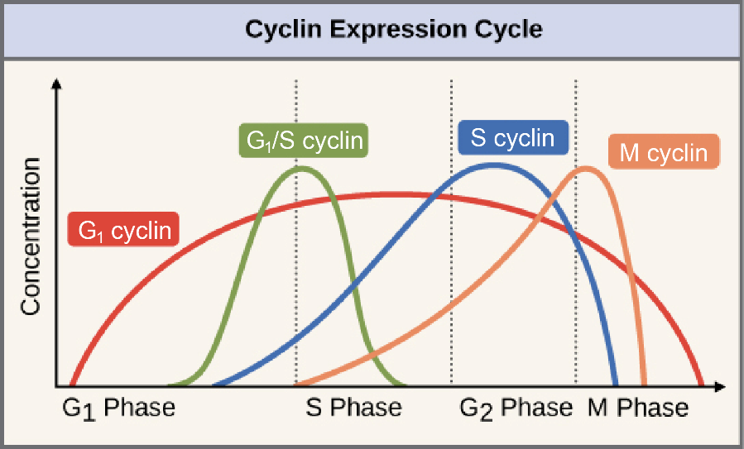
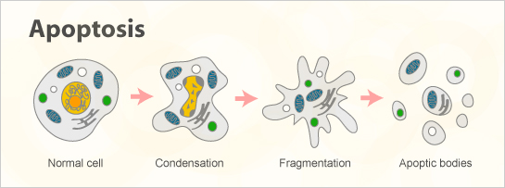
Controls on Cell Division
The Cell Cycle is controlled by regulatory proteins both inside and outside the cell. Dozens of proteins regulate the cell cycle.
Internal Regulators- proteins used as checkpoints to the cell cycle. Example is cyclin, which regulate the timing of the cell cycle in eukaryotic cells.

Slide 24
Controls on Cell Division
External Regulators- Can speed up, or slow down the cell cycle.
Growth factors- simulate the growth and division of cells. Especially useful in wound healing.
Notes:
https://www.youtube.com/watch?v=5Iq0P4FdXbs

Slide 25
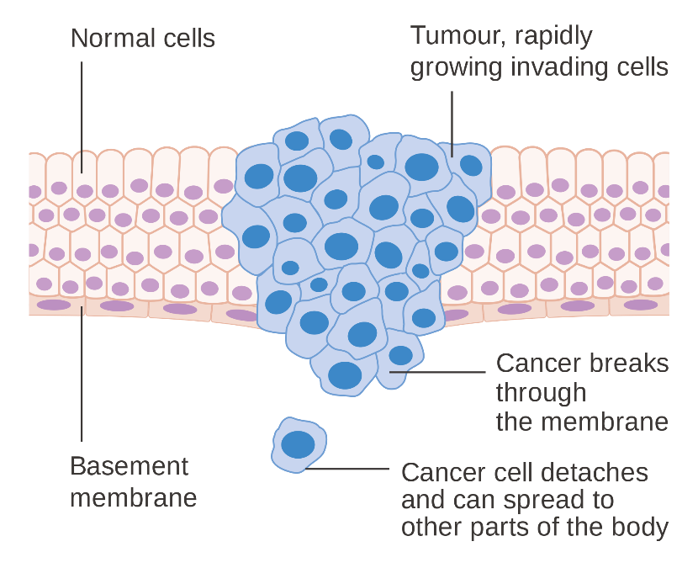
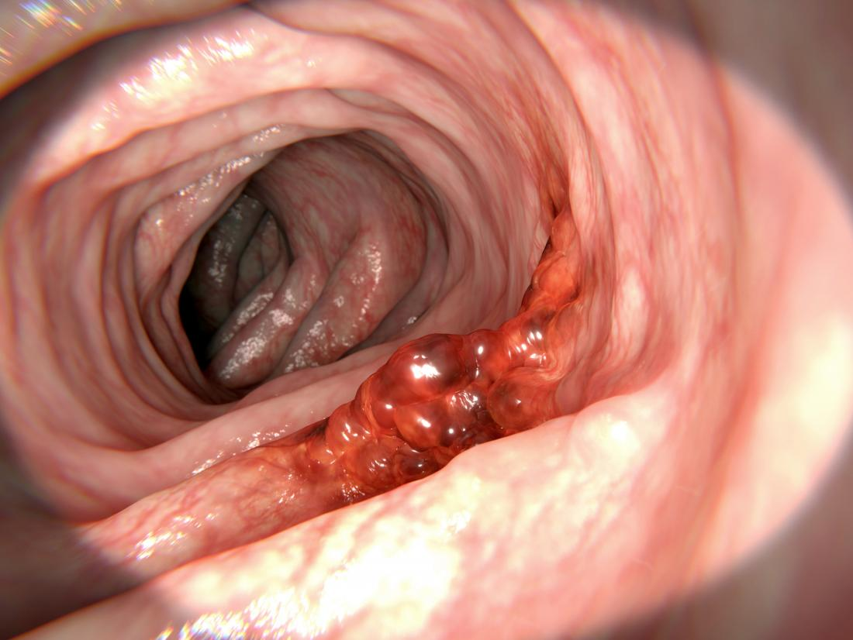
Cancer: Uncontrolled Cell Growth
Cancer cells do not respond to the signals that regulate the growth of most cells. As a result, the cell cycle is disrupted, and cells grow and divide uncontrollably.
Notes:
Benign- non-cancerous
Malignant- invade and destroy surrounding health tissue.

Slide 26
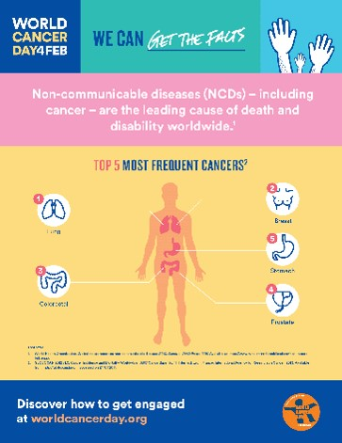
What Causes Cancer?
Caused by defects in the genes that regulate cell growth and division.
Basically, cell cycle is broken down (defect in a checkpoint protein, p53, account for a large number of cancers).
Smoking/chewing tobacco
Radiation exposure
Viral infections (rarely)

Slide 27
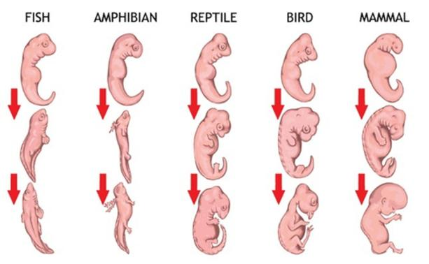
Cell Differentiation
During the development of an organism, cells differentiate into many distinct cell types.

Slide 28
Cell Differentiation
Stem cells- unspecialized cell that can give rise to one or more types of specialized cells.
Found in places like the bone marrow, hair follicles and places in the brain and heart.
Totipotent- cells that can develop into any type of cell found in the body.
Zygote, fertilized egg
Pluripotent- cells that are capable of developing into most, but not all, of the body’s cell types.
Inner cell mass of the embryo, blastocyst.
Multipotent- cell with limited potential to develop into many types of differentiated cells.
Stem cells that replace cells in tissues where they are found.

Slide 29
Cell Differentiation

Slide 30
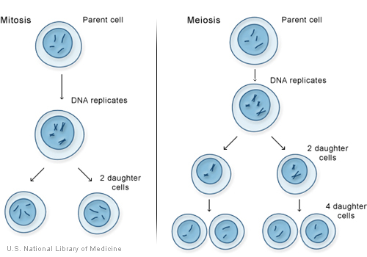
Mitosis vs. Meiosis
Mitosis results in the production of two genetically identical diploid cells, whereas meiosis produces four genetically different haploid cells.
Diploid- a cell with two sets of homologous chromosomes.
Haploid- a cell with a single set of chromosomes.
Homologous chromosomes are a corresponding set of chromosomes, one from each parent.

Slide 31
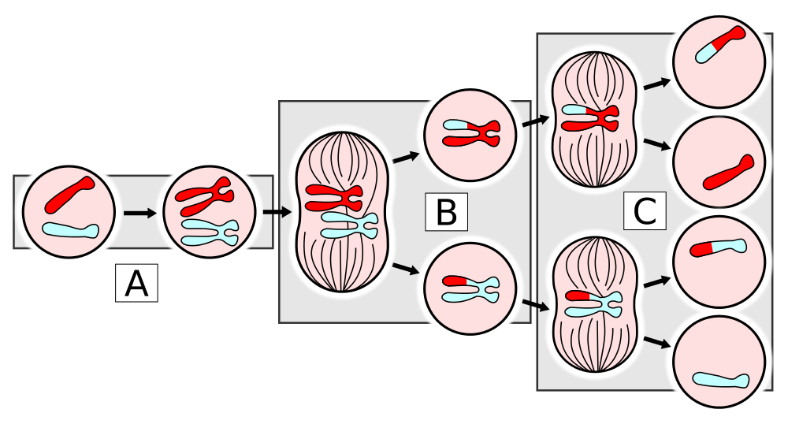
Mitosis vs. Meiosis

Slide 32
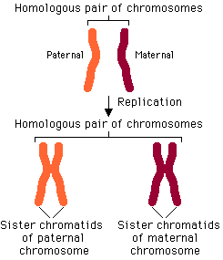
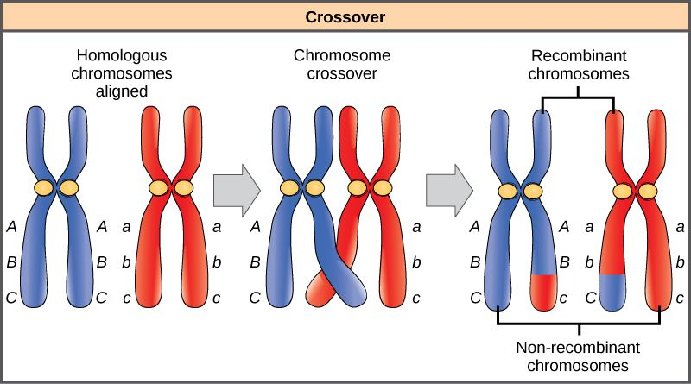
Meiosis I: Crossing Over during Prophase I
Crossing-over: As the chromosomes pair up, sometimes bits and pieces of the homologous chromosomes are exchanged. These new combinations of alleles increase the genetic variation in a population.
Tetrad
Notes:
https://www.youtube.com/watch?v=VzDMG7ke69g

Slide 33
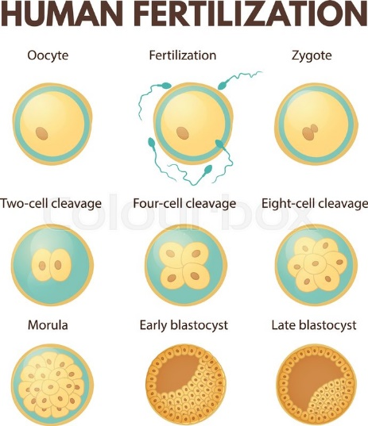
Human Development
Totipotent- cells that can develop into any type of cell found in the body.
Zygote, fertilized egg
Pluripotent- cells that are capable of developing into most, but not all, of the body’s cell types.
Inner cell mass of the embryo, blastocyst.
Multipotent- cell with limited potential to develop into many types of differentiated cells.
Stem cells that replace cells in tissues where they are found.
Stem cells- unspecialized cell that can give rise to one or more types of specialized cells.
Found in places like the bone marrow, hair follicles and places in the brain and heart.

