Slide 1
Reach students and parents where they are.
TO THE EDUCATOR LEADING PD: These presenter notes will appear throughout with tips and suggestions for your session. They’re easy to remove before you present—just click on the gray bar and hit delete!

Slide 2
How many tools do you use to reach students and parents?
TO THE EDUCATOR LEADING PD: Ask participants to share how they communicate with other stakeholders and the challenges they face.

Slide 3
Send messages that students and parents can’t miss
Remind is a communication platform that helps teachers build relationships with students and parents every day.
By connecting school communities, Remind makes it easy to manage class communication—and make more time for teaching and learning.

Slide 4
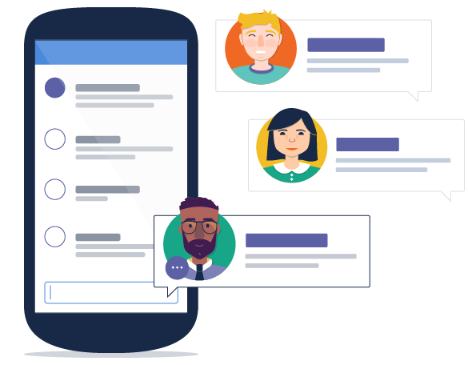
Make your day more productive
Real-time messaging for your class, group, or just a single person.
Reminders can be scheduled ahead of time.
Messages can be sent on the go from a laptop, mobile app, or tablet.

Slide 5
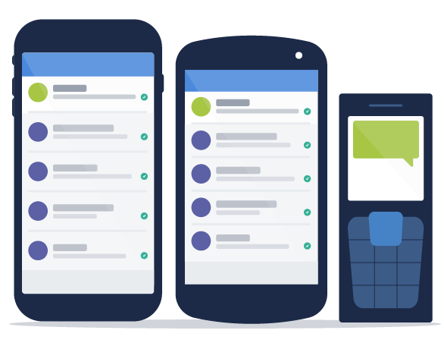
Get every family involved
Messages can be sent to any phone. Families don’t need smartphones or even Internet to use Remind.
Translate your messages into more than 85 languages.

Slide 6
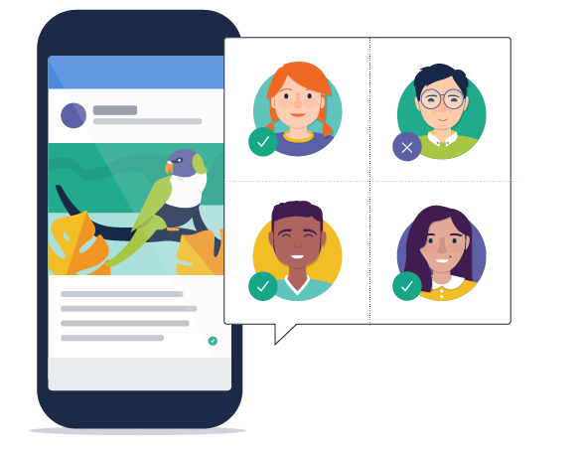
Build stronger relationships
Send messages the way people actually communicate.
A typical teenager sends and receives over 30 texts per day. (Source)
92% of all adults own cell phones, and they rarely turn them off. (Source)
See who’s reading them and who’s missing out.

Slide 7
Support student outcomes
Poinciana HS, FL: A 60% improvement in pilot-group attendance
PS 151, NY: A 3x improvement in parent turnout at school events.
John Swett Elementary School, CA: 99% of parents surveyed feel positively about receiving Remind messages
University HS, NJ: A 2-letter grade improvement due to increased parent involvement

Slide 8
4 C S A L I G N M E N T
I S T E S T A N D A R D S
Communication: Questions, ideas, and solutions around topics
Creativity: New approaches to problems
Critical thinking: Process and analyze problems in new ways
Collaboration: working together
Model digital age work and learning
Promote and model digital citizenship & responsibility
Facilitate student learning and creativity
Design and develop digital age learning experiences & assessments
Engage in professional growth and leadership
TO THE EDUCATOR LEADING PD: Lead a short discussion about how Remind aligns with
the 4 Cs and ISTE standards.

Slide 9
Getting started
TO THE EDUCATOR LEADING PD: In this section, you’ll lead a quick demo with a sample class and help participants create accounts.

Slide 10
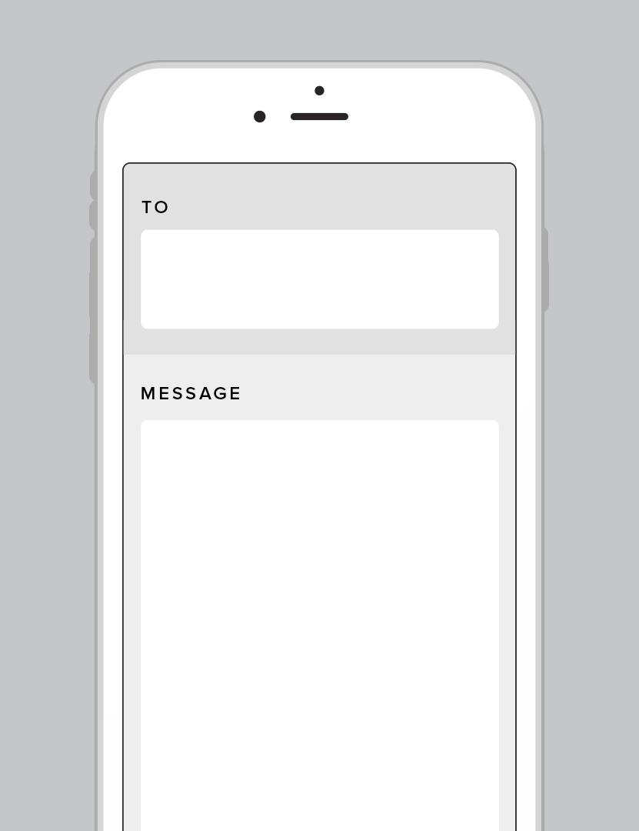
WHAT PARTICIPANTS SEE How does Remind work?
To receive messages via text, text @classcode to 81010.
Trouble using 81010? Try texting @classcode to (516) 874-3612 instead.
*Standard text message rates apply.
81010
@classcode
TO THE EDUCATOR LEADING PD: Replace @classcode in the image above with the class code for the sample class you created for this session.

Slide 11
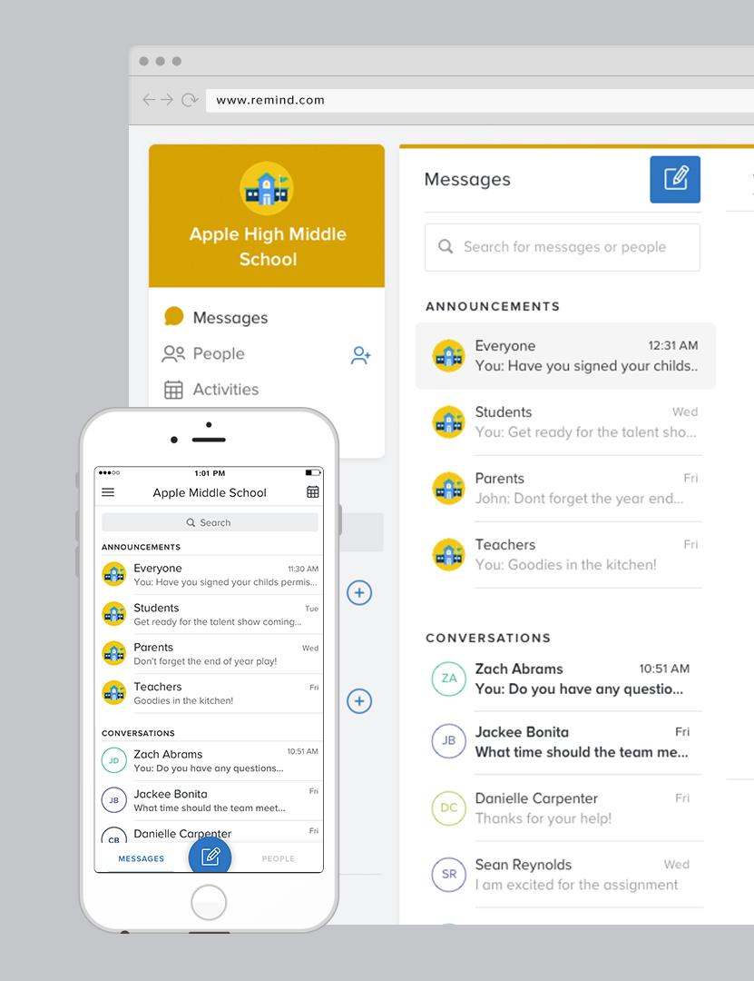
WHAT CLASS OWNERS SEE How does Remind work?
See who’s joined a class in real time. (Personal contact information doesn’t appear.)
Send a class announcement or start a conversation.
Check your delivery summary to see who’s received your messages.
TO THE EDUCATOR LEADING PD: Open Remind in your browser to demonstrate how the participant list looks when people join. Then, send a sample announcement.

Slide 12
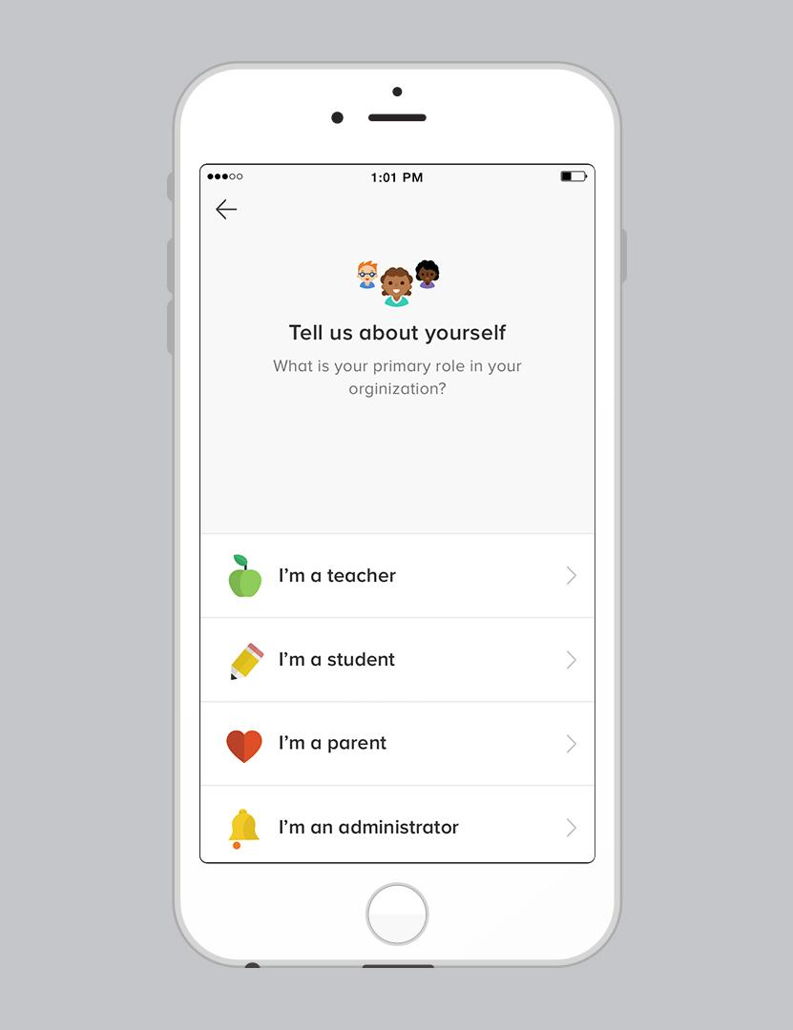
Set up your account
Download the free app for iOS and Android or visit Remind.com to sign up.
Click Create Class to set up your first class. Then, invite a partner to join by:
Texting your class code to 81010
Entering your class code in the app
You can also add them directly with an email address or cell phone number.
TO THE EDUCATOR LEADING PD:
Participants will use these sample classes for some hands-on activities, coming right up.
After they’re done, they can archive these classes by going to class settings.

Slide 13
Features
TO THE EDUCATOR LEADING PD: Encourage your participants to try out the following features with the sample class they just created!

Slide 14
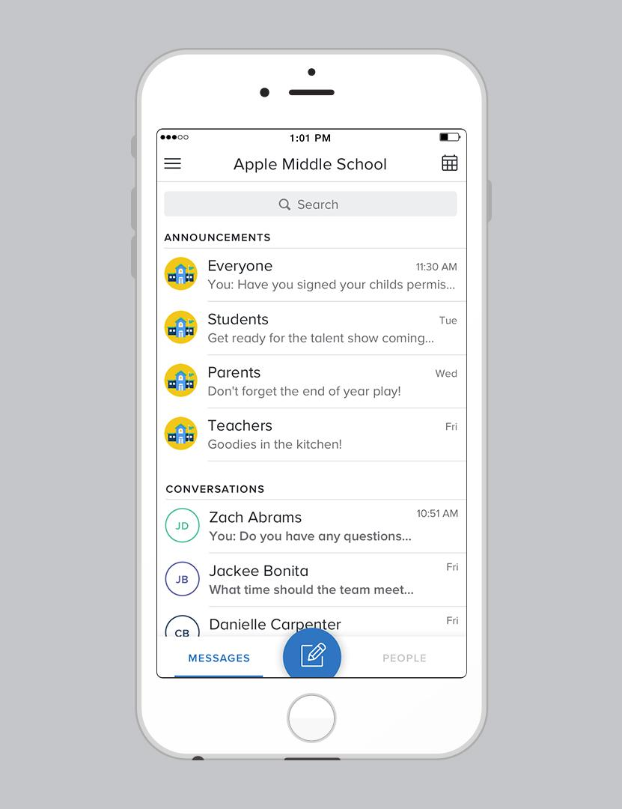
Messaging that works for you
Set office hours to let students and parents know the best times to reach you.
Send an announcement to an entire class or personalize messages to individuals and smaller groups.
Turn off replies when you’re done with a conversation.
TO THE EDUCATOR LEADING PD: Ask participants to set their office hours by going to their account settings.
Then, ask them to try sending a class announcement and an individual message.
From their conversation, ask them to turn off replies.

Slide 15
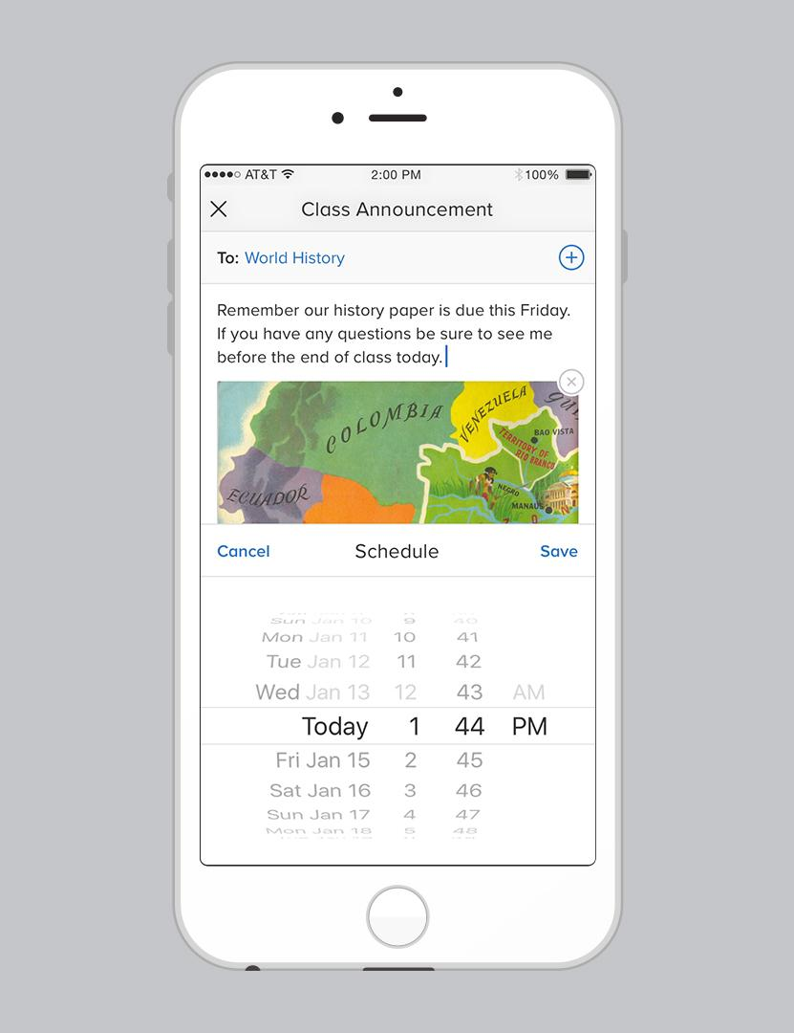
Schedule
Save time by scheduling announcements in advance.
Take 5 minutes to schedule event reminders
for the week or even month ahead.
TIP
TO THE EDUCATOR LEADING PD: Ask participants to schedule an announcement.

Slide 16
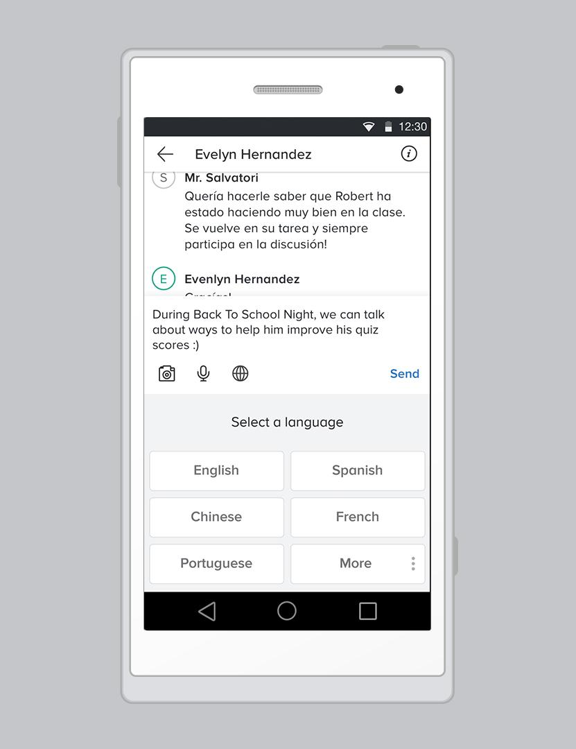
Translate
Reach every family with the ability to translate messages into 85+ languages before you send.
Anyone using the app will have the option of translating your messages as well.
TIP
TO THE EDUCATOR LEADING PD: Ask participants to translate a message before sending.

Slide 17
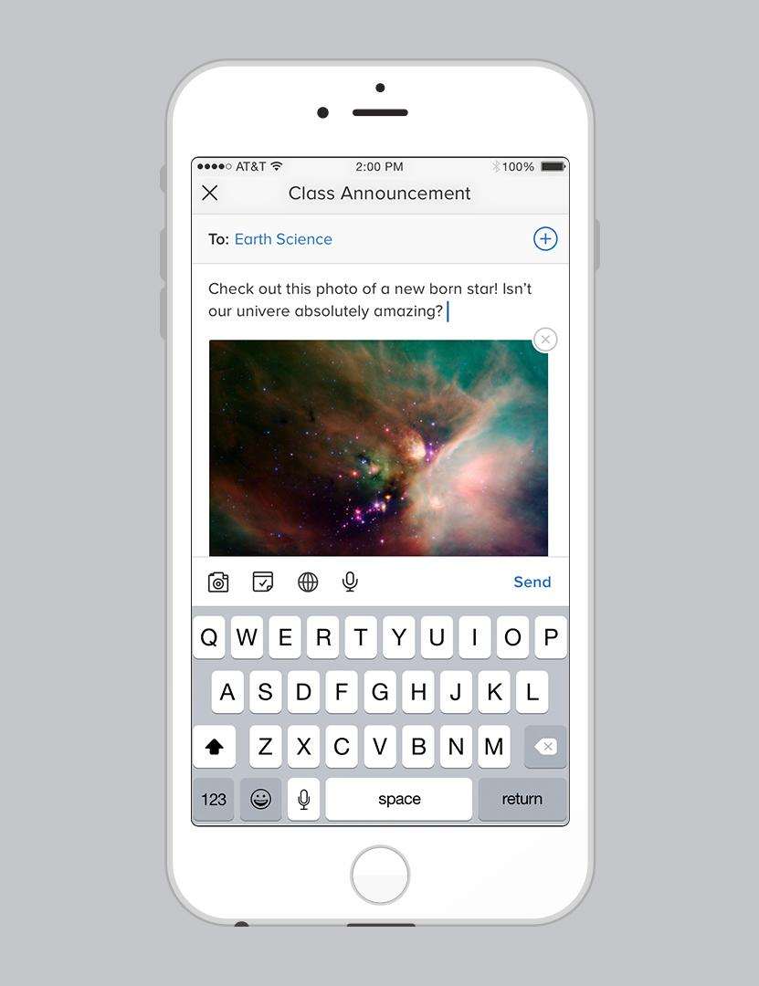
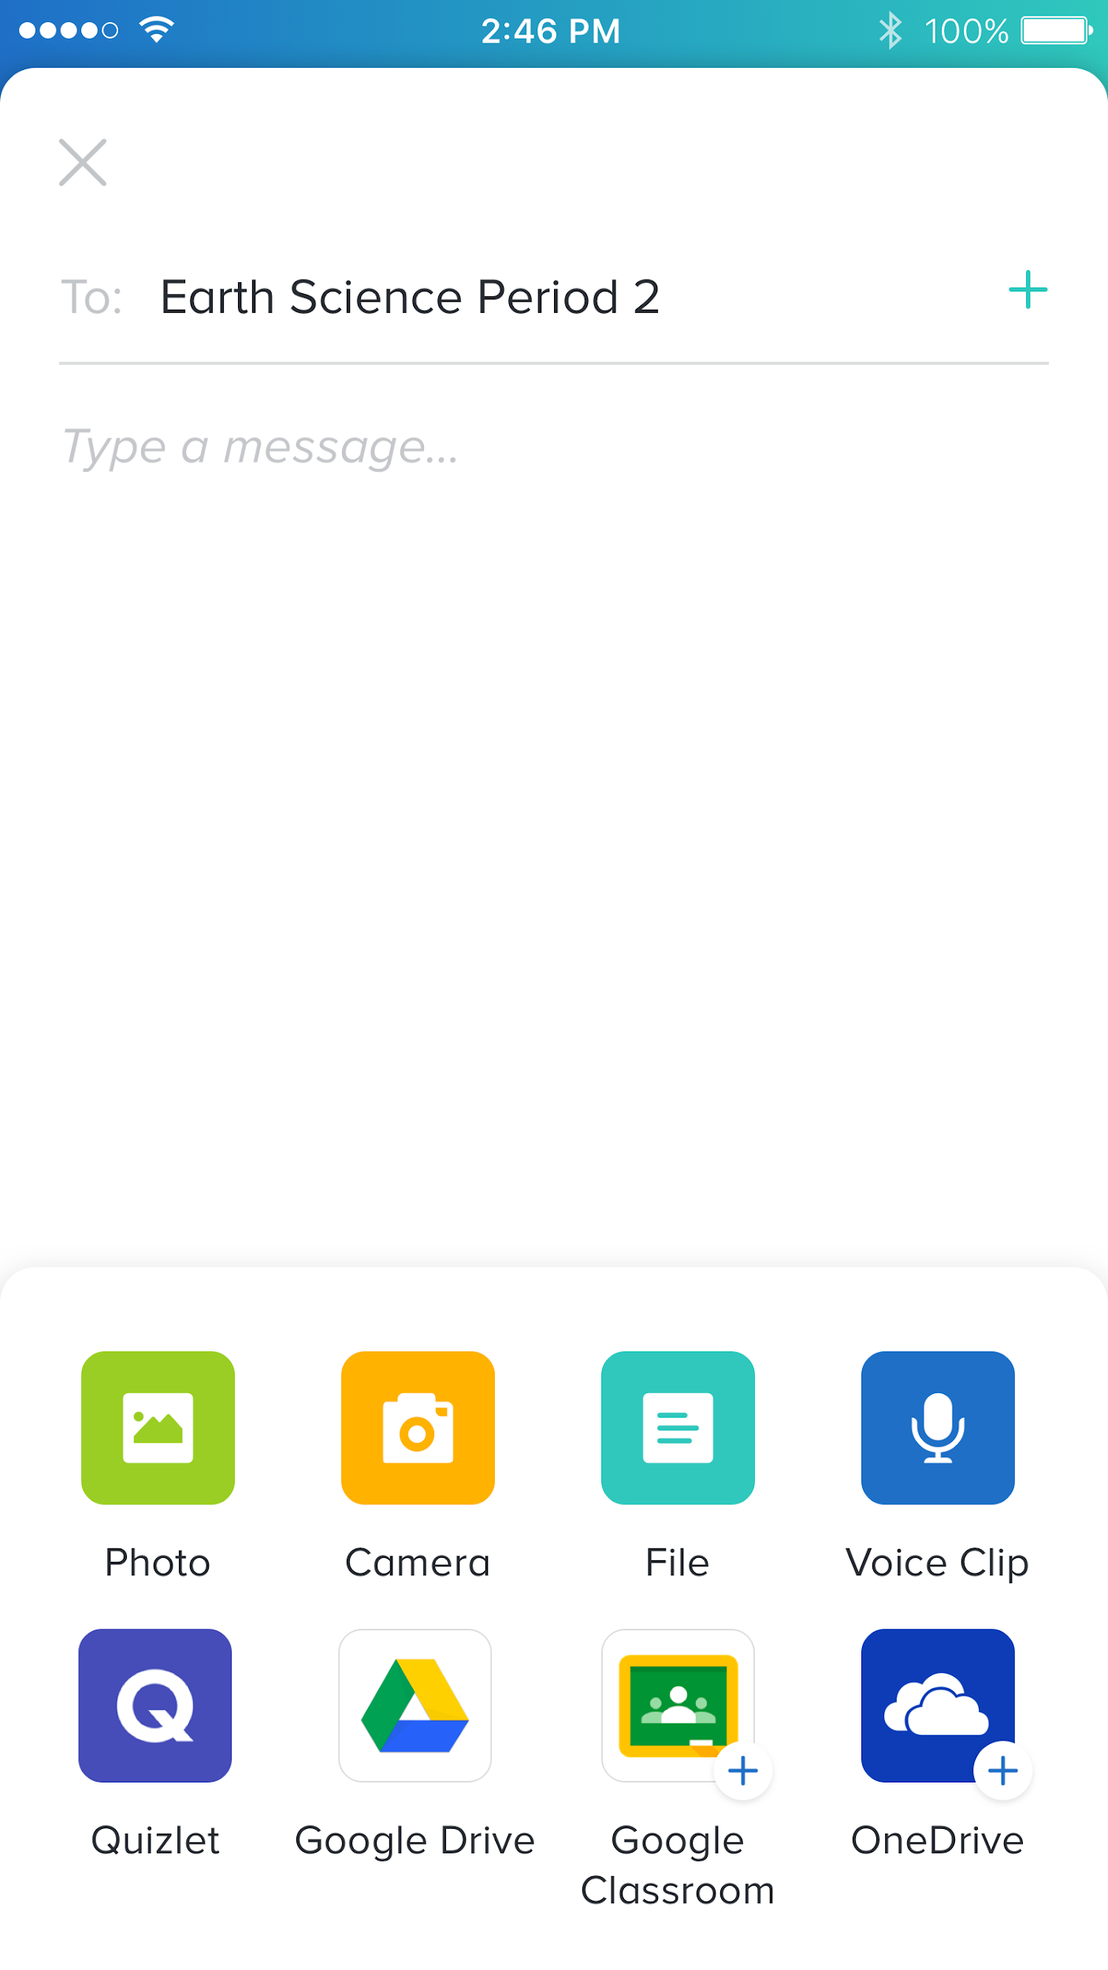
App integrations
Access and share your favorite resources from Google, Microsoft OneDrive, and more—without leaving Remind.
You can connect your favorite apps from the composer or your account settings.
TIP
TO THE EDUCATOR LEADING PD: Ask participants to open their composer and find where they can connect their accounts.

Slide 18
Add attachments
Share photos, PDFs, files, and voice clips with your messages.
Instead of printing handouts, send them as PDFs to staff or families via Remind.
TIP
TO THE EDUCATOR LEADING PD: Ask participants to attach a picture or file to a message.

Slide 19
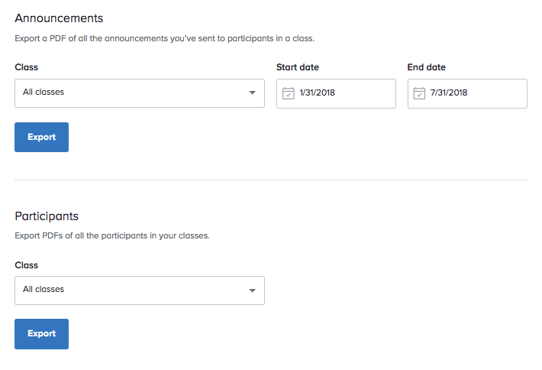
Export message history
Need documentation for home-school communication? Download your message history by date.
Access the export feature online by going to your account settings.
TIP

Slide 20
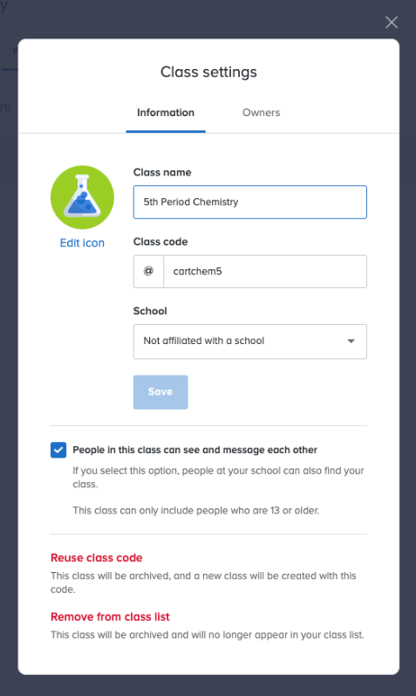
Communication for the classroom—and beyond
With a free individual account, you can create 10 classes with up to 150 participants in each class.
TIP
When you’re done with a class, archive it to free up space.
TO THE EDUCATOR LEADING PD: To archive a class, just click Remove from class list, which is shown at the bottom of the screenshot on the slide.

Slide 21
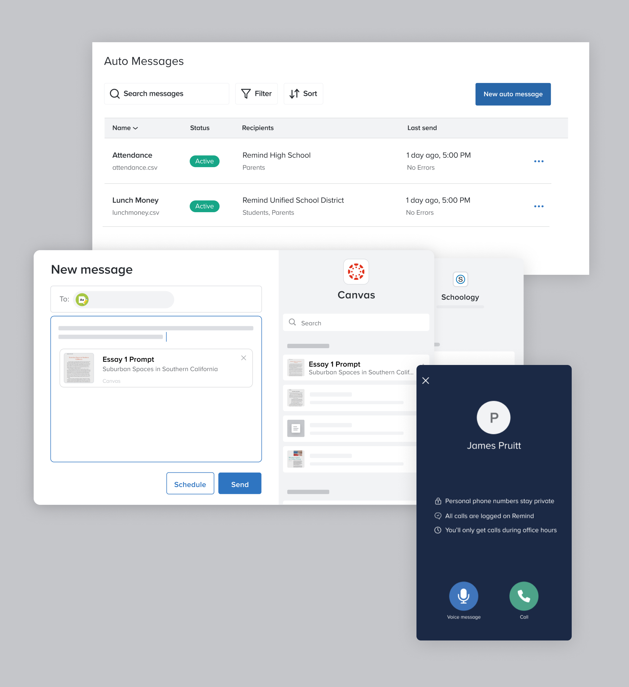
A platform made for schools and districts
For larger groups and organizations, the Remind plan includes higher class maximums and features for administrator oversight, communication, and more.
TIP
Customize your plan by adding premium features like LMS integration, advanced messaging, and urgent messaging.
TO THE EDUCATOR LEADING PD: Share this slide with your administrator if you’re interested in upgrading your organization to the Remind plan.

Slide 22
Ways to use Remind

Slide 23
Support student learning at home
M
Ms. Watkins
Hi families! Today we learned about volcanoes. Please ask your child the difference between lava and magma!
Ms. Watkins
Georgia
4/21/15 Delivered
2
M
Ms. Watkins
Do you know what type of rock this is?

Slide 24
H
Principal Hunt
Get parents involved at school
Parents: Please remember that we have a Parents’ Association meeting January 26. Dinner will be served!
Jayne Hunt
New York City
6/10/15 Delivered
5
H
Principal Hunt
Pre-K signup is from now until March 4. Please see Ms. Rivera for more information.
6/1/15 Delivered
1 6

Slide 25
Strengthen your community
P
Principal Dodd
Go to Mi Tradicion today from 4 PM to close to help support Tanner’s Kick-It Fund!
Bobby Dodd
Ohio
Today Delivered
130

Slide 26
T
Team Kennedy
Motivate and encourage
Thank you to everyone for an uplifting 1st Week! You are Making It Happen as we ride on that Energy Bus towards A Time For Greatness at JFK HS!
Sean Gaillard
North Carolina
4 hr ago Delivered
36
T
Team Kennedy
Today marks the 52nd Anniversary of the MLK “I Have a Dream” Speech. Here’s a brief blog post I wrote for you: http://bit.ly/1Jo4Xqx
11 hr ago Delivered
1 6

Slide 27
Reach families in urgent situations
P
Principal White
We had a massive power outage on Friday and even lost use of our phones for more than four hours. With Remind, I was able to ease concerns and update more than 700 parents and family members. As a principal, having the ability to contact my community in such a simple and direct manner is priceless and much appreciated.
P.A. White
California
11/7/15 Delivered
342 102

Slide 28
Send staff updates and information
K
Jennifer Kloczko
For the fire drill, remember to take your red folder. Hold up your green card if all are present, red if any students are missing.
Jennifer Kloczko California
4/5/15 Delivered
23 86
K
Jennifer Kloczko
Wear blue tomorrow in honor of World Autism Awareness Day!
4/1/15 Delivered
342 102

Slide 29
How can you use Remind in your classroom?
TO THE EDUCATOR LEADING PD: Ask participants how they can use Remind with their students and parents.
What ideas do they have? What problems could Remind help them solve?

Slide 30
Frequently asked questions
CAN I SHARE A REMIND CLASS WITH ANOTHER EDUCATOR?
You can promote another teacher to owner from your class settings. All owners have the same administrative abilities for the class.
WHAT IF STUDENTS OR PARENTS DON’T HAVE SMARTPHONES?
Students and parents can get Remind messages on any phone that can receive text messages, including prepaid phones, flip phones, and government-provided phones.
WHAT IF STUDENTS OR PARENTS DON’T HAVE A PHONE AT ALL?
Remind accounts can be created on any computer with internet access. Participants will see their messages whenever they log in to Remind.com, or they can choose to receive messages via email.
1
2
3

Slide 31
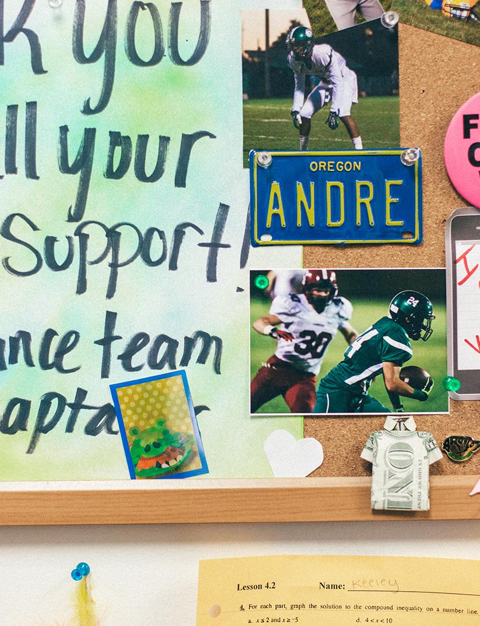
Get connected
Visit the Remind Help Center for instructions and tips about everything from account basics to class management.
Follow @RemindHQ on Twitter and Instagram for educator content, exclusive sneak peeks, and opportunities to win swag.
@RemindHQ

Slide 32
Thank you!

