Slide 1
Kinetic-molecular theory
Is based on the idea that particles of matter are always in motion.
This can be used to explain the properties of solids, liquids, and gases in terms of energy of particles and the forces that act between them.

Slide 2
Kinetic-molecular Theory of gases
An Ideal gas is a hypothetical gas that perfectly fits the FIVE assumptions of the kinetic-molecular theory.
A Real gas is a gas that does not behave completely according to the assumptions of the kinetic-molecular theory.

Slide 3
5 Assumptions:
1. gases consist of large numbers of tiny particles that are far apart relative to their size.

Slide 4
2. collisions between gas particles and between particles and container walls are elastic collisions. (elastic collision – one in which there is no net loss of total kinetic energy.

Slide 5
3. gas particles are in continuous, rapid, random motion. They therefore possess kinetic energy, which is energy of motion.

Slide 6
4. there are no forces of attraction between gas particles.
5. the temperature of a gas depends on the average kinetic energy of the particles of the gas.

Slide 7
Kinetic-Molecular theory of gases
Expansion – gases do not have a definite shape or a definite volume. They completely fill whatever container they are held in.
Fluidity – gas particles slide past each other, remember there is no attraction between gas particles. This lets gases flow and behave like liquids.
Low Density – density of gases at atmospheric pressure is about 1/1000 the density of the same substance in the liquid or solid state. The reason, the gas particles are very far apart.

Slide 8
Kinetic-Molecular theory of gases
Compressibility – gas particles can be compressed together because of the distances between each gas particle. Gases can transmit pressure equally in all directions.
Diffusion and Effusion –
Diffusion – spontaneous mixing of the particles of two substances caused by their random motion.
Effusion – a process by which gas particles pass through a tiny opening.

Slide 9
Kinetic energy equation
KE = $\frac{1}{2}$ mv² KE – kinetic energy m – mass v- velocity

Slide 10
Kinetic-Molecular theory of Liquids
Remember, whatever state of matter the substance is in, the particles of that matter are always in motion.
A liquid is a form of matter that has a definite volume and takes the shape of its container.
Particles of liquids are much closer to each other than gas particles.
The liquid particles are attracted to each other by the intermolecular forces (dipole-dipole forces) which can be quite strong.

Slide 11
Kinetic-Molecular theory of Liquids
Liquids
Relatively High Density – this is a result of the close arrangement of liquid particles. Water is one substance that is less dense as a solid than a liquid. Most liquids when they are in solid form are more dense.

Slide 12
Kinetic-Molecular theory of Liquids
Relative incompressibility – liquids are very difficult to compress into a smaller volume. Liquids can transmit pressure equally in all directions.
Ability to Diffuse – liquids, just like gases, can diffuse and mix with other liquids. Any liquid gradually diffuses throughout any other liquid in which it can dissolve. This is much slower in liquids than in gases.
Surface Tension – a force that tends to pull adjacent parts of a liquid’s surface together, thereby decreasing surface area to the smallest possible size.

Slide 13
Kinetic-Molecular theory of Liquids
Surface tension cont.
Capillary action – the attraction of the surface of a liquid to the surface of a solid.
a liquid will rise quite high in a very narrow tube and will wet the tube if a strong attraction exists between the liquid molecules and the molecules that make up the surface of the tube. Think meniscus, concave liquid surface. Capillary action is also why plants get water from it’s roots.

Slide 15
Kinetic-Molecular theory of Liquids
Vaporization is the process by which a liquid or solid changes to a gas.
Evaporation is a form of vaporization but,
Evaporation is the process by which particles escape from the surface of a non-boiling liquid and enter the gas state.
Boiling is the change of a liquid to bubbles of vapor that appear throughout the liquid. It also increases the temperature of the liquid.

Slide 16
Kinetic-Molecular theory of Liquids
Freezing is the physical change of a liquid to a solid by removal of energy as heat. Also called solidification.

Slide 17
Kinetic-Molecular Theory of SOLIDS
There are two types of solids:
Crystalline solids – exist as crystals, a crystal is a substance in which the particles are arranged in an orderly, geometric, repeating pattern.
Amorphous solid is one in which the particles are arranged randomly. Glass and plastics are good examples of amorphous solids.

Slide 19
Kinetic-Molecular Theory of solids
Solids have 1) a definite shape and volume
2) definite melting point
3)high density and incompressibility
4) low rate of diffusion

Slide 20
Melting physical change from a solid to a liquid
Melting point
The temperature at which a solid becomes a liquid

Slide 21
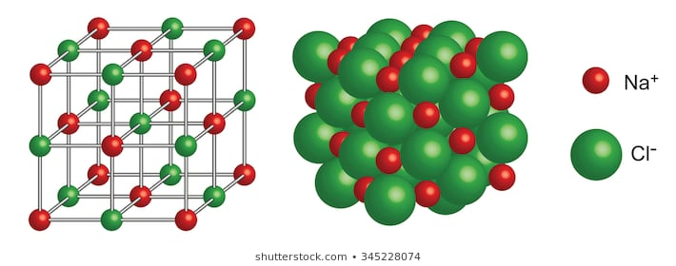
Crystal structure total three dimensional arrangement of particles of a crystal cubic

Slide 22
Fluorite crystal cubic

Slide 23
Emerald hexagonal

Slide 24
Calcite trigonal

Slide 25
Aragonite orthorhombic

Slide 26
Crystals can be classified by shape or chemical bonding type (4 types)
1. ionic crystals consist of positive and negative ions ( hard and brittle, high melting points, good insulators
2. covalent network crystals each atom is covalently bonded to its nearest neighbor atom
(hard and brittle, high melting points, nonconductors or semiconductors

Slide 27
3. metallic crystals consists of metal cations surrounded by a sea of delocalized valence electrons. Good conductors
4. covalent molecular crystals covalent molecular substance consists of covalently bonded molecules held together by intermolecular forces. (low melting points, relatively soft, easily vaporized, good insulators

Slide 28
Changes of State, sec 4
Phase – any part of a system that has uniform composition and properties
Solid
Liquid
Gas
plasma

Slide 30
Liquid Vapor equilibrium

Slide 31
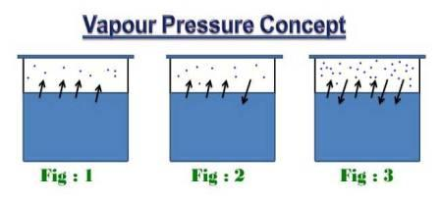
Equilibrium – a dynamic condition in which two opposing changes occur at equal rates in a closed system.
Equilibrium vapor pressure – the pressure exerted by a vapor in equilibrium with its corresponding liquid at a given temperature

Slide 32
If the temperature of the system is increased the equilibrium vapor pressure also increases
The more molecules of liquid with enough energy to escape liquid phase to vapor phase increases the equilibrium vapor pressure

Slide 33
Volatile liquids – liquids that evaporate readily, have relatively weak forces of attraction between their particles

Slide 34
The vapor pressure of any liquid increases as its temperature increases,
A liquid boils when its vapor pressure equals the pressure of the atmosphere – boiling point
Water boils at 100º C
^{For comparison}
Isopropyl alcohol boils at 180.5º C
Celcius converted to Fahrenheit
(Temp x 9/5) + 32 = degree fahrenheit

Slide 35
As vapor pressure increases above a liquid the temperature of the liquid increases until it is equal to the vapor pressure
Water boils at 100ºc at normal atmospheric pressure
Normal Atmospheric pressure is 1 atm or
760 torr or 101.3 kPa

Slide 37
Molar enthalpy of vaporization Hv (delta means change in)
Delta H sub v
The amount of energy as heat needed to vaporize one mole of a liquid at the liquids boiling point at constant pressure
Molar enthalpy of vaporization measures the attraction between particles of a liquid

Slide 38
Molar enthalpy of fusion H_{f}
Delta H sub f
Amount of energy as heat required to melt one mole of a solid at the solids melting point

Slide 39
Phase diagram -= graph of pressure versus temperature that shows conditions under which the phases of a substance exist. A phase diagram also reveals how the states of a system change with changing temperature or pressure

Slide 40
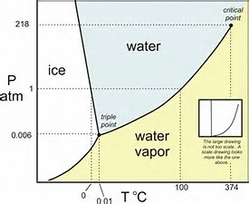
Phase diagram

Slide 41
Triple point – of a substance indicates the temperature and pressure conditions at which the solid, liquid, and vapor of the substance can coexist at equilibrium
Critical point – of a substance indicates the critical temperature and critical pressure
Critical temperature – ( t_{c} ) is the temperature above which the substance cannot exist in the liquid state
Critical pressure – ( Pc ) is the lowest pressure at which the substance can exist as a liquid at the critical temperature

