Slide 1
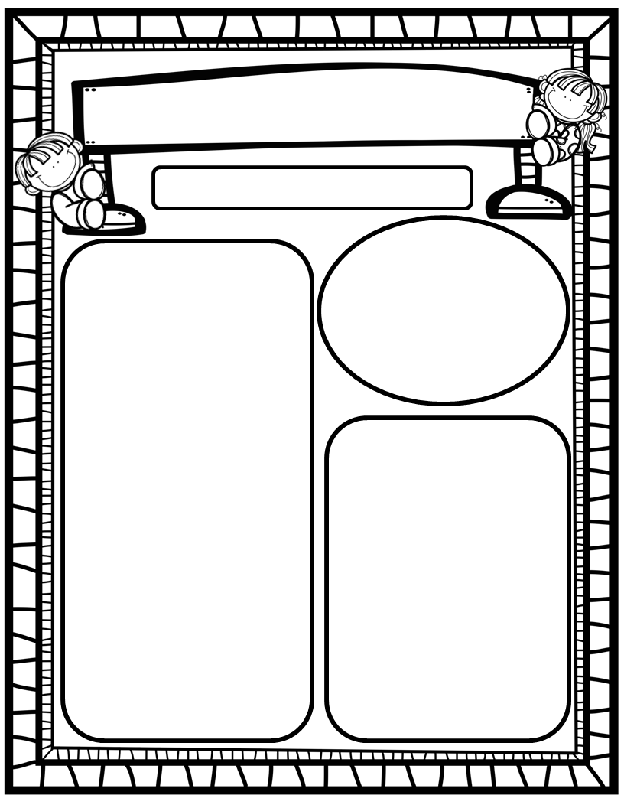
The Deason Digest Weekly Blast
February 17th, 2025
Homework:
Read to and with your child each night and record books on Reading Rally Log!
Practice HFW’s: the, I, and, a, is, as, said, to, do, of, see, he, be, me, from, was, you, have, what
Go Math Home Practice for Ch. 10
UFLI Home Practice Pages
Go over Weekly Work and discuss
We Are Learning About…
Reading: We will review the vowels Aa, Ii, Oo (SHORT sound production, mouth placement, words that begin with the sound & words with sound in middle), and HFW’s REVIEW. We will identify main topic and several key details. We will look at pictures, get our mouths ready, and use chunky monkey to help us stretchy-snake tricky words faster. EQ: How can we learn about the past?
Writing: We will focus on printing and tracing upper and lowercase Aa, Ii, and Oo, as well as using stretchy-spelling and sight words to write complete sentences!
Math: We will end Go Math Ch. 10: Put Together and Take Apart Numbers to 10, and begin Go M ath Ch. 11: Addition Up to 5!
Science: We will begin Unit 4: Day and Night!
Social Studies: We will continue to practice I-Care Rules. We will practice what it means to show Courage! We will continue learning about impactful African Americans as we progress in Black History Month! We will discuss Presidents’ Day, and the impact George Washington and Abraham Lincoln had on our country!
Important Dates:
February 17: Presidents Day/No School
February 19: Class and Spring Picture Day
February 20: SAC/PTO 6pm/7pm
February 27: BHM Late Night Library

