Slide 1
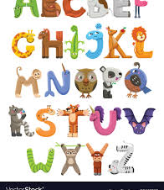
Watch Ms. Burr’s video or sing and dance to the song:
https://drive.google.com/file/d/1KRtVU6lFYIaNTTwtukmOCaN2-h2bWuCe/view
Animal Alphabet

Slide 2
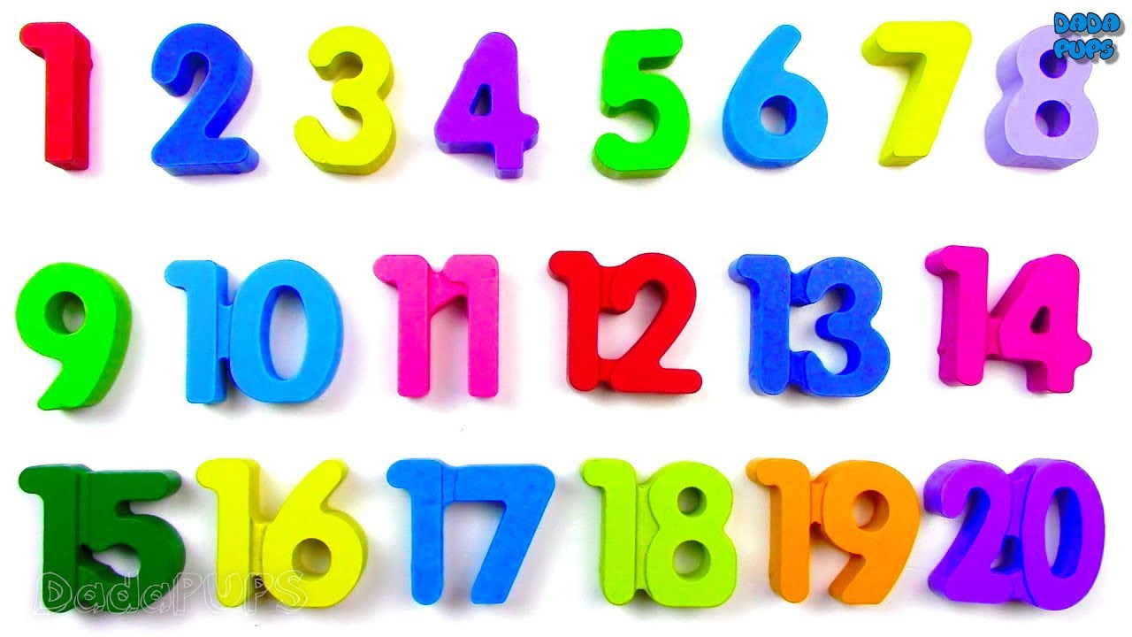
Watch the video: https://www.youtube.com/watch?v=azIG0kLIlgs
Count to 20!
Touch each number as you count!

Slide 3
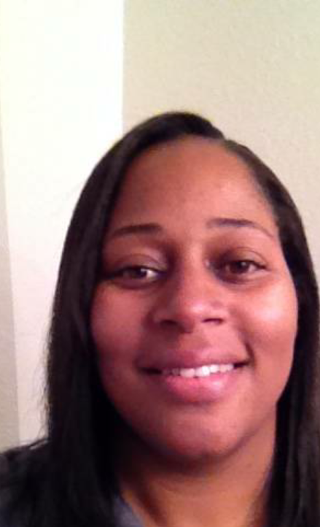
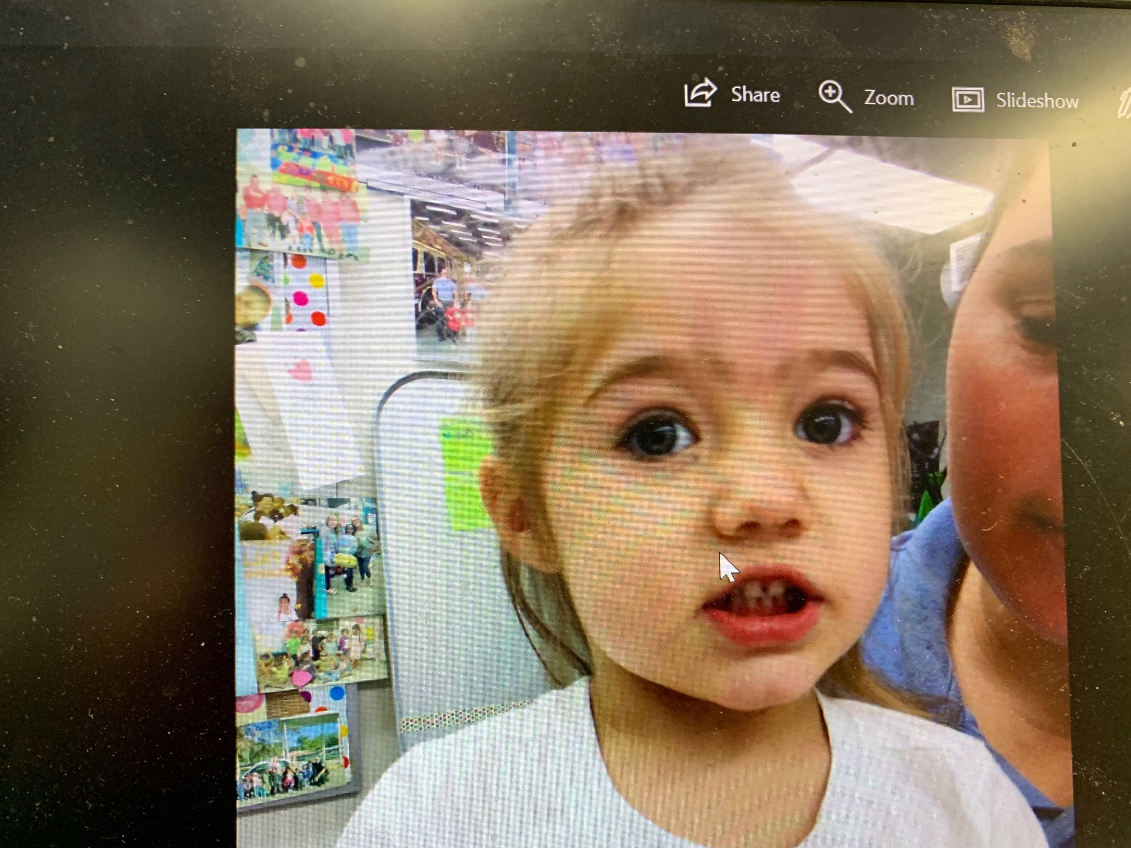
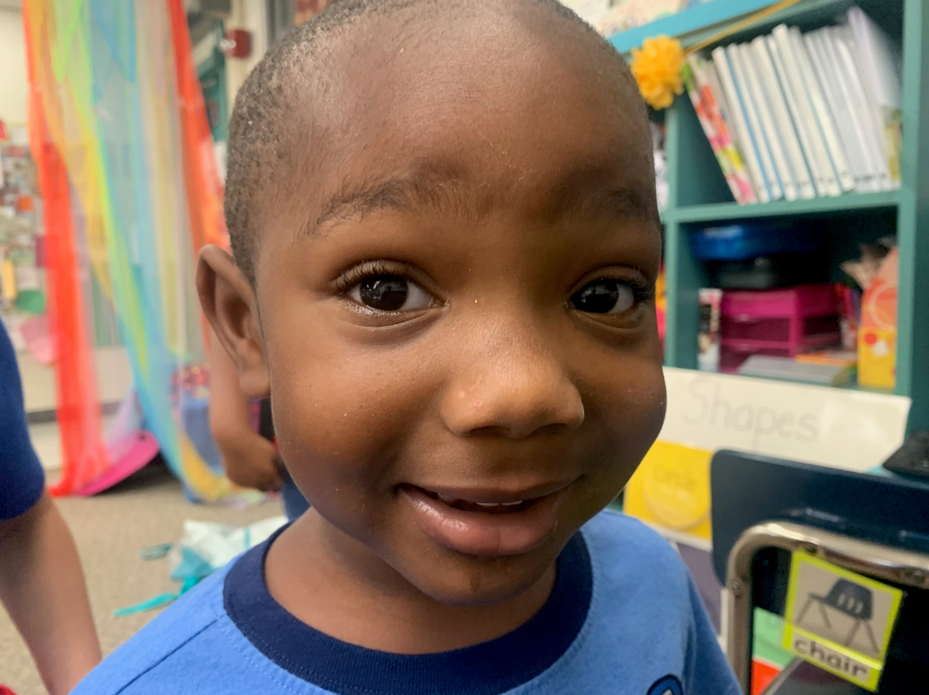
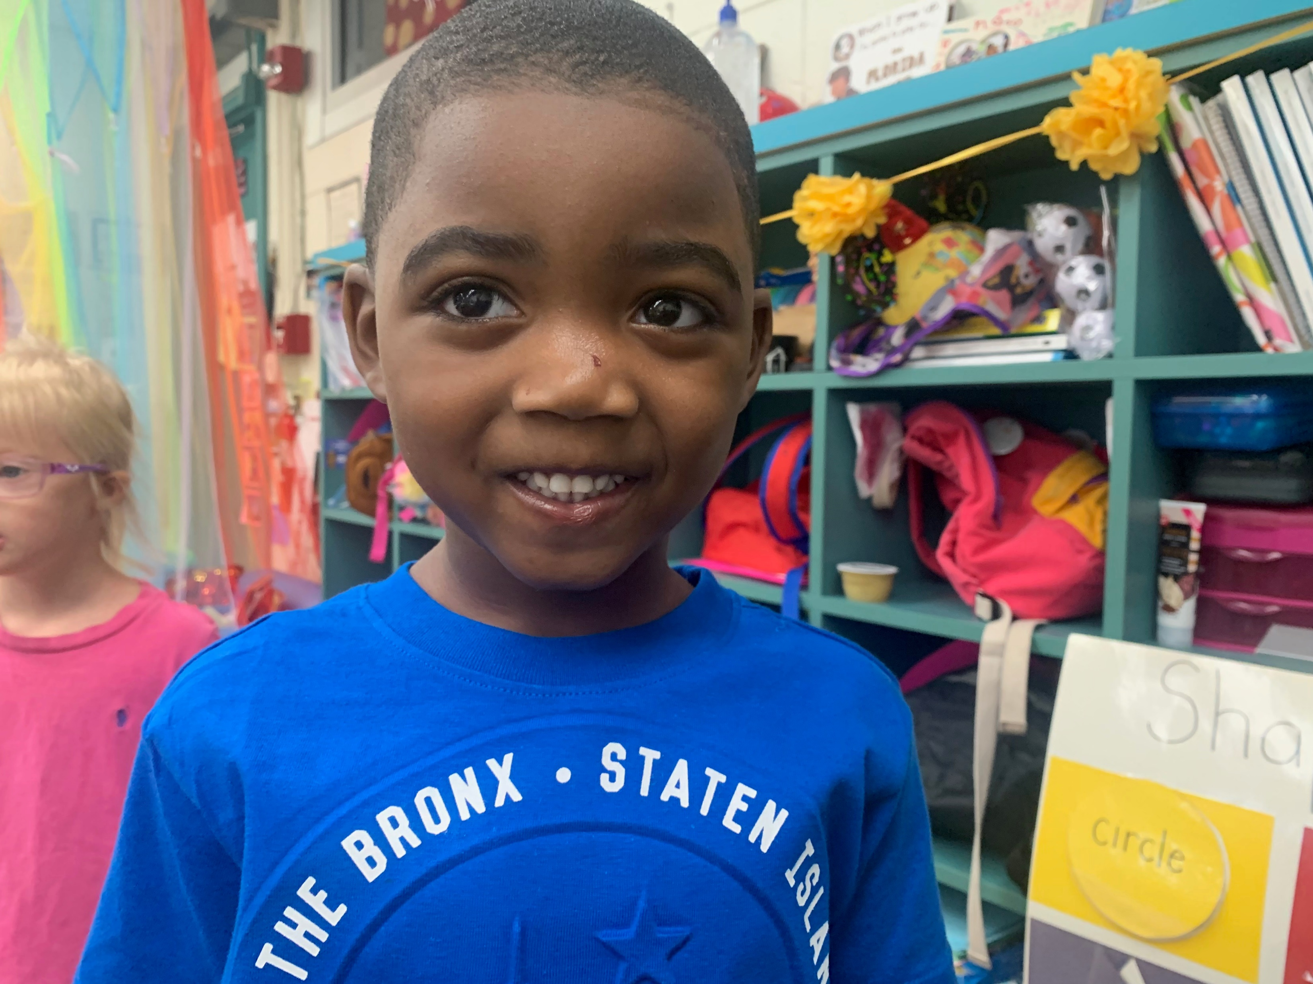
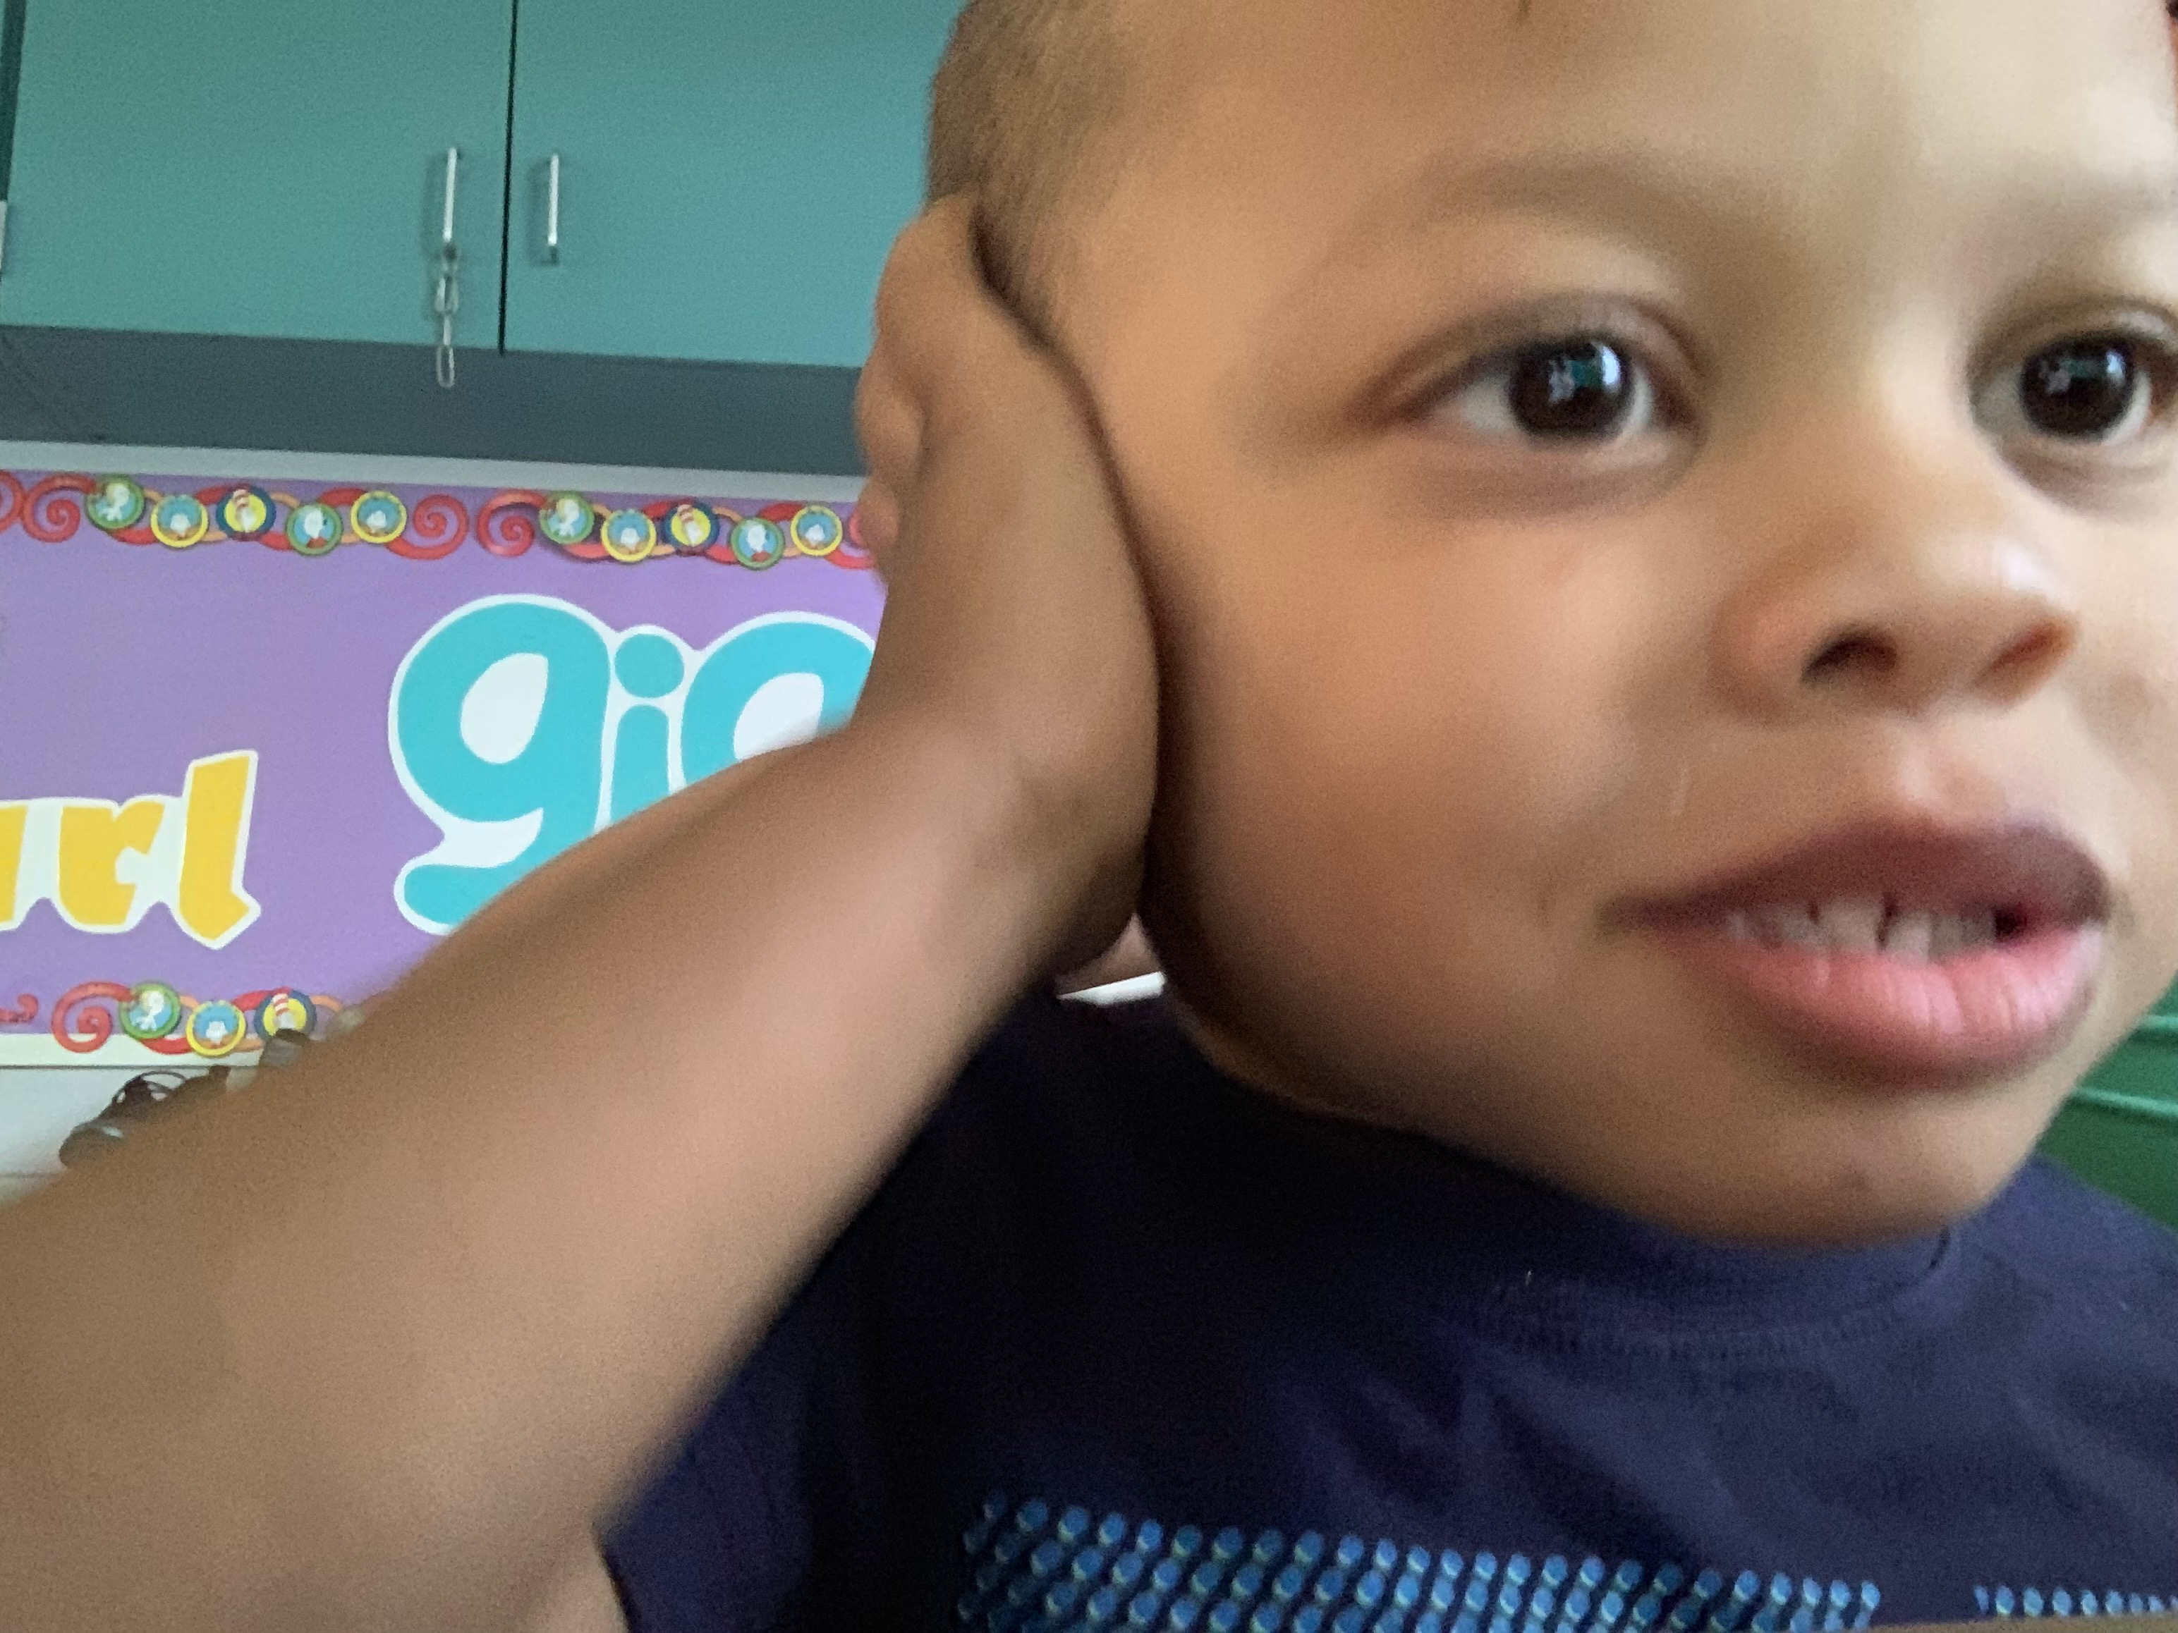
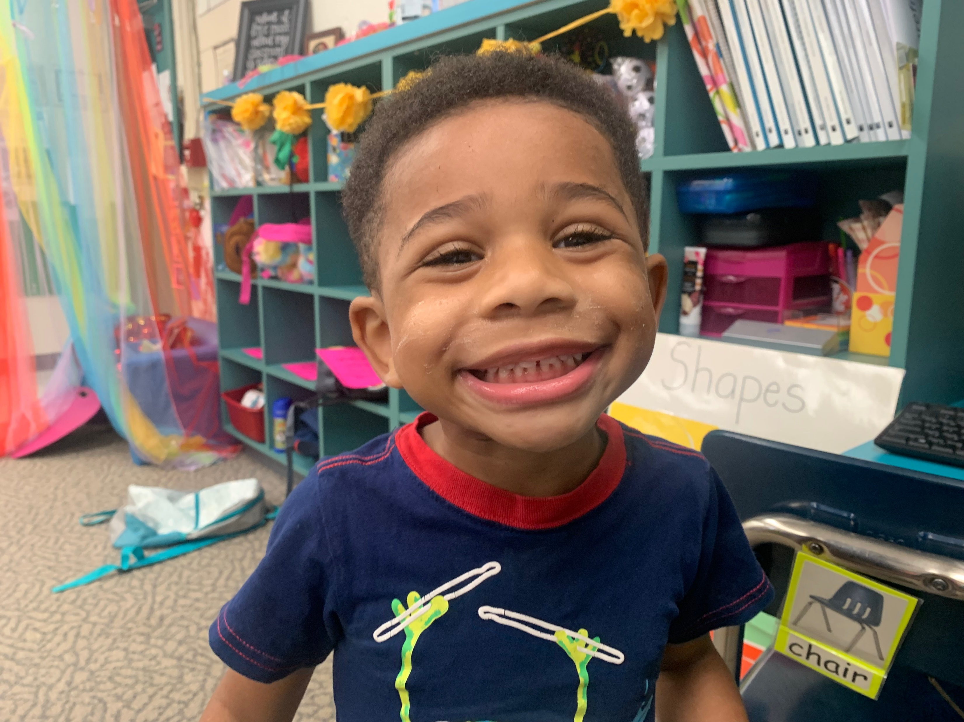
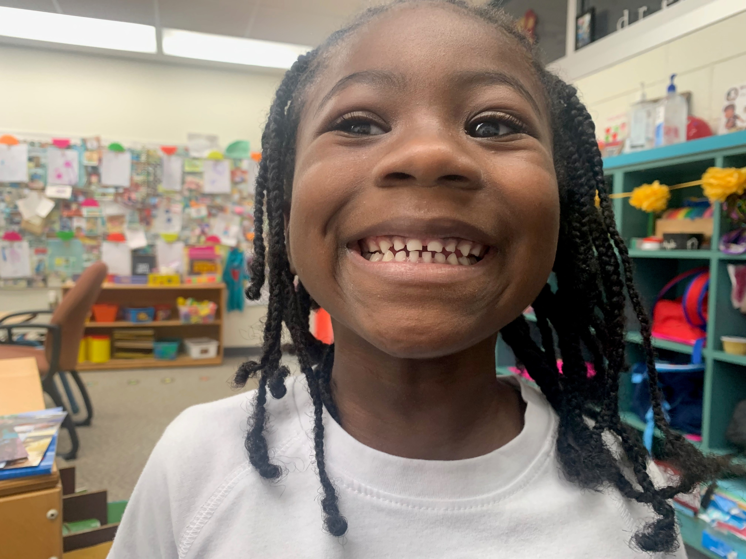
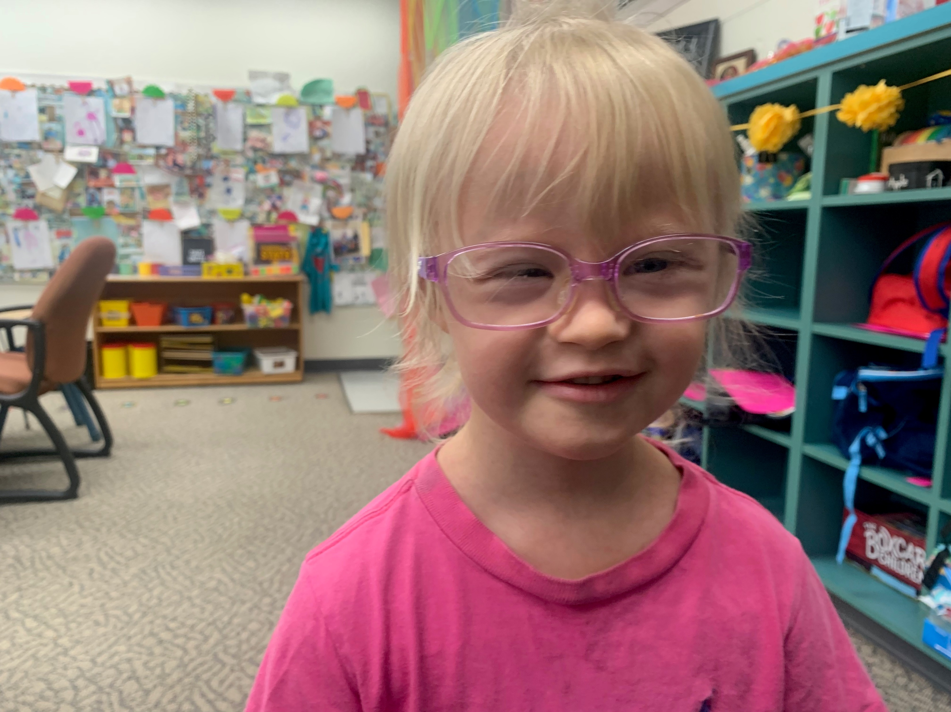
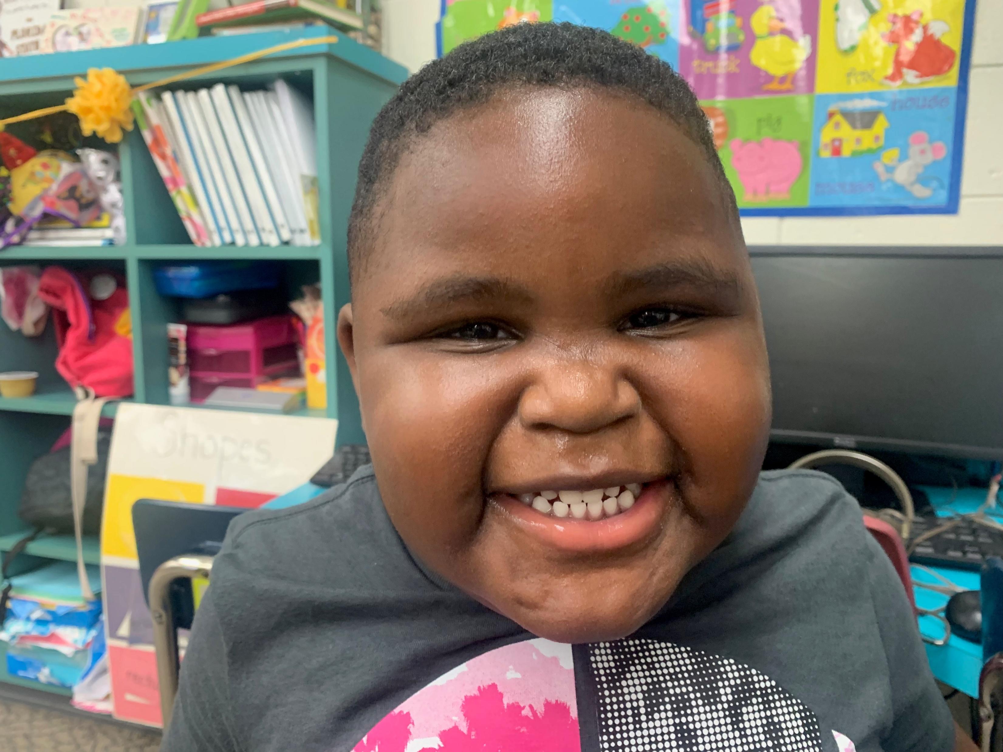
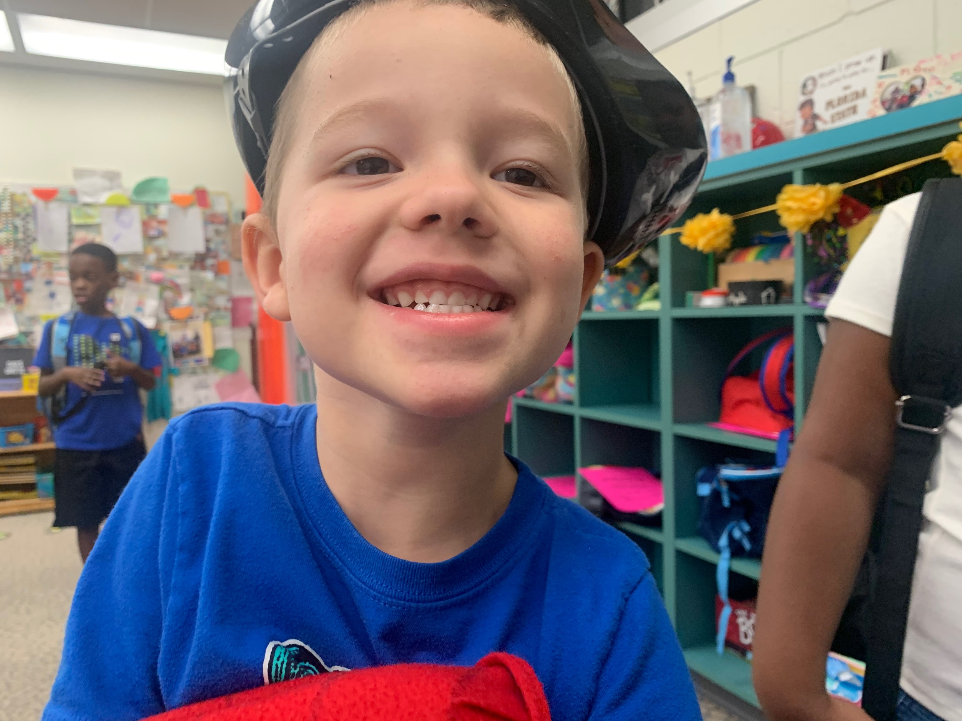
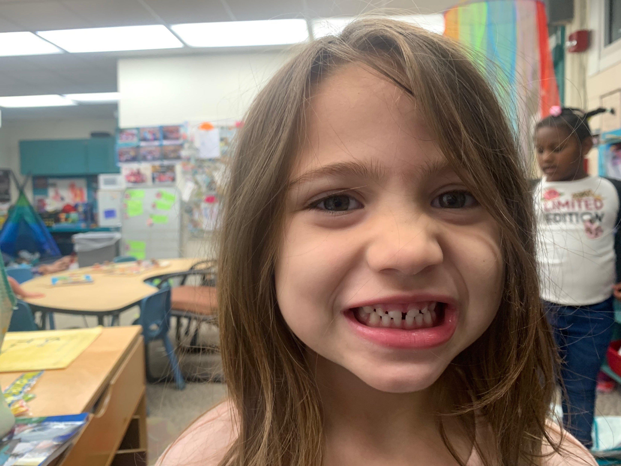
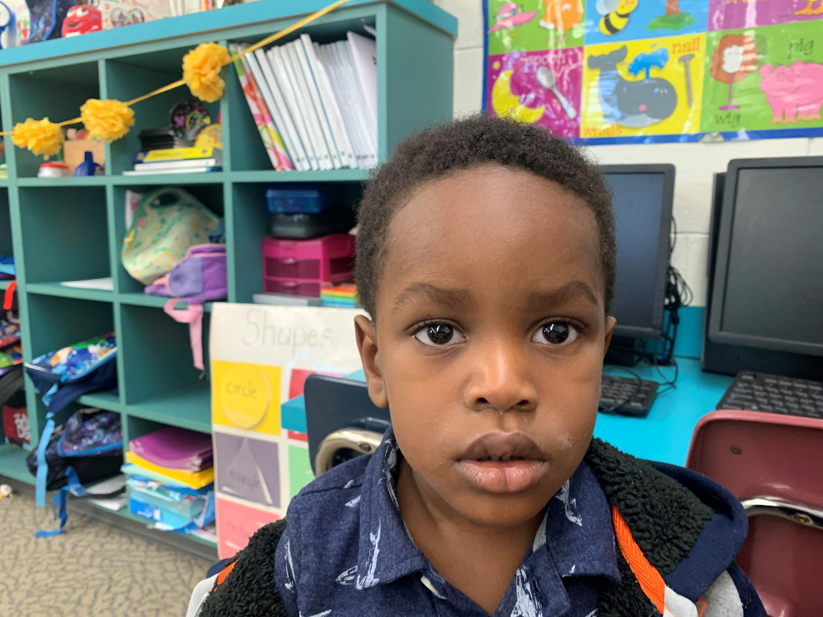
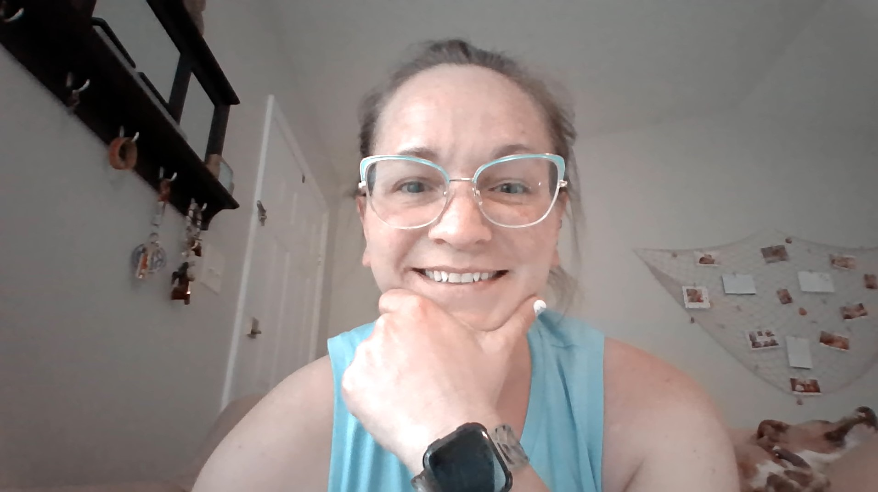
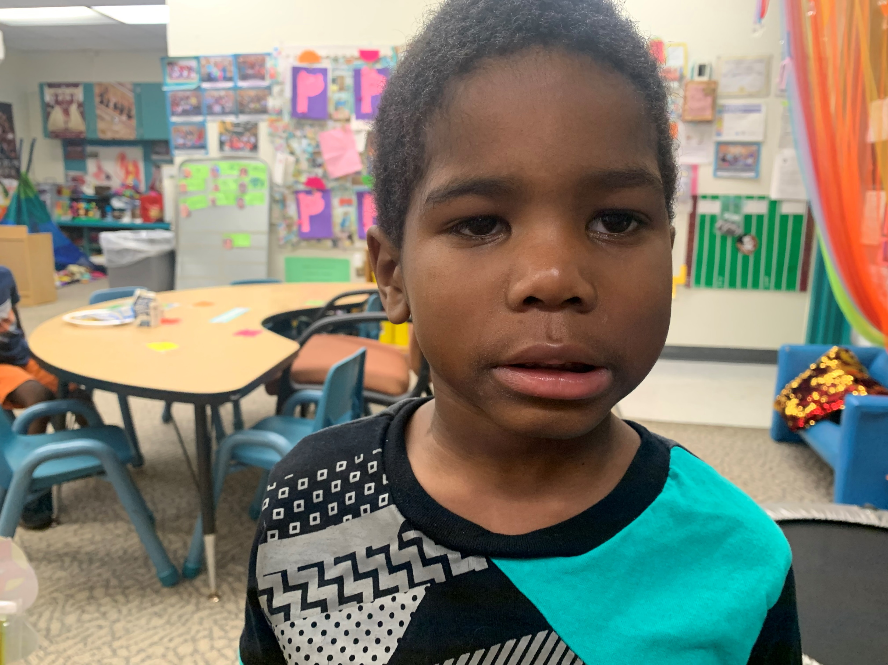
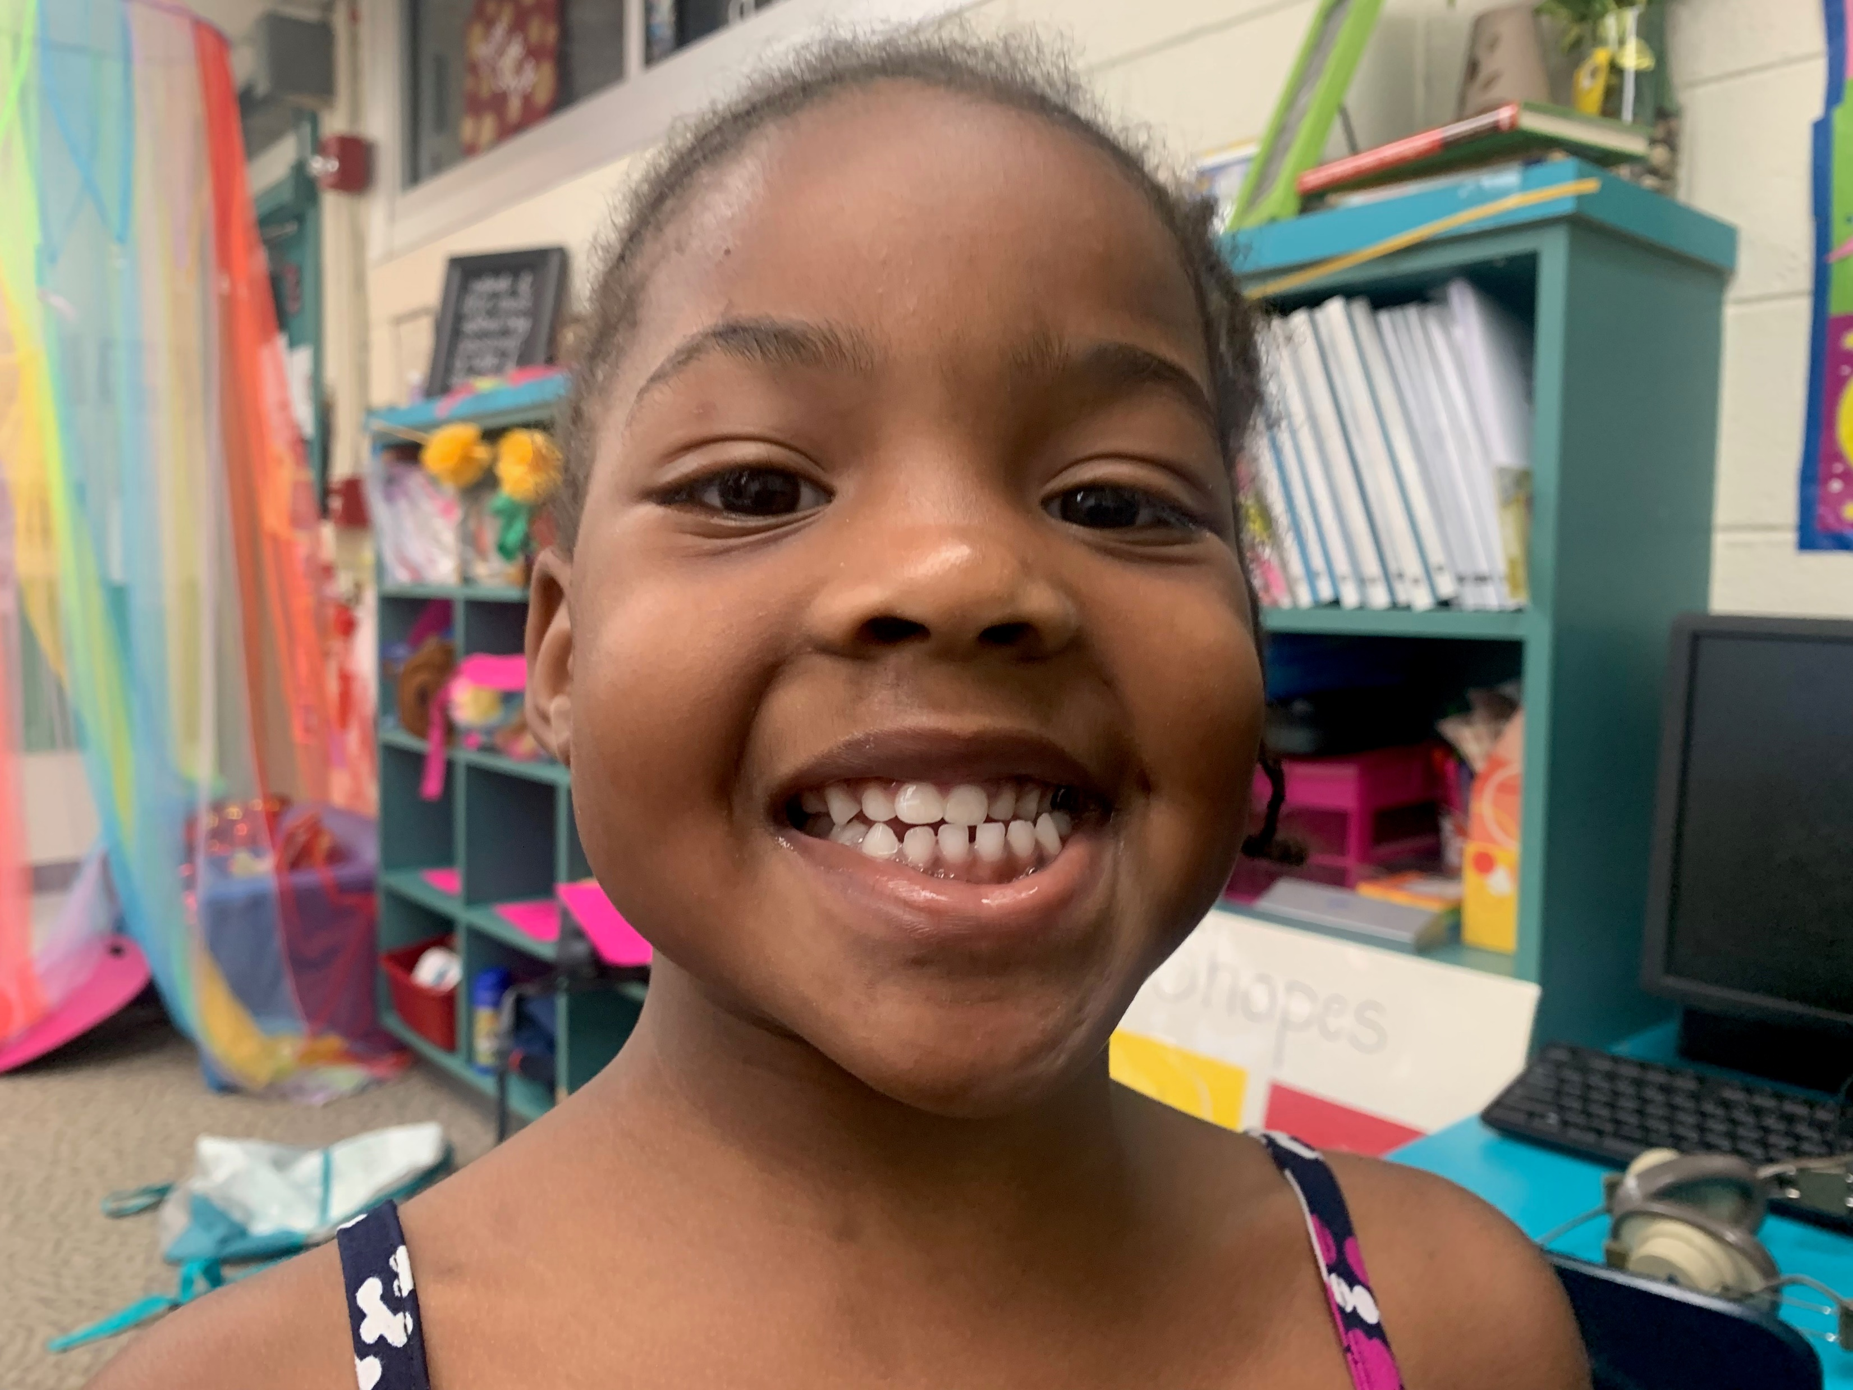
Name your friends! We miss you! Can you name all the letters in your name? What letter does each person’s name start with?
Amelia Kasen Jayshun Perry
Ms. Clemons
Keithphawnie Ayrien Iona Kaleb Logan
Scarlett Venson Ms. Burr Delonte Daelyn

Slide 4
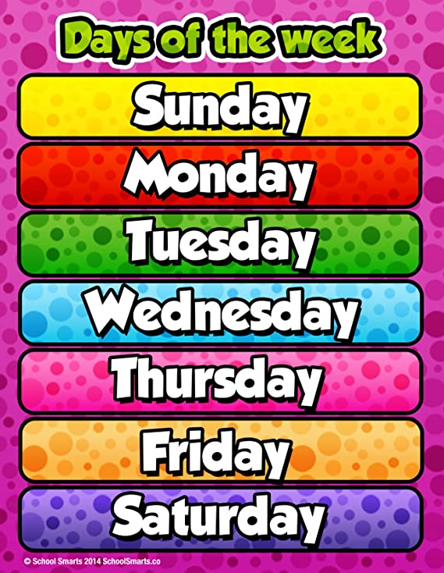
What day of the week was YESTERDAY?
What day of the week is TODAY?
What day will be TOMORROW?
What letter does each day of the week start with?
Watch the song!
https://www.youtube.com/watch?v=oKqAblcwFOA

Slide 5
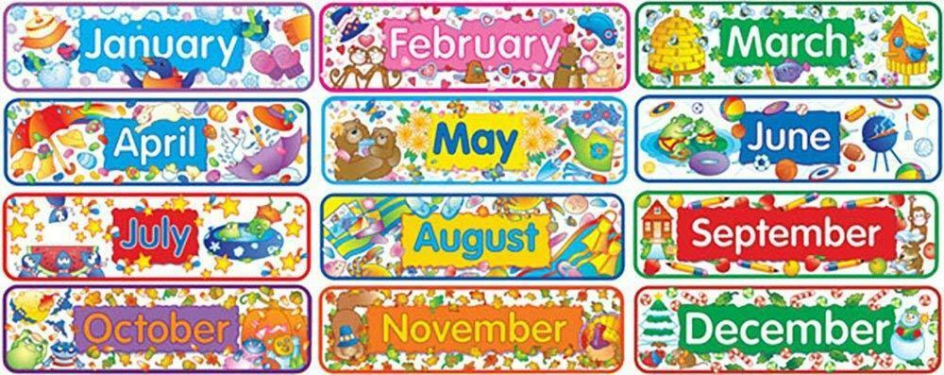
How many months are in a year?
Do the Macarena Months song: https://www.youtube.com/watch?v=aOY5YuBgUHg

Slide 6
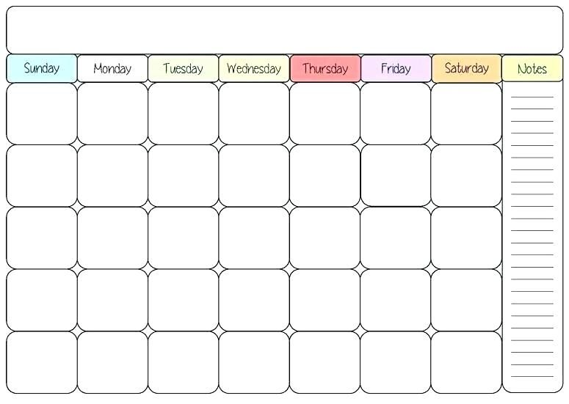
April 2020
Count how many days we have had in April so far…
1
2
3
4
5
6
7
8
9
10
11
13
14
15
16
18
…touch each number as you count!
12
17
19
20
21
22
23
24
25
26
27
28
29
30

Slide 7
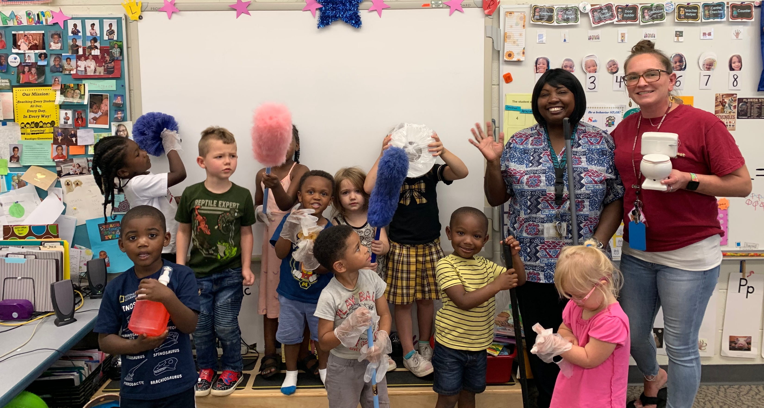
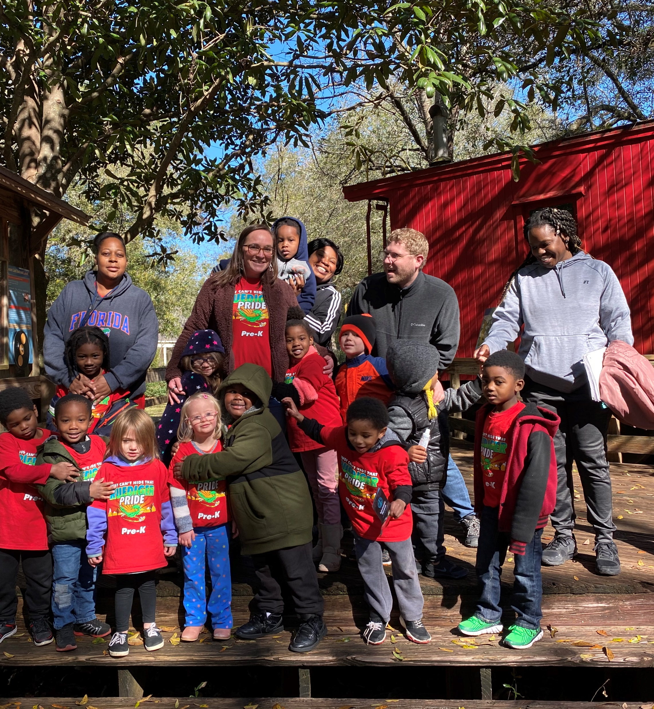
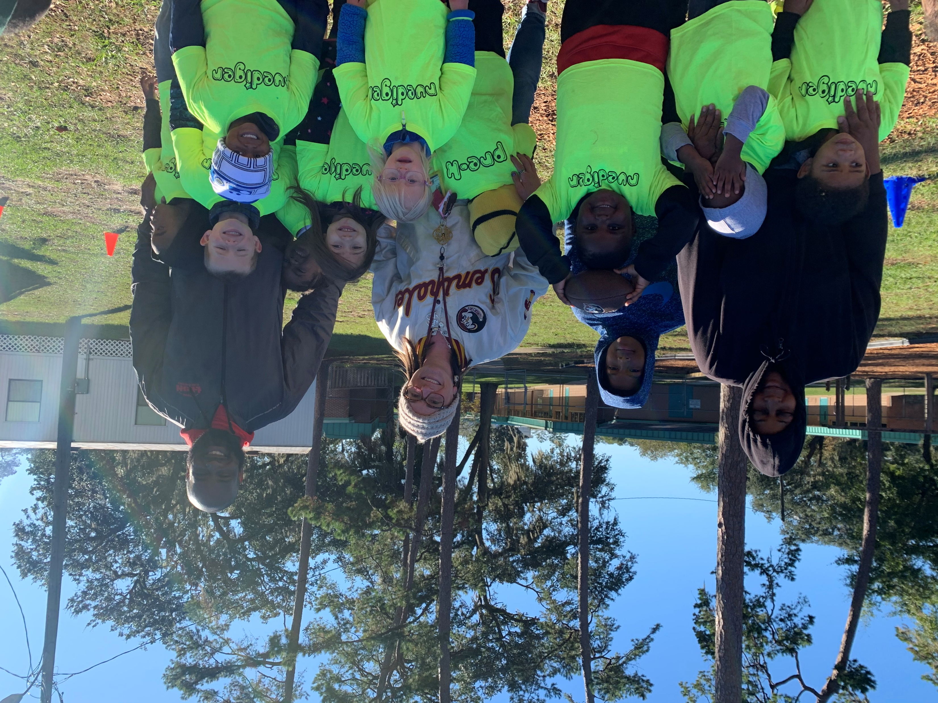
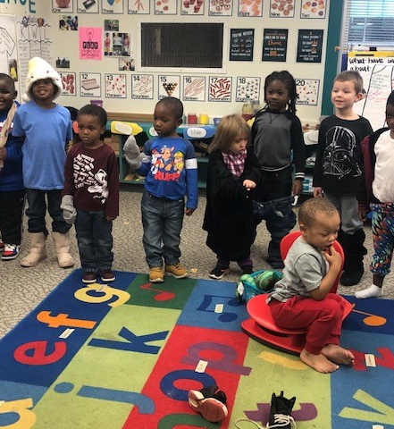

Slide 8
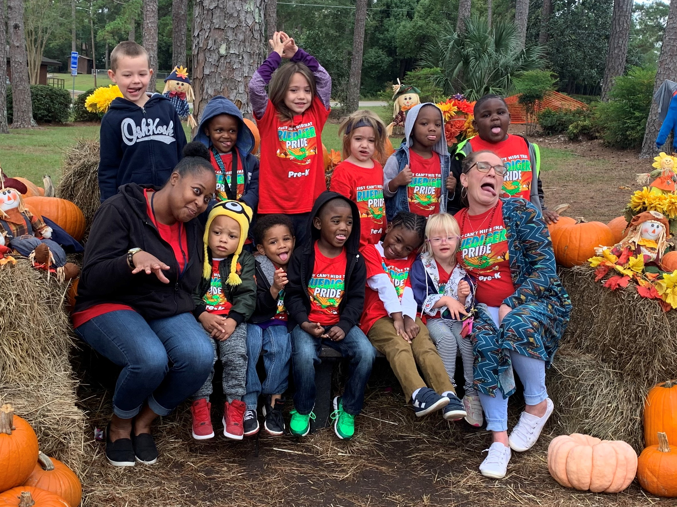

Slide 9
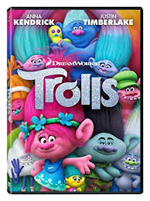
Let it Go: https://www.youtube.com/watch?v=moSFlvxnbgk
Can’t Stop the Feelin’: https://www.youtube.com/watch?v=oWgTqLCLE8k
WE MISS YOU! –Ms. Burr & Ms. Clemons –click on the black rectangle!

