Slide 1
Wes Peden
By: Kayla Carter and Haley Mcdermid

Slide 2
Who is Wes Peden?
Wes Peden is 2012-2014 Most popular juggler
Wes Peden designs juggling to perform in space stations and other places
He is a young Juggler from Rochester, New York. Born May 9, 1990
http://viflux.com/portfolio/throw-joy-by-wes-peden-trailer--1220765

Slide 3
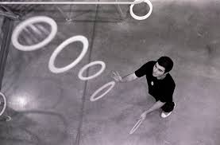
Accomplishments of Wes Peden
2007-2014 First place in the top 40 juggler (except 2011)
6 club Backcrosses, 6 club singles, 7 club (8x,6)* in 2008
6 club b97531 in 2009
6 club halfshower in 2012
7 club Backcrosses, 7 catches 2015
http://www.cleanvideosearch.com/media/action/yt/watch?videoId=Q1hwb1h8R5s

Slide 4
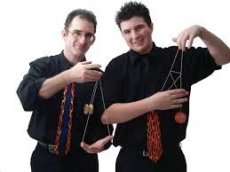
How wes became a juggler
His father Jeff Peden taught Wes how to juggle when he was 5 years old
Wes started performing juggling at the age of 11 with his father Jeff
He attended many competitions in many different countries such as Japan, Israel, Australia, and Iceland and 14 others

Slide 5
Other views for Wes Peden
He is making a film called “Expectations” it has some clips of juggling tricks he has done over the years
He has another video called “Marshmallow” which apparently was really good for the juggling world
Click below for Expectations trailer
https://www.youtube.com/watch?v=bTd0URwzmpA

Slide 6
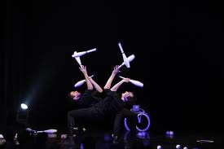
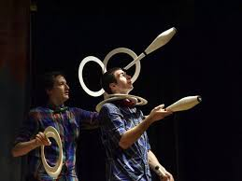
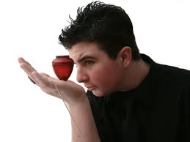
Instagram page
https://instagram.com/wespeden/

Slide 7
THE
End

