Slide 1
Weather in Environments and Climate Zones
SC.5.E.7.5 Recognize that some of the weather-related differences, such as temperature and humidity, are found among different environments, such as swamps, deserts, and mountains.
SC.5.E.7.6 Describe characteristics (temperature and precipitation) of different climate zones as they relate to latitude, elevation, and proximity to bodies of water.
Notes:
Today, we will explore some of the weather-related differences, such as temperature and humidity, that are found among different environments, such as swamps, deserts, and mountains. We will also look at characteristics (temperature and precipitation) of different climate zones as they relate to latitude, elevation, and proximity to bodies of water.

Slide 2
Different Environments
A forested or shrub-filled
wetland with low elevation.
THE SWAMP
Areas of land which receive very little rainfall during the year.
DESERTS
A large landform that stretches above the surrounding land
MOUNTAINS
Notes:
Differences in weather conditions are commonly found among different environments.

Slide 3
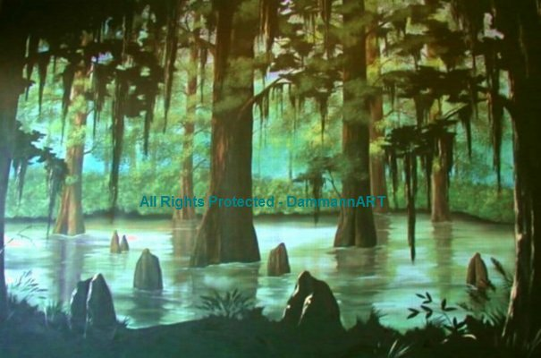
SWAMP
A forested or shrub-filled wetland
with low elevation. The water comes from surrounding rivers or lakes that have been flooded. The swamp becomes filled with water to significant depths. The surrounding land may also become flooded with water.
T H E S W A M P
Notes:
A swamp is a forested or shrub-filled wetland with low elevation. The water comes from surrounding rivers or lakes that have been flooded. The swamp becomes filled with water to significant depths. The surrounding land may also become flooded with water. The water in the swamp is very slow moving. The swamp can become very dry during certain parts of the year. In fall and summer months, it becomes very warm and humid. The humidity lessens and the temperature becomes cooler during the other seasons.

Slide 4
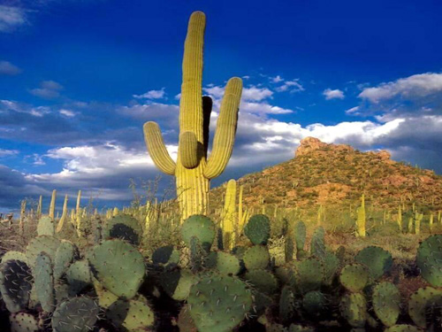
DESERT
THE GRAND CANYON ARIZONA DESERT
Deserts are areas of land which receive very little rainfall during the year.
Notes:
Deserts are areas of land that receive very little rainfall during the year. Because of the lack of moisture in the area, the humidity level is little to none. The temperature however, is very hot during the day yet, cold at night. The harsh weather conditions make it very hard for most organisms to survive in the desert.

Slide 5
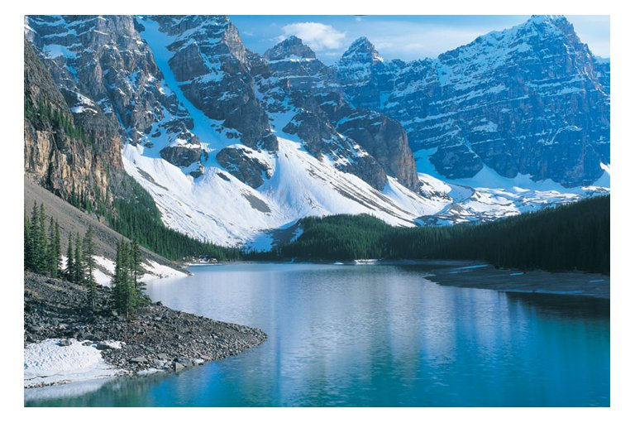
MOUNTAINS
A large landform that stretches above the surrounding land in a limited area usually in the form of a peak.
THE ROCKY MOUNTAINS
Notes:
Mountainous environments have much lower temperatures due to their higher altitude. Mountains block the flow of air masses, therefore, causing them to rise above the mountain’s terrain. The cool rising air mass causes condensation and precipitation, providing more vegetation on one particular side of the mountain. The cooler air holds less humidity as it reaches the top of the mountain.

Slide 6
TEMPERATURE AND HUMIDITY
ENVIRONMENT
TEMPERATURE
HUMIDITY
Very warm during the summer but cooler during other seasons
Higher during warmer seasons and lower during cooler seasons
SWAMPS
Very hot during the day and cold at night
Little to none
DESERTS
Lower due to high altitudes
Less as it reaches the top of the mountain
MOUNTAINS
Notes:
The temperature and humidity is very different between swamps, deserts, and mountainous terrain.

Slide 7
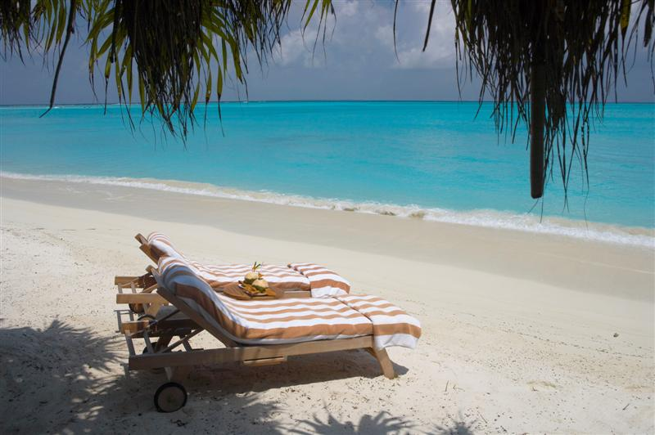
TROPICAL CLIMATE ZONES
Area located between 23.5° north and 23.5° south of the equator. Because of its closeness to the equator it receives very direct sun rays and therefore, has higher temperatures.
MARCO ISLANDS
Notes:
The Tropical Climate Zone is the area located between 23.5° north and 23.5° south of the equator. Because of its closeness to the equator, it receives very direct sun rays and therefore, has higher temperatures. The amount of precipitation ranges from very little to extremely high levels. The rainforest, the savanna, and the desert biome all fall under the category of Tropical Climate Zones. Places like South America, Africa, and India are examples of locations that have this type of climate.

Slide 8
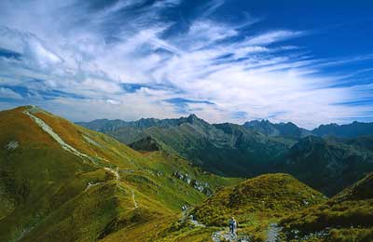
TEMPERATE CLIMATE ZONES
Malopolska
Area located between 23.5° and 66.5° north and south of the equator. Temperate is defined as between two extremes, tropical heat and arctic cold.
Notes:
The Temperate Climate Zone is the area located between 23.5° and 66.5° north and south of the equator. Temperate is defined as between two extremes, tropical heat and arctic cold. Temperate zones have hot summers and cold winters. Within these regions, several different types of weather may occur depending on an area’s location in relation to bodies of water and landmasses. Biomes in this area include but are not limited to: the deciduous forests and the grasslands. The Great Plains, Korea, and Japan are all locations that have temperate climates.

Slide 9
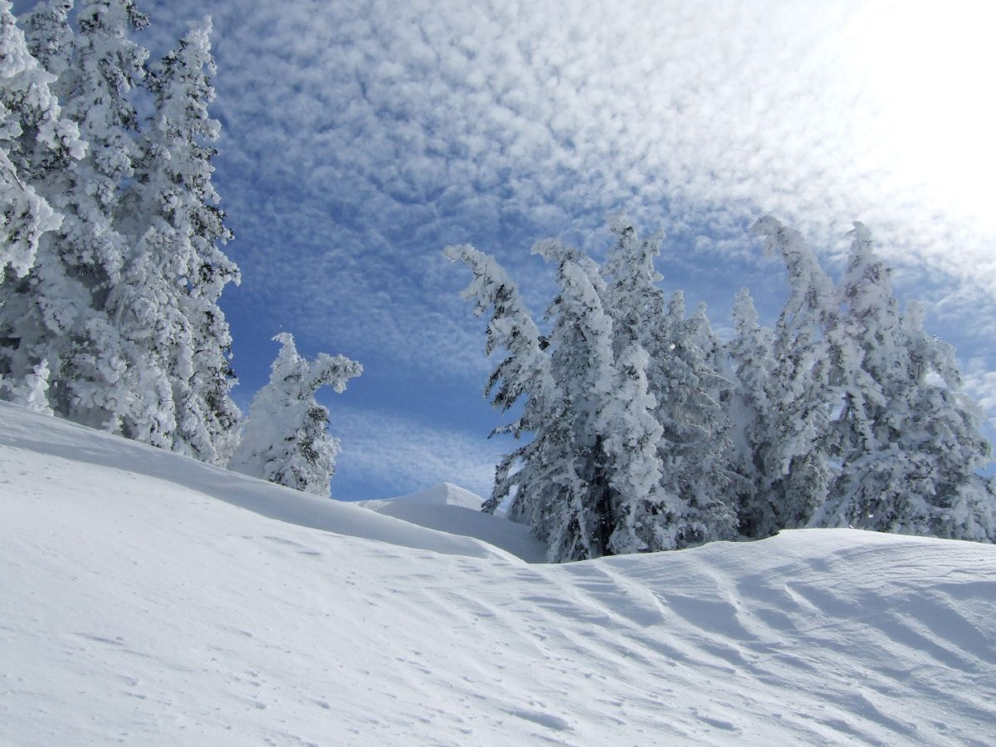
POLAR CLIMATE ZONES
Area located between 66.5° north and south of the equator and the poles. This area receives very little radiation.
POLAR
ZONE
Notes:
The Polar Climate Zone is the area located between 66.5° north and south of the equator and the poles. This area receives very little radiation and therefore, has low temperatures and precipitation that forms ice throughout the year. The tundra, the alpine, and the taiga are all biomes in the Polar Regions. Places like the Rocky Mountains in North America, Canada, and Alaska have polar climates.

Slide 10
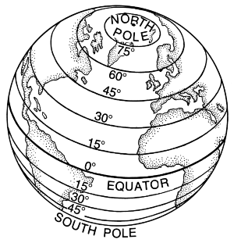
POLAR ZONE
between 66.5°
North
TEMPERATE ZONE
23.5° and 66.5° North
TROPICAL ZONE
between 23.5° north and 23.5° south
TEMPERATE ZONE
23.5° and 66.5° South
POLAR ZONE
between 66.5°
South
Notes:
The latitude of a location on the Earth is the angular distance of that location south or north of the Equator.

Slide 11
TEMPERATURE AND PRECIPITATION
ENVIRONMENT
TEMPERATURE
PRECIPITATION
TROPICAL CLIMATE ZONES
Higher because its so close to the equator
Ranging from little to very high levels
TEMPERATE CLIMATE ZONES
Between tropical heat and arctic cold
Dependent on area’s location in relation to bodies of water and landmasses
POLAR CLIMATE
ZONES
Low throughout
the year
Low and forms
ice all year
Notes:
Climate zones differ in temperature and precipitation as the latitude, elevation, and proximity to bodies of water changes.

