Slide 1
All About Tops
By Emily Schall – 5th Period

Slide 2
History of Spin Tops
To tell the history of throw tops, you must start with spin tops. They are not known exactly when they were first introduced.
Although it does not have a specific invention date, it does have a history dating very far back.
Clay tops – 3500 B.C. in the city of Ur, southeast of modern Baghdad, Iraq
Terra Cotta tops - 3000 B.C. at Troy, now northwest Anatolia in modern Turkey
Wood tops – Between 2000 – 1400 B.C., discovered in Egypt
Roman bone tops – 2000 B.C. to 27 B.C.
Whip tops - 1250 B.C. in China

Slide 3
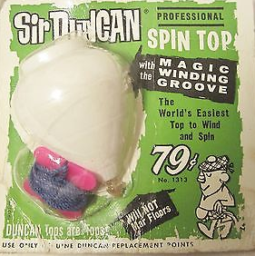
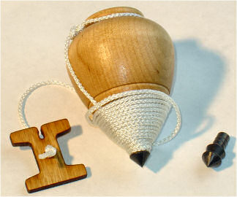
History of Throw Tops
According to yoyomuseum.com, throw tops became a favorite pastime of European and American children during the 18th and 19th centuries.
Commonly made with wood, iron, and tin, where as they’re more commonly made with plastic today.

Slide 4
Bearing vs. Fixed
A bearing tip, as seen on the left, allows the top to spin independently and the tip does not spin. A fixed tip however spins with the top.
A fixed tipped top will fix itself if it is tilting on the ground, however a bearing top will not.
Some tricks require a bearing or fixed tip, and some tricks are also possible with the other.

Slide 5
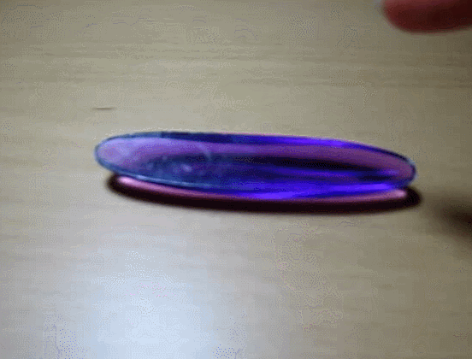
Types of Tops
Dreidel
Four sided, played with during Hanukkah
Each side shows different letters of the hebrew alphabet, and is meant to be a game
Rattleback
Semi-ellipsoidal top, rotates
on its axis in a direction,
becomes unstable, “rattles”,
then reverses to the other
direction

Slide 6
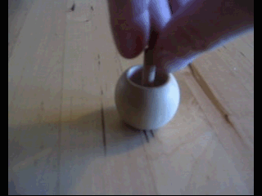
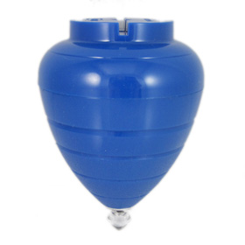
Types of Tops (cont.)
Tippe Top
When spun at high angular velocity, it slowly tilts until it lifts the body off of the ground with the handle.
Trompo / Whipping Top
What we all know and call a throw top. Thrown by winding a string around the top and then body then thrown so it lands on its point.

Slide 7
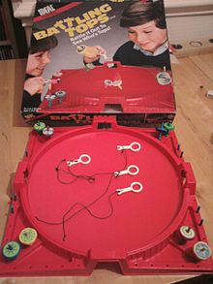
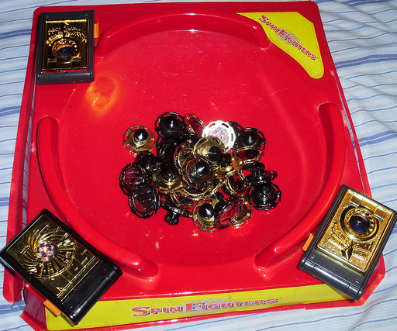
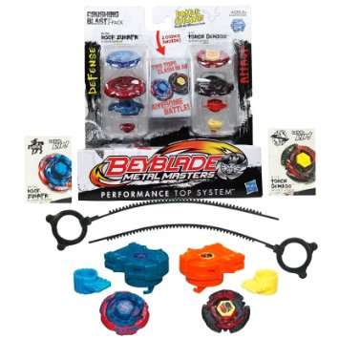
Types of Tops (cont.)
There are also ‘competitive’ tops which use strings or launchers as seen. This brings awareness, fun and the element of competition to the concept of spin tops to children. (Although the win/loss seems to be mostly random.)
Battling Tops Spin Fighters Beyblade

Slide 8
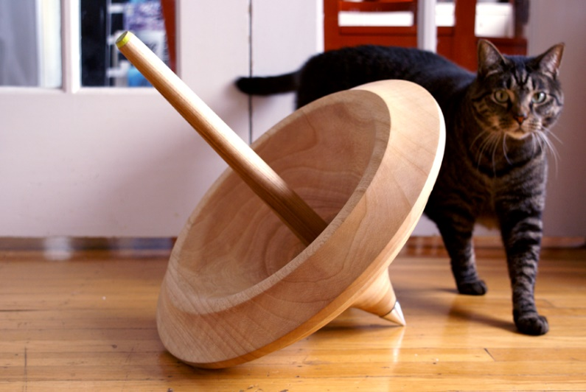
Trivia
Tops work based on the “Gyroscopic Effect” .
The name ‘trompo’ (we know as throw top) came from Latin America.
Japan has similar tops known as ‘komas’. Each city in Japan has a specific design for their koma.
The largest top weighs around 15 lbs., found in primitive Malay and most often used by adults.

Slide 9
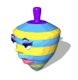
Credits for Images and Info
Images:
http://www.ebay.com/itm/141842545175
http://blog.turnertoys.com/category/wooden-toys-blocks/
http://uncyclopedia.wikia.com/wiki/File:Dreidel.gif
Custom made gif of the Rattleback from https://commons.wikimedia.org/wiki/File:Rattleback_in_action.ogg
https://en.wikipedia.org/wiki/Tippe_top#/media/File:Snurra_uppochner.gif
http://shop.yoyoexpert.com/product/282/Duncan-bearing-King-Spin-Top
https://en.wikipedia.org/wiki/Battling_Tops
http://www.fanpop.com/clubs/whatever-happened-to/images/25390585/title/spin-fighters-photo
http://www.gifmania.co.uk/Objects-Animated-Gifs/Animated-Toys/Spinning-Tops/
Information:
http://www.yoyomuseum.com/museum_view.php?action=profiles&subaction=spintop
http://www.byron.com/topbook/history.html
http://www.woodenspinningtops.com/Home.html
https://en.wikipedia.org/wiki/Top
https://en.wikipedia.org/wiki/Dreidel
http://www.toys-toys-toys.co.uk/2012/02/history-of-spinning-top-how-does.html
Don’t ask me about this

