Slide 1
12.3 Tangent to a Curve

Slide 2
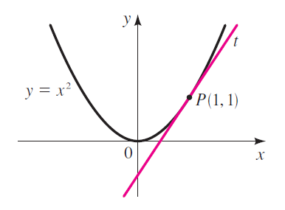
A line tangent to a curve is the line that passes through the point and that has a slope that is the same as the slope of the curve at that point.

Slide 3
Let A and B be two points near each other on the curve and let the coordinates of A be (x, f(x)). Suppose the x-coordinate of B differs from the x-coordinate of A by a small amount, h. Then the coordinates of B are (x + h, f(x + h))
What is the slope of the line?

Slide 4
Suppose A remains fixed while B moves a long the curve toward A. Then the value of h will become smaller, approaching zero. Thus, h can be considered as a variable that approaches zero as B approaches A. If B is made to coincide with A, then the secant line becomes tangent to the curve at point A.

Slide 5
Find the slope of a line tangent to y = 2x² – 3x + 1

Slide 6
The first derivative (f’(x)) of a function tells you the slope of all lines tangent to the function and is defined as:

Slide 7
Find the equation of the line tangent to the graph at the indicated point: y = x² + x – 1 at (-4, 11)

Slide 8
Find the equation of the line tangent to the graph at the indicated point:

Slide 9
Find the derivative of the function f(x) = 8x² + 2x – 4 at x = 2.

Slide 10
12.3 b Derivatives
Who uses this?
Quantitative Analyst
Financial Engineer
Fund Accountant
Engineering Researcher

Slide 11
The derivative of a function f(x) is another function f’(x), that gives the slope of the tangent line to the function at any point.

Slide 12
The process of finding the derivative is called differentiation. (this is one of the main parts of Calculus)
Another common notation for

Slide 13
Ex 1 Find an expression for the slope of the tangent line to the graph of y = 2x² – 3x + 4 at any point.
Find the slopes of the tangent lines when x = -1 and x = 5.

Slide 14
Rules:
Constant:
f(x) = constant
f’(x) = 0
2. Power: if f(x) = x^{n} (n is a rational #)
then f’(x) = nx^{n – 1}
EX 2 f(x) = x³

Slide 15
3. Product of Constant & Power:
f(x) = cx^{n}
then f’(x) = cnx^{n - 1}
EX 3: f(x) = 4x²
4. Sum & Difference:
if f(x) = g(x) +/- h(x)
then f’(x)=g’(x) +/- h’(x)
EX 4: f(x) = x³ + 5x² + 6

Slide 16
5. Product:
What does this mean?
Derivative of the first factor times the second factor plus the first factor times the derivative of the second factor.

Slide 17
Ex 5
f(x) = (x² + 3)(2x – 7)
f(x)=(x + 1)(x² – 2x)

Slide 18
6. Quotient:

Slide 21
Power of a Polynomial (The Chain Rule):
EX 9: f(x)=(3x – 4)³

Slide 22
Ex 10

Slide 23
Ex 11

Slide 24
Ex 12

Slide 25
WS 12.3

