Slide 1
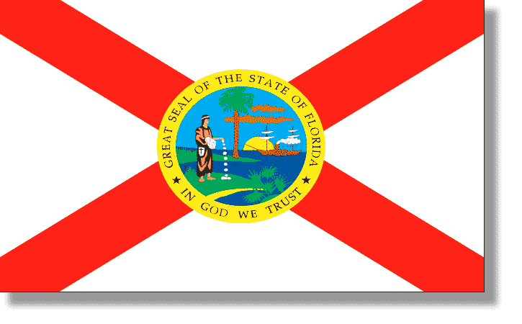
Florida History Unit

Slide 2
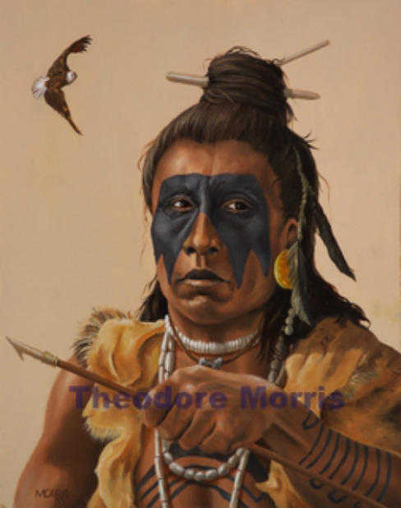
Origins
In the early 1500’s There were three large Native American cultures in Florida: the Timucua in Northeast and Central Florida,

Slide 3
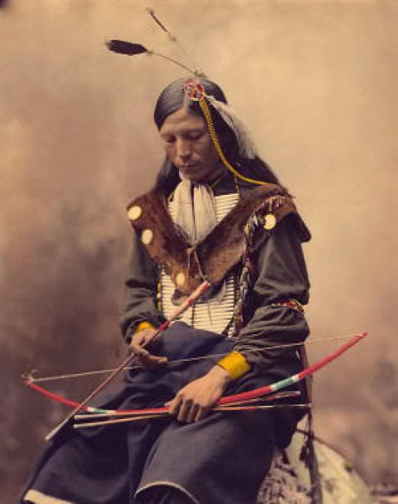
Origins
the Apalachee in the Big Bend area,

Slide 4
Origins
and the Calusa in South Florida.

Slide 5
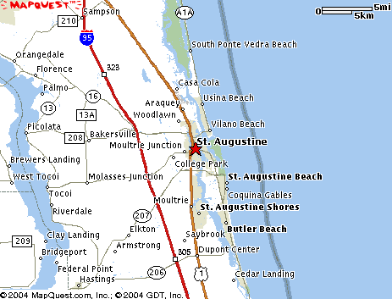
Spanish Influence
1513-1521
Spanish explorer Juan Ponce de León and his expedition were the first documented Europeans to land on the Florida peninsula. He landed on the East Coast, near present-day St. Augustine.

Slide 6
Spanish Influence
Ponce de León named the peninsula "Florida" as the season was "Pascua Florida" (Flowery Easter).
He then sailed to South Florida, where he was wounded in a fight with the members of the Calusa.

Slide 7
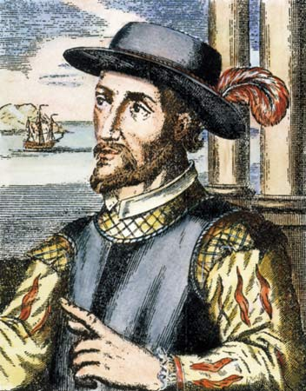
Spanish Influence
After serving time as governor of Puerto Rico, Ponce de León returns to Florida in search of gold. Contracted by the Spanish crown to colonize and Christianize the native peoples, Ponce de León was killed in South Florida.

Slide 8
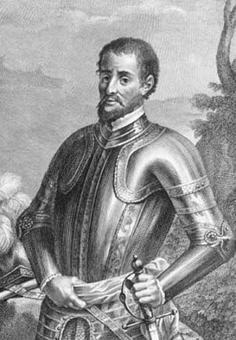
Spanish Influence
1539-1542
Spanish explorer Hernando De Soto, landed in Florida with an 800-man expedition. After wintering in present-day Tallahassee.

Slide 9
England’s Influence
1763
The end of the French and Indian (Seven Years War) results in the transfer of Florida from Spain to England. The colony was divided into East and West Florida. St. Augustine remains the capital of East Florida, with Pensacola the capital of West Florida.

Slide 10
England’s Influence
1771
The American Revolution begins. Florida did not join its fellow thirteen English colonies in the revolution and remained loyal to England.

Slide 11
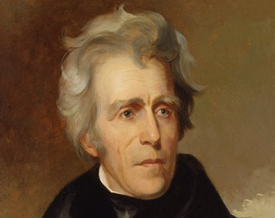
An American Territory
1821
Florida becomes a US Territory, with Andrew Jackson as its first governor.

Slide 12
Statehood
1821
Tallahassee was established as the capitol of Florida.
1845
The Act establishing statehood for Florida was approved on March 3, 1845 by the second session of the 28th Congress. Florida the 27th state.

Slide 13
Florida Symbols

Slide 14
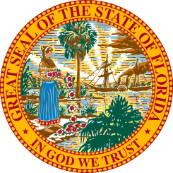
Florida Symbols

Slide 15
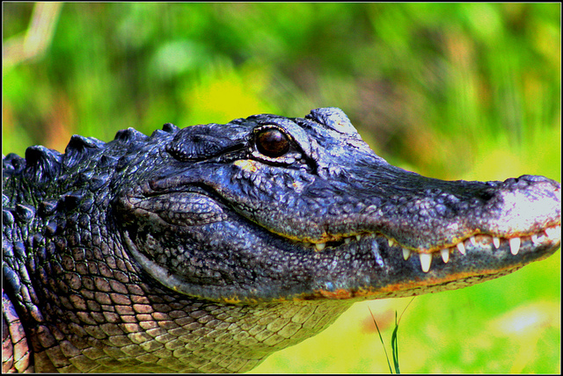
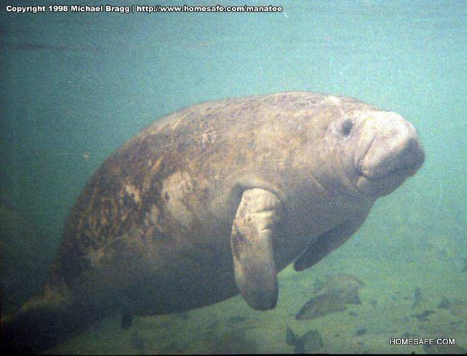
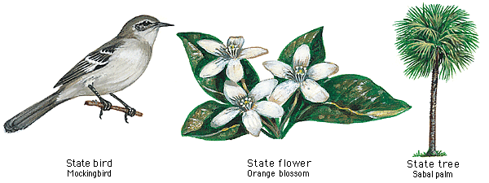
Florida Symbols

Slide 16
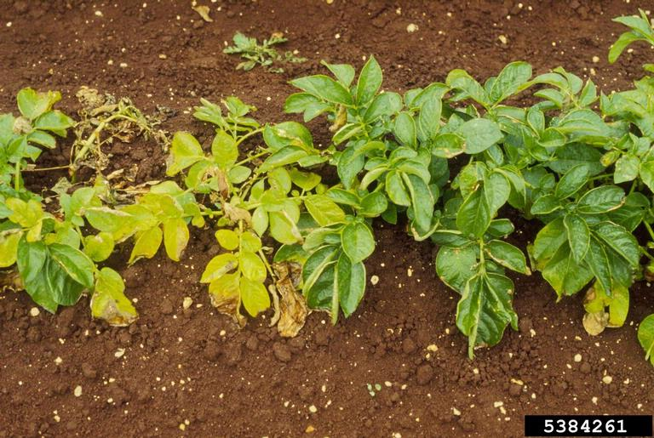
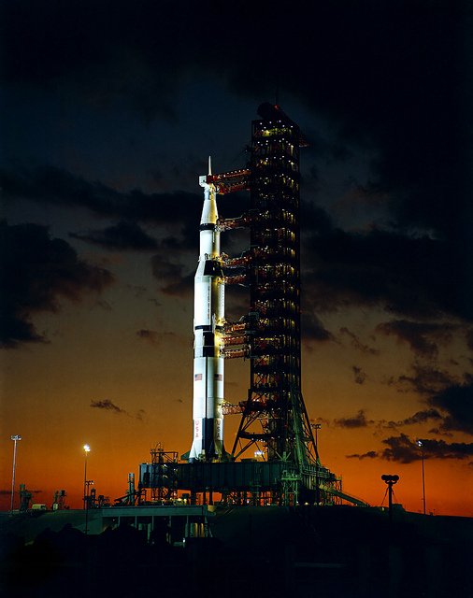
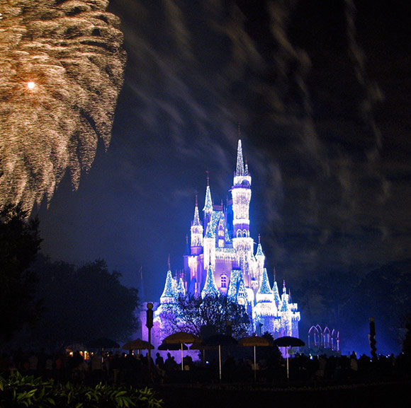
State Revenue

