Slide 1
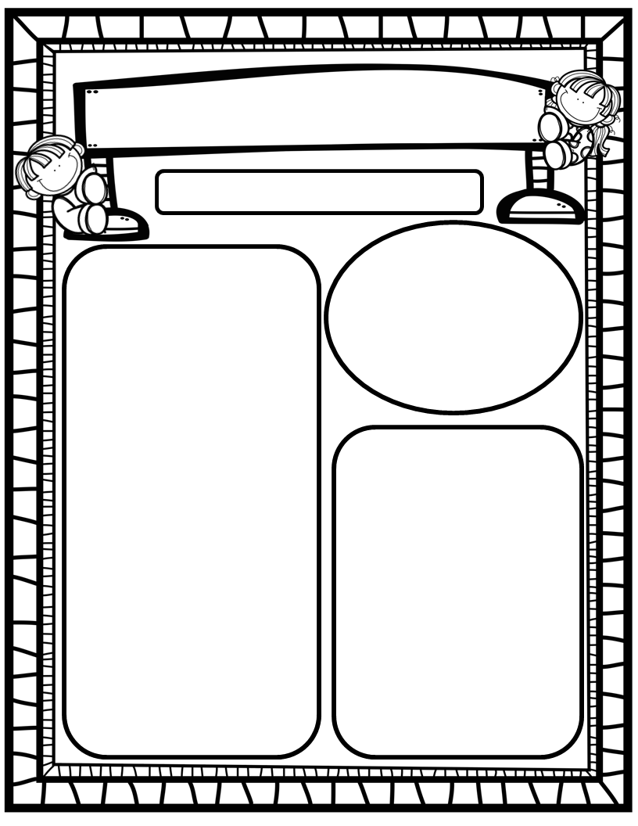
The Deason Digest Weekly Blast
May 12th-24th, 2025
Homework:
Read to and with your child each night and complete Reading Rally Log!
Practice HFW’s: the, I, and, a, is, as, said, to, do, of, see, he, be, me, from, was, you, have, what, your, want, go, no, so, goes, says, she, we, they, their, were, talk, walk, could, would, should, or, for, where, there, who, by, my, one, once, two, does, many, any
Go Math Home Practice for Ch. 20
UFLI Home Practice Pages
Go over Weekly Work and discuss
We Are Learning About…
Reading: We will focus on the –ES and –ED ending, as well as HFW’s two, does, many, any. We will identify author’s purpose in texts we read. We will look at pictures, get our mouths ready, flip vowel sounds, and use digraph chunks to help us stretchy-snake tricky words faster. EQ’s: What are the various animal habitats?
Writing: We will focus on printing and tracing upper and lowercase letters, as well as using stretchy-spelling and sight words to write complete sentences!
Math: We will finish Ch. 20: Sorting and Graphing Data!
Science: We will continue our plant investigation and our animal life-cycle observations!
Social Studies: We will continue to practice I-Care Rules.!
Important Dates:
May 16: Patriotic Performance and Picnic @10:30
May 21-23: Early Release Days, Dismiss at 12:20!
May 23: Last Day of School

