Slide 1
8.4-8.6 Area Between Two Curves Part 1
-Find the area of a region between two curves using integration

Slide 2
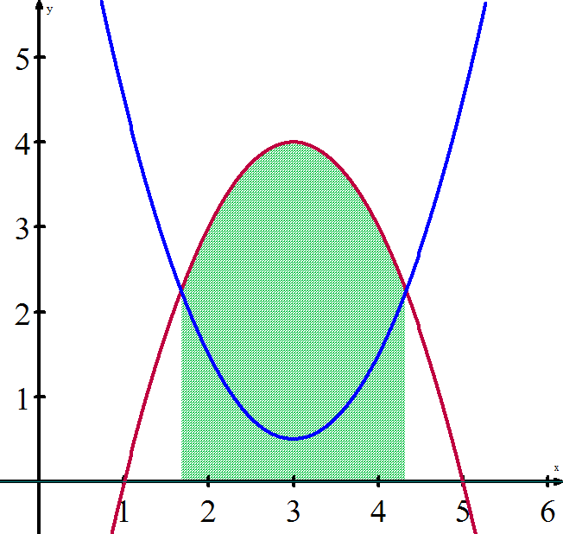
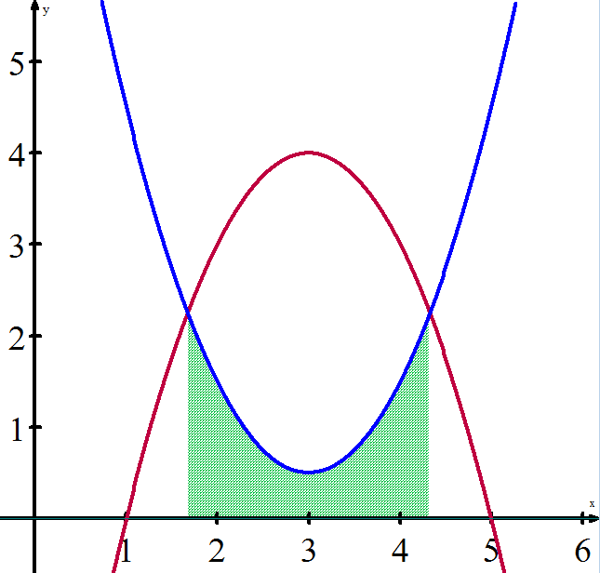
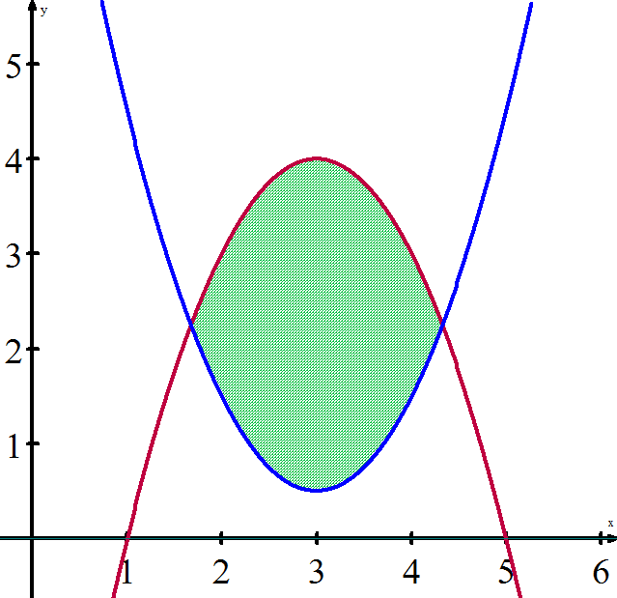
We can extend the idea of definite integrals finding the area of a region under a curve to the area of a region between two curves. If two functions are both continuous on an interval [a, b], then the region between the curves can be found by subtracting the area of the upper region and the area of the lower region.
Area of upper function ( – ) Area of lower function = Area between the functions
f(x) g(x)

Slide 3
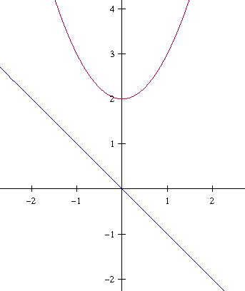
Ex 1 Finding the Area of a Region Between Two Curves Find the area of the region bounded by the graphs of y = x² + 2, y = -x, x = 0, and x = 1.

Slide 4
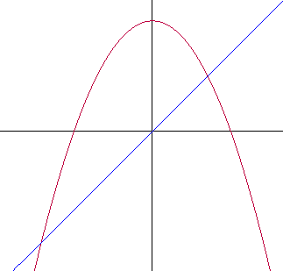
Ex 2 A Region Lying Between Two Intersecting Graphs Find the area of the region bounded by the graphs of f(x) = 2 – x² and g(x) = x.

Slide 5
Ex 3 The sine and cosine curves intersect infinitely many times, bounding regions of equal areas. Find the area of each one of these regions.

Slide 6
WS 8.4-8.6 a

