Slide 1
Juggling Trivia
By Olamoyo Thomas

Slide 2
Yo-Yo | Ball | Club
100 | 100 | 100
200 | 200 | 200
300 | 300 | 300

Slide 3
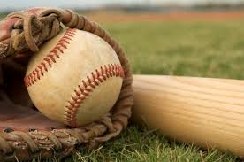
Which one of these is not a use of clubs? (Back)
Juggling
Passing
Using the club as a baseball bat.
Balancing
“Using the club as a baseball bat” is the correct answer.

Slide 4
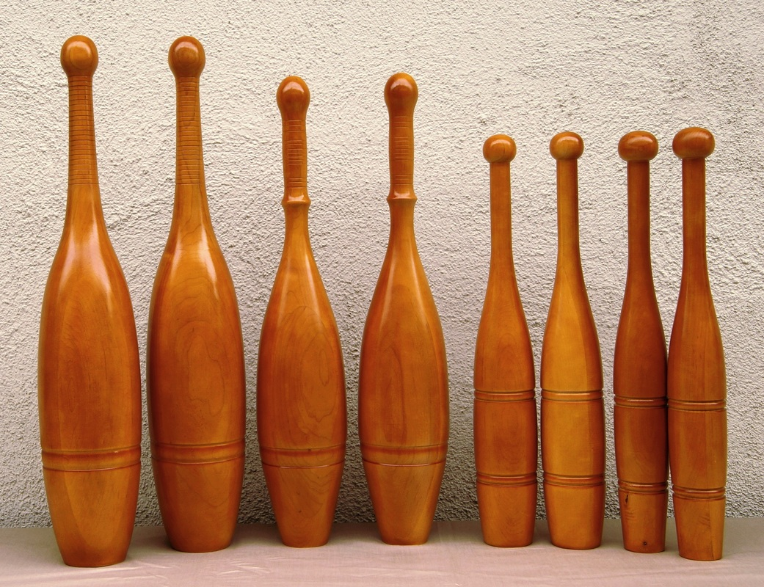
The first Juggling clubs were modeled after _____? (Back)
Indian Clubs
American Clubs
Ottoman Clubs
Syrian Clubs
The correct answer is, “Indian Clubs”

Slide 5
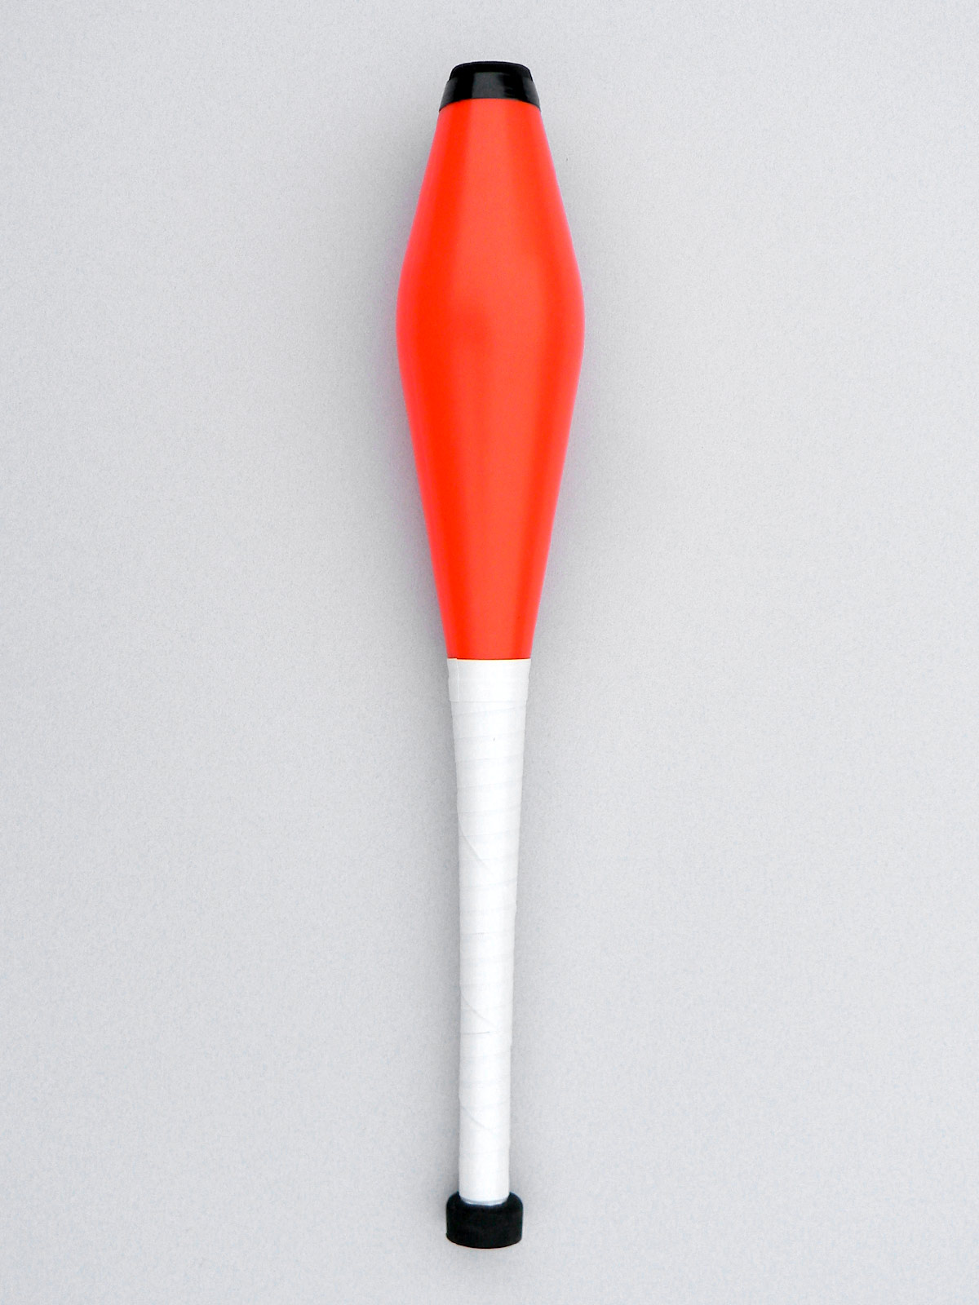
The first people to manufacture modern clubs were _______? (back)
Watson and Crick
Tom and Jerry
Edward Van Wyck and Harry Lind
Lennon and McCartney
The correct answer is “Edward Van Wyck and Harry Lind”

Slide 6
What is the Highest number of balls ever juggled? (back)
20 Balls (Joseph Joestar)
No official record
11 Balls (Alex Barron)
13 Balls (Aang)
The correct answer is 11 balls by Alex Barron.

Slide 7
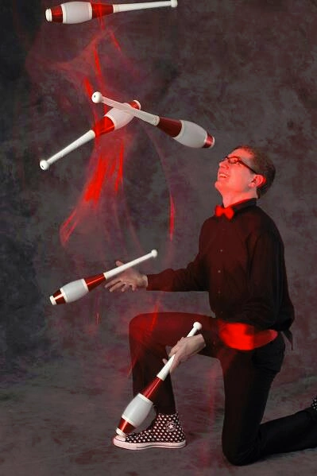
How long is the longest cascade? (back)
David Slick – 12 hours and 5 minutes
Thor Jackson – 2 hours and 2 minutes
Gola Bora – 5 hours and 43 minutes
Zack Nether – 8 hours, 2 minutes, and 34 seconds
The correct answer is 12 hours and 5 minutes (David Slick).

Slide 8
What siteswap pattern is this: (Back)
7777777
6451
B97531
DB97531

Slide 9
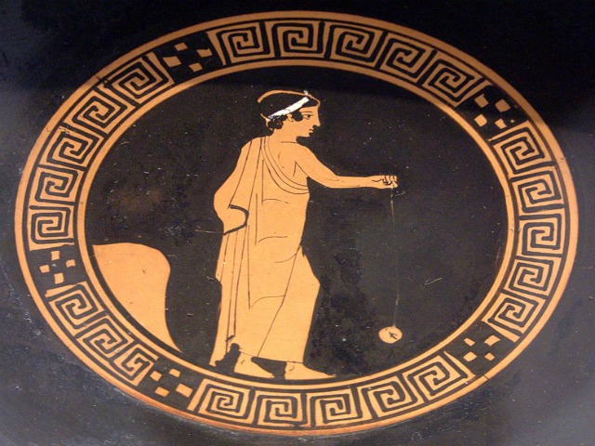
Where were yo-yos invented? (back)
China or Greece
The United States
The Ottoman Empire
The Roman Empire
The correct answer is China or Greece.

Slide 10
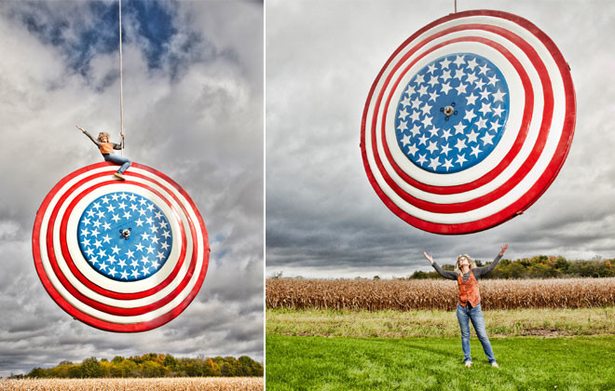
How big is the biggest Yo-yo (in diameter)? (back)
6 feet, 2 inches
2 feet, 1.5 inch
9 feet, 10 inches
11 feet, 10.75 inches
The correct answer is 11 feet, 10.75 inches.

Slide 11
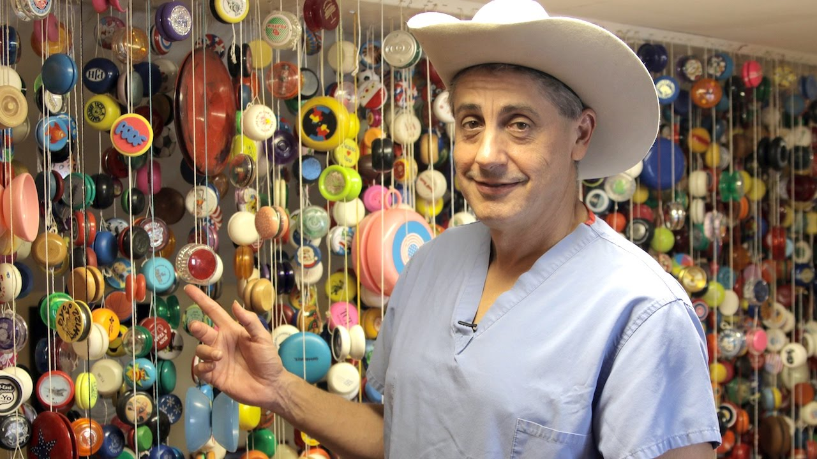
How many yo-yos makes up the Largest collection of yo-yos? (back)
4586 yo-yos
243 yo-yos
2000 yo-yos
1843 yo-yos
The correct answer is 4586 yo-yos.

Slide 12
The end
Sadly…

