Slide 1
Vova and Olga Galchenko

Slide 2
Background info
Vladimir (Born September 15, 1987) known as Vova
Olga Galchenko(Born July 31, 1990)
Originally from Penza, Russia
Vova joined a circus school at 7 years age
Olga joined several year later
2001, their father started filming them performing tricks and posting them on a website.
Soon began receiving invitations to perform abroad.

Slide 3
Early Career
Well known in the Euro juggling community.
At the ages of 12 and 15 preformed in many large juggling conventions and festivals.
British Juggling Convention 2002
Dresden Juggling Convention 2002 and 2003
the European Youth Circus Festival 2002 and the European Juggling Convention 2003.

Slide 4
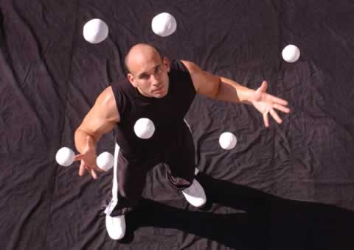
Life in America
In 2003, Brother and sister settled in Las Angeles
Worked with Jason Garfield (founder of WJF) to improve technical skills
They place second in the International Jugglers’ Association summer festival in Reno, Nevada.

Slide 5
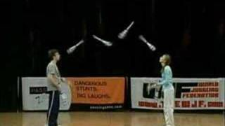
WJF
December 2004, they took part in the first World Juggling Federation competition in Las Vegas, Nevada.
Vova won first place in 5 competitions
Advanced Clubs
Five Club Moves
Three Club 360s
Five Club 360s
Olga won the Junior Clubs and second in Women’s Advanced Clubs.
Together they won the Teams Six Club and Teams Seven Club.
Click here to see their performance!

Slide 6
The 2005 Split
Olga wanted to Concentrate on her schooling
Vova Began performing on his own

Slide 7
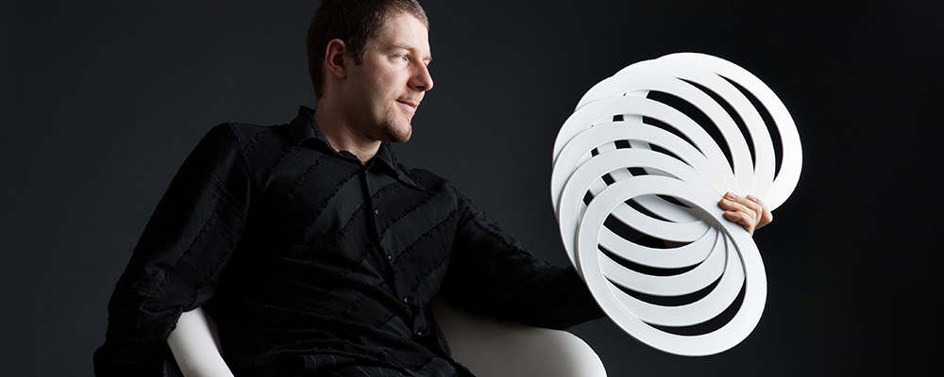
Back Together
2006, (WJF) competition in Las Vegas, Nevada
Vova and Olga won Team Club Passing
First performance as a pair in competition for one and a half years
Vova also performed with professional juggler Thomas Dietz

Slide 8
Today
Vova and Olga have shifter their focus somewhat away from Juggling.
They studied computer engineering and computer science at rival universities in Los Angeles.
Olga at UCLA
Vova at USC
Vova has released multiple iphone apps, geared towards jugglers
Since 2012, Vova has been working at Box
An online file sharing and personal cloud content management service for businesses.

