Slide 1
5.3 b Graphing Equations in Slope-Intercept Form
Notes #_____ ____/____/____

Slide 2
What is Slope-Intercept Form?
Equation:
m: slope
b: y – intercept
(where the graph touches the y-axis!)
y
y=mx+b
(0,b)
x

Slide 3
Rewrite the equation in slope intercept form. Then Identify the slope and the y-intercept.
E1 3x + 2y = 6 E2 5x – 4y = 8

Slide 4
Steps…
Is it in slope intercept form?
If not, then make it that way ( y=mx+b )
Identify the y-intercept (b)
Identify the slope (m)
Graph the y-intercept
Always on the y-axis
Use the slope to find the next point

Slide 5
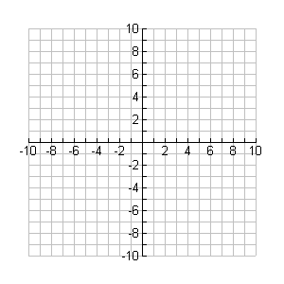
Example 3
Graph the equation.

Slide 6
Example 4
Graph the equation.
-2x + 5y = 10
m =
b =

Slide 7
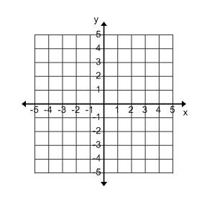
Write an equation in slope-intercept form for each graph.
E5 E6

