Slide 1
Unit 5 Week 2: Cooperation Works!
Second Grade
Week 7: May 11- May 15

Slide 2
Essential Question: How do people get along?
Cooperation is when you work together.
Listening and talking helps people get along.
Cooperation can make the work go faster and can help people get along.

Slide 3
Vocabulary
Amused
Define: If something amused you, it made you smile or laugh.
Example: The kids told jokes and amused each other.
Cooperate
Define: If you cooperate with someone, you work together on something.
Example: Runners must cooperate to win a relay race.
Describe
Define: If you describe something, you tell what it is like.
Example: I would describe my cat as small and fluffy.
Entertained
Define: If something entertained you, it pleased or interested you.
Example: The funny clown entertained me.

Slide 4
Vocabulary
Imagination
Define: Your imagination is your ability to make up ideas and form pictures in your mind.
Example: Ryan uses his imagination to pretend he was in space.
Interact
Define: If you interact with someone, you talk and work with them.
Example: Mia likes to chat and interact with her friends at lunch.
Patient
Define: If you are patient, you are able to wait for a long time for something.
Example: The boy was patient and waited for his friend.
Peaceful
Define: A peaceful place is calm and quiet.
Example: It was peaceful in the quiet library.

Slide 5
Spelling Words
Soil
Broil
Moist
Point
Toil
Oil
Toy
Joy
Coin
Noise
Crown
Mound
I’ll
Laugh
Maybe

Slide 6
Diphthongs: oy and oi
Two letters blended together can stand for one vowel sound. The letters oy and oi can stand for the vowel sound in boy and foil.
Oy | Oi
Boy Toy Joy | Foil Soil Point Coin Noise Oil

Slide 7
Consonant + le
When a word ends in –le, the consonant before it plus the letter le form the last syllable. (c + le, el, or al)
This sound in an end syllable can also be spelled –al or –el.
Example:
Bagel → ba/gel
Handle → han/dle
Local → Lo/cal

Slide 8
Pronouns
Pronouns are used to take the place of nouns (person, place or thing).
The pronouns I and we can be subjects in a sentence.
I like to work in a group. We are meeting today.
The pronouns me and us can be used in the predicate part of the sentence.
Jake works for me. He asked us to help.
Name yourself last when talking about yourself and another person
Molly and I are writing the report.
The pronoun I is always a capital letter.

Slide 9
Summarize
To summarize a story, you tell only the most important events and details of the story in your own words.
Use details from the story to summarize.

Slide 10
idioms
Idioms are words or phrases that have difference meanings than the real meanings of the words.
Look for clues in nearby words or sentences to find the meaning of an idiom.
Examples:
“Time flies” → Time is going by fast
“Zip your lips” → stop talking/be quiet
“Cut it out” → stop what you’re doing
“Butterflies in my stomach” → nervous

Slide 11
Point of View
Point of View is what the characters think about the events in a story.
Look for clues about a character’s point of view in the text.
Think about what a character says and does.

Slide 12
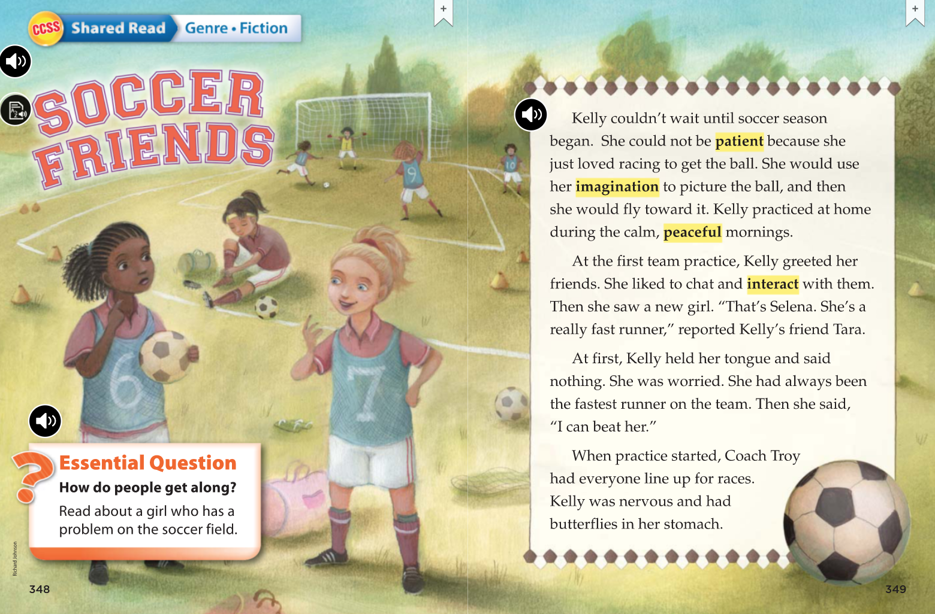

Slide 13
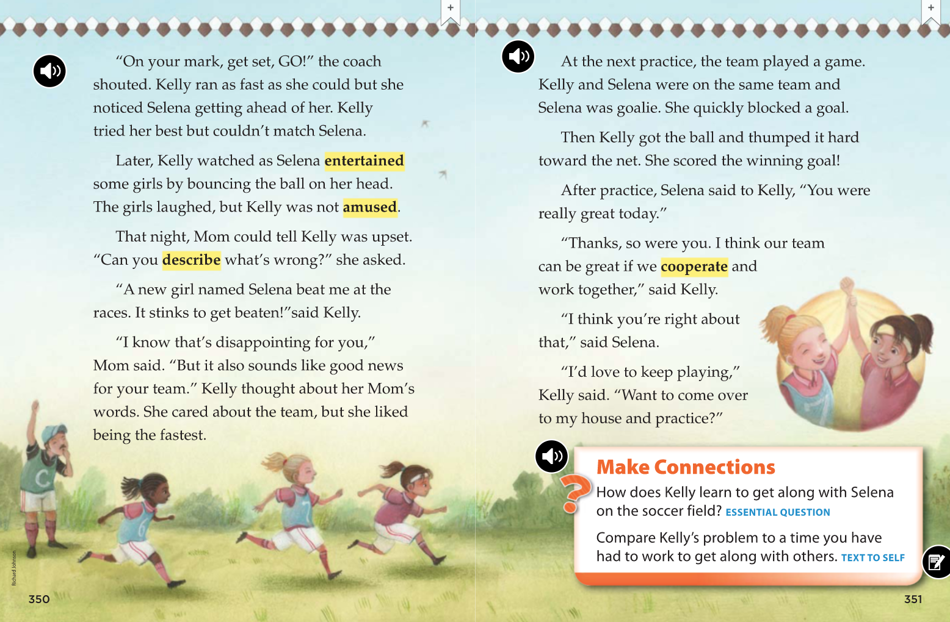

Slide 14
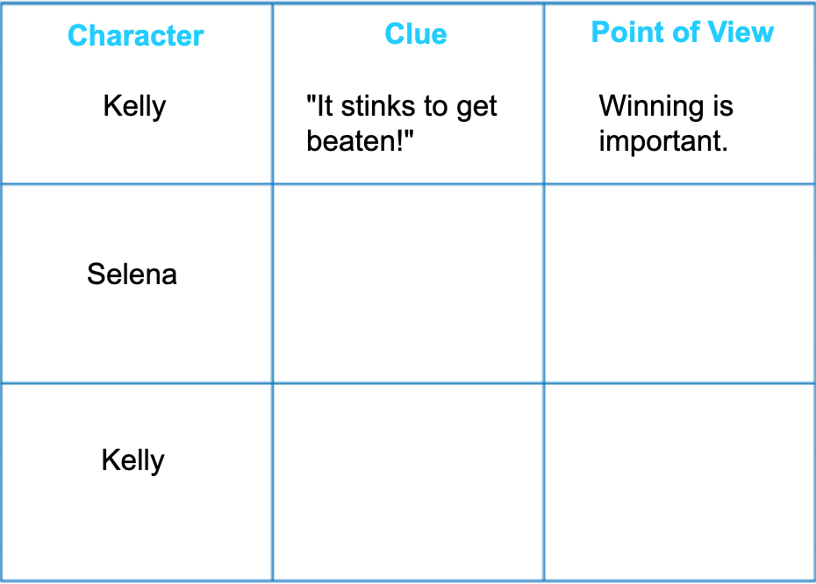
Point of View
What is the point of view from each of the girls?
“You were really great today.”
Selena is a good soccer player.
“ I think our team can be great if we cooperate and work together’ said Kelly”
Cooperation is important to create a winning team.

Slide 15
Idioms
Example from Soccer Friends:
“She could not be patient because she just loved racing to get the ball. She would use her imagination to picture the ball, and then she would fly toward it.”
The idiom is: “fly towards it” which describes how Kelly moves towards the ball.
Idiom: “fly toward it”
Context Clue: “racing to get the ball”
The idiom “fly toward it” means “moving quickly towards it”.

Slide 16
Vocabulary Practice
Amused
Cooperate
Describe
Entertained
Imagination
Interact
Patient
Peaceful
amused
We were ________________ while watching the funny dancers.
I find it ____________ to sit in the quiet outdoors.
I would ___________ the coat by saying it’s red and soft.
She uses her _____________ to pretend she is a princess.
peaceful
describe
imagination

Slide 17
Vocabulary Practice
Amused
Cooperate
Describe
Entertained
Imagination
Interact
Patient
Peaceful
The soccer team had to _____________ to win the game.
The actors _____________ the people in the audience.
At school we ____________ and chat with our teacher and classmates.
If all of the swings are full, I must be _____________ and wait my turn.
cooperate
entertained
interact
patient

