Slide 1
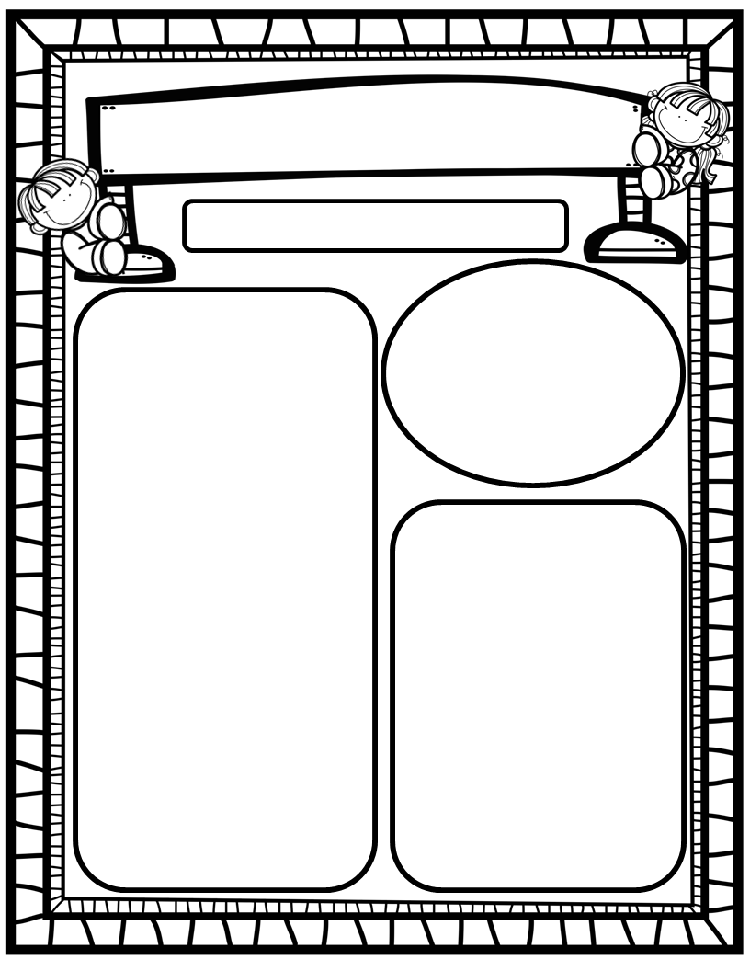
The Deason Digest Weekly Blast
February 10th, 2025
We Are Learning About…
Reading: We will review the vowels Aa and Ii (SHORT sound production, mouth placement, words that begin with the sound & words with sound in middle), and HFW’s REVIEW. We will identify main characters, setting, story events, as well as compare stories to decide which we like best. We will look at pictures, get our mouths ready, and use chunky monkey to help us stretchy-snake tricky words faster. EQ: Why is it important to make inventions better?
Writing: We will focus on printing and tracing upper and lowercase Aa and Ii, as well as using stretchy-spelling and sight words to write complete sentences!
Math: We will continue Go Math Ch. 10 Put Together and Take Apart Numbers to 10!
Science: We will finish Unit 7: Motion!
Social Studies: We will continue to practice I-Care Rules. We will practice what it means to show Courage! We will continue learning about impactful African Americans as we progress in Black History Month!
Homework:
Read to and with your child each night and record books on Reading Rally Log!
Practice HFW’s: the, I, and, a, is, as, said, to, do, of, see, he, be, me, from, was, you, have, what
Go Math Home Practice for Ch. 10
UFLI Home Practice Pages
Go over Weekly Work and discuss
Important Dates:
February 14: Valentine’s Day Card Exchange
February 17: Presidents Day/No School
February 19: Class and Spring Picture Day
February 20: SAC/PTO 6pm/7pm
February 27: Late Night Library

