Slide 1
Coordinate Planes

Slide 2
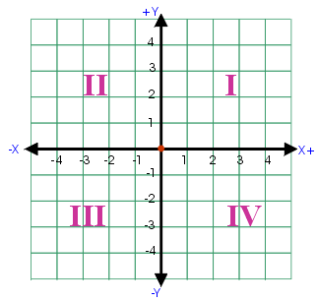
Vocabulary
Coordinate plane: The plane formed by two perpendicular lines called the x-axis and y-axis.
The coordinate plane is divided into four regions. Each region is called a quadrant.

Slide 3
Vocabulary
x-axis
origin
x-axis: the horizontal number line.
y-axis: the vertical number line.
Origin: the center of the coordinate plane. It has coordinates (0, 0). It is the point where we always start when we are graphing.
y-axis

Slide 4
Vocabulary
Ordered pair: a pair of numbers that represents a unique point in the coordinate plane. The first value is the x coordinate and the second value is the y coordinate.
Ex. 1: (2, 3) → 2 is the x coordinate and 3 is the y coordinate
(2,3)

Slide 5
To graph a point in the coordinate plane start at the origin.
Look first at the x coordinate. If the x coordinate is positive, move that many spaces to the right. If the x coordinate is negative, move that many spaces to the left.
From your x coordinate location look at the y coordinate. If the y coordinate is positive, go up that many spaces. If the y coordinate is negative, go down that many spaces.
Now graph the following: A(0, 2), B(4, -3), C(-2, -1), D(2, 3), E(2, 0) and F(-5, 3).

Slide 6
Homework
WS 1-6 a

