Slide 1
Photosynthesis
Assembled and presented by Dean Struempf

Slide 2
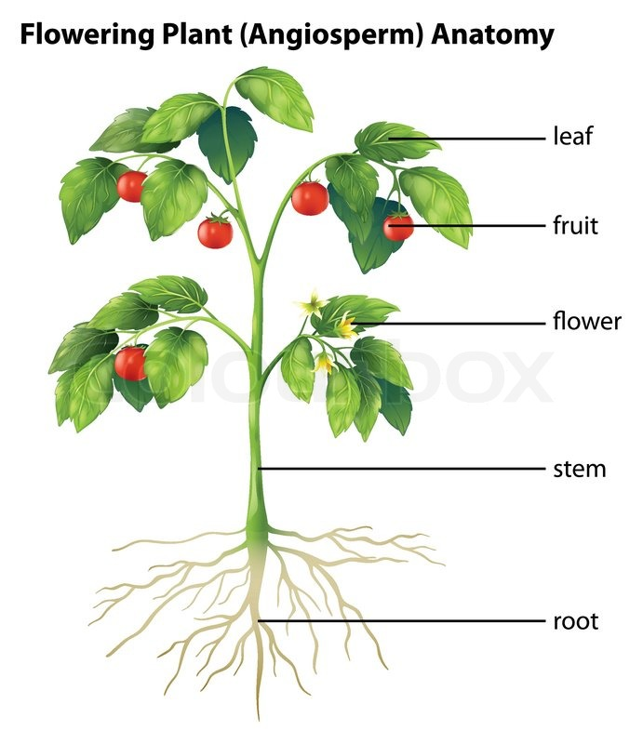
Review Anatomy and Physiology of Plants
Roots- support a plant, anchor it in the ground, store food, and absorb water and dissolved nutrients from the soil.
Stems- stems produce leaves, branches, and flowers, hold leaves up to the sun, and transport substances throughout the plant.
Leaf- structure optimized to absorb light and carry out photosynthesis.

Slide 3
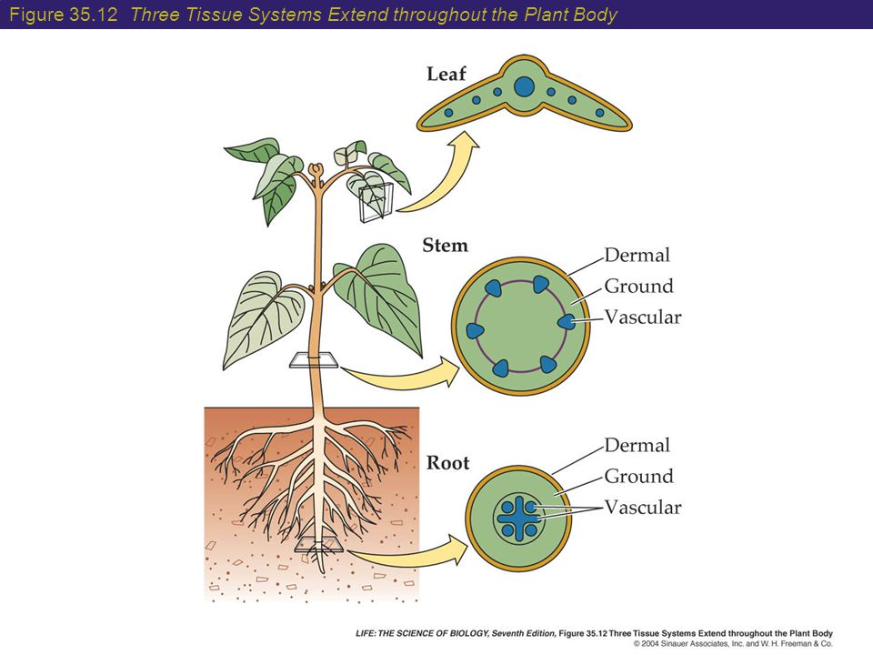
Review anatomy and physiology of plants
Dermal Tissue: the protective outer covering of a plant.
Vascular Tissue: transport water and nutrients throughout the plant
Ground Tissue: produces and stores sugars, and contributes to physical support of the plant.

Slide 4
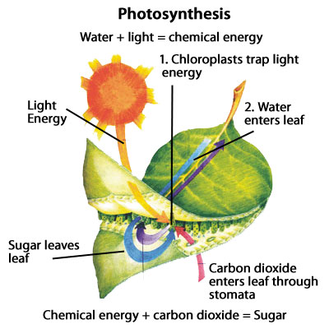
What is all this transportation about?

Slide 5
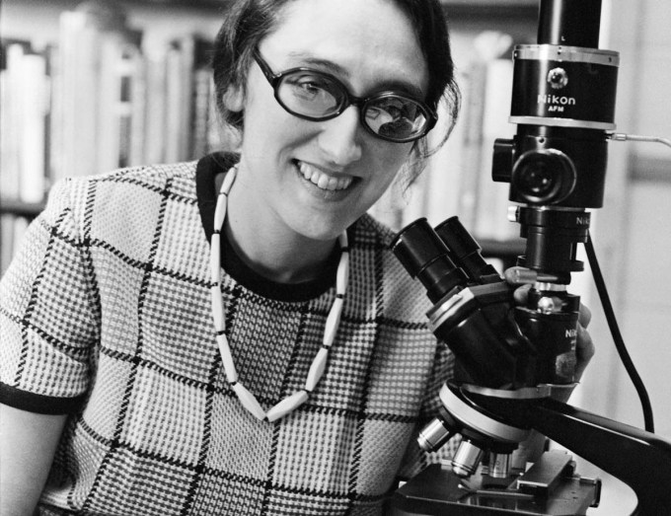
the endosymbiotic Theory
Developed by Lynn Margulis at the University of Massachusetts in the 1960’s, this theory proposes:
“Eukaryotic cells formed from a symbiotic relationship among several different prokaryotic cells”

Slide 6
The endosymbiotic theory

Slide 8
What is all this transportation about?

Slide 9
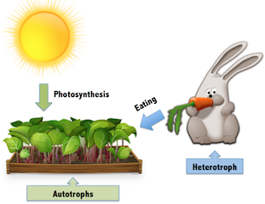
Photosynthesis
Photosynthesis uses the energy of sunlight to convert water and carbon dioxide (low-energy reactants) into high-energy sugars and oxygen (products).

Slide 10
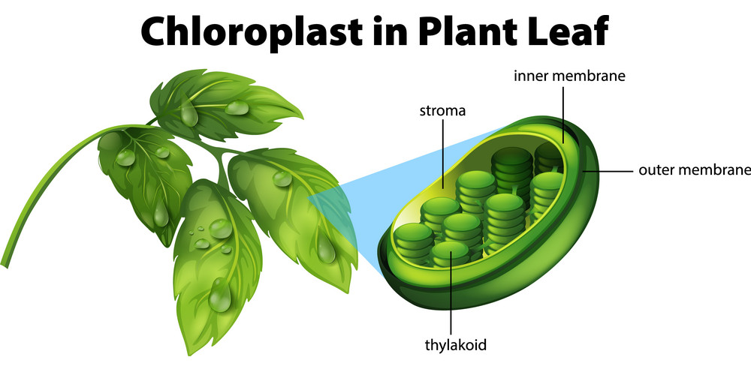
Photosynthesis
Photosynthetic organisms use pigments (light absorbing compounds) to capture the energy in sunlight.
Chlorophyll (reason why plants are green)
Contained in the Thylakoids

Slide 11
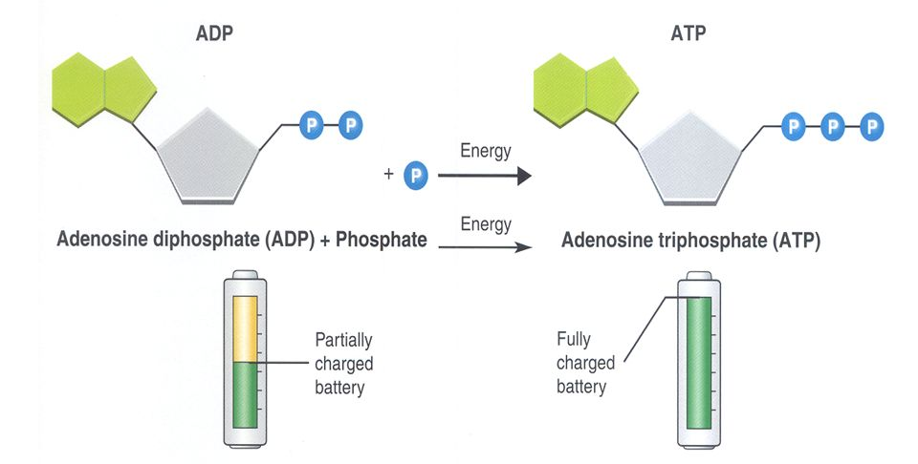
Photosynthesis & Energy
Energy- The ability to do work
Energy is stored in the chemical bonds within molecules.
ATP (small, quick)
Glucose (large, long-term)

Slide 12
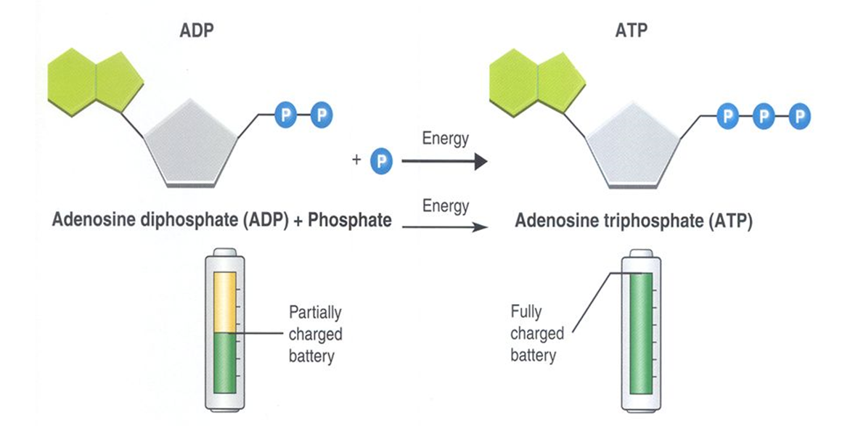
ADP & ATP
ATP can release and store energy by breaking and re-forming the bonds between its phosphate groups. This characteristic of ATP makes it exceptionally useful as a basic energy source for all cells.
Think of it like energy currency. If a transaction requires energy, ATP is used to pay for that activity to occur.

Slide 13
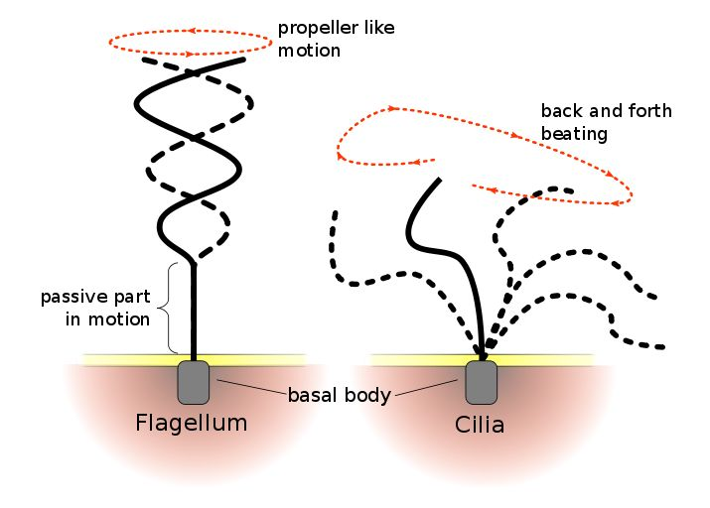
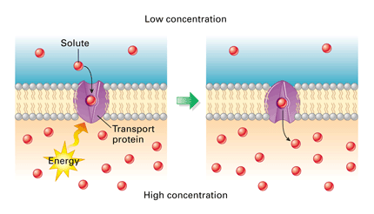
How Cells use ATP
Cells use ATP for a variety of activities, the most prevalent is active transport.
Cellular movement, such as in motor proteins that contract muscle and power the wavelike movement of cilia and flagella.
Responses to chemical signals at the cell surface.
Protein synthesis.

Slide 14
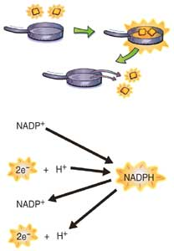
NADP⁺ & NADPH
Nicotinamide adenine dinucleotide phosphate
An electron carrier compound that can accept a pair of high-energy electrons and transfer them to another molecule.
Used to transfer electrons from Chlorophyll to other molecules.

Slide 15
Light-dependent Reactions & Light-independent reactions

Slide 16
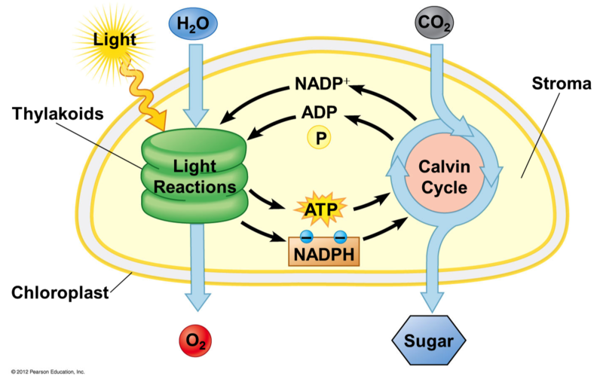
Light-dependent Reaction
Requires light energy (sun) and light-absorbing pigments (chlorophyll).
Occurs within the Thylakoid membranes.
Where ADP is converted to ATP
Convert low energy electrons from water to high energy electrons using solar energy.
This split is what produces oxygen gas!

Slide 17
Light-dependent Reaction: Electron Transport Chain

Slide 18
Light-independent reaction
No light is required, and takes place in the stroma (fluid portion of chloroplasts)
Calvin Cycle
The ATP and NADPH molecules produced in the light-dependent reactions are used to build high-energy sugars from carbon dioxide.

Slide 19
Light-independent reaction: Calvin Cycle

Slide 20
Light-dependent Reactions & Light-independent reactions

Slide 21
Photosynthesis
Photosynthesis uses the energy of sunlight to convert water and carbon dioxide (low-energy reactants) into high-energy sugars and oxygen (products).

Slide 22
Photosynthesis and Cellular Respiration

