Slide 1
TOGETHER WE DO MORE
Leon County Schools
2024-2025 | UWBB Campaign

Slide 2
Your LCS Campaign Leadership Team
Rocky Hanna - Superintendent
Dr. Michelle Gayle – Deputy Superintendent
Stacey Turknett – Executive Assistant to Dr. Gayle
Mr. Desmond Cole – Principal Amos P. Godby High School
Rusty Edwards – Director School Management
Dwan Knight – Physical Education teacher, Woodville K-8
Janie Frazier --- Science teacher, Deerlake Middle School
Fred Johnson --- Director, Transportation
Rob McQueen – Divisional Director, Code Enforcement
Jamie Holleman– Coordinator, School Choice
Kendra Hatcher– Project Manager, School Safety & Security
Brooke Brunner– Director, Early Childhood
Brittany Stokes– Public Relations Project Manager for Lively Technical College
Shane Syfrett – Assistant Superintendent Academic Services
Eric Clark – Executive Director, The Foundation of Leon County Schools

Slide 3
Berneice Cox, President & CEO
United Way of the Big Bend

Slide 4
UWBB Campaign Contact
Angela Gibbs
Vice President of Philanthropy & Communications
angela@uwbb.org
850.414.0858

Slide 5
Your Support. Our Impact.

Slide 6
Congratulations and Thank You!
Leon County Schools
#7 overall campaign
2023-2024:
$87,212
Top 5 Campaigns | 2023-2024:
Godby High School
Fairview Middle School
Chiles High School
Deerlake Middle School
Transportation

Slide 8
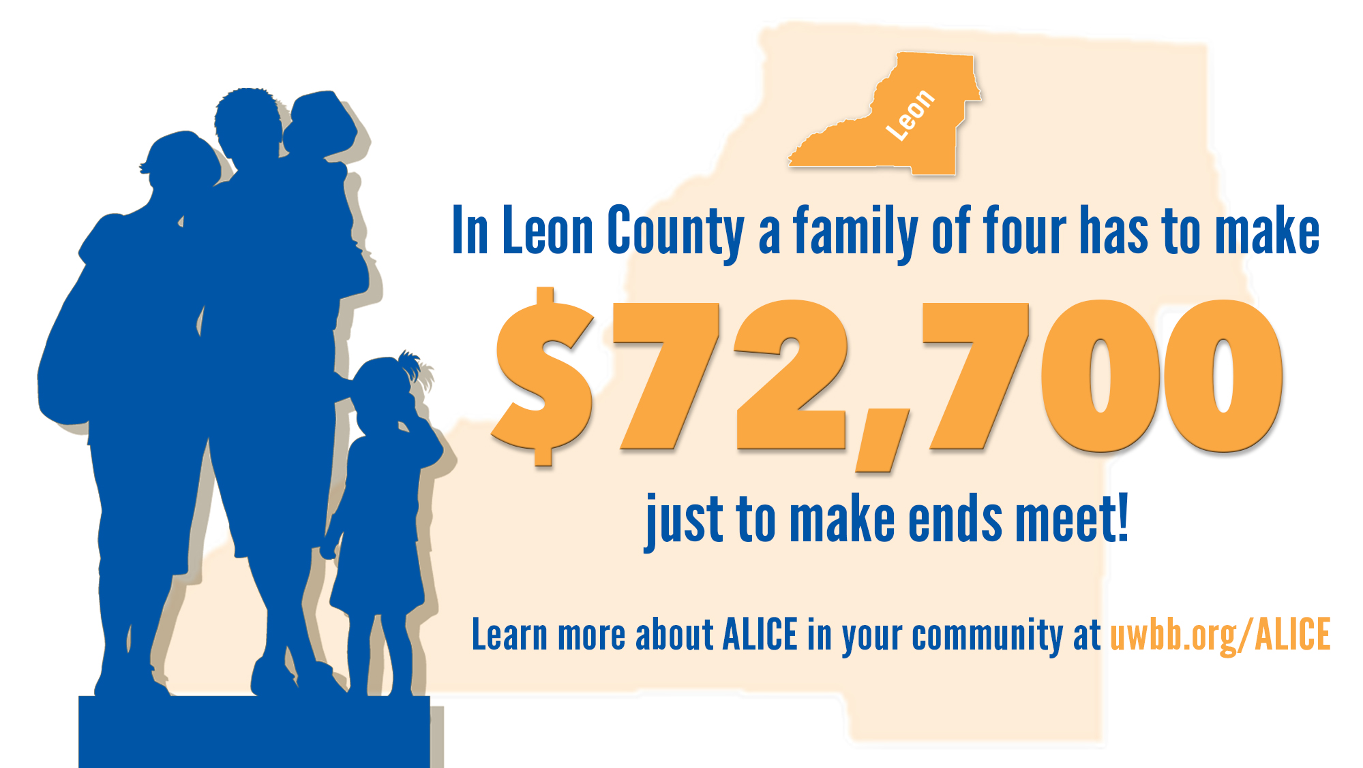

Slide 9
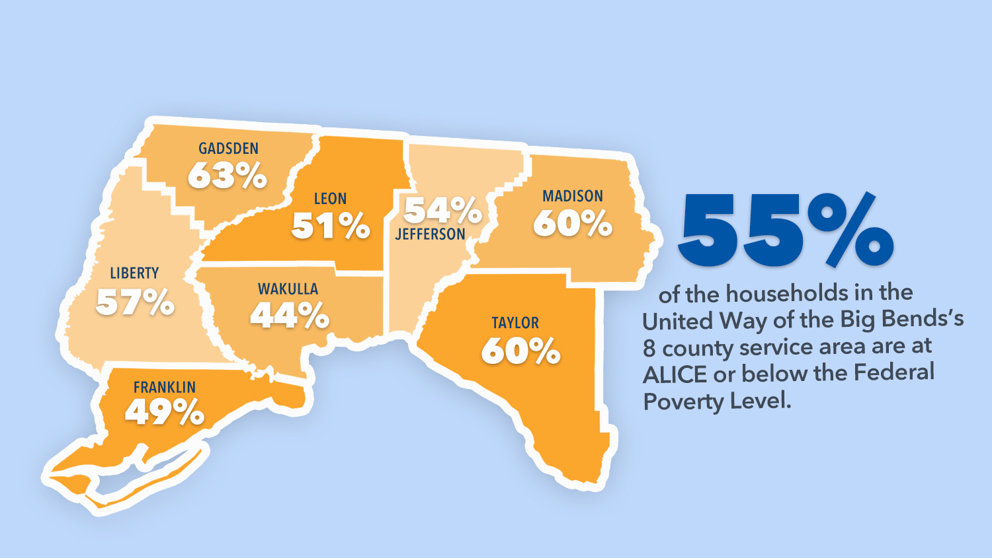
ALICE in the Big Bend

Slide 10
Opportunities for Your School

Slide 11
UWBB Programs That Benefit Your School & Our Community
Notes:
ReadingPals is a statewide early literacy initiative that provides volunteer mentors for students from Pre-k to 3rd grade who may need extra help. Mentors are matched one-to-one with students in Pre-K through third grade.
MATHPals, a mentoring program for kindergarten through third grade students, creates a creative and encouraging environment for learning math by matching caring mentors one-to-one with students who are in need of extra help developing essential mathematical skills.
Read United is an initiative that provides volunteers an opportunity to share the love of reading with children in our community over a week-long event in early spring each year; each participating 1st Grade classroom at Title I schools & early childcare programs receives a set of books.
SMILE UNITED, a pediatric dental care initiative, provides beneficial dental services to second & sixth grade students in Title I schools across Leon & Gadsden Counties.

Slide 12
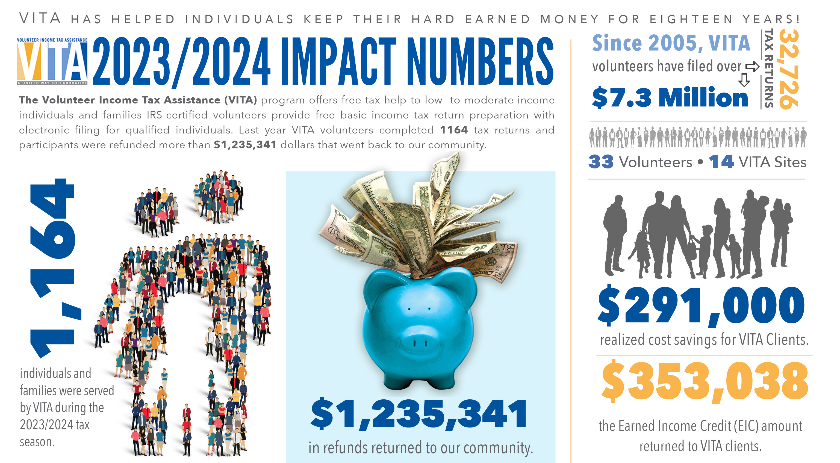

Slide 13
Steps to a Successful Campaign

Slide 15
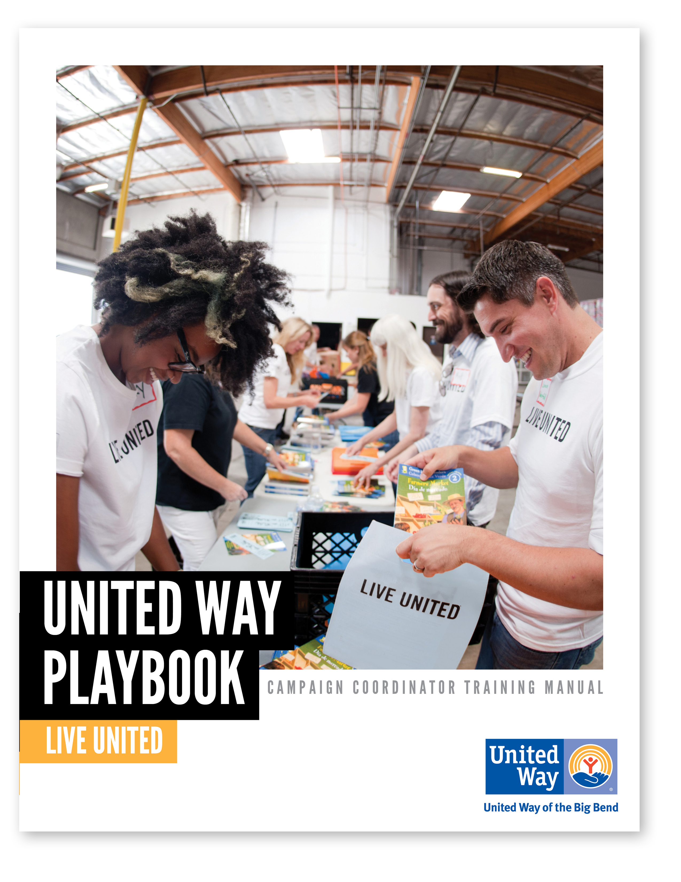
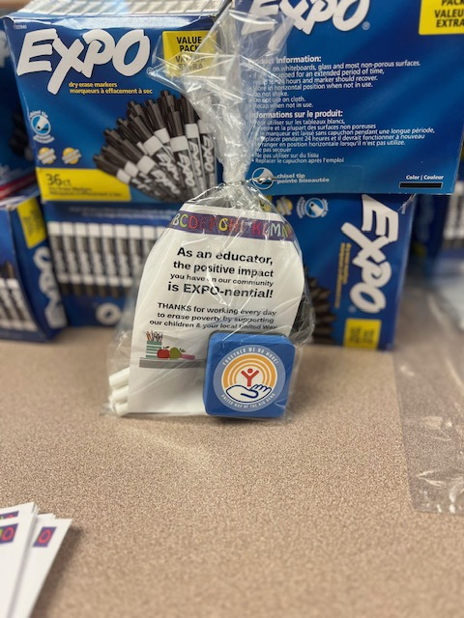
Make It Happen!
Download your Playbook today!

Slide 16
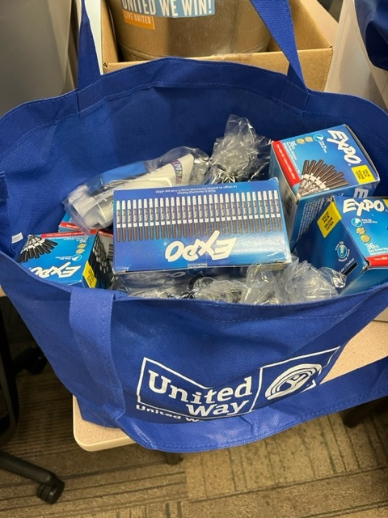
Make It FUN!
Notes:
Remind them to GET SOCIAL!!!! offers great tips for Employee Campaign Coordinators to help generate enthusiasm and excitement around the campaign.

Slide 18
Dr. Michele Gayle

Slide 19
Mark Your Calendars
Important dates to remember:
Campaign Kicks Off – August 6, 2024
Turn in Day #1 | Turn in Day #2 | Turn in Day #3
September 9th | September 16th | September 23rd
2p-5p Admin East Building | 2p-5p Admin East Building | 9a-12p Admin East Building
Notes:
End of Payroll Campaign- September 22nd
(All payroll forms, cash, and check donations due)
*Special events can occur from now until the end of January 2024. Funds from special events must be submitted by Friday, February 16.

Slide 20
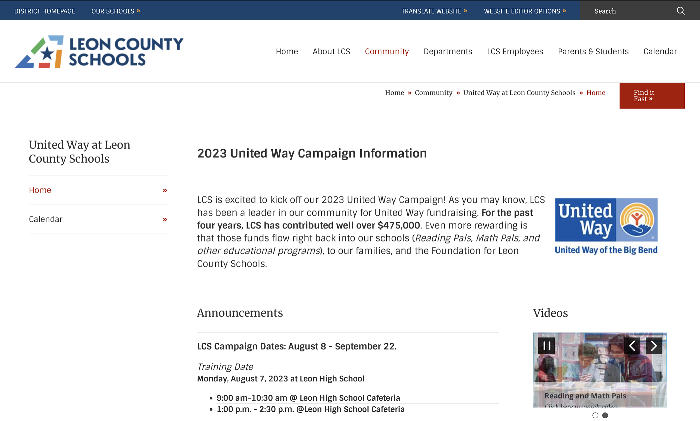
https://www.leonschools.net/domain/8488

Slide 21
Making Your Pledge

Slide 22
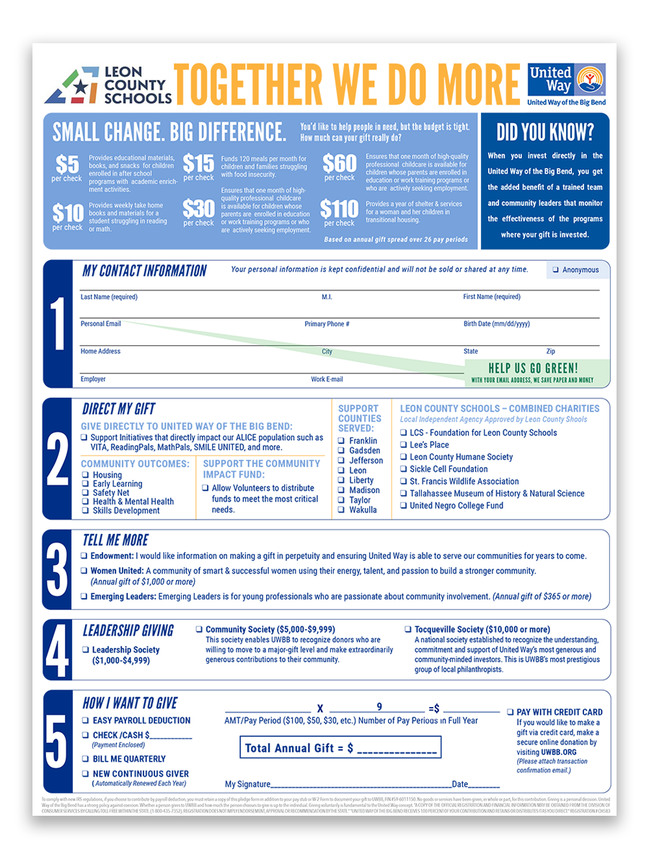
Pledge Form
What is the necessary information on the Pledge Form?
Name
Contact Info: Address or email address
Contribution Amount
Impact Area
County
Notes:
Annual and new Continuous Givers
Continuous Givers – no need to complete a form; unless there are any Changes: New Change form (do we need to add an image of that form?)
Program Partners/Combined Charities Partners
Check
Credit Card
Payroll deduction (Annual, New Continuous Giver & Continuous Giver)
Most UWBB donors give through their workplace, which is where you as an ECC come in!
Payroll deduction remains the most utilized form of giving and is what you will see the most. It’s easier and often allows donors to consider giving more than what they could with a one-time gift.

Slide 23
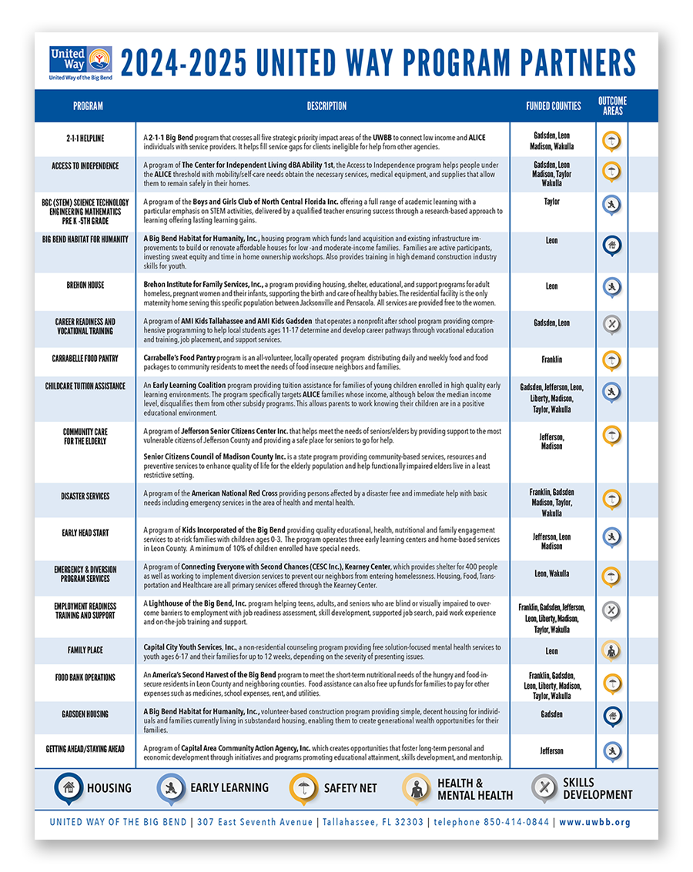
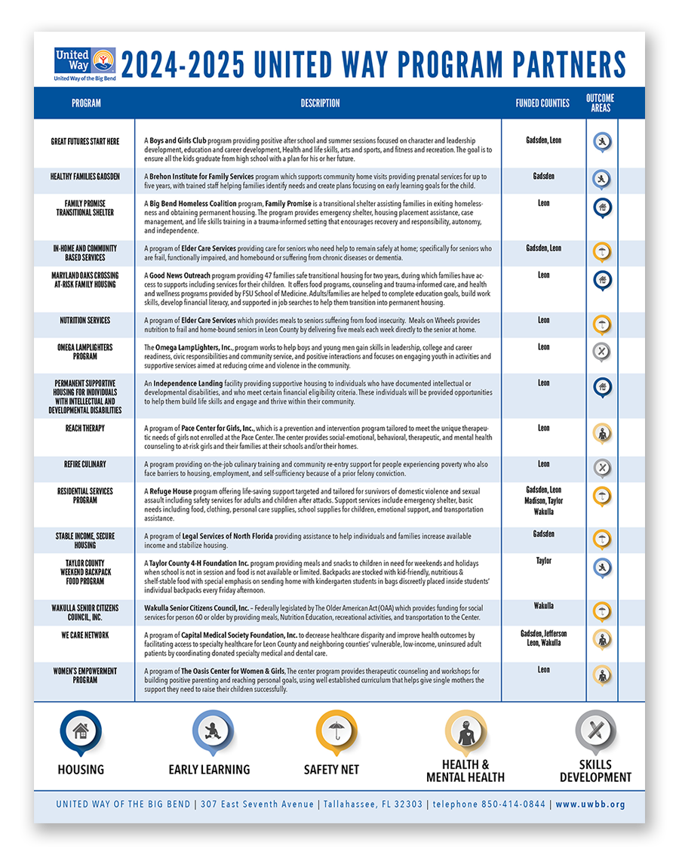
2024-2025 Program Partners
https://uwbb.org/programpartners/

Slide 24
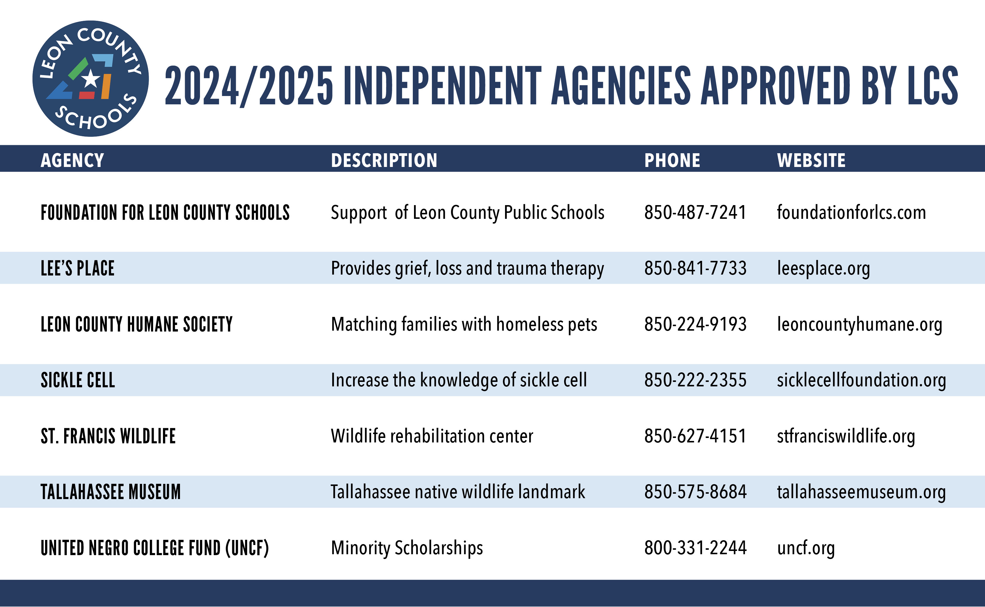

Slide 25
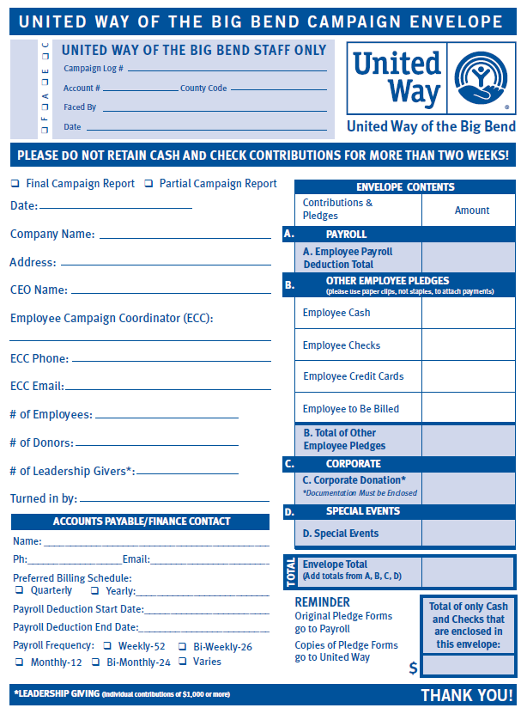
Sample Campaign Envelope
What is the necessary information on the Envelope?
Company Name – Please write in your school or department
Number of Employees (Total # of employees – not just those pledging)
ECC Name and Phone
Total for # of Donors, Pledged, and Money enclosed for each pledge type
Envelopes MUST be sealed

Slide 26
Questions?

