Slide 1
Welcome to our Kindergarten Virtual Meet the Teacher! This school year will be different than any other because our class is made up of both in person students and digital students; however, we are still “Mrs. Klees’ Kindergarten Kiddos”! Together we will learn lots of math, science, and social studies concepts plus learn to read and write. I am blessed to have your child in my class this year. I can’t wait to get started ☺
Please click on the tabs at the top to learn more information about our class.
Love,
Mrs. Klees

Slide 2
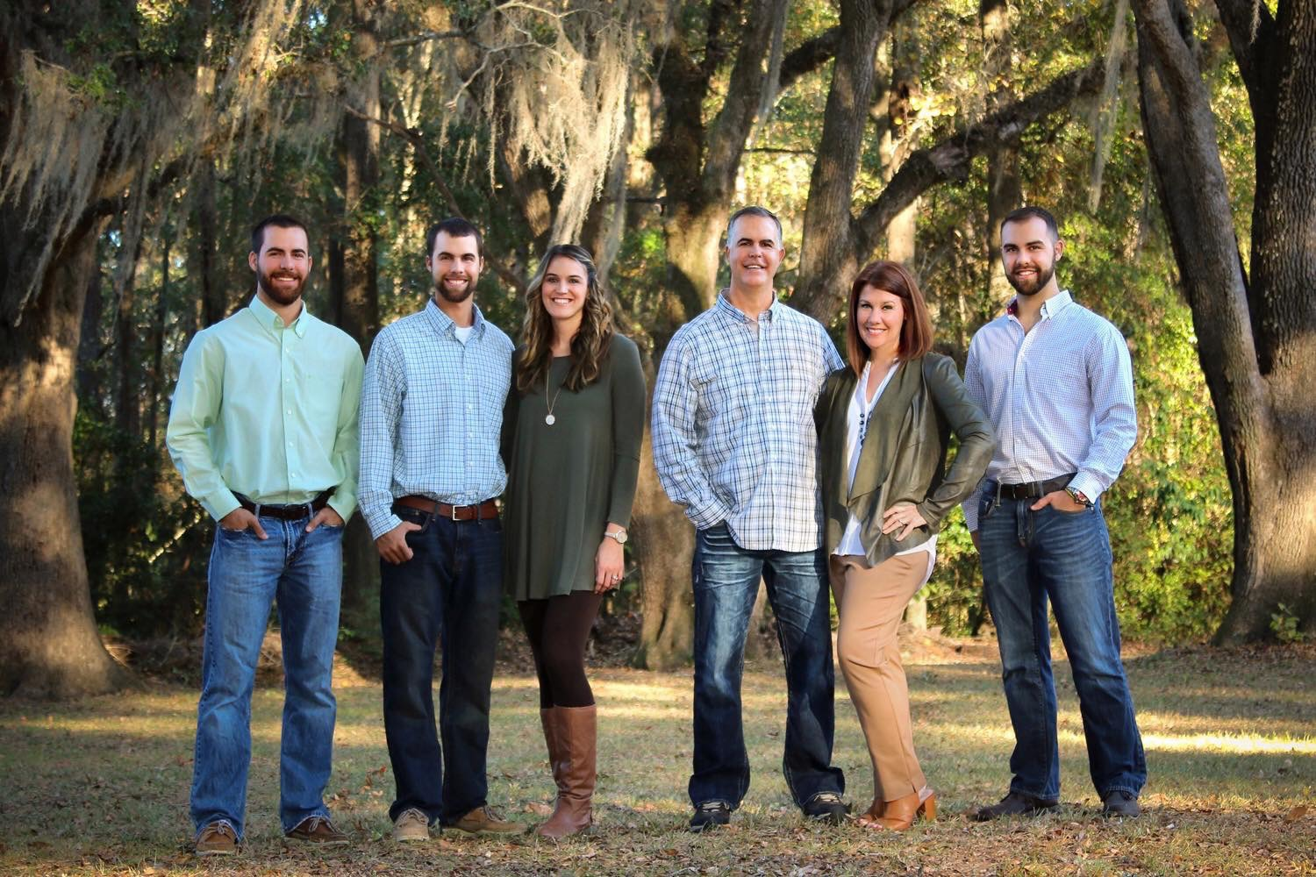
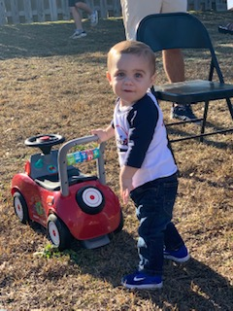
Welcome to my 25th year in the classroom!! I have taught at Fort Braden School for 11 years and I’m thrilled to have your child in my class. A little bit about me- I’ve been married to Robbie for 33 years and we have have three grown sons, a daughter-in-law, and our first grandson, Colton, who definitely has my heart! I love my family and consider my kindergarten kiddos family too.
I enjoy spending time with my family, going to the beach, walking, reading, and eating chocolate!

Slide 3
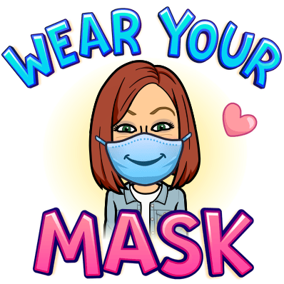
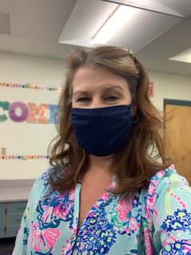
MRS. KLEES MASK ON/MASK OFF

Slide 4
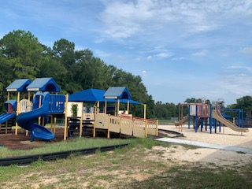
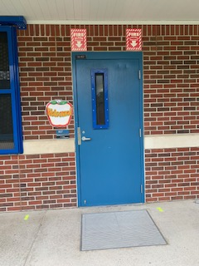
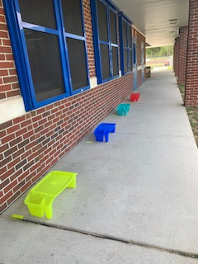
Welcome
to Room 407!
Portable desks for outside mask breaks set 6 ft apart ☺
The kindergarten playground is right outside our door.

Slide 5
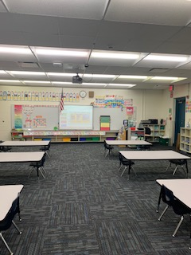
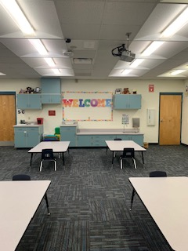
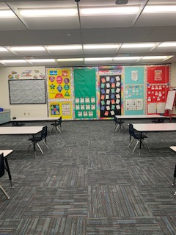
REAR VIEW
FRONT VIEW
SIDE VIEW

Slide 6
Our Daily Schedule
8:35 School Begins
8:45 Morning Meeting with Digital Students and Classmates**
9:00-10:30 Language Arts Instruction and Student Conferences
10:30-11:30 Lunch and Developmental Play
12:00-1:20 Math Instruction and Special Area
1:20-2:30 Science or Social Studies, Student Conferences, Accelerated Reader
2:30-2:50 Review of the Day and Prepare for Dismissal
**First day morning meeting time will be later due to 9:00 first day drop off **
***Kindergarten students will begin transitioning to car pick up at 2:30***
Special Area Schedule
M-Art T-Media/Guideance
W-PE TH- Music F-Art

Slide 7
Please check your email for a “Student Information” document that I need you to complete and return to me via email. My email is Kleesc@leonschools.net

Slide 8
We are unable to assist students in tying shoes, opening & closing food/drink items, putting back-packs on or zipping zippers. PLEASE make sure your child is able to do the above tasks before their first day of school.
PLEASE make sure your child is able to properly wear their mask for an extended amount of time without touching their mask/face.
Please make sure your child is able to use the restroom on their own, flush, and wash their hands.

Slide 9
Download the Remind App to communicate and stay up to date on information! Click the link below.
https://www.remind.com/join/36dbbd

Slide 10
Please click on the attached link to hear the story,
Twas the Night Before Kindergarten read by Mrs. Klees

