Slide 1
3.3 Real Zeros of Polynomials

Slide 2
Rational Zero Theorem
If the polynomial P(x) has integer coefficients then every rational zero of P is of the form p/q where p is a factor of the constant and q is a factor of the leading coefficient.
3 lists:
Factors of p:
Factors of q:
Possible roots: p/q

Slide 3
List all possible rational roots.
Possible roots: p/q
P(x) = 9x⁶ – 5x³ + 27
Factors of p:
Factors of q:
Final Possibilities
Cancel out duplicates

Slide 4
Use the rational zero theorem to factor:
P(x) = 3x³ – 4x² – 13x - 6
Final Possibilities
Possible roots: p/q
Use synthetic division to find one of the factors
This means the factors are:
Now factor the quadratic.

Slide 5
Use the rational zero theorem to factor:
Final Possibilities
P(x) = -x³ – 3x² + 13x + 15
Use synthetic division to check
This means the factors are:
Now factor the quadratic.

Slide 6
Find all the real zeros
Final Possibilities
P(x) = x³ – 6x + 4
Use synthetic division to check
Zeros:
Factors:
Use the quadratic formula.

Slide 7
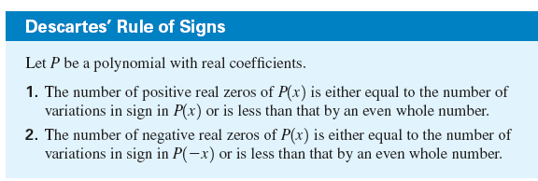
Descartes Rule
In some cases this rule is helpful in eliminating candidates from a lengthy list of possible rational roots.

Slide 8
Use Descartes Rule to determine the possible number of positive and negative real zeros of the polynomial.
P(x) = x³ + 4x² + 3x - 2
Only one change in sign
Therefore: only one positive real zero
Two changes in sign
Therefore: only two possible negative real zero

Slide 9
True or False: all zeros of the polynomial P(x) = 4x³ + 19x² + 11x – 7 lie between -3 and 1?
All positive
Therefore 1 is an upper bound
All alternate between + and -?
Therefore -3 is NOT a lower bound

Slide 10
Find all the zeros:
P(x) = 2x⁵ + 5x⁴ – 8x³ – 14x² + 6x + 9
Final Possibilities
List of Zeros

Slide 11
Find all the zeros:
y = 6x⁴ – 5x³ – 38x² – 5x + 6
Final Possibilities
List of Zeros

Slide 12
Find all the zeros:
P(x) = 2x⁵ - 11x⁴ – 10x³ + 56x² + 88x + 35

Slide 13
Homework pg 279 #7, 9, 12, 16, 18, 22, 24, 28, 30-33

