Slide 4
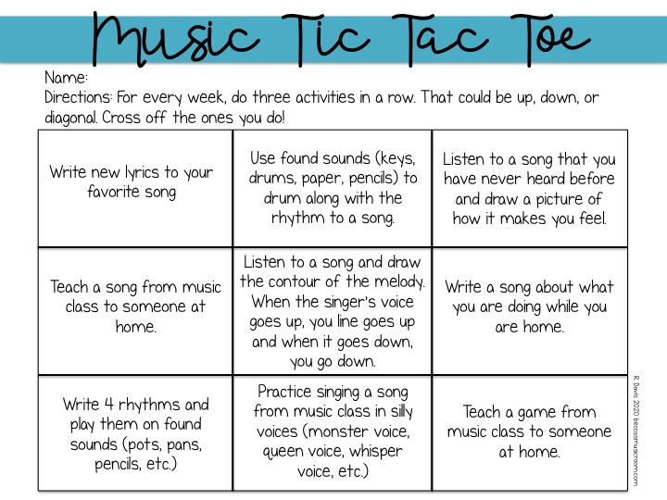

Slide 5
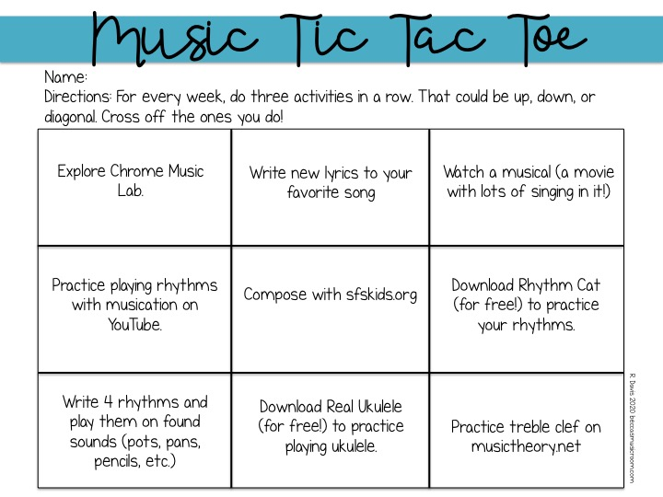

Slide 6
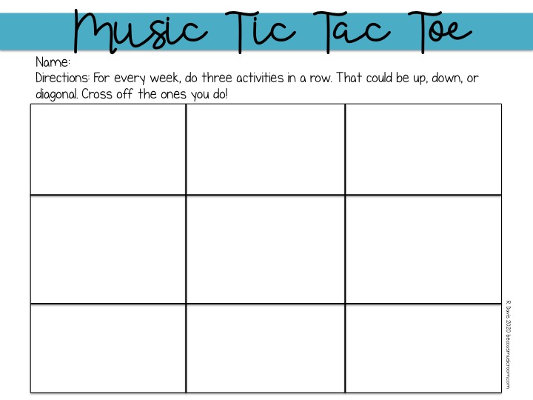
Practice matching the rhythm pattern
https://www.classicsforkids.com/games/rhythm_master.php
Produce an opera
http://classicalkusc.org/kids/opera/
Explore an Orchestra
https://www.classicsforkids.com/music/instruments_orchestra.php
Turn on the radio and find a song you like. Does the song tell a story?
Make an instrument from something in your house.
Make up a rhythm pattern that you can do over and over.
Can you write new words to an old song? Try it with the Happy Birthday song.
Play an instrument that you found in your home with a song on the radio.
Pat, snap and clap along with these bees.
https://youtu.be/bOXFrgB083A

