Slide 1
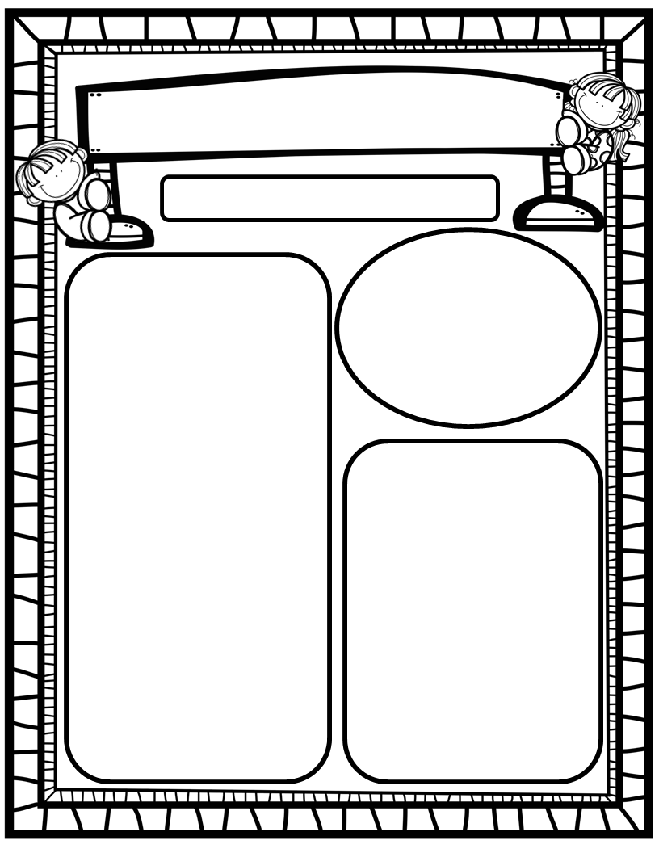
The Deason Digest Weekly Blast
March 24th, 2025
Homework:
Read to and with your child each night and complete Reading Rally Log!
Practice HFW’s: the, I, and, a, is, as, said, to, do, of, see, he, be, me, from, was, you, have, what, your, want, go, no, so, goes, says, she, we, they, their, were
Toucan Sight Word Folders
Go Math Home Practice for Ch. 13
UFLI Home Practice Pages
Go over Weekly Work and discuss
We Are Learning About…
Reading: We will focus on the digraph TH (voiced and unvoiced), as well as HFW’s they, their, were. We will identify characters, setting, and story events in texts we read. We will look at pictures, get our mouths ready, and use chunky monkey to help us stretchy-snake tricky words faster. EQ: What are our favorite family traditions?
Writing: We will focus on printing and tracing upper and lowercase letters, as well as using stretchy-spelling and sight words to write complete sentences!
Math: We will finish Go Math Ch. 13: Addition to 10 and begin Ch. 14: Subtraction to 10!
Science: We will continue learning about living things and non-living things!
Social Studies: We will continue to practice I-Care Rules. We will practice what it means to Share! We will discuss and learn about impactful women in history and today in honor of Women’s History Month!
Important Dates:
March 24: Principal’s Book Chat
(K-2) for “Rick the Rock”
April 4 First Friday Friendship Lunch in cafeteria
April 12 Ox Bottom HOA Spring Event(HRES School Supply Drive)
April 17 Kindergarten Orientation(incoming students preview what a classroom routine looks like with their families)
April 18 Spring Holiday
April 26 Carnival

