Slide 1
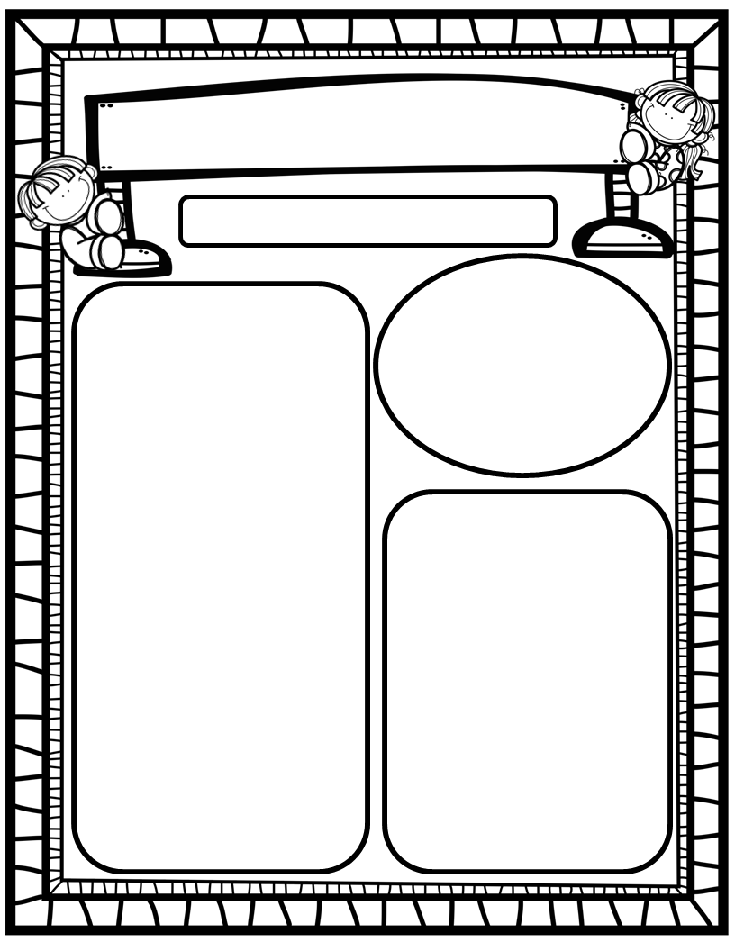
Manuel’s Weekly Blast
January 29th, 2024
Homework:
Read to and with your child each night/Record books on Reading Rally Logs
Go Math Practice pages for Chapters 1-8
Practice the HFW’s: a, and, I, the, is, in, as, said, do, to, of, see, be, he, me, from, look, are, was, yes, you
Talk with your kiddos about what they are learning by going over their weekly papers and behavior grades with them!
We Are Learning About…
Reading: We will focus on letters Xx and Qq (identification, mouth placement to make sounds, blending/sounding out words containing these letters), and sight word you. We will determine the types of stories we like best. Weekly Question: Why do we like certain types of stories?
Writing: We will print letters, sight words, as well as our first names! We will stretchy-spell our words and write to describe our favorite types of stories!
Math: We will continue GoMath Ch. 8: Count, Represent and Compare Numbers Through 20!
Science: We will continue Unit 7: Force and Motion!
Social Studies: We will review I-Care Rules and our Hawks Rise Character Trait: Obedience! We will celebrate the 100th Day of Kindergarten and discuss why this day is important!
Important Dates:
January 31: 100th Day Sign-up items due
February 1: 100th Day of School (changed due to storm day)
February 2: First Friday-NEST Lunch

