Slide 1
6.8.5 Conjugates & Absolute Value & 14.4 The Geometry of Complex Numbers
Learning Goals
Learn to represent the conjugate and calculate the absolute value of complex numbers
Learn to plot complex numbers in the complex plane

Slide 2
Standard Format & Conjugate of Complex Numbers
Format
often represented by singular letters
Conjugate
“z bar”

Slide 3
Absolute Value
A complex numbers distance from zero on the complex plane
if
Ex. Find for each complex number z.

Slide 4
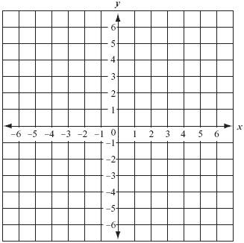
Plotting Complex Numbers in Complex Plane
Plot the following complex numbers
in the complex plane.
a.
b.
c.

Slide 5
Plotting Complex Numbers in Complex Plane
Plot the following complex numbers in the complex plane.
w = 1 - i and z = 4 + 3i
w
z
w + z
w -z

Slide 6
Complex Numbers in Complex Plane
For EACH point on the graph…..
Name the complex number.
Find it’s additive inverse.
Find it’s complex conjugate.
Find it’s absolute value.
Ex 1 Point A
Ex 2 Point B
A
B

Slide 7
6.8.5 & 14.4 Concept Check
For EACH point on the graph…..
Name the complex number.
Find it’s additive inverse.
Find it’s complex conjugate.
Find it’s absolute value.
Ex 3 Point C
Ex 4 Point D
D
C

